Slide 1
GeoFluids 2020
Peter Flemings
Jack Germaine
Maria Nikolinakou

Slide 2
http://www-udc.ig.utexas.edu/geofluids/aboutus.php
(Proposal document posted here)

Slide 3
Overview
10 year program (2019-2028)
1st payment May 2019
no cost to terminate
1 year buy-in if you start late
Signed MOA (Memorandum of Agreement or Amendment if already a member)
Signing amendment does obligate first payment.
Led by University of Texas (Institute for Geophysics) - partnered with Tufts University
Cost: Initiate at $50,000, increment at 2% per year.

Slide 4
Status of GeoFluids 2020 Participation
Company | Signed MOA Ammendment | Paid YR 1?
Anadarko | In Process | NO
BHP | In Process | NO
BP | TBD | NO
Chevron | TBD | NO
ConocoPhillips | Yes | NO
Equinor | TBD | NO
ExxonMobil | Yes | NO
Hess Corp | TBD | NO
Pemex | TBD | NO
Repsol | Yes | NO
Shell | Yes | NO
6 of 11 current companies have already indicated they will join GeoFluids 2020

Slide 5
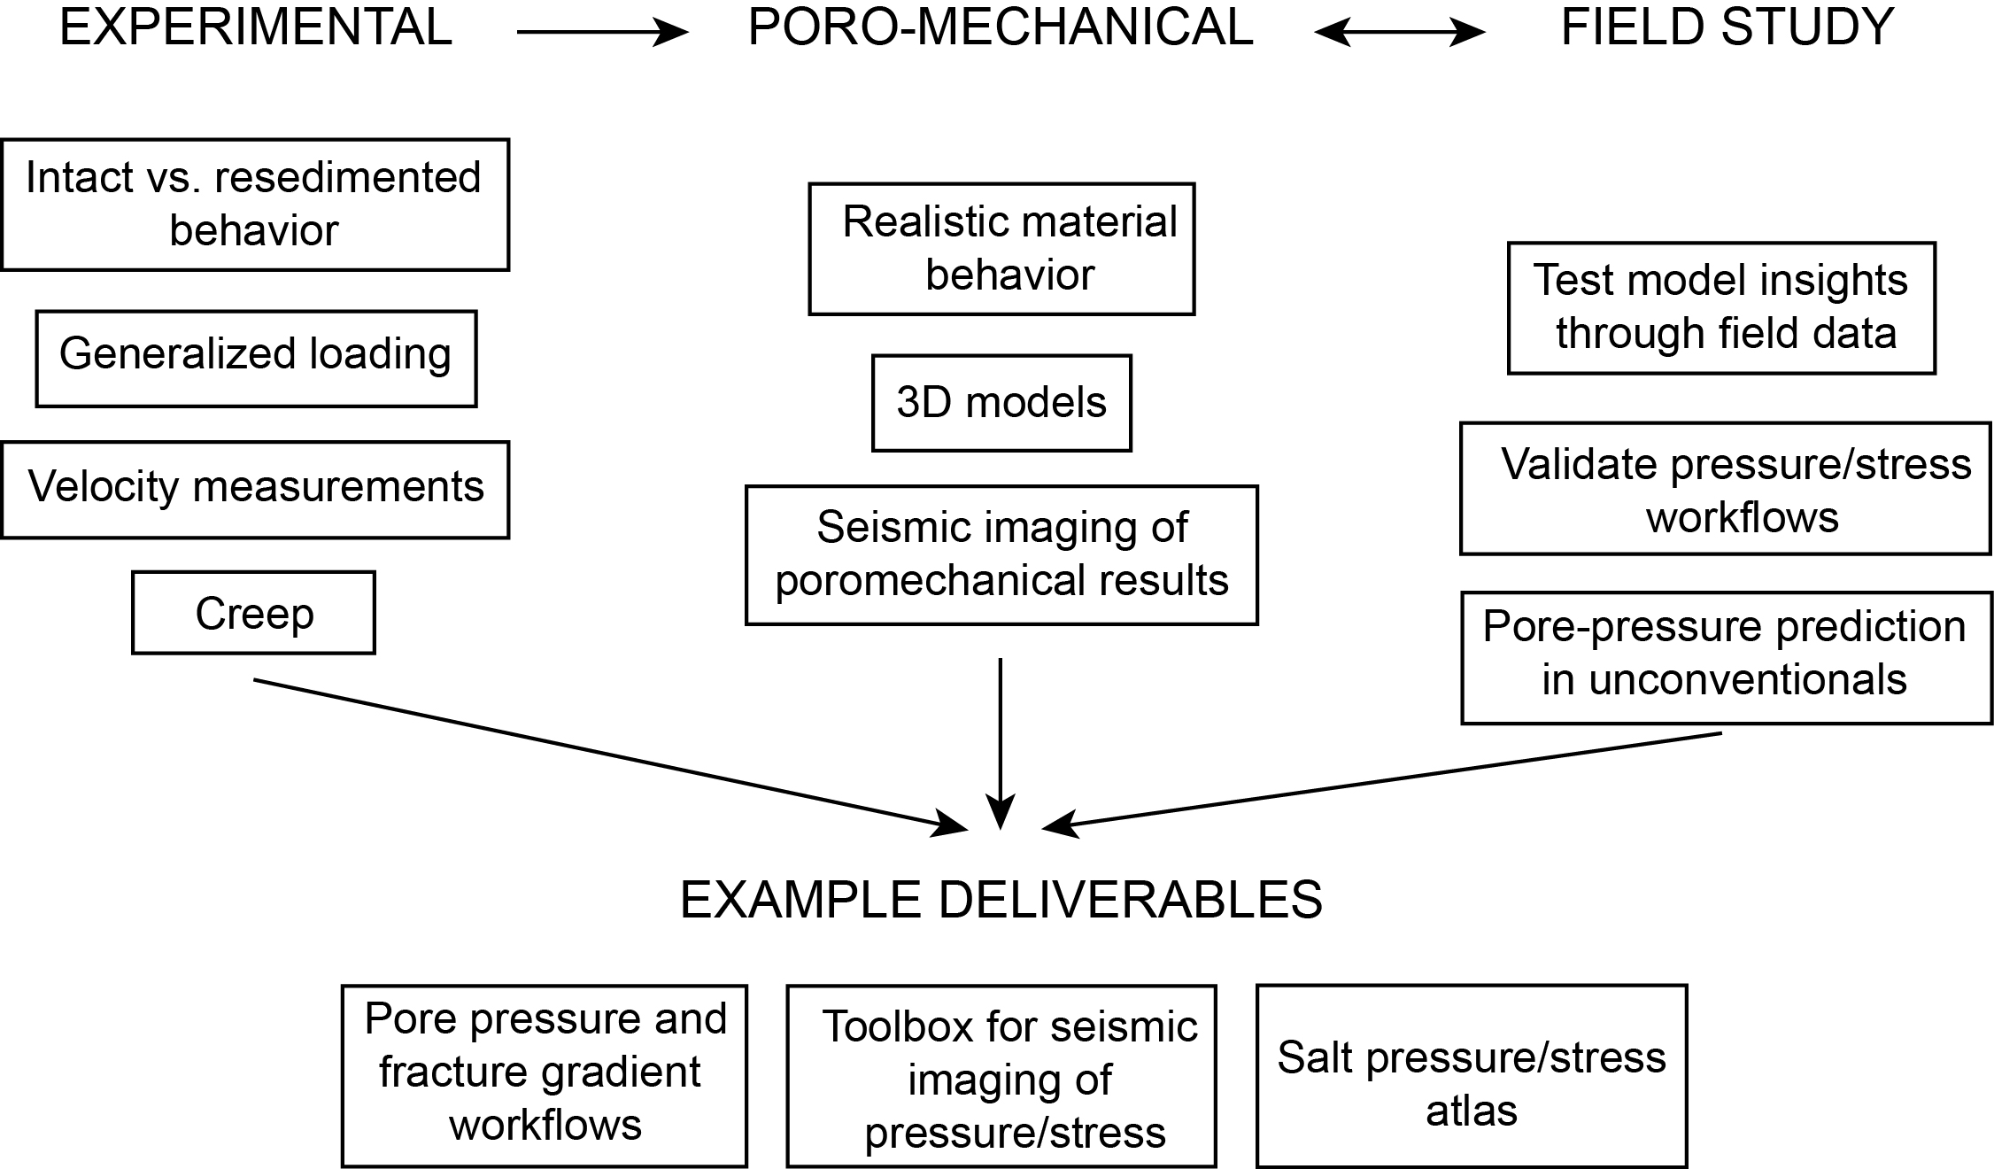
Potential of the Future: UT GeoFluids 2020

Slide 6
Potential of the Future: UT GeoFluids 2020

Slide 7
Research goals
Experimental
Intact vs. resedimented behavior
Complex stress paths
Velocity: VTI and role of composition and texture
Poromechanical
Link pressure prediction with whole earth stress models.
Incorporate stress dependency and material anisotropy
Develop synthetic seismic images of geomechanical results
Unloading & pore pressure prediction (unconventionals)
Field studies
Apply workflows to field problems

Slide 8
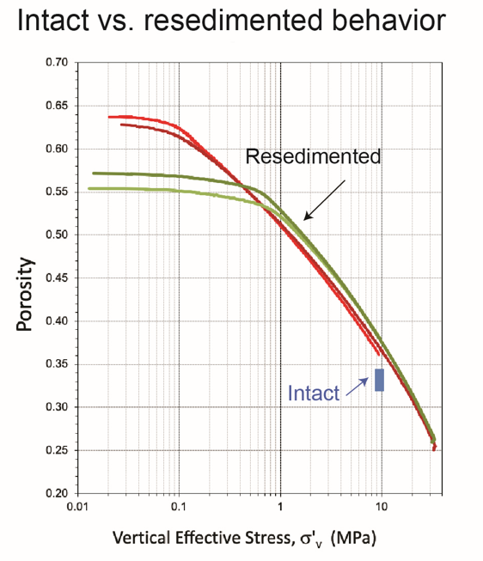
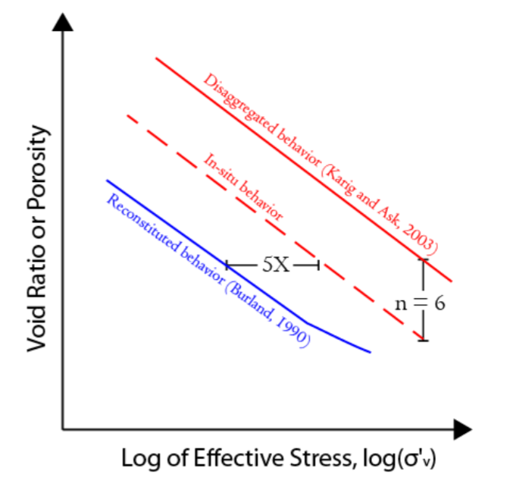
Experimental Challenge #1: Intact vs. resedimented behavior
Plan:
We will systematically compare resedimented with intact behavior.
Industry provides core samples (pilot project initiated)
Perform uniaxial compression, undrained triaxial shear, velocity measurements on intact core and companion resedimented specimens.
Develop map between resedimented and intact behavior.

Slide 9
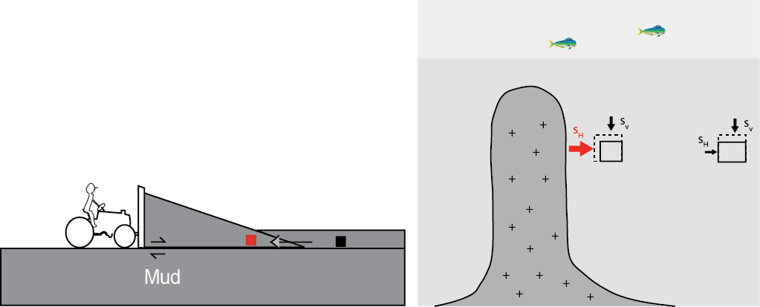
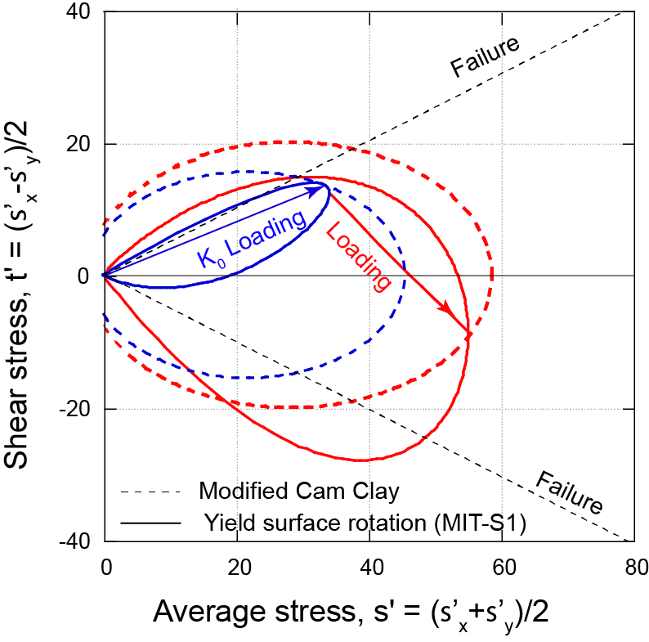
Experimental Challenge #2: Poro-mechanical behavior under generalized load conditions.
Plan:
Mudrock behavior along complex stress paths
compression and shear behaviors and evolution rates of the yield surface.
1st use triaxial device to investigate yield surface rotation to compressional (horizontal major principal stress) stress space
2nd Develop 3-axis testing device
large strains
decouples intermediate principal stress from the direction of loading.
Investigate compression and shear behavior as the material transitions from K₀ state of stress to the more general conditions found around salt features or within thrust belts.

Slide 10
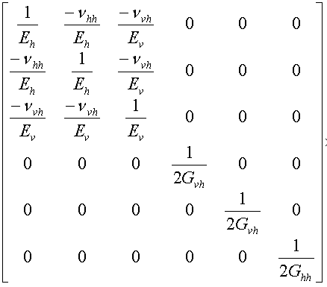
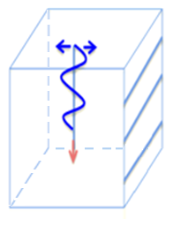
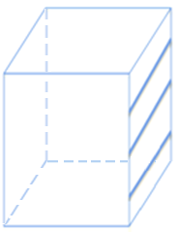
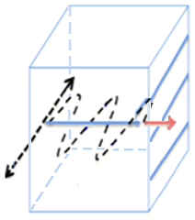
Experimental Challenge #3: Elastic Moduli transverse isotropic material 0-100 MPa
Plan:
Elastic anisotropy (Young's modulus, shear modulus, and Poisson’s ratio) varies with stress level during K₀ consolidation and is dependent on the general stress state (non-K₀ conditions).
Explore velocities during different compression paths (K₀, isostatic, etc.) and undrained shearing.
Different technologies for different stress levels
$$V_{pi}$$
$$θ$$

Slide 11
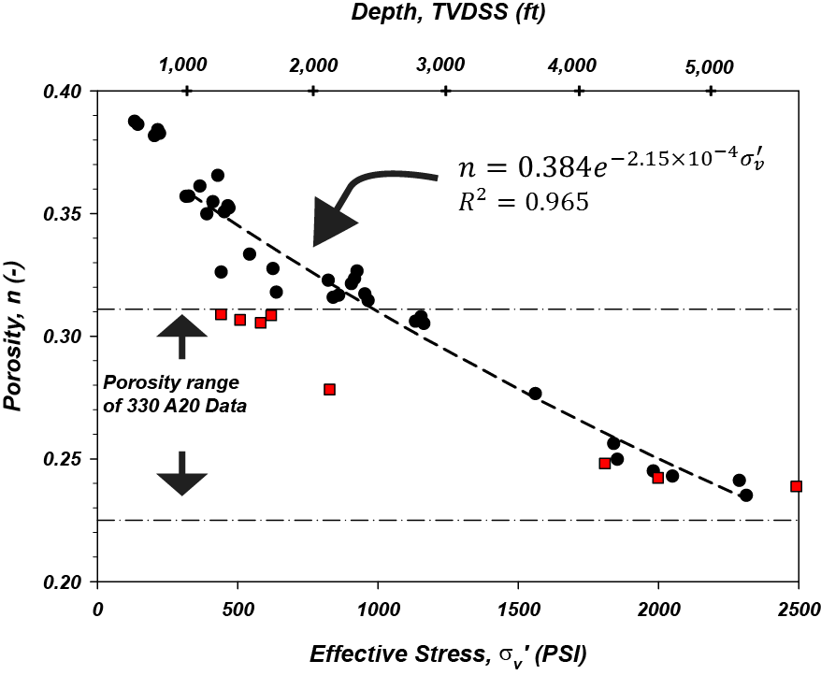
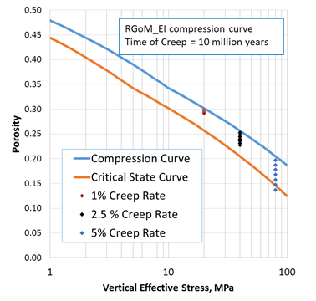
Experimental Challenge #4: Rate effects
Plan:
Deeper, hotter, mudrocks more compressed at given effective stress
smectite-illite, unloading, creep?
Uniaxial compression tests under varying strain rates and constant axial effective stress conditions (incremental loading)
characterize creep rate and variation in the lateral stress ratio as a function of time and stress.
Use rigid wall devices and triaxial devices to vary the drainage height and provide lateral stress measurements.
Output: an understanding of the strain rate dependent compression curves that will form the basis of a rate-dependent mudrock model. Determine potential for stress relaxation during the process of uniaxial compression.

Slide 12
Model Challenge #1: Stress dependency
Plan:
Demonstrate dependence of frictional and undrained strength, and stress ratio on stress level. We observe dependence of the yield and iso-volumetric surfaces on stress level and loading direction.
We are incorporating stress level dependency into numerical models.
We will develop an enhanced critical state model that builds on our experimental findings. Incorporate:
the asymmetry (rotation) and evolution of the yield surface under complex geologic loading and high stress levels;
stress-level dependency of frictional strength, undrained strength and stress ratio;
strain-strain rate sensitivity.
Output: More realistic description of stress states

Slide 13
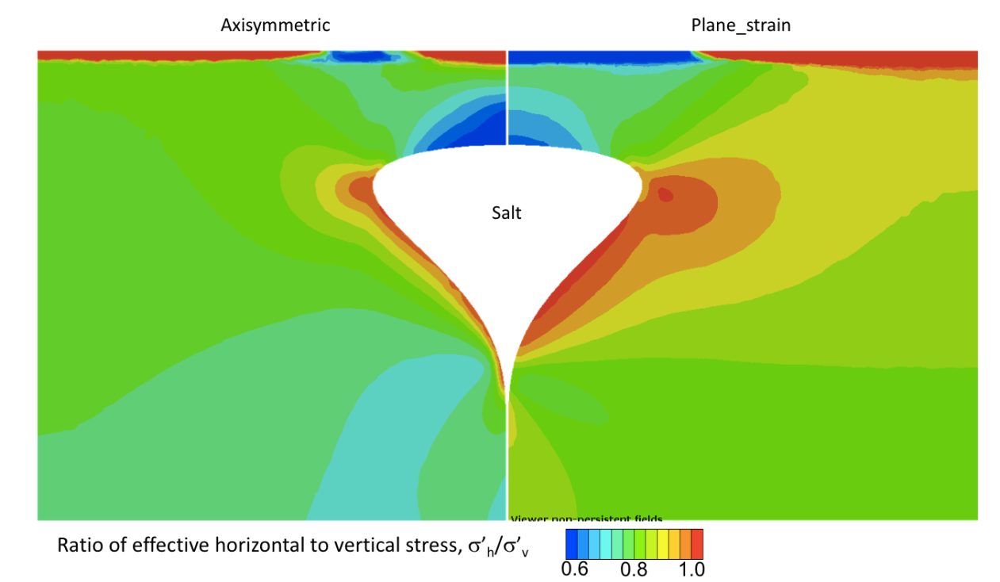
Model Challenge #2: 3D modeling of salt systems
Plan:
We have studied salt systems using either plane-strain or axisymmetric models. These approaches cannot capture complex 3D salt geometries.
We will develop static 3-dimensional models and study the effect of complex geometries to stress and pressure.
We will build models of actual salt bodies and evaluate our geomechanical results with available data.
We will provide criteria and guidelines for investing in a 3D studies.

Slide 14
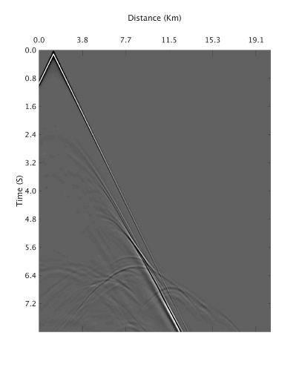
Model Challenge #3: Link stress/pressure to seismic imaging
Plan:
Build anisotropic velocity models using third order elasticity, based on the full stress tensor of our geomechanical models.
Use anisotropic models to create synthetic seismic images of our geomechanical results.
Application:
seismic migration (imaging)
time migrated data using these models can be used for AVO analysis
Insight into how stress recorded in seismic data
Shot
Shot Gather
(Spikes & Sen)

Slide 15
Model Challenge #4 : Pressure prediction workflows
Plan:
Validate pressure/stress prediction workflows in field.
Evaluate the relative benefits of investing into three-dimensional workflows.
Drilling window, σ₃-u (ppg)
7
FES
5.4
3.7
2
VES
Mud weights calculated from sea floor

Slide 16
Field Challenges: Apply workflows to field examples
Plan:
Validate pressure & stress predictions with field data
Validate & optimize pressure & stress predictions workflows through application
Work integrated salt system data set with borehole data and seismic data
Work integrated thrust system data set with borehole data and seismic data

Slide 17
Unconventional Challenge
Challenge:
Pore pressures impacted by erosional unloading and hydrocarbon maturation.
Effective-stress approaches may not be successful.
Need process understanding of pore pressure evolution
Develop systematic pore pressure prediction approach
Potential Field Locations:
Powder River Basin of Wyoming
Permian Basin of West Texas
Notes:
We see an opportunity for.

Slide 18
Unconventional Challenge
Approach:
Build pore pressure database (kicks, connection gases, DFITs and production data)
Characterize petrophysical response (Vp, Vs, RES)
Build geological understanding (history of deposition/erosion, the organic content, and maturation timing).
Build model of unloading response
Goal:
Optimized approach for pressure/stress prediction in unconventional basins
Illuminate role of unloading on overpressure?
Role of overpressure in hydrocarbon recovery?
Great projects for graduate students.

Slide 19
Deliverables:
Cuttings Protocol: We will deliver a protocol for on-site (on-rig) cleaning and testing of cuttings. We will provide correlations between liquid limits/clay fraction and stress ratio, friction angle, and undrained strength. This tool will allow quick estimation of least principal stress and strength during drilling.
Salt Pressure-Stress Atlas: An atlas that links that relates salt geometry to pressure and stress predictions. This will provide insight into qualitatively estimating stress, pressure, and hazardous zones near salt.
Road Map for Intact vs. Resedimented Behavior: We will build a database that compares intact with resedimented behavior.
Online Experimental Database: We will provide an online database containing our experimental measurements for use by the sponsors for internal evaluations.
Poromechanical Model Results: Communicate and distribute model results in standard industry software format and in excel spreadsheets so that the insights are more easily applied.
Online Software: We will continue to build online software to communicate the concepts we are developing in UT GeoFluids.
Workflows: We will continue to develop our workflow to couple seismic models with poromechanical models to predict pressure and stress.
Synthetic Seismic Images: We will deliver tools and workflows to generate synthetic seismic datasets from our poromechanical models.
Annual meeting:

Slide 20
Potential of the Future: UT GeoFluids 2020

