Slide 1




GeoFluids 2020
Peter Flemings
Jack Germaine
Maria Nikolinakou

Slide 2
Agenda:
8:00-8:30: Arrival and security check
8:15-9:00: Coffee with pastries
9:00-9:15: UT GeoFluids Proposal Overview - Flemings
9:15-9:45: Experimental Plan followed by Q&A: Germaine
9:45-10:15: Poromechanical Plan followed by Q&A: Nikolinakou
10:15-10:30: Break
10:30-11:00: Field Studies Plan followed by Q&A: Flemings
11:00-11:10: Bureaucratic details - Flemings
11:10-11:30: Discussion

Slide 3
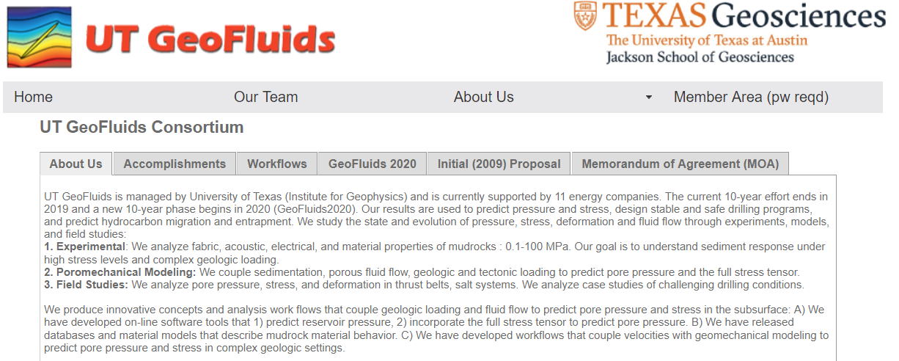
http://www-udc.ig.utexas.edu/geofluids/aboutus.php
UT GeoFluids 2020 proposal

Slide 4
Overview
10 year program (2019-2028)
  1st payment May 2019
  no cost to terminate
  After 2019, 1 year buy-in
Led by University of Texas (Institute for Geophysics) - partnered with Tufts University
Cost: Initiate at $50,000, increment at 2% per year.

Slide 5
What do we do?
Pore pressure prediction has been largely empirical and reliant on ‘uniaxial’ approach. However, the discipline is on the edge of a more holistic approach.
We the full stress tensor to complex soil behavior to predict stress and pressure. We incorporate this approach in workflows and apply it to field studies.
We are developing a unified approach that incorporates stress dependency, creep, and loading path to predict pressure and stress.
We already see evidence that this unified approach improves well design and provide insight into geological processes. These advances will expand.

Slide 6
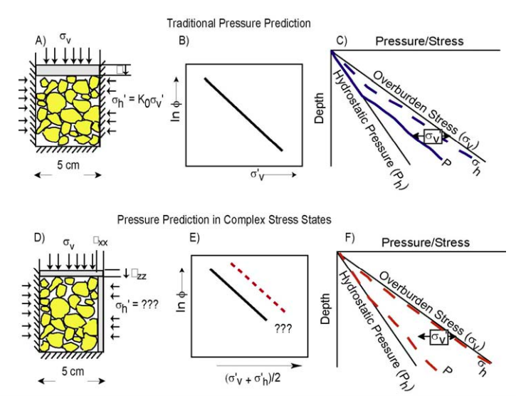
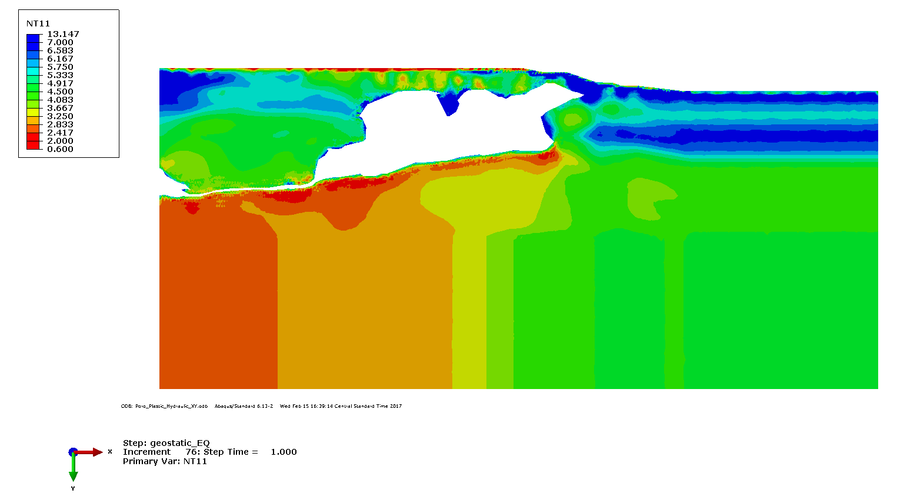
2009 vs. 2018 2019 vs. 2028!
In 2009, a conceptual vision: the incorporation of geomechanics, through integration of experiment, theory and field observation, would lead to advances in pore pressure and stress prediction
Drilling window, σ₃-u (ppg)
Systematic approach to couple seismic velocity to geomechanical models for pore pressure prediction
2009- Vague Concept that full stress tensor matters

Slide 7
UT GeoFluids Research: couple geology and fluid flow
Study the state and evolution of pressure, stress, deformation and fluid migration through experiments, models, and field study. Produce innovative concepts that couple geology and fluid flow.
  Experimental: Analyze fabric, acoustic, electrical, and material properties of mudrocks : 0.1-100 MPa.
  Poromechanical Modeling: Develop/apply coupled models to link realistic rheologies, deformation, stress (shear and normal), and pore pressure.
  Field Study: Analyze pore pressure, stress, deformation in thrust belts and in the sub-salt.

Slide 8
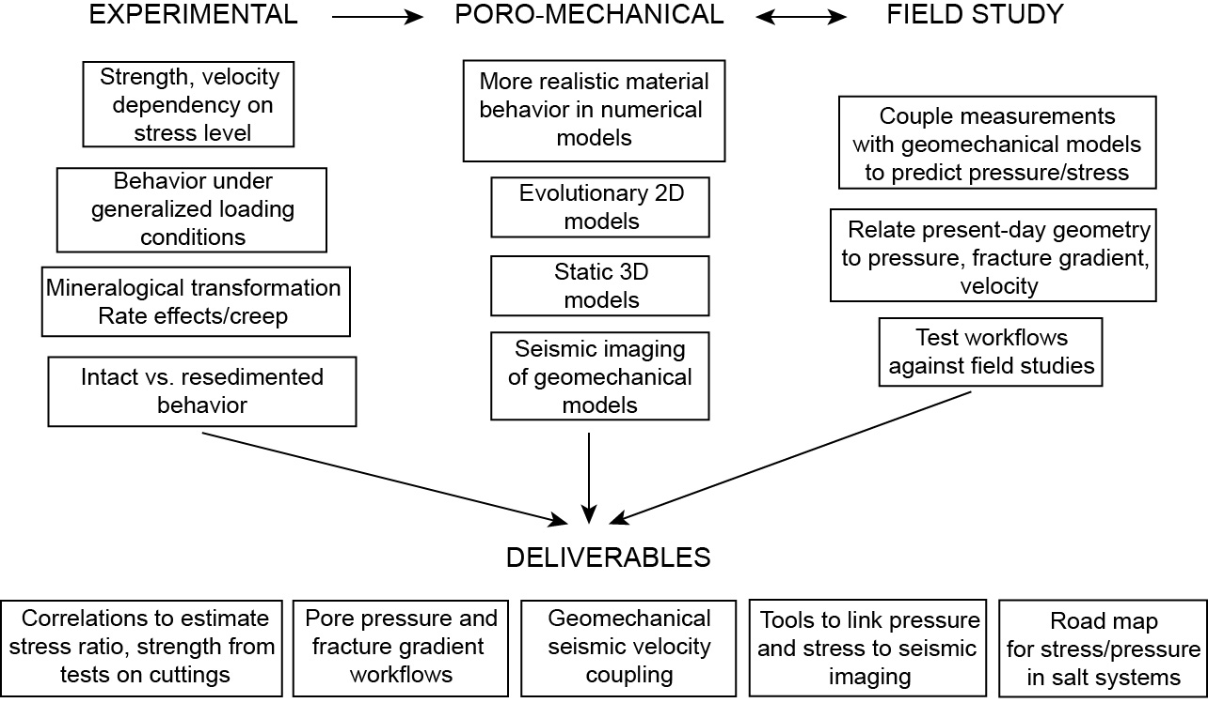
Research goals

Slide 9
2.1 Experimental studies

Slide 10
Outline: Experimental Program
UT GeoFluids achievements in mudrock behavior
  Resedimentation technology
  Fundamental trends with stress level and lithology
UT GeoFluids 2020 proposed research:
  Proposal section 2.1.2: Resedimented vs Intact
  Proposal section 2.1.3: Generalized loading effects
  Proposal section 2.1.4: Wave velocity characterization
  Proposal section 2.1.5: Visco-plastic effects

Slide 11
Experimental Overview
Stress range 0.1 to 100 MPa
  1 – 1000 TSF
  14.5 -14,500 psi
13 different materials
Resedimented Specimens
Physical characteristics
  PSD, CEC, SSA, liquid limit
  Mineralogy, microfabric
Mechanical Properties
  Permeability, compressibility, strength
  Velocity, resistivity

Slide 12
Primary Materials Under Investigation
Abbreviation | Name | Source
RBBC | Boston Blue Clay | Excavation
RGoM-EI | Gulf of Mexico - Eugene Island Block | Core
RGoM-Ursa | Gulf of Mexico - Ursa | Core
RSFBM | San Francisco Bay Mud | Core
RLC | London Clay | Core
RPC | Presumpscot Clay | Core
RNC | Nankai Clay | Core
RUC | Ugnu Clay | Core
SS | Skibbereen Silt | Core
RK-Cornwall | Cornwall Kaolin | Mined
RK-EPK | Edgar Plastic Kaolin | Mined
RK-VTK | Villanova Tulo White Kaolin | Mined
Illite | Illite | Mined
R prefix in abbreviation indicates Resedimentation
Notes:
13 materials

Slide 13
Plasticity Distribution of Test Materials
Notes:
3 kaolins below A line
Focus on BBC, Ssilt, Uras, London, Eug Isl
Extensive range

Slide 14
Resedimentation from Natural Samples
Maintains natural complexity
Uniform test specimens
Controlled formation history
  Fabric, density, and stress
Controlled composition
  PSD, mineralogy, pore chemistry
Unlimited supply
No sample disturbance

Slide 15
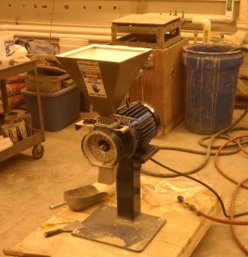
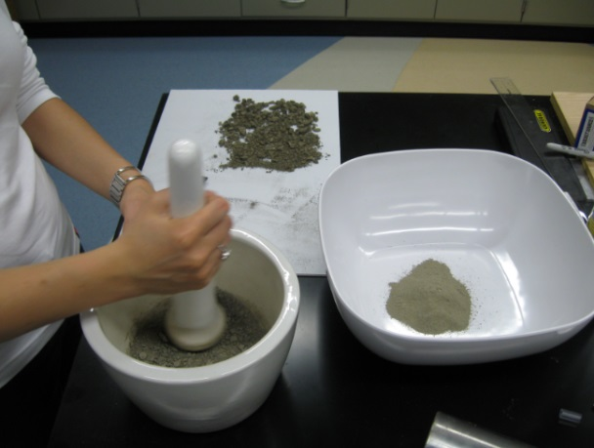
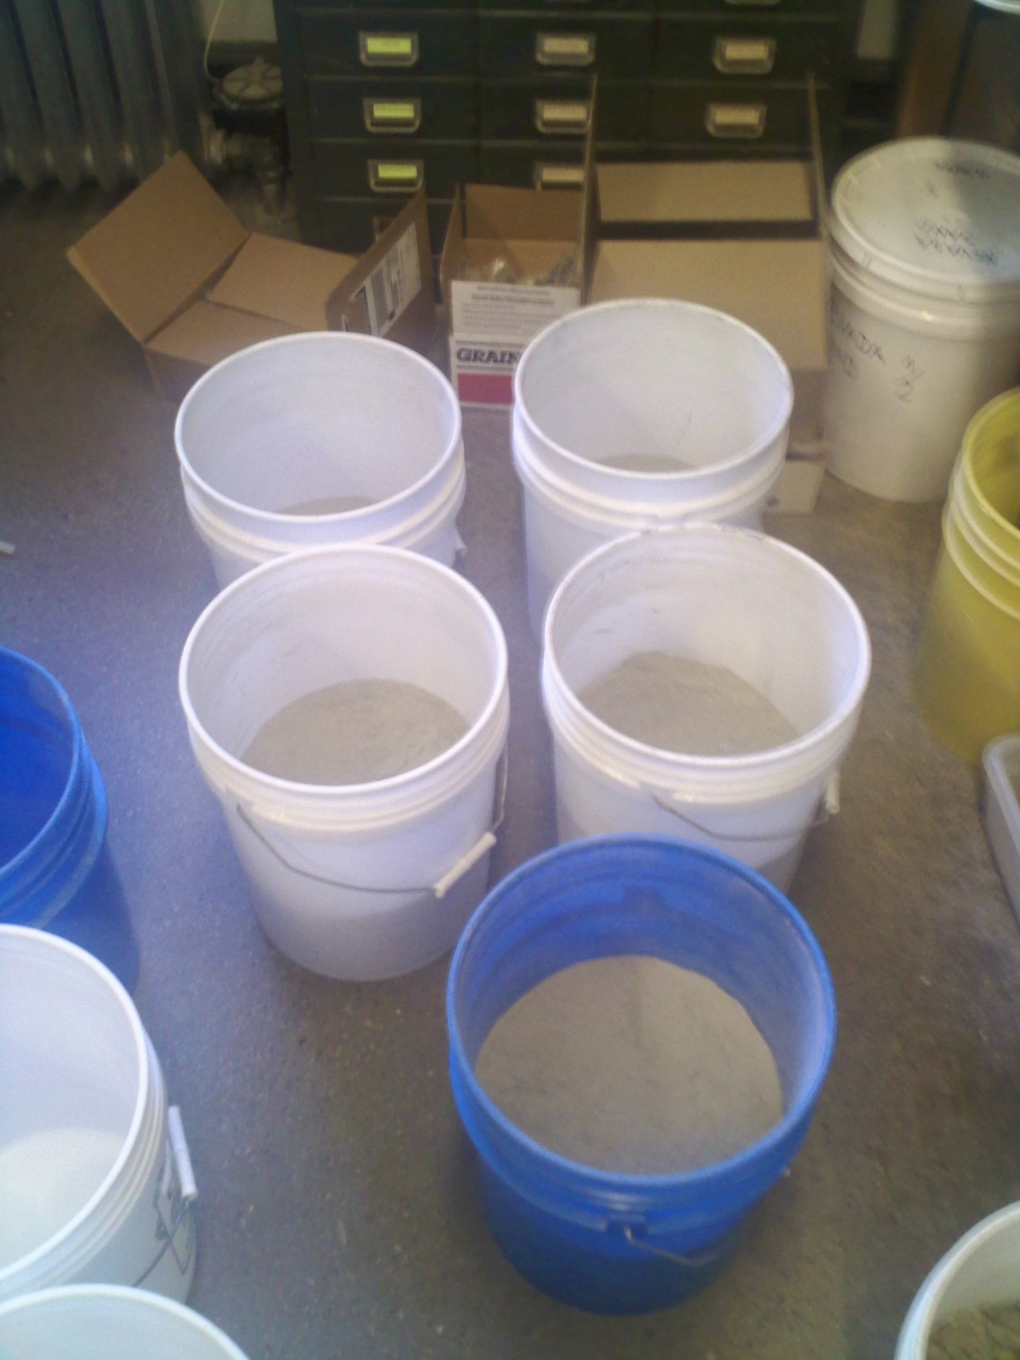
Grind to Fine Powder
Resedimentation Method
Method depends on quantity
  Mortar and pestle
  Ball mill
  Rotary disc grinder
99% passing #100 sieve
Does not break particles
Not likely to destroy clay flocs
Notes:
Flocs persist because leaching causes different behavior

Slide 16
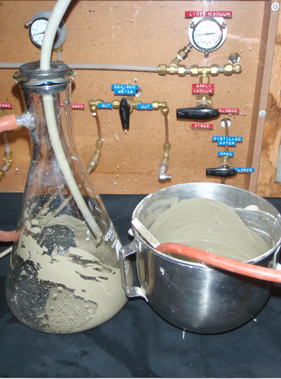
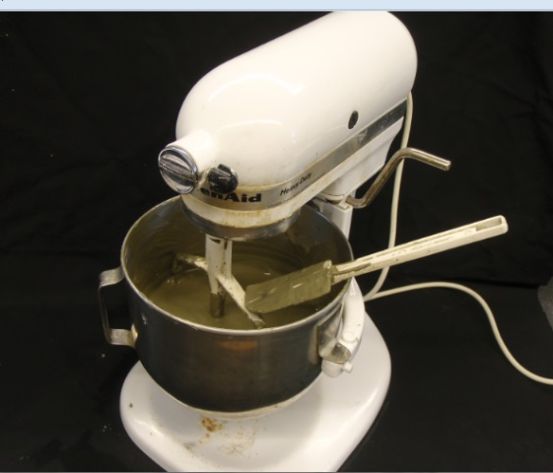
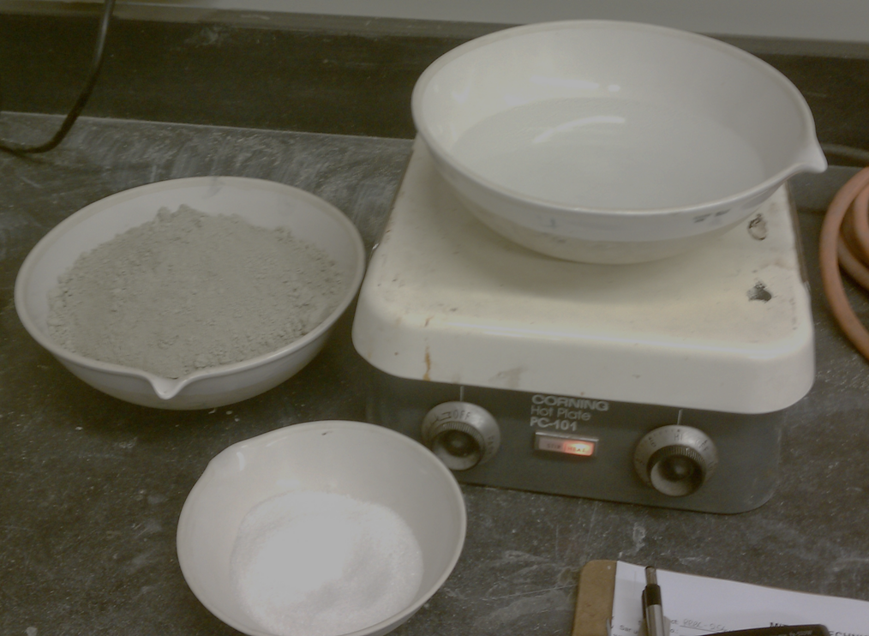
Mix Individual Batches
Resedimentation Method
Blend ingredients
Temper to hydrate particles
Evacuate to remove air
Tremie into rigid walled cylinder

Slide 17
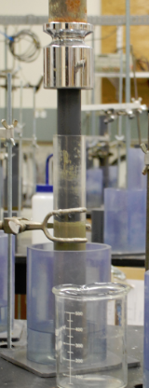
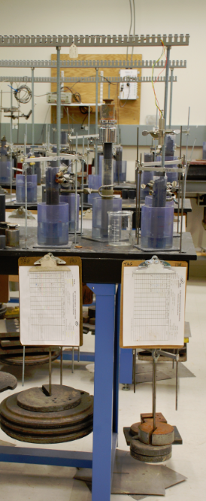
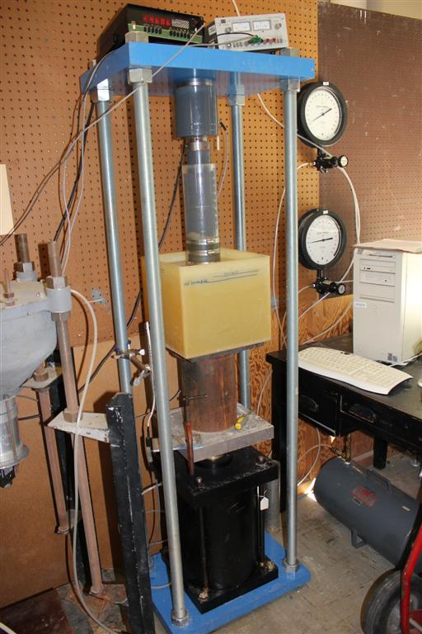
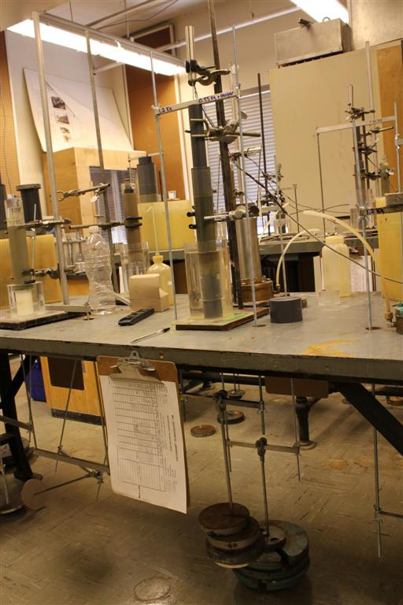
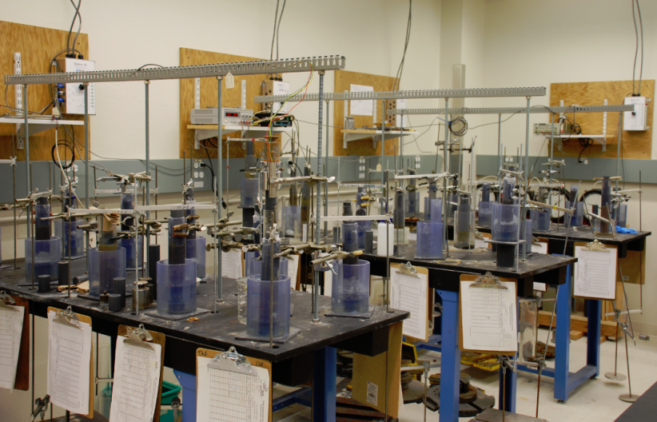
Incrementally Consolidate
Resedimentation Method
Floating ring geometry
Load at EOP
LIR = 1
Secondary at max stress
Unload to OCR = 4 to 5
Extrude sample

Slide 18
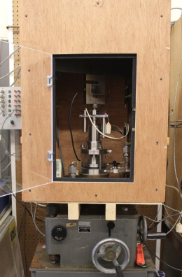
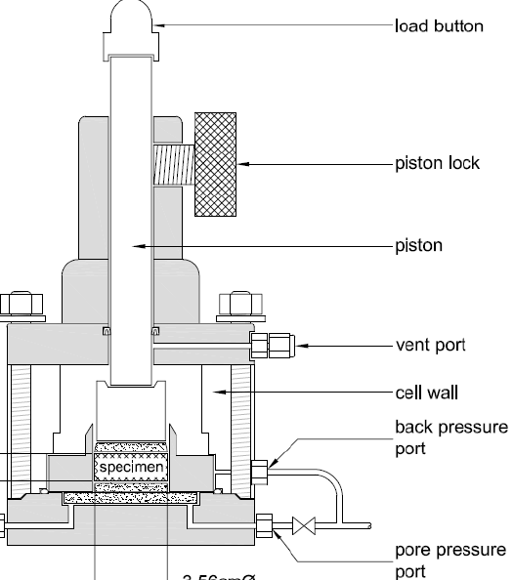
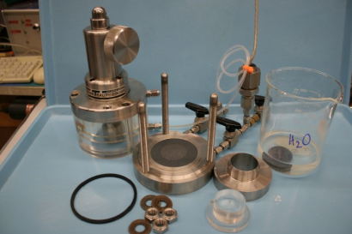
Equipment for Uniaxial Compression Testing
Low Stress < 12 MPa
Medium Stress < 40 MPa
High Stress <100 MPa
Measure:
Permeability
Compressibility

Slide 19
Typical Permeability Behavior
Increasing w_{L}
1 cm/sec =᷉ 10 ⁻⁹ m²
Notes:
-16 is equal to 10-7 cm/s
Need to change this over to EI

Slide 20
Uniaxial Compression Behavior
1 MPa =᷉ 10 TSF
Notes:
Slopes different shape and position
Sensitive to type at low stress
Not much difference at high stress
Will require different model formulations

Slide 21
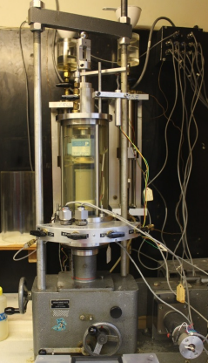
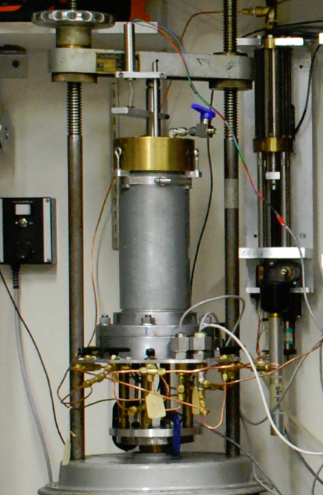
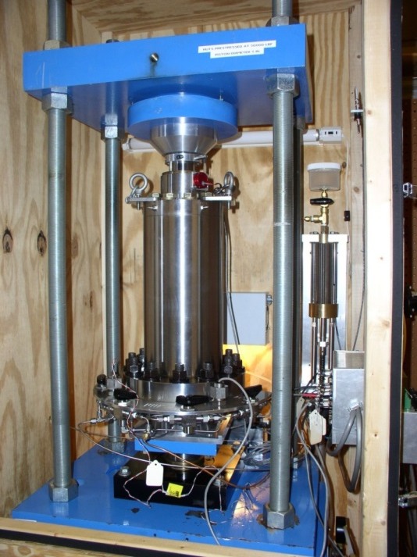
Equipment for Triaxial Shear Testing
< 12 MPa
< 40 MPa
<100 MPa
Basic Design
Measure:
Compression
Lateral Stress Ratio
Undrained Strength
Friction Angle

Slide 22
Variation in K_{0,NC} with Stress and Composition
K_{0,NC} = K_{0,10}(0.1σ’_{v [MPa]})^{J}
Log K_{0,NC}
J
K_{0,10}
Log σ‘_{v}
1 MPa =᷉ 10 TSF
Notes:
Considerable variation with BBC
Severe increase with GoM
GoM is consistent with
Intercept at 10 MPA
Trends cross but are ordered in this stress range
Exponent J

Slide 23
Triaxial Compression Undrained Shear - RBBC
Normally consolidated after K_{o} compression
3
σ’_{vc}
(MPa)
10 MPa
8.0
6.0
4.0
2.0
1.0
0.5
0.15

Slide 24
Normalized stress strain curves
Triaxial Compression Undrained Shear - RBBC
Divide stresses by consolidation stress
Finite starting shear stress
Definite peak
With stress
  Lower strength
  Increased strain
  Less softening
Stress Level
0.15 MPa
10 MPa

Slide 25
Triaxial Compression Undrained Shear - RBBC
Normalized Stress Paths
Undrained Strength Ratio
Stress Level
Friction Angle
Lateral Stress Ratio
p’=(σ’_{a}+σ’_{r})/2

Slide 26
Normally Consolidated Shearing Friction Angle
φ’_{cs} = A(0.001σ’_{p [MPa]})^{B}
Log φ’
B
A
Log σ’_{p}
A @ 1000 MPa
1 MPa =᷉ 10 TSF

Slide 27
Proposed Research
UT GeoFluids Proposal
Section 2.1

Slide 28
Example: Resed. Vs. Intact Permeability Behavior
  Proposal section 2.1.2: Resedimented vs Intact
K measured in lab
  CRS test
K predicted from
  Liquid Limit
  initial porosity
1 cm/sec =᷉ 10 ⁻⁹ m²

Slide 29
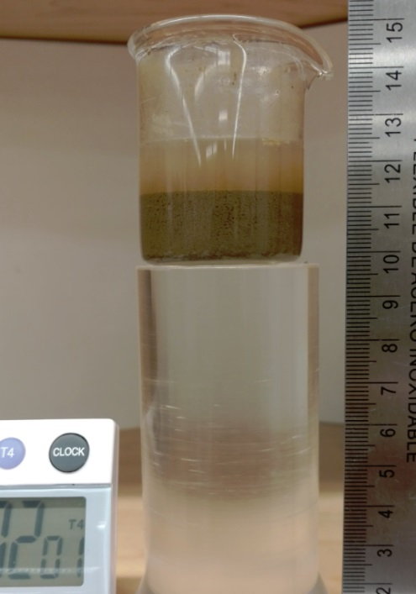
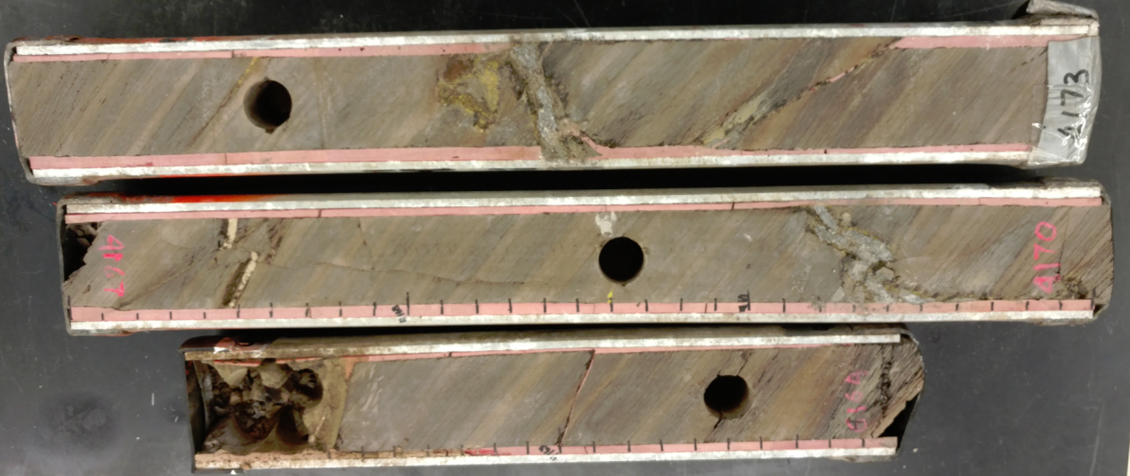
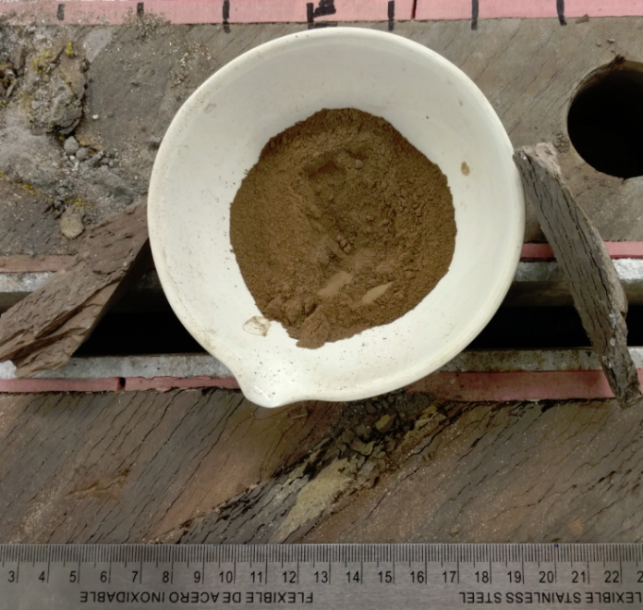
Intact Core Provided by Chevron
  Proposal section 2.1.2: Resedimented vs Intact
Strongly Layered
Extensive separation cracks
Considerable fine sand content
Little clay size
Weakly lithified

Slide 30
  Proposal section 2.1.2: Resedimented vs Intact
We will:
  Measure site specific resedimentation behavior
  Compare field vs resedimented compression behavior
  Compare laboratory TX shear results
  Compare laboratory velocity results
This requires sponsor support to provide:
  Field compression data
  Intact core

Slide 31
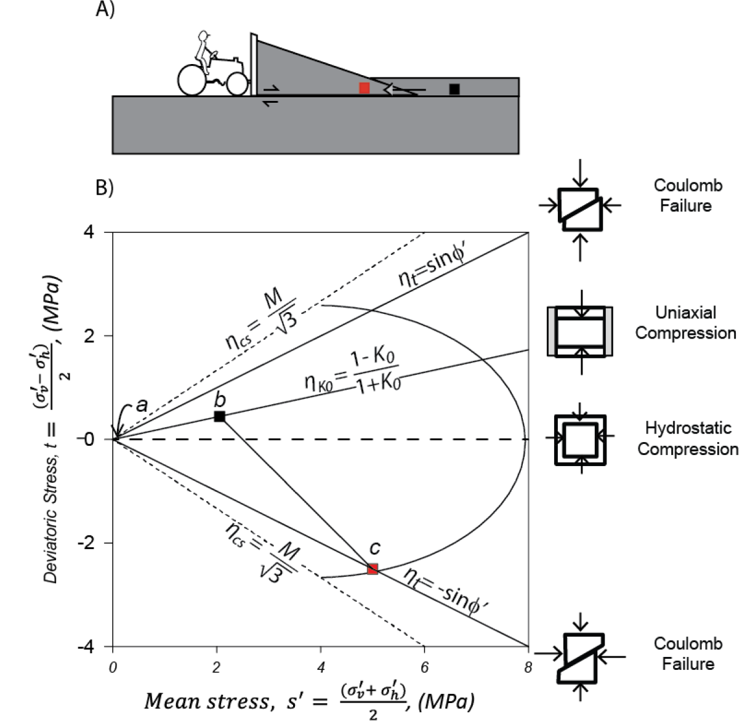
Field Example: Fold and Thrust Belt Systems
  Proposal section 2.1.3: Generalized loading effects
b. Far Field Stress Conditions
Uniaxal compression
Major stress is vertical
Intermediate equals minor
c. Inner Prism Stress Conditions
Plane strain compression
Major stress is horizontal
Intermediate about average
(Flemings and Saffer, JGR, 2018)

Slide 32
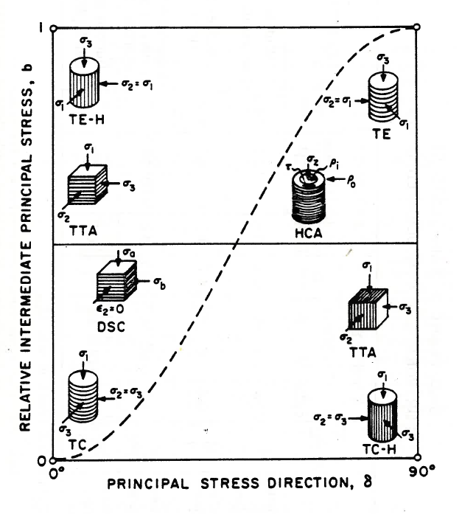
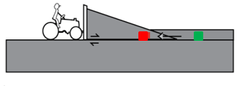
Laboratory Capabilities
  Proposal section 2.1.3: Generalized loading effects
1
Behavior Depends on:
  Initial (equilibrated) stress state
  Direction of loading relative to deposition
  Relative value of intermediate stress
Intermediate Principal Stress
b = (σ₂ - σ₃) / (σ₁ - σ₃)
0
0 90
Major Principal Stress Direction
θ (degrees from vertical)

Slide 33
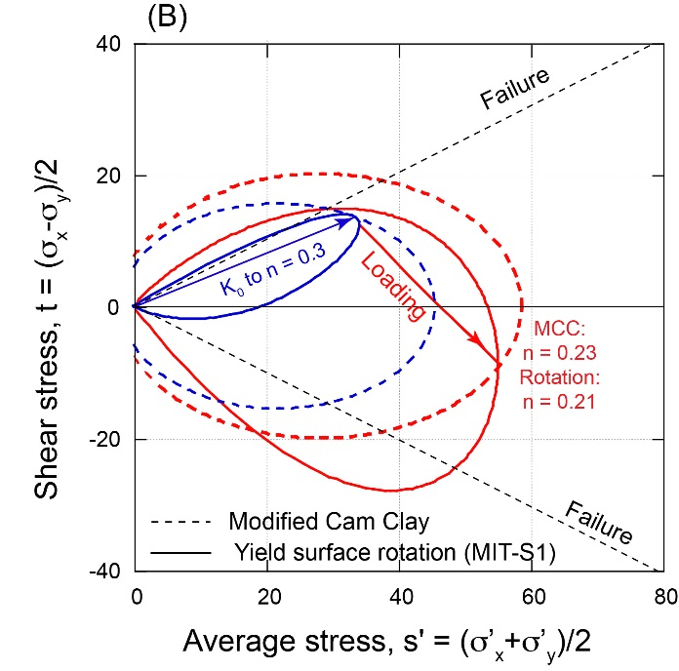
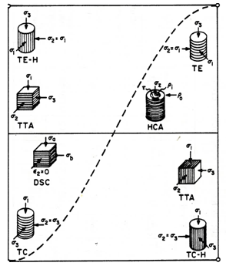
  Proposal section 2.1.3: Generalized loading effects
Loading Conditions Change Yield Surface

Slide 34
  Proposal section 2.1.3: Generalized loading effects
We will:
  Measure the shape of the yield surface
    Using TX stress space
    Following uniaxial compression
    Up to 100 MPa
  Measure the yield surface rotation
    Due to non-uniaxial compression
  Develop capability to independently control the intermediate principal stress

Slide 35
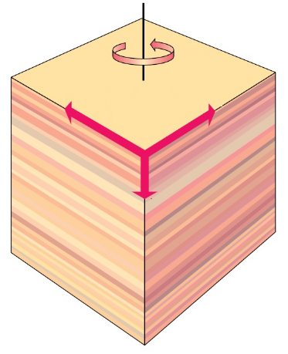
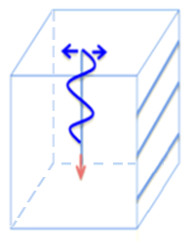
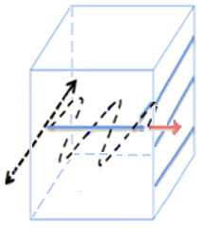
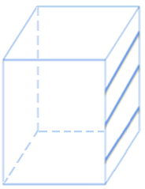







  Proposal 2.1.4: Wave velocity characterization
Characterization of TI Elastic Stiffness
Vertical Velocities
Horizontal Velocities
Vertical Axis of Symmetry
$$V_{sv}$$
$$V_{sv}$$
$$V_{ph}$$
$$V_{sh}$$
$$V_{pv}$$
Inclined Velocity
$$V_{pi}$$
$$θ$$
Side to side
Top to bottom
Side to top
Notes:
Explain how to get each element and for which ones we need horizontal and diagonal velocities

Slide 36
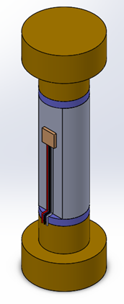
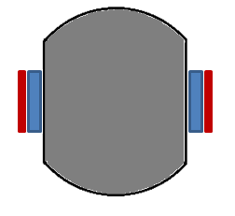
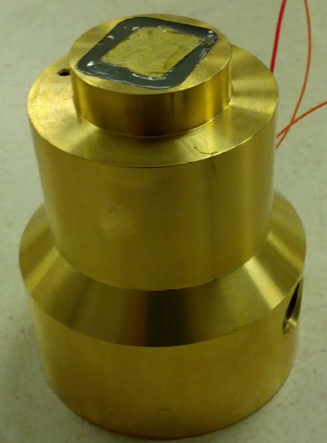
Wave Velocity Technology
  Proposal 2.1.4: Wave velocity characterization
Piezo ceramic crystals
Cylindrical triaxial specimen
Large deformation capability
10 MPa Pressure capacity
P&S Receivers
3 cm
8 cm
S Receiver
2 cm
P Sender
P Receiver
Soil Specimen
S Sender
Vertical Actuators
Horizontal Actuators

Slide 37
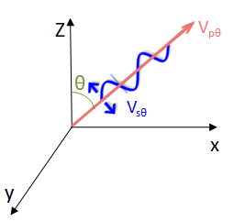
Velocity Variation with Direction
  Proposal 2.1.4: Wave velocity characterization
Measured V_{ph}
Measured V_{pv}
Measured V_{pi}
Measured V_{sv}
Uniaxial Compression
5 measurements at each stress state
RGoM-EI at 5.6 MPa
Measured V_{sh}

Slide 38
  Proposal 2.1.4: Wave velocity characterization
We will:
  Measure the wave velocity anisotropy during:
    Uniaxial compression
    General drained loading
    Undrained shearing
    Up to 100 MPa
  Develop new capability
    Measure velocity anisotropy at 100 MPa

Slide 39
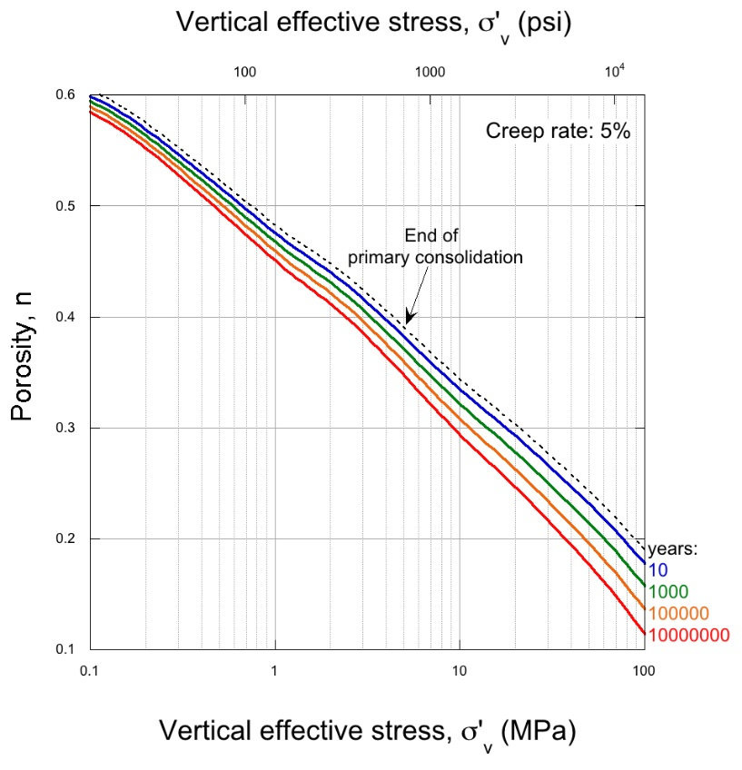
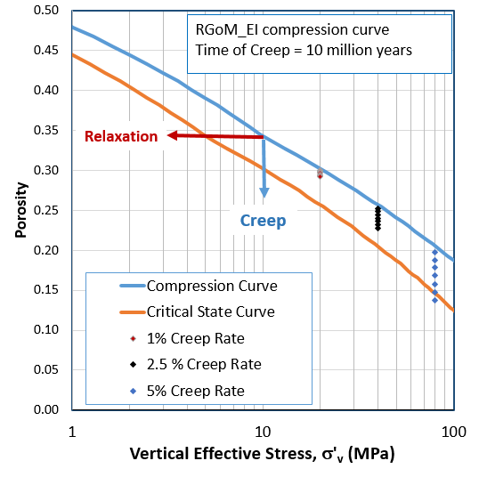
  Proposal section 2.1.5: Visco-plastic effects
Uniaxial Compression
Continued densification under constant effective stress
Continued reduction in effective stress under constant volume
Creep per log cycle of time is 1 to 5 % of compression slope

Slide 40
  Proposal section 2.1.5: Visco-plastic effects
We will:
  Measure the time dependent compression:
    Using constant rate of strain 1D tests
    Incremental loading 1D tests
    TX tests with lateral stress measurements
  Measure the time dependent stress relaxation:
    TX tests
    Undrained shearing
    Drained shearing
  Testing will focus on the 5 to 100 MPa range

Slide 41
Research goals

Slide 42
Questions

Slide 43
2.2 Poromechanical Modeling

Slide 44
Outline
UT GeoFluids achievements in poromechnical modeling
  Static models
  Evolutionary models
UT GeoFluids 2020 proposed research plan for poromechanics:
  Proposal section 2.2.2: Incorporation of experimental observations (e.g., stress level dependency)
  Proposal section 2.2.3: 3D poromechanical modeling
  Proposal section 2.2.4: Couple poromechanical results with reflection seismology to improve pressure prediction as well as imaging

Slide 45
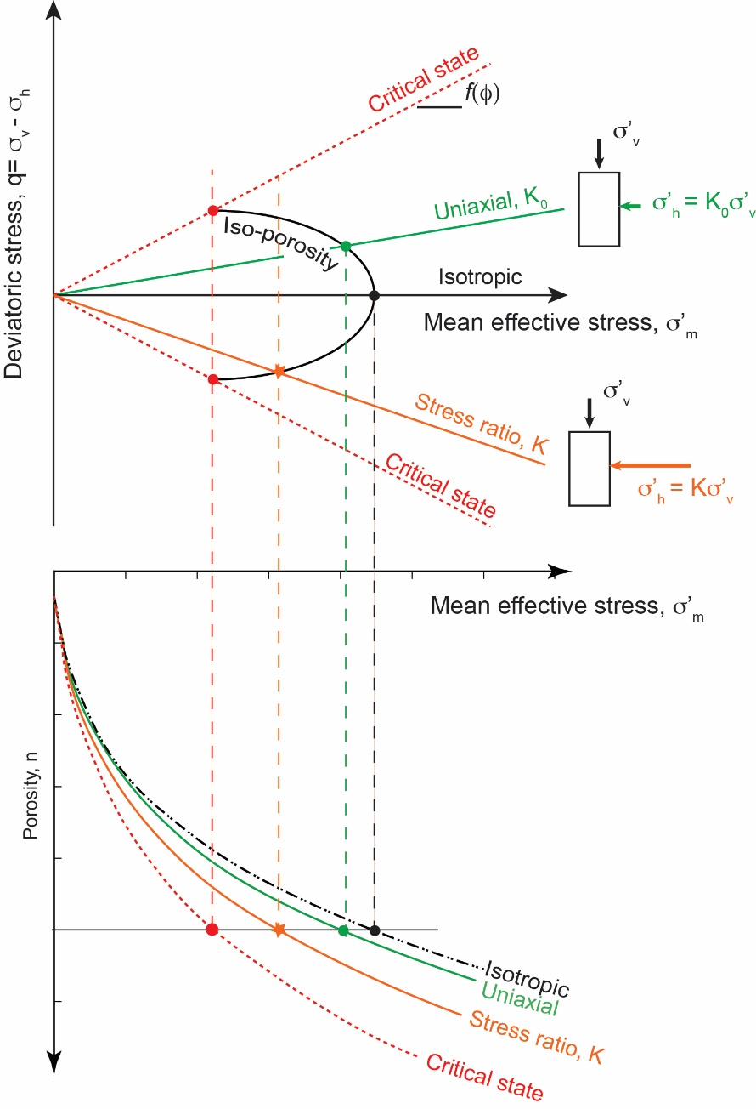
Elastoplastic mudrock models
Critical state soil mechanics.
Contribution of mean and differential stress to compaction and pore-pressure.
Fundamental attribute of UT GeoFluids research.
Notes:
Various presentations and workshops
Importance to advancement of the field

Slide 46
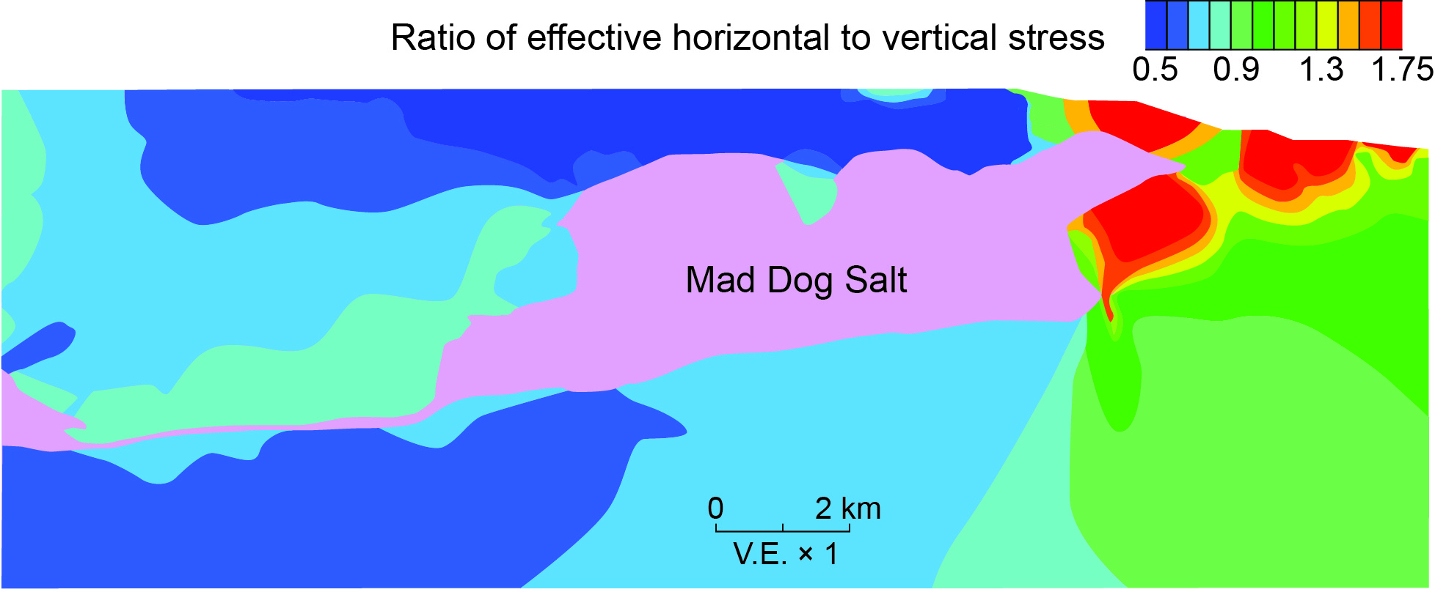
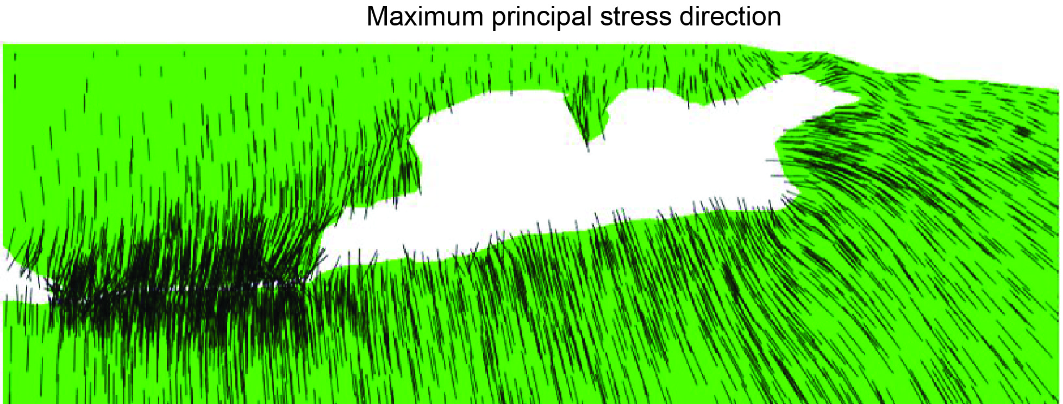
Static poromechanical models
Heidari et al; Geophysics; in press
Static models
Represent present-day geometry
Allow poromechanical study of specific geologic systems

Slide 47
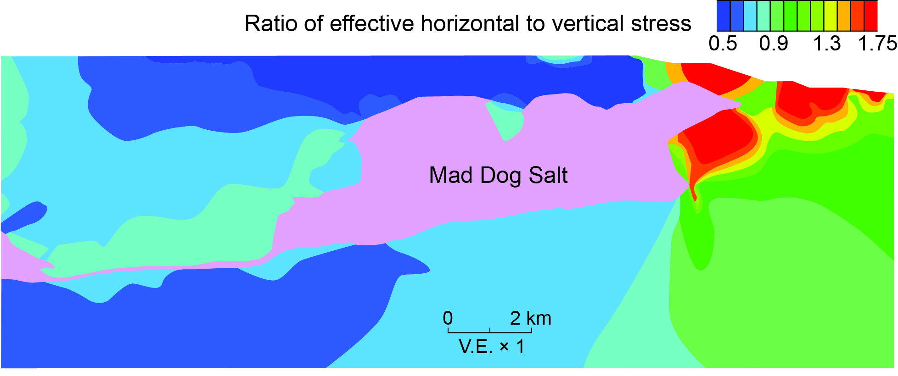
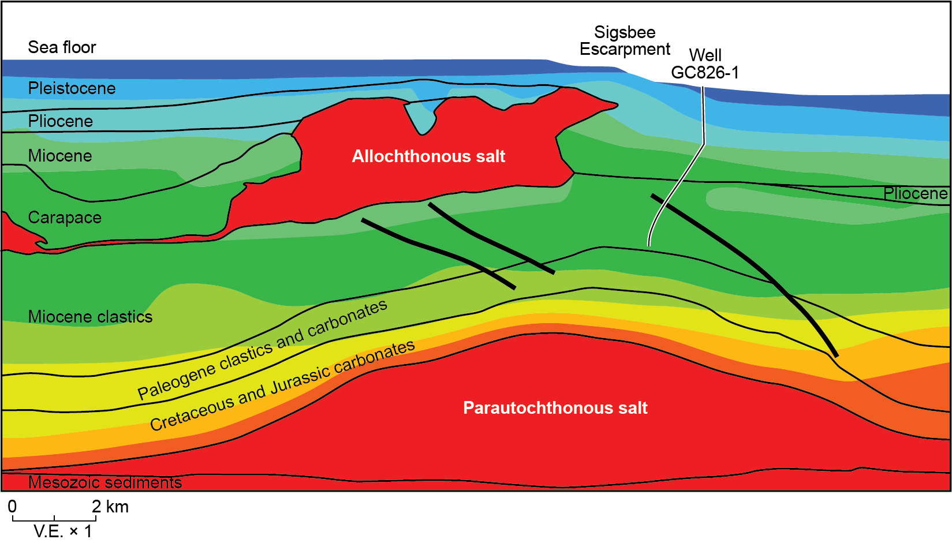
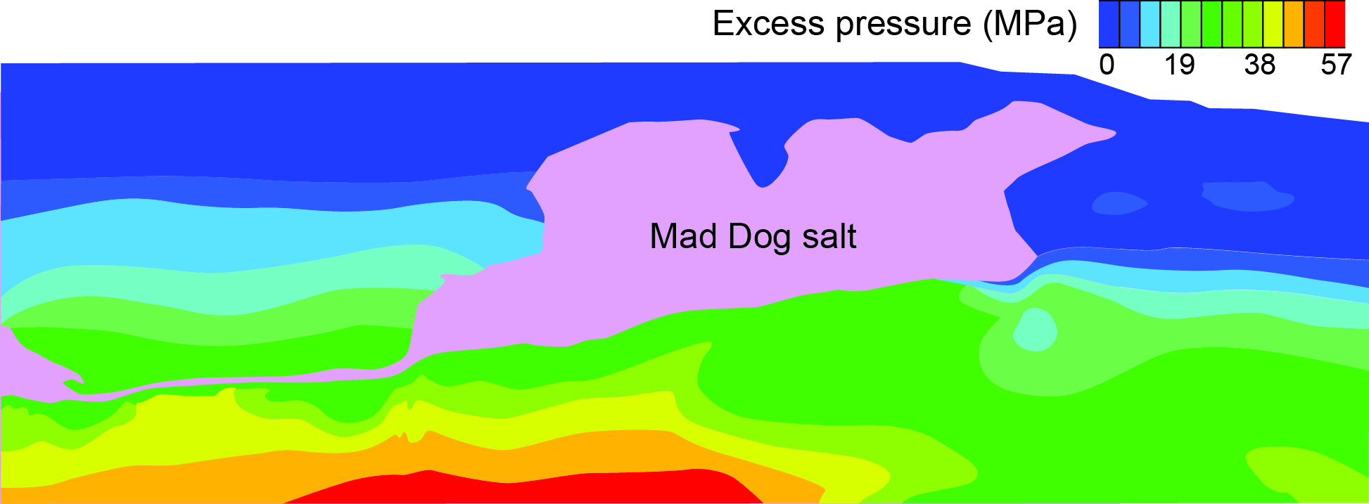
Coupling velocities with static poromechanical models
+
Heidari et al; Geophysics; in press
Seismic data: Courtesy of BP
We developed a workflow to couple static poromechanical models with seismic velocities to enhance pressure and stress prediction

Slide 48
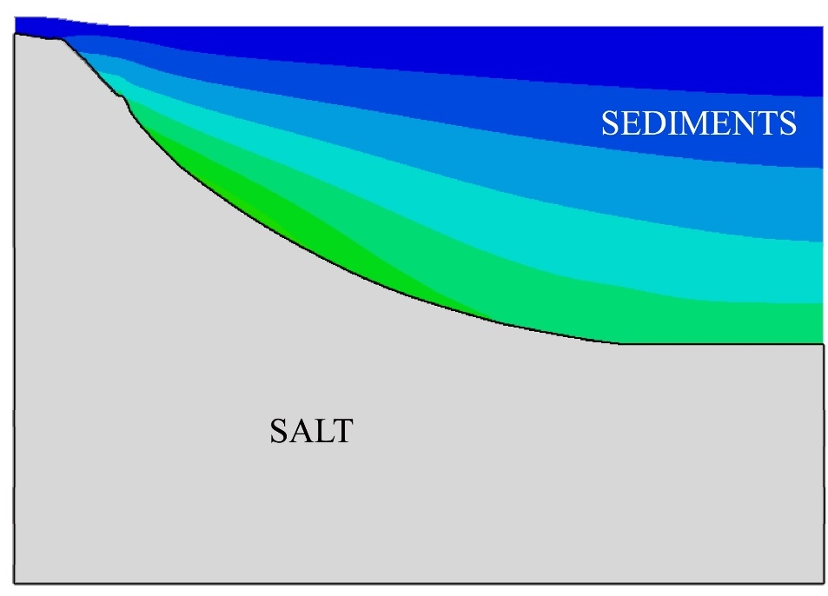
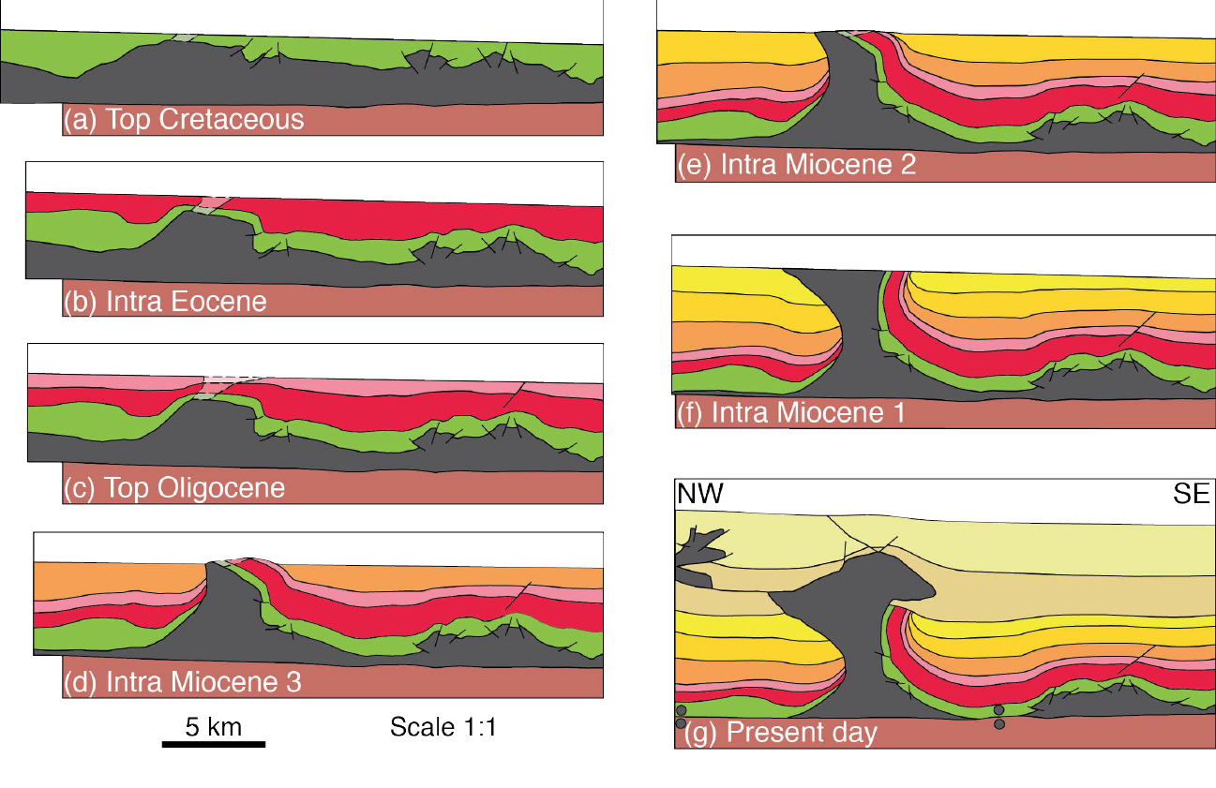
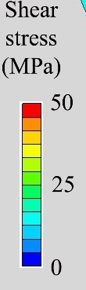
Static poromechanical models
Static model of diapir
Rowan et al, AAPG 2016
Static models cannot capture the stress and pore pressure history associated with the evolution of the geologic system

Slide 49
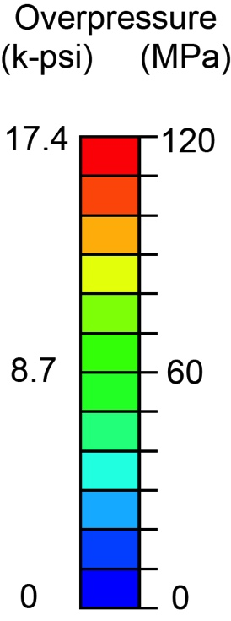
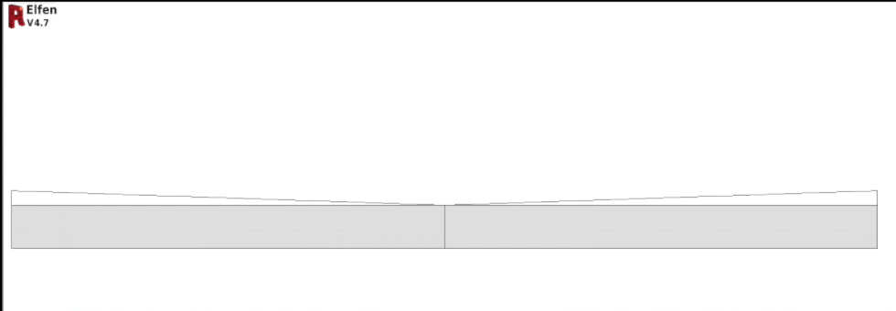
Evolutionary poromechanical model
3 km
Nikolinakou et al, 2018, JMPG
Evolutionary poromechanical models couple salt flow with deposition and porous fluid flow
They predict how stress, pressure, strength, porosity evolve with time

Slide 50

Evolutionary vs. static poromechanical models
Evolutionary models can incorporate stress and strain changes associated with the geologic history (Nikolinakou et al, 2014b, JMPG)

Slide 51



Evolutionary vs. static poromechanical models
A) EVOLUTIONARY
B) STATIC
Static models may not be able to identify hazardous drilling zones (Nikolinakou et al, 2014b, JMPG)

Slide 52


Evolutionary models: deformation patterns
Sedimentation and shortening history affect deformation patterns:
Thrust zones
vs.
Coherent folds
Nikolinakou et al, 2018, ARMA

Slide 53


Stress changes related to salt-system evolution
mean
stress
350
175
0
Heidari et al, 2016, Tectonophysics
Local increase in mean stress and decrease in porosity near a source-layer weld

Slide 54


Practical implications: Drilling window
λ* = 1: Pore pressure on lithostat
λ* = 0: Pore pressure on hydrostat
High pore pressure
Low minimum principal
Minimal drilling window subsalt
}

Slide 55



Presence of sand (permeable) layer
No sand layer
Sand layer
3 km
40 m.y.
Excess pressure (MPa)
Heidari et el, 2017, ARMA
80
Sand layers allow for excess pressure transmission towards salt
➔ Higher pore pressures near salt wall
40
0
More complete models that couple salt flow and fluid flow to stress and strength predict fundamentally different geologic behavior

Slide 56


Mechanics of thrust belts
Overpressure (MPa)
Trench
20 km
VE =1
Gao et al, 2018, JGR
Transient models couple tectonic loading with porous fluid flow and predict overpressure and stress in both hanging wall and footwall.

Slide 57


Mechanics of thrust belts
Gao et al, 2018, JGR
Poromechanical models of thrust belts quantify the contribution of mean and shear stress to porosity loss
Notes:
Trace the evolution of the strain ellipse

Slide 58
UT GeoFluids 2020 Proposal
Section 2.2: Poromechanical studies

Slide 59

Proposal section 2.2.2: Incorporate more realistic behavior
Traditional constitutive models:
Stress ratio, friction angle: constant
Orders of magnitude difference
in scale and stress level
Notes:
Not clear if our constitutive model assumptions still apply
More realistic material behavior for these geologic scales

Slide 60
Proposal section 2.2.2: Incorporate more realistic behavior
We will develop a constitutive model that incorporates:
stress-level dependency of frictional strength, undrained strength and stress ratio;
the asymmetry (rotation) and evolution of the yield surface under complex geologic loading and high stress levels;
stress-strain rate sensitivity.
Output: numerical models with more realistic material description

Slide 61


Proposal section 2.2.2: Stress dependency
Casey at al, 2016, JGR
Casey et al; JGR 2016
Effective stress ratio increases with confining stress
Friction angle decreases with confining stress
Notes:
Experimental work; Dramatic change in material properties
Empirically observed, now measured
Input for models; borehole stability analyses

Slide 62


Proposal section 2.2.2: Stress dependency
We are incorporating stress level dependency into numerical models.
We predict fundamentally different stress distributions

Slide 63

Proposal section 2.2.2: Stress dependency
Heidari at al, 2018, ARMA
We are developing an enhanced critical state model that builds on our experimental findings.

Slide 64


Proposal section 2.2.2: Yield surface shape & rotation
❓
❓
Shape of yield and iso-porosity surface greatly impacts model behavior, stress and pressure prediction
Notes:
Here symmetric
Next issue: yield surface: how does it look like and ho does it evolve in high stress stress levels and complex stress paths
Examples: we are probing yield surface for GoM material; we are exploring how the yield surface evolves in complex stress paths
Cutting edge problem + how to incorporate behavior in models; make it accessible for industry workflows

Slide 65


Proposal section 2.2.3: 3D modeling of salt systems
Salt system offshore West Africa, (courtesy of Repsol)
Need to incorporate the complexity of the 3D salt geometries in poromechanical modeling.

Slide 66
Proposal section 2.2.3: 3D modeling of salt systems
Develop static 3-dimensional models and study the effect of complex geometries to stress and pressure.
Explore evolutionary 3-dimensional models.
Build models of actual salt bodies and evaluate our poromechanical results with available data.
Provide criteria and guidelines for investing in a 3D studies.
Notes:
Plane-strain or axisymmetric models cannot capture complex 3D salt geometries.

Slide 67



Proposal 2.2.4: Link stress/pressure to seismic imaging
Approach based on evolutionary models
Improve seismic analysis tools
Signature of stress and pressure on seismic imaging
Final porosity, pore pressure and stress
Bedding orientation and strain evolution
Elastoplastic moduli
Synthetic seismic image
Synthetic shot gathers
Anisotropic velocity (CIG) models
Kyle Spikes and Mrinal Sen
Notes:
Entire stress/strain history and elastoplastic stress description; bedding information; porosity
Gain insights on how stress and pressure are recorded on seismic data
This is a forward approach

Slide 68

Proposal 2.2.4: Link stress/pressure to seismic imaging Approach based on field data and static models
Improve seismic tools
Direct stress inversion
Signature of stress on seismic imaging
Compare with measured data
Re-define salt shape
Synthetic
seismic
image
Synthetic shot gathers
Anisotropic velocity (CIG) models
Kyle Spikes and Mrinal Sen

Slide 69


Proposal 2.2.4: Rock physics models
Rock physics approaches to calculate stiffness tensor:
Empirical relationships derived from laboratory measurements
Perturbations of a background velocity with anisotropic considerations constrained by laboratory measurements
Third-order elasticity constrained by laboratory measurements
(Spikes & Sen)
Kyle Spikes and Mrinal Sen
Notes:
A fundamental challenge: how to incorporate the poromechanical results into rock physics models

Slide 70
Proposal section 2.2: Poromechanics - Key points
  We will incorporate experimental observations into numerical analyses (e.g., stress level dependency).
  We will build 3D poromechanical models to study the effect of salt geometry on stress and pressure.
  We will create couple poromechanical results with reflection seismology to improve pressure and stress prediction as well as imaging.

Slide 71
Research goals

Slide 72
2.3 Field study

Slide 73
Outline
UT GeoFluids achievements in Field Studies
  Coupling velocity data with geomechanical modeling for pressure & stress prediction
  Flow Focusing
  Salt Systems
  Thrust Belts
UT GeoFluids 2020 proposed research plan for field studies:
  Proposal section 2.3.2: Validation of pormechanical predictions with field study (e.g., stress level dependency)
  Proposal section 2.3.3: Validation of pressure prediction workflows

Slide 74








Achievements in Field Studies: FES method
Pore pressure ($u$)
$$u=σ_{m}−σ_{m}^{′}$$
Mean total stress ($σ_{m}$)
Mean effective stress ($σ_{m}^{′}$)
Geomechanical modeling
Iso-velocity contours*
$$σ_{m}^{′}=\frac{σ_{e}^{′}}{2}+\sqrt{{\left(\frac{σ_{e}^{′}}{2}\right)}^{2}−{\left(\frac{q}{M}\right)}^{2}}$$
Velocity variation with equivalent stress
$$σ_{e}^{′}={(\frac{V−V_{0}}{A_{e}})}^{\frac{1}{B_{e}}}$$
Shear stress ($q$)

Slide 75

Achievements in Field Studies:
Coupling velocity data with geomechanical modeling for pressure & stress prediction (Heidari et al., in press)

Slide 76

Achievements in Field Studies: Flow Focusing

Slide 77

Achievements in Field Studies: Flow Focusing

Slide 78

Achievements in Field Studies: Flow Focusing

Slide 79


Achievements in Field Studies: Flow Focusing
Estimate reservoir pressure from mudstone pressure, reservoir geometry, and mudstone permeability
Gao and Flemings (2017)
Flemings & Lupa(2004)

Slide 80


Achievements in Field Studies: Flow Focusing
Field Tested the Protected Trap Concept
Trap Integrity Map
Pore pressure of Q sand converges on the overburden

Slide 81


Achievements in Field Studies: Flow Focusing
Pressure regression in Macondo
A
A’

Slide 82
Achievements in Field Studies: Salt Systems
Testing workflows
Heidari et al; Geophysics; in press

Slide 83

Achievements in Field Studies: Salt Systems
Quantify Mean & Shear Induced Pressures
Approach:
Document pressure and stress in salt systems
compared pressure & stress predictions with field data
Notes:
- I’ll explain what is driving these differences.

Slide 84


Achievements in Field Studies: Thrust Belts
Incorporate complex stress state for pressure and stress prediction
Applied in Nankai Trough
Flemings and Saffer, 2018

Slide 85

UT GeoFluids 2020 proposed research plan for field studies:
Proposal section 2.3.2: Validate poromechanical predictions with field studies
Example: Document salt-induced pressure and stress effects?
Approach: Work with sponsors and public databases to identify data sets in salt systems and thrust belts to document geomechanical model predictions

Slide 86

UT GeoFluids 2020 proposed research plan for field studies:
Proposal section 2.3.3: Validation of pressure prediction workflows
Validate pressure/stress prediction workflows in field with available data.
Extend pressure-prediction workflows by coupling three-dimensional geomechanical models with velocity data.
FES
VES
Mud weights calculated from sea floor
Drilling window, σ₃-u (ppg)

Slide 87
2.4 Deliverables

Slide 88

Technology transfer
2018 annual meeting Austin: 63 attendees from all 11 companies

Slide 89

Website

Slide 90


Website: Presentations

Slide 91

Website: Publications

Slide 92


Website: on line databases

Slide 93

Website:
Software

Slide 94


The new UT-FAST P³ tool

Slide 95

Predicting pore pressure using the full stress tensor

Slide 96
Proposal Section 2.4: Deliverables:
Cuttings Protocol: We will deliver a protocol for on-site (on-rig) cleaning and testing of cuttings. We will provide correlations between liquid limits/clay fraction and stress ratio, friction angle, and undrained strength. This tool will allow quick estimation of least principal stress and strength during drilling.
Salt Pressure-Stress Atlas: We will build an atlas that relates salt geometry to pressure and stress predictions. This atlas will provide insights into qualitatively estimating stress, pressure, and hazardous zones near salt.
Road Map for Intact vs. Resedimented Behavior: We will build a database that compares intact with resedimented behavior.
Online Experimental Database: We will provide an online database containing our experimental measurements for use by the sponsors for internal evaluations.

Slide 97
Proposal Section 2.4: Deliverables:
Poromechanical Model Results: We will communicate and distribute poromechanical model results in standard industry software format and in excel spreadsheets, so that the insights are more easily applied.
Online Software: We will continue to build online software to communicate the concepts we are developing in UT GeoFluids.
Workflows: We will continue to develop our workflow to couple seismic models with poromechanical models to predict pressure and stress.
Synthetic Seismic Images: We will deliver tools and workflows to generate synthetic seismic datasets from our poromechanical models.
Annual Meetings & Annual Company Visits.

Slide 98
2.5 Logistics

Slide 99
Logistics:
First payment in May 2019 ($50,000). Increment at 2%/yr.
No penalty for withdrawing
Members who enter after Year 1 will pay one back year.
Current members will need to sign an amendment
New members will need to sign an agreement that reflects the 2009 proposal and the amendment.

Slide 100
Outstanding Question for discussion:
Explore stress evolution during production?
Explore pressure/stress in unconventional basins (e.g. Permian Basin)?

Slide 101
UT GeoFluids experimental publications
Deireh, A., Chang, I.Y., Whittaker, M.L., Weigand, S., Keane,D., Rix, J., Germaine, J.T., Joester, D., and Flemings, P.B., (2017), “Clay Gel Porosity Revisited: the Case Against the Honeycomb Structure,” Applied Clay Science.
Casey, B., Germaine, J.T, Flemings, P.B. and Fahy, B.P., (2017), “In Situ Stress State and Strength in Mudrocks,” J. Geophysical Research: Solid Earth, 121(8), 5611-5623
Adams, A., Nordquist, T.J., Germaine, J.T., and Flemings, P.B. (2016), “Permeability Anisotropy and Resistivity Anisotropy of Mechanically Compressed Mudrocks,” Canadian Geotechnical Journal, 53(9), 1474-1482. 10.1139/cgj-2015-0596
Casey, B., Germaine, J.T., Abdulhadi, N.O., Kontopoulos, N.S., and Jones, C.A., (2015), “Undrained Young’s Modulus of Fine-Grained Soils,” J. Geotechnical and Geoenvironmental Engineering, ASCE, DOI: 10.1061/(ASCE)GT.1943-5606.0001382
Casey, B., Germaine, J.T., Flemings, P.B., and Fahy, B.P. (2015), “Estimating Horizontal Stresses for Mudrocks under One-Dimensional Compression,” Marine and Petroleum Geology, (63), 178-186.
Casey, B, and Germaine, J.T., (2014), “An evaluation of three triaxial systems with results from 0.1 to 100 MPa,” Geotechnical Testing Journal, ASTM, V37, N6
Marjanovic, J. and Germaine, J.T., (2013), “Experimental Study Investigating the Effects of the Setup Conditions on Bender Element Velocity Results,” Geotechnical Testing Journal, 36, (2), GTJ20120131.
Casey, B. A., and Germaine, J.T., (2013), “The Stress Dependence of Shear Strength in Fine-Grained Soils and Correlations with Liquid Limit,” Journal of Geotechnical and Geoenvironmental Engineering, ASCE, 139, (10), 1709-1718.

Slide 102
UT GeoFluids experimental publications
Casey, B., and Germaine, J.T., (2013), “Liquid Limit as a Predictor of Fine-Grained Soil Strength,” Journal of Geotechnical and Geoenvironmental Engineering, ASCE
Casey, B., Germaine, J.T., Flemings, P.B., Gao, B., Reece, J.S., and Betts, W., (2012), “Liquid Limit as a Predictor of Mudrock Permeability,” Marine and Petroleum Geology, (44), 256-263.
Adams, A., Germaine, J.T., Flemings, P.B., and Day-Stirrat, R., (2013), “Stress Induced Permeability Anisotropy of Resedimented Boston Blue Clay,” Water Resources Research, doi: 10.1002/wrcr.20470
Abdulhadi, N.O., Germaine, J.T, and Whittle, A.J., (2012), “Stress-Dependent Behavior of Saturated Clay,” Canadian Geotechnical Journal, 49, 907-916
Day-Stirrat, R.J., Schleicher, A.M., Schneider, J., Flemings, P.B., Germaine, J.T., and van der Pluijm, B.A., (2011), “Preferred orientation of phyllosilicates: Effects of composition and stress on resedimented mudstone microfabrics,” Journal of Structural Geology, 33 (9) 1347-1358.
Schneider, J., Flemings, P.B., Day-Stirrat, R.J., and Germaine, J.T., (2011), “Insights into pore-scale controls on mudstone permeability through resedimentation experiments,” Geology, 39 (11), 1011-1014.
Abdulhadi, N.O., Germaine, J.T., and Whittle, A.J., (2011), “Thick-Walled Cylinder Testing of Clay for the Study of Wellbore Instability,” Journal of Geotechnical Testing Journal, 34 (6), 766-776.
Abdulhadi, N.O., Germaine, J.T., and Whittle, A.J., (2011), “Experimental Study of Wellbore Instability in Clays,” Journal of Geotechnical and Geoenvironmental Engineering, ASCE, 137 (8), 766-776.

Slide 103
UT GeoFluids poromechanical publications
Nikolinakou M.A., Heidari M., Flemings P.B., Hudec M.R., 2018. Geomechanical modeling of pore pressure in evolving salt systems, Marine and Petroleum Geology, doi: https://doi.org/10.1016/j.marpetgeo.2018.03.013
Gao, B., Flemings, P., Nikolinakou, M., Saffer, D., Heidari, M., 2018 (online). Mechanics of Fold-and-Thrust Belts Based on Geomechanical Modeling. Journal of Geophysical Research.
Heidari, M., Nikolinakou, M.A., Flemings P.B. (in press). Coupling geomechanical modeling with seismic pressure prediction. Geophysics.
Nikolinakou M.A., Flemings P.B., Heidari M., Hudec M.R. (2018): Stress and pore pressure in mudrocks bounding salt systems; submitted to Rock Mechanics Rock Engineering .
Heidari, M., Nikolinakou M.A., and Flemings, P. B. (2018): “Enhancing Modified Cam Clay Model for large stress range”, 52nd U.S. Rock Mechanics/Geomechanics Symposium, Seattle, WA, June 17-20; Paper # 790..
Nikolinakou M.A., HeidariM., Hudec M.R., and Flemings, P. B. (2018): “ Geomechanical modeling of stress and deformation associated with salt‐sheet advance”, 52nd U.S. Rock Mechanics/Geomechanics Symposium, Seattle, WA, June 17-20; Paper # 637.
Nikolinakou, M. A ., M. Heidari, M. R. Hudec, and P. B. Flemings, 2017, Initiation and growth of salt diapirs in tectonically stable settings: upbuilding and megaflaps, American Association of Petroleum Geologists Bulletin, DOI:10.1306/09021615245.

Slide 104
UT GeoFluids poromechanical publications
Luo, G., Hudec, M. R., Flemings, P. B., and Nikolinakou, M. A., 2017, Deformation, stress, and pore pressure in an evolving suprasalt basin: Journal of Geophysical Research: Solid Earth, v. 122, no. 7, p. 5663–5690, http://doi.org/10.1002/2016JB013779.
Gao, B., and Flemings, P.B., 2017, Pore pressure within dipping reservoirs in overpressured basins, Marine and Petroleum Geology, 80, 94-111, doi:http://dx.doi.org/10.1016/j.marpetgeo.2016.11.014.
Nikolinakou, M.A., Flemings, P.B., Hudec, M.R., 2016, Modeling of shales in salt-hydrocarbon systems, Rock Mechanics Rock Engineering, v. 49, pp699–705 DOI 10.1007/s00603-015-0863-2.
Heidari, M., M. A. Nikolinakou, M. R. Hudec, and P. B. Flemings, 2016, Geomechanical analysis of a welding salt layer and its effects on adjacent sediments: Tectonophysics, v. 683, p. 172-181, doi http://dx.doi.org/10.1016/j.tecto.2016.06.027.
Heidari, M., M. A. Nikolinakou, P. B. Flemings, and M. R. Hudec, 2016, A simplified stress analysis of rising salt domes: Basin Research, doi 10.1111/bre.12181.
Luo, G., P. B. Flemings, M. R. Hudec, and M. A. Nikolinakou, 2015, The role of pore fluid overpressure in the substrates of advancing salt sheets, ice glaciers, and critical-state wedges, J. Geophys. Res. Solid Earth, 120, 87–105, doi: 10.1002/2014JB011326.

Slide 105
UT GeoFluids poromechanical publications
Nikolinakou, M.A., Flemings, P.B., Hudec, M.R. (2014a): “Modeling stress evolution around a rising salt diapir”, Journal of Marine and Petroleum Geology, v. 51, pp230-238, doi: http://dx.doi.org/10.1016/j.marpetgeo.2014.07.002.
Nikolinakou, M.A., Hudec, M.R., Flemings, P.B. (2014b): “Comparison of evolutionary and static modeling of stresses around a salt diapir”, Journal of Marine and Petroleum Geology, v. 57, pp537-545, doi: http://dx.doi.org/10.1016/j.marpetgeo.2013.11.021.
Nikolinakou, M.A., Luo, G., Hudec M.R., Flemings P.B. (2012): “Geomechanical Modeling of Stresses Adjacent to Salt Bodies: 2. Poro-Elasto-Plasticity and Coupled Overpressures”, American Association of Petroleum Geologists Bulletin, vol. 96, No1, pp65-85, doi: DOI:10.1306/04111110143.
Luo, G., Nikolinakou, M.A., Hudec M.R., Flemings P.B. (2012): “Geomechanical Modeling of Stresses Adjacent to Salt Bodies: 1. Uncoupled models”, American Association of Petroleum Geologists Bulletin, vol. 96, No1, pp43-64, doi: DOI:10.1306/04111110144.

Slide 106
UT GeoFluids Field Studies publications
Gao, B., and Flemings, P.B., 2017, Pore pressure within dipping reservoirs in overpressured basins, Marine and Petroleum Geology, 80, 94-111, doi:http://dx.doi.org/10.1016/j.marpetgeo.2016.11.014.
Pinkston, William, 2017, Pore Pressure at the Macondo Well, Mississippi Canyon, Gulf of Mexico, MS dissertation, The University of Texas at Austin, advisor P.B. Flemings
Flemings, P.B., Saffer, D.M., 2018. Pressure and Stress Prediction in the Nankai Accretionary Prism: A Critical State Soil Mechanics Porosity-based approach, Journal of Geophysical Research, doi:10.1002/2017JB015025.
Reilly, M., Flemings, P.B., 2010, Deep Pore Pressures and Seafloor Venting in the Auger Basin, Gulf of Mexico, Basin Research, V. 22, p. 380-397, doi:10.1111/j.1365-2117.2010.00481.
Merrell, M.P., Flemings, P.B., Bowers, G.L., 2014, Subsalt Pressure Prediction in the Miocene Mad Dog Field, Gulf of Mexico, AAPG Bulletin, v. 98, no. 2, p. 315-340, doi:10.1306/06251312156.
Seldon, B., Flemings, P.B., 2005, Reservoir Pressure and Seafloor Venting: Predicting Trap Integrity in a Deepwater Turbidite Reservoir, AAPG Bulletin, v. 89, no. 2, p. 193-209.
Sanford, Jason, 2015, The Cretaceous-Paleogene boundary deposit in the Gulf of Mexico: Oceanic basin response to the Chicxulub impact and Geomechanics of reservoir-scale sand injectites, Panoche Hills, California, MS dissertation, The Unversity of Texas at Austin, advisor P.B. Flemings.

Slide 107
UT GeoFluids Field Studies publications
Sanford, Jason, 2015, The Cretaceous-Paleogene boundary deposit in the Gulf of Mexico: Oceanic basin response to the Chicxulub impact and Geomechanics of reservoir-scale sand injectites, Panoche Hills, California, MS dissertation, The Unversity of Texas at Austin, advisor P.B. Flemings.
Long, H., Flemings, P.B., Germaine, J.T. and Saffer, D.M., 2011, Consolidation and overpressure near the seafloor in the Ursa Basin, deepwater Gulf of Mexico, Earth Planet. Sci. Lett., 305, 11-20
Flemings, P.B., Long, H., Dugan, B., Germaine, J., John, C., Behrmann, J.H., Sawyer, D., and Expedition 308 Scientists, 2008, Erratum to "Pore pressure penetrometers document high overpressure near the seafloor where multiple submarine landslides have occurred on the continental slope, offshore Louisiana, Gulf of Mexico" [Earth and Planetary Science Letters 269/3-4 (2008) 309-32, Earth and Planetary Science Letters, doi: 10.1016/j.epsl.2008.06.027.
Flemings P.B., Stump, B.B., Finkbeiner, T., Zoback, M., 2002, Flow Focusing in Overpressured Sandstones: Theory, Observations, and Applications , American Journal of Science, v. 302, p. 827-855.
Lupa, J.A., Flemings, P.B., Tennant, S., 2002, Pressure and Trap Integrity in the Deepwater Gulf of Mexico, The Leading Edge, V. 21, no. 1, p. 84-87.
Finkbeiner, T., Zoback, M., Stump B.B., Flemings, P.B., 2001, Stress, Pore Pressure, and Dynamically Constrained Hydrocarbon Columns in the South Eugene Island 330 Field, Gulf of Mexico, American Association of Petroleum Geologists Bulletin, V. 85, no. 6, p. 1007-1031.

