Slide 1
Geoscientific data analysis using UNIX and GMT
4/8: GMT II, projections
Thorsten Becker
The University of Texas at Austin
April 2021

Slide 2
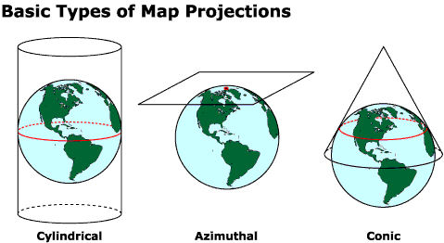
Map projections

Slide 3
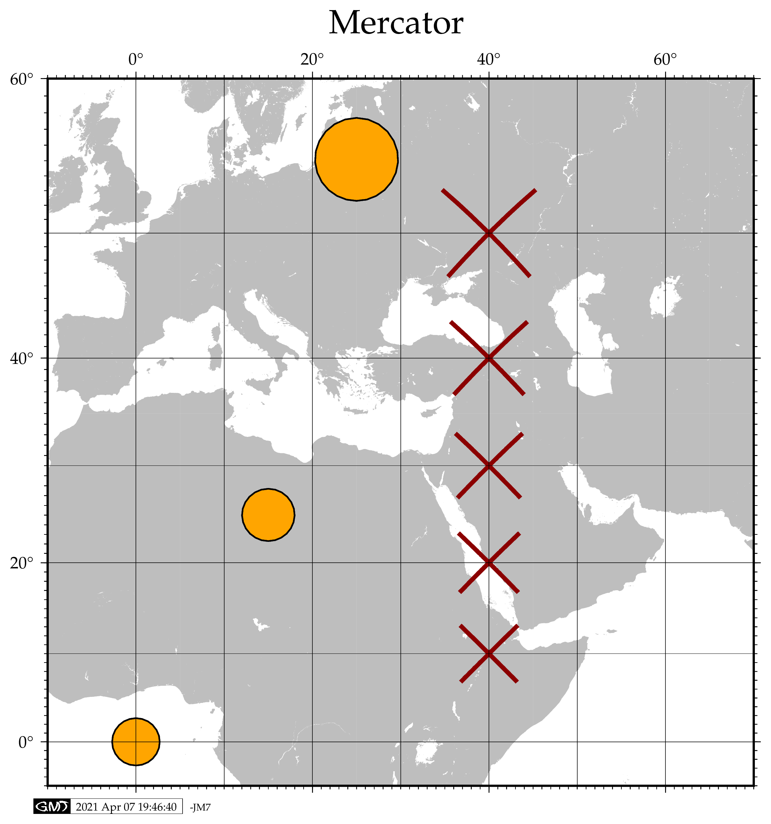
Cylindrical
Conformal
Azimuth straight line

Slide 4
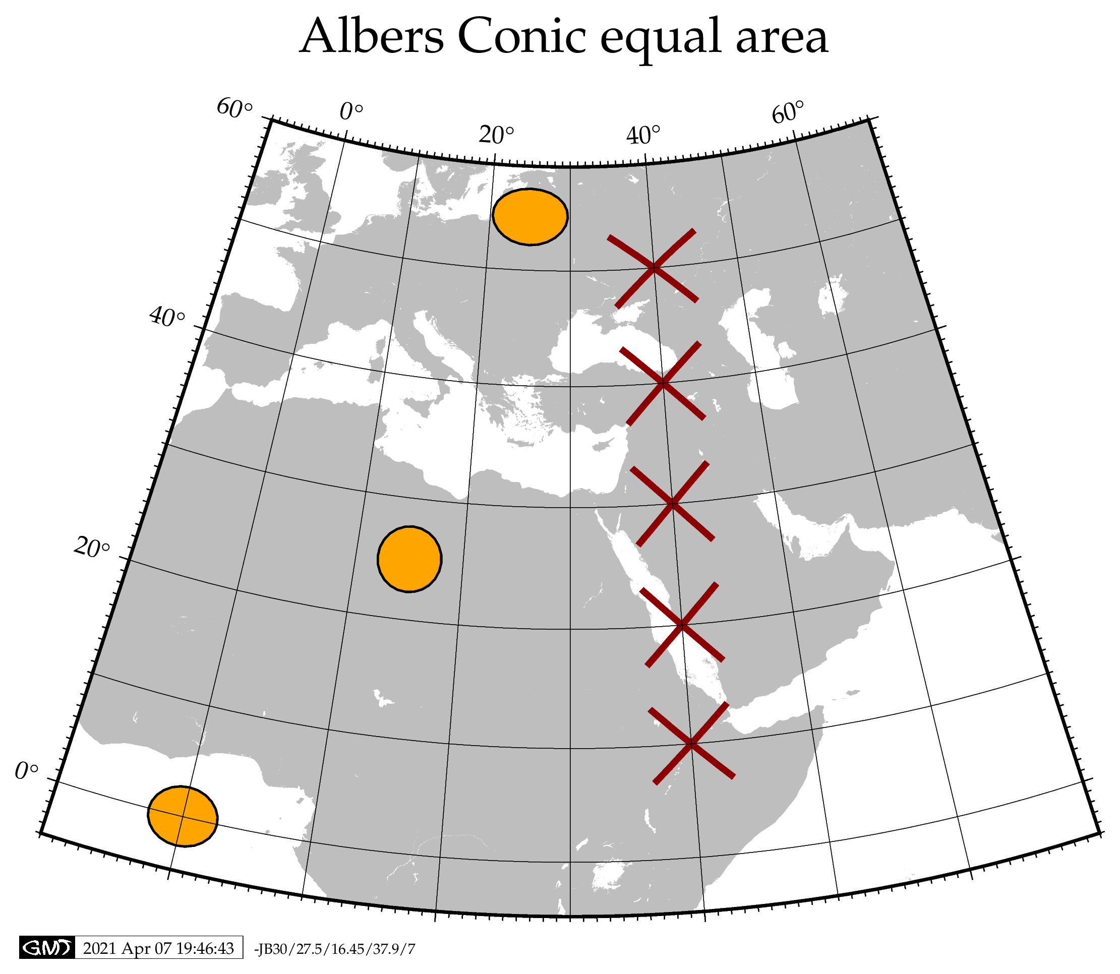
Conic
W-E maps

Slide 5
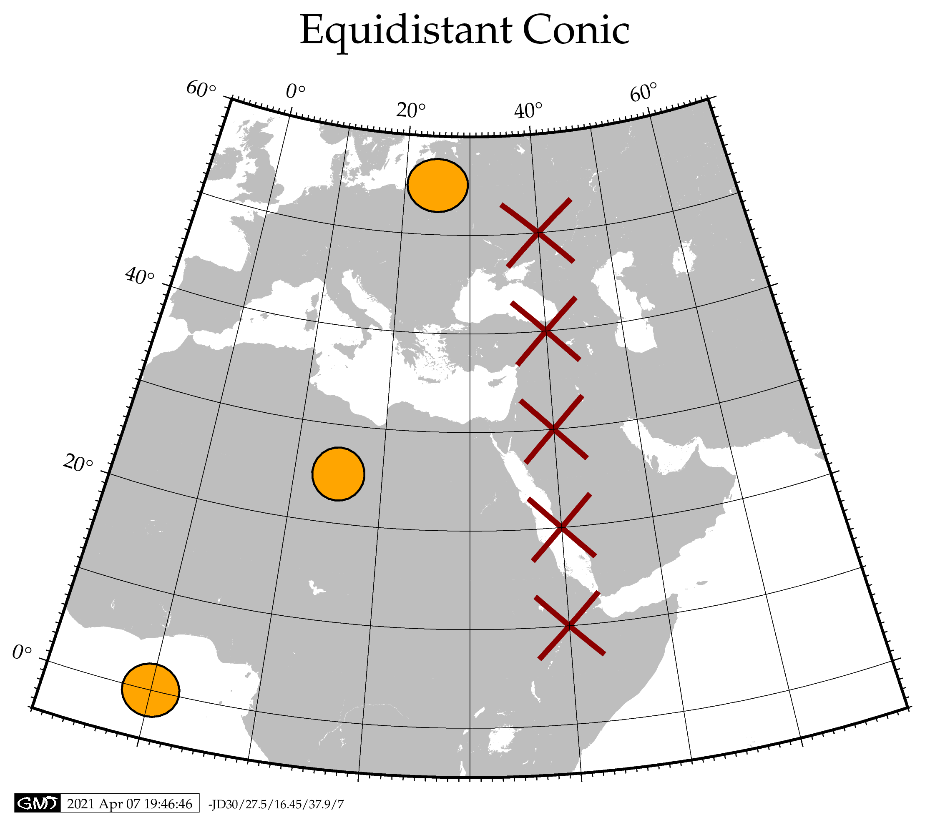
Conic
Scale true along meridian

Slide 6
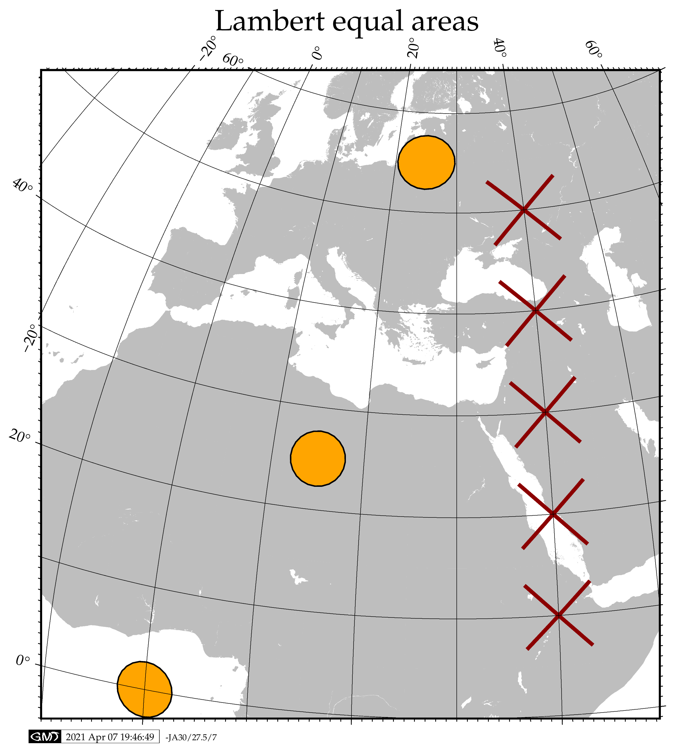
Conic

Slide 7
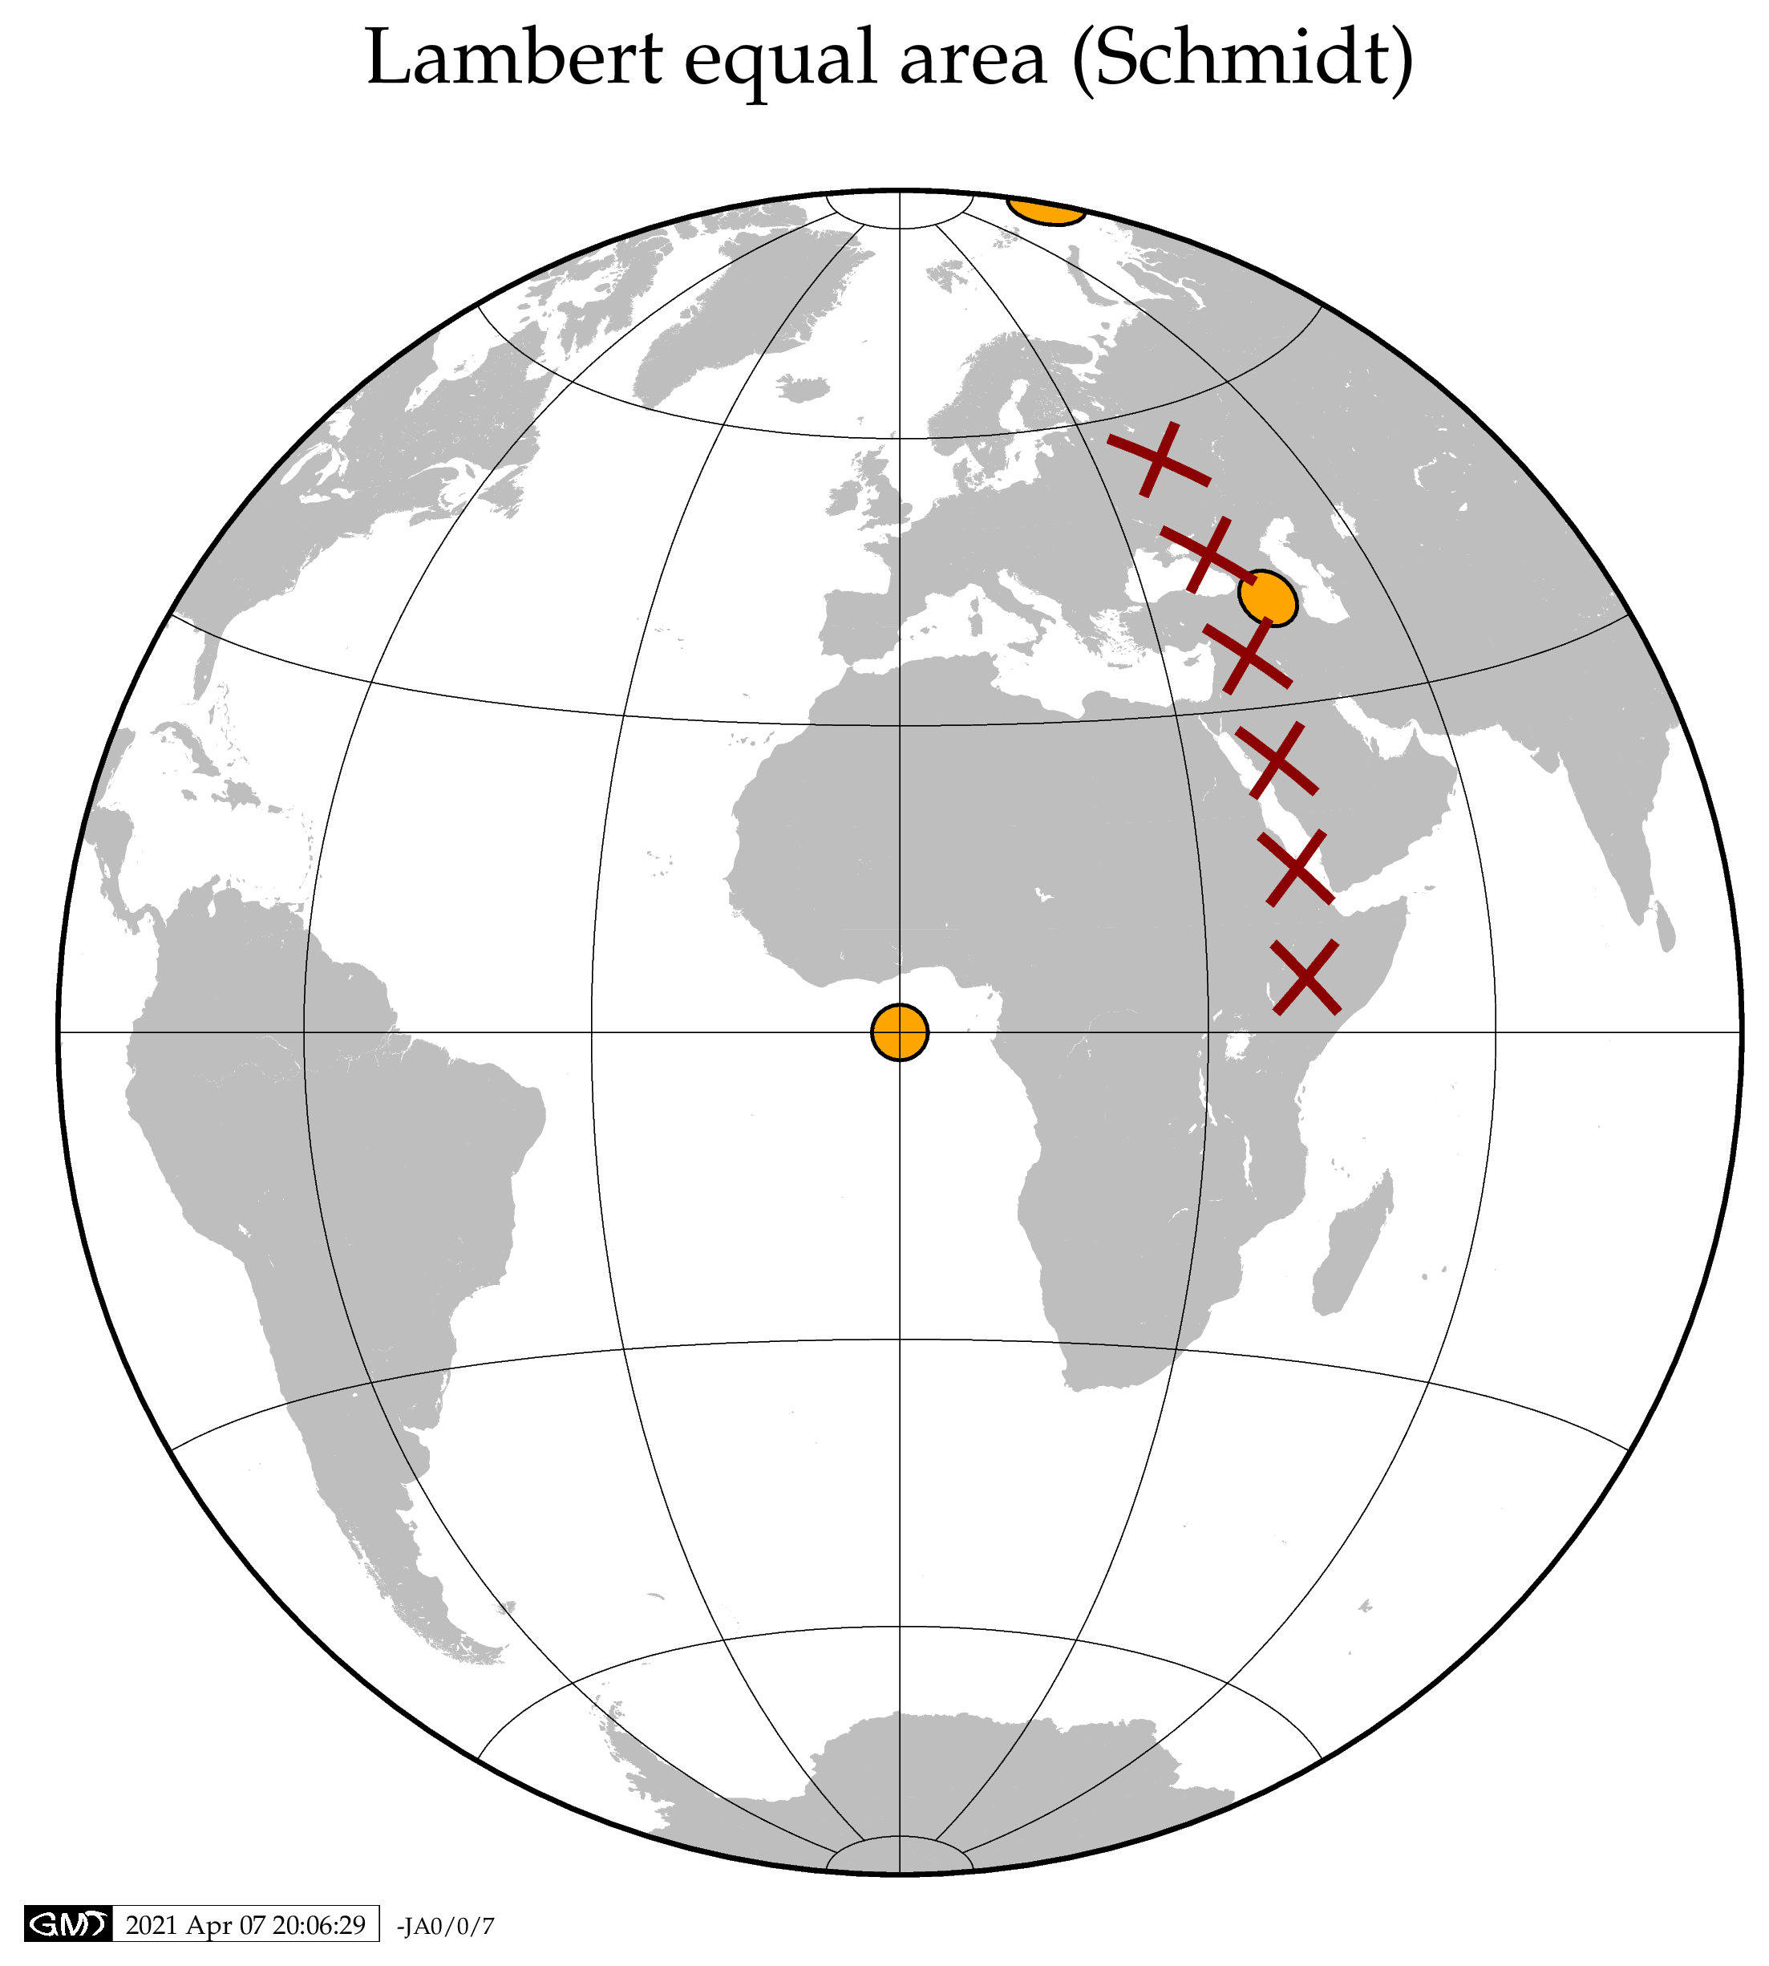
Azimuthal
Not perspective

Slide 8
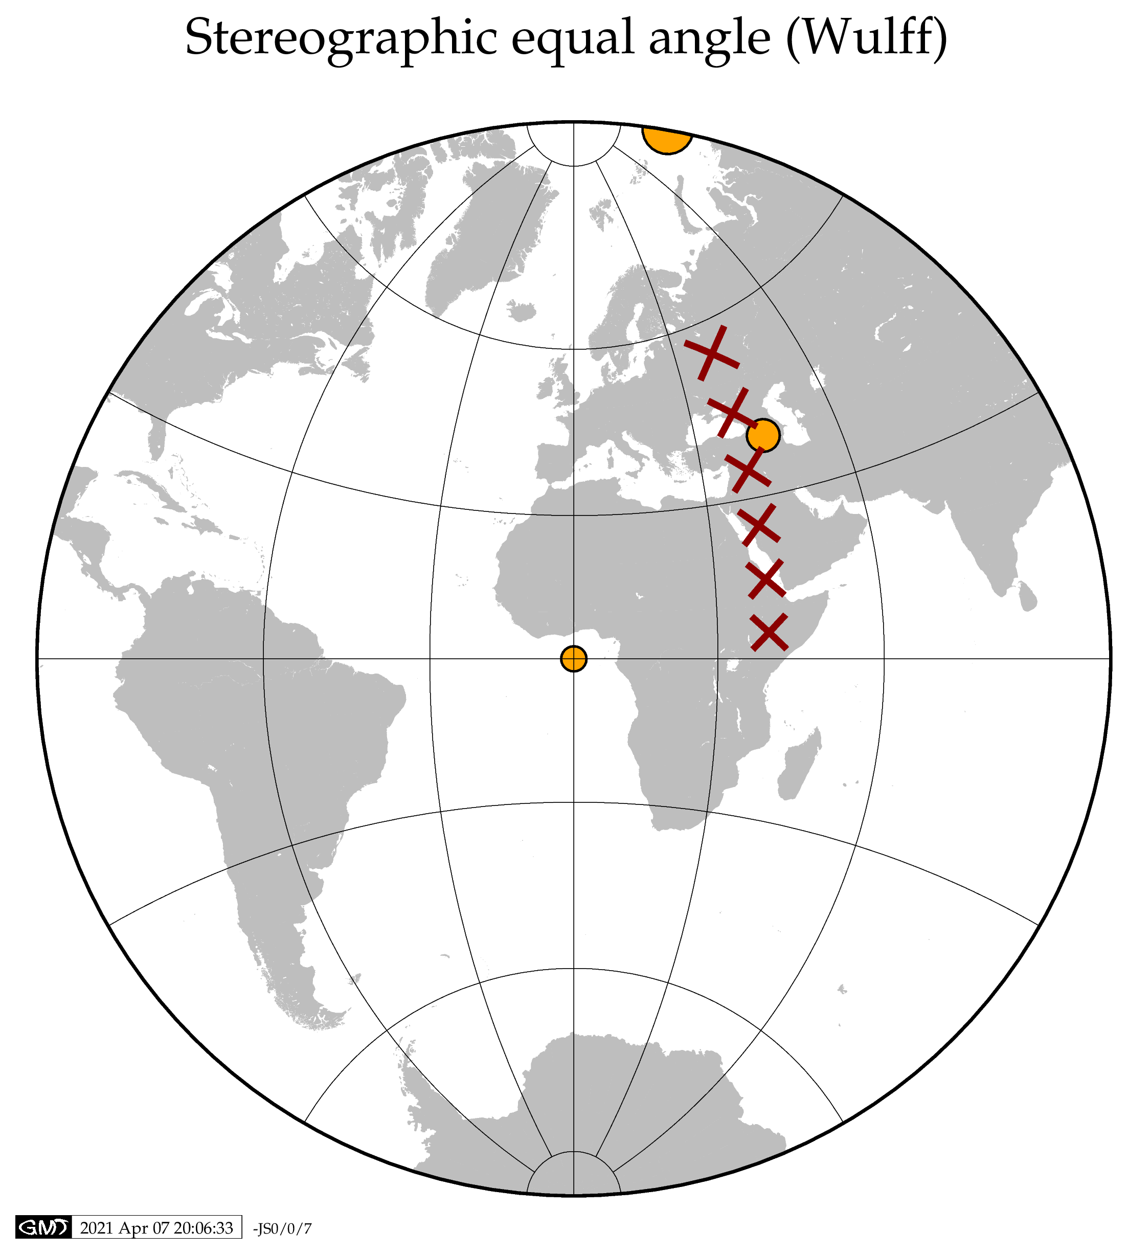
Azimuthal
Conformal

Slide 9
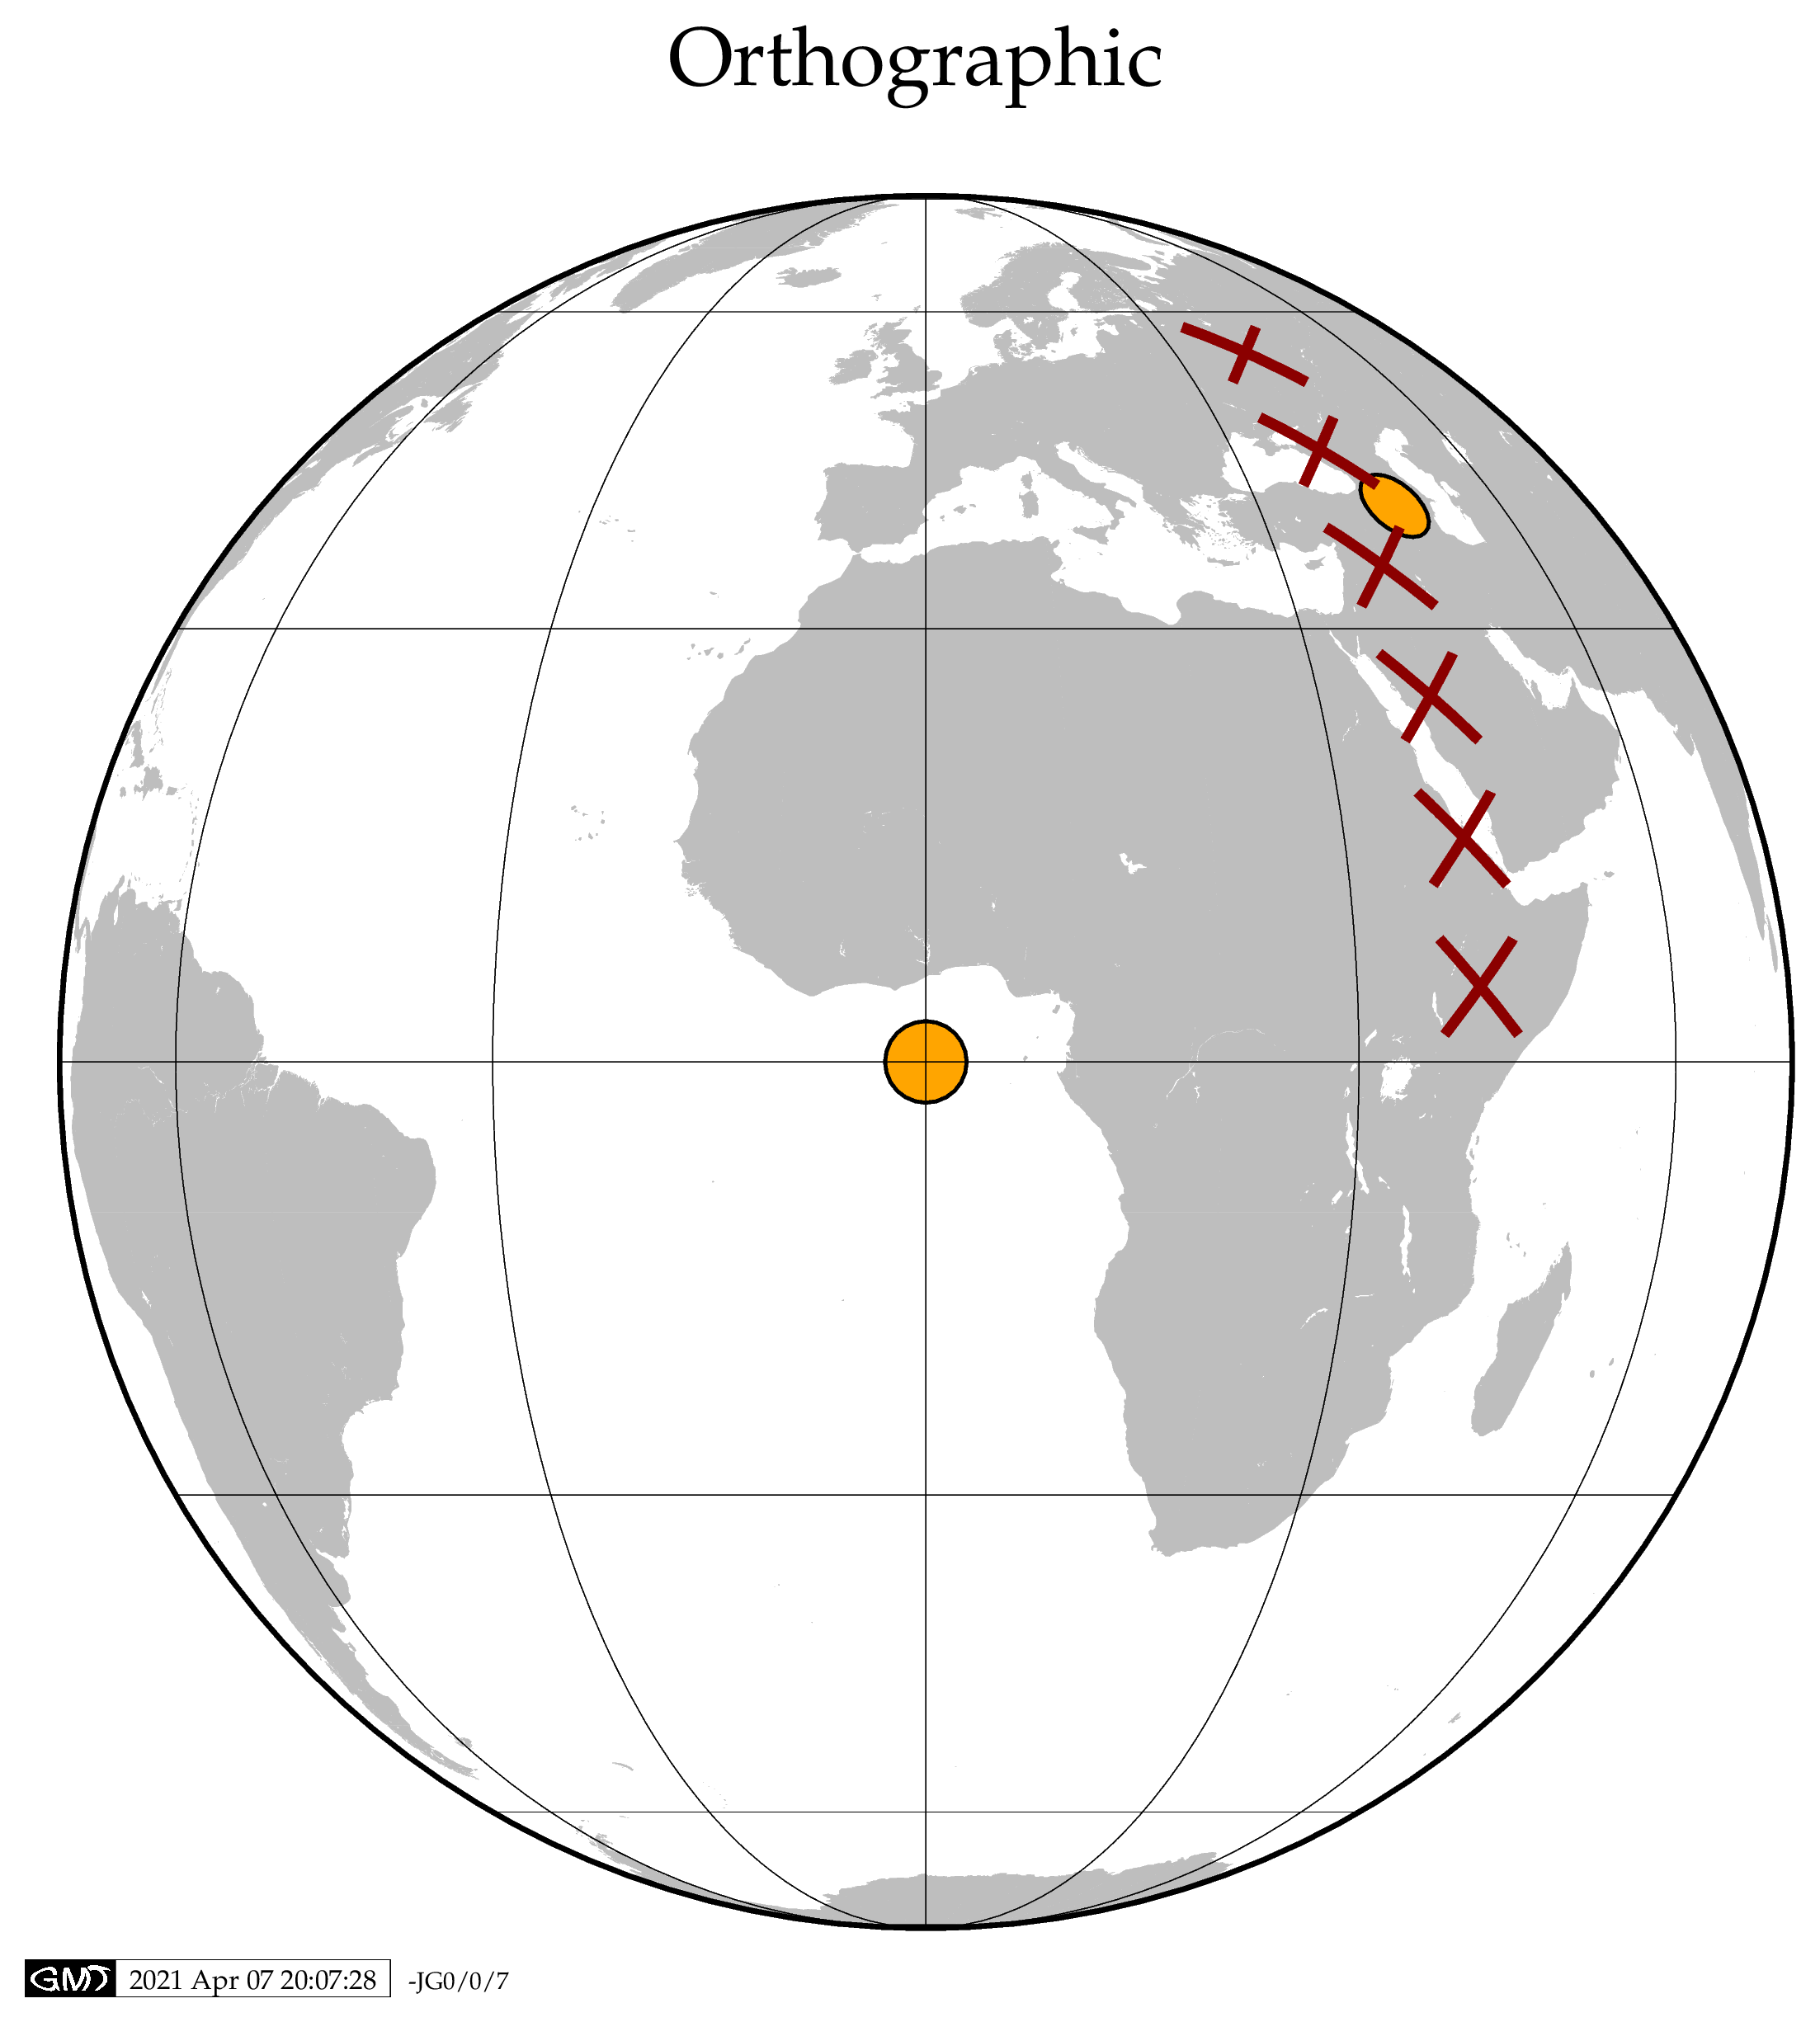
Perspective from infinite distance

Slide 10
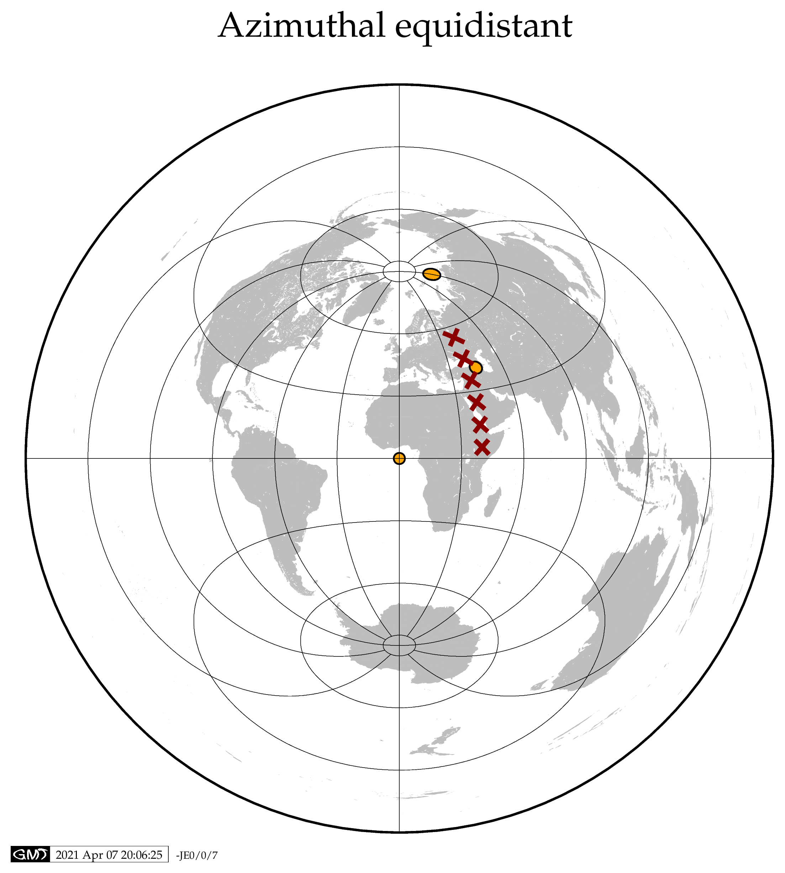
Distance from map center true

Slide 11
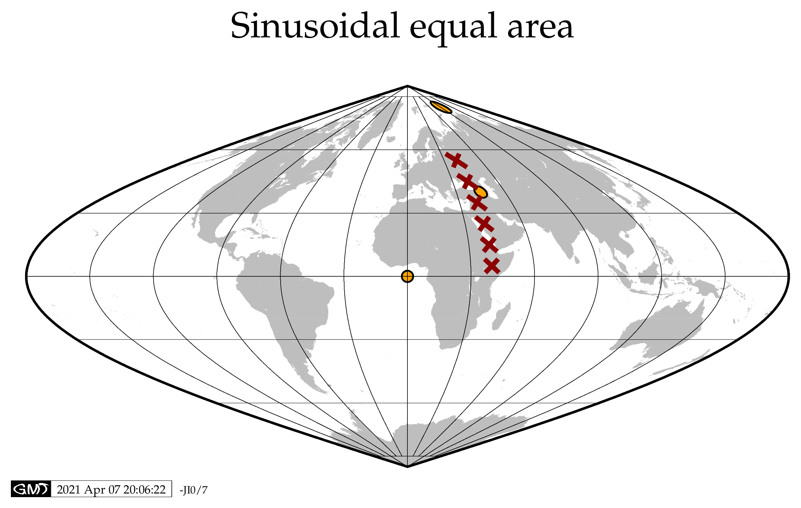

Slide 12
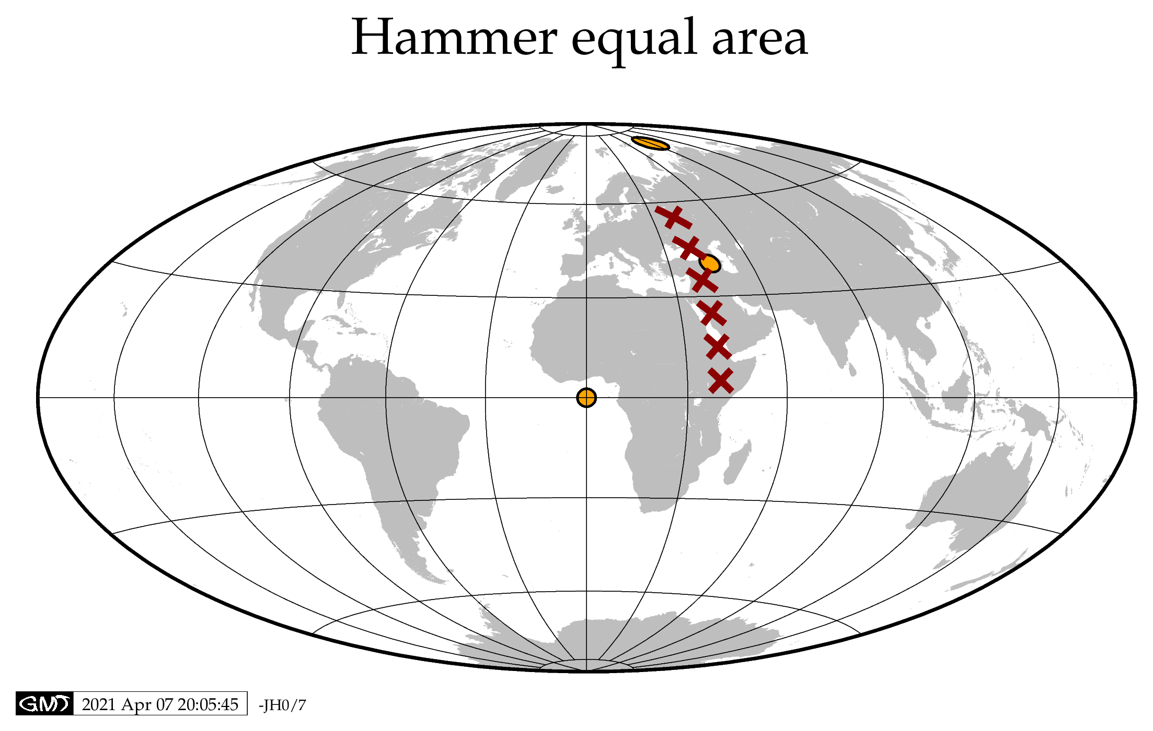

Slide 13
Pseudo cylindrical

Slide 14
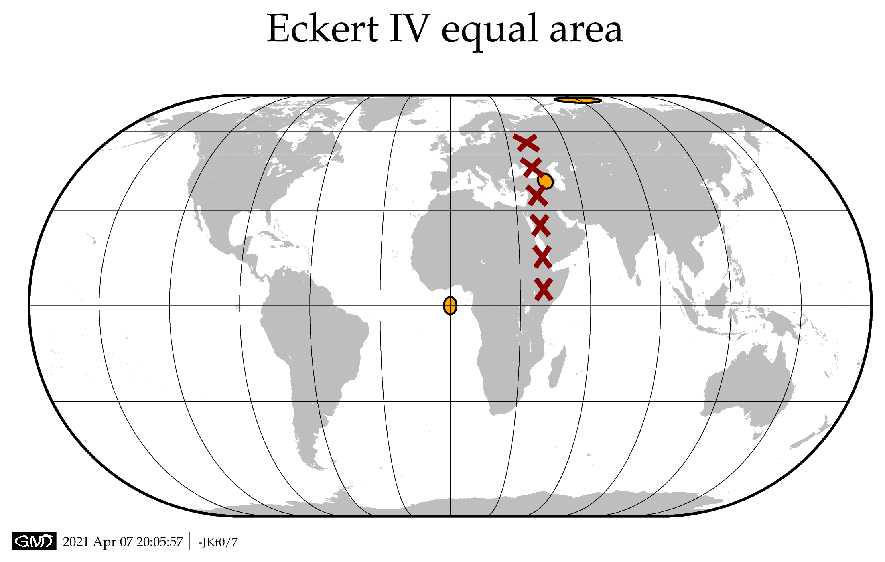
Pseudo cylindrical

Slide 15
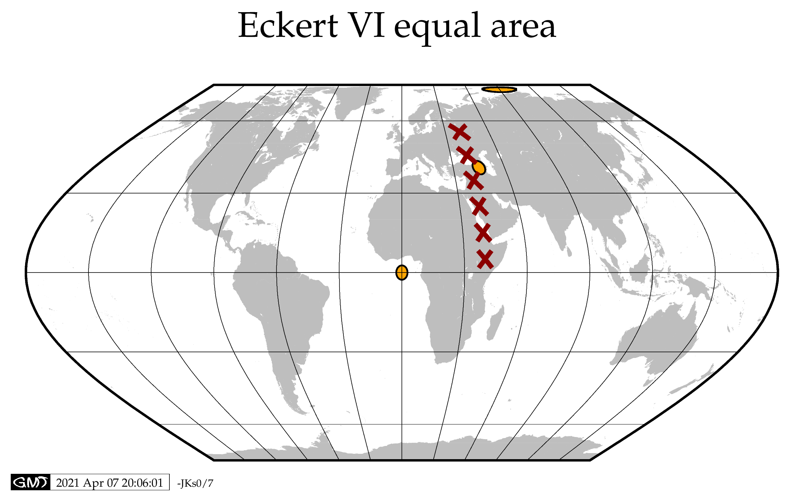
Pseudo cylindrical

Slide 16
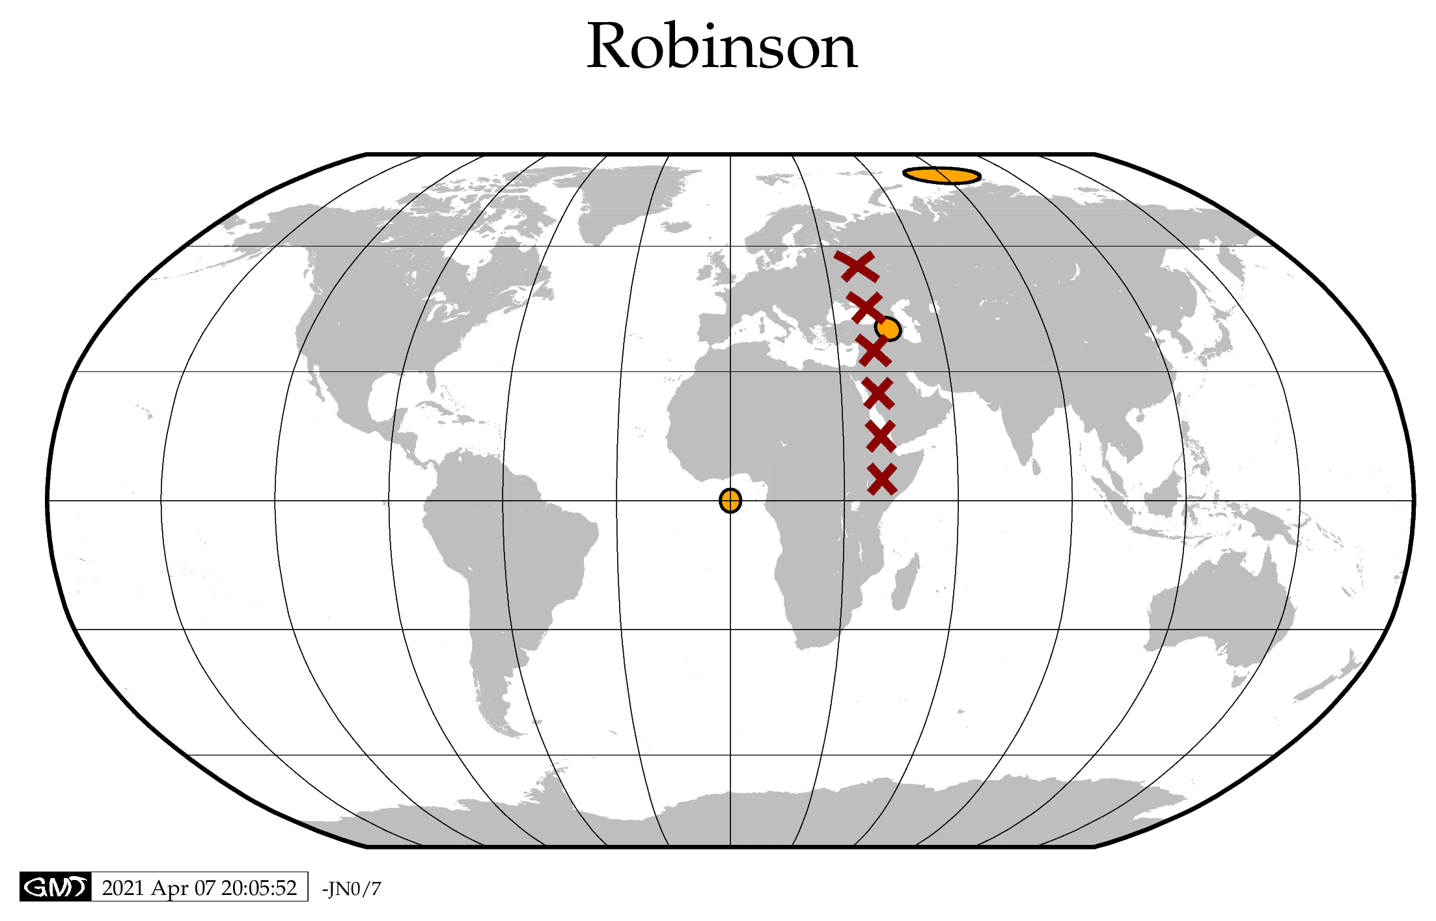
Attempt at compromise
1963
Used by National Geographic Society 1988

Slide 17
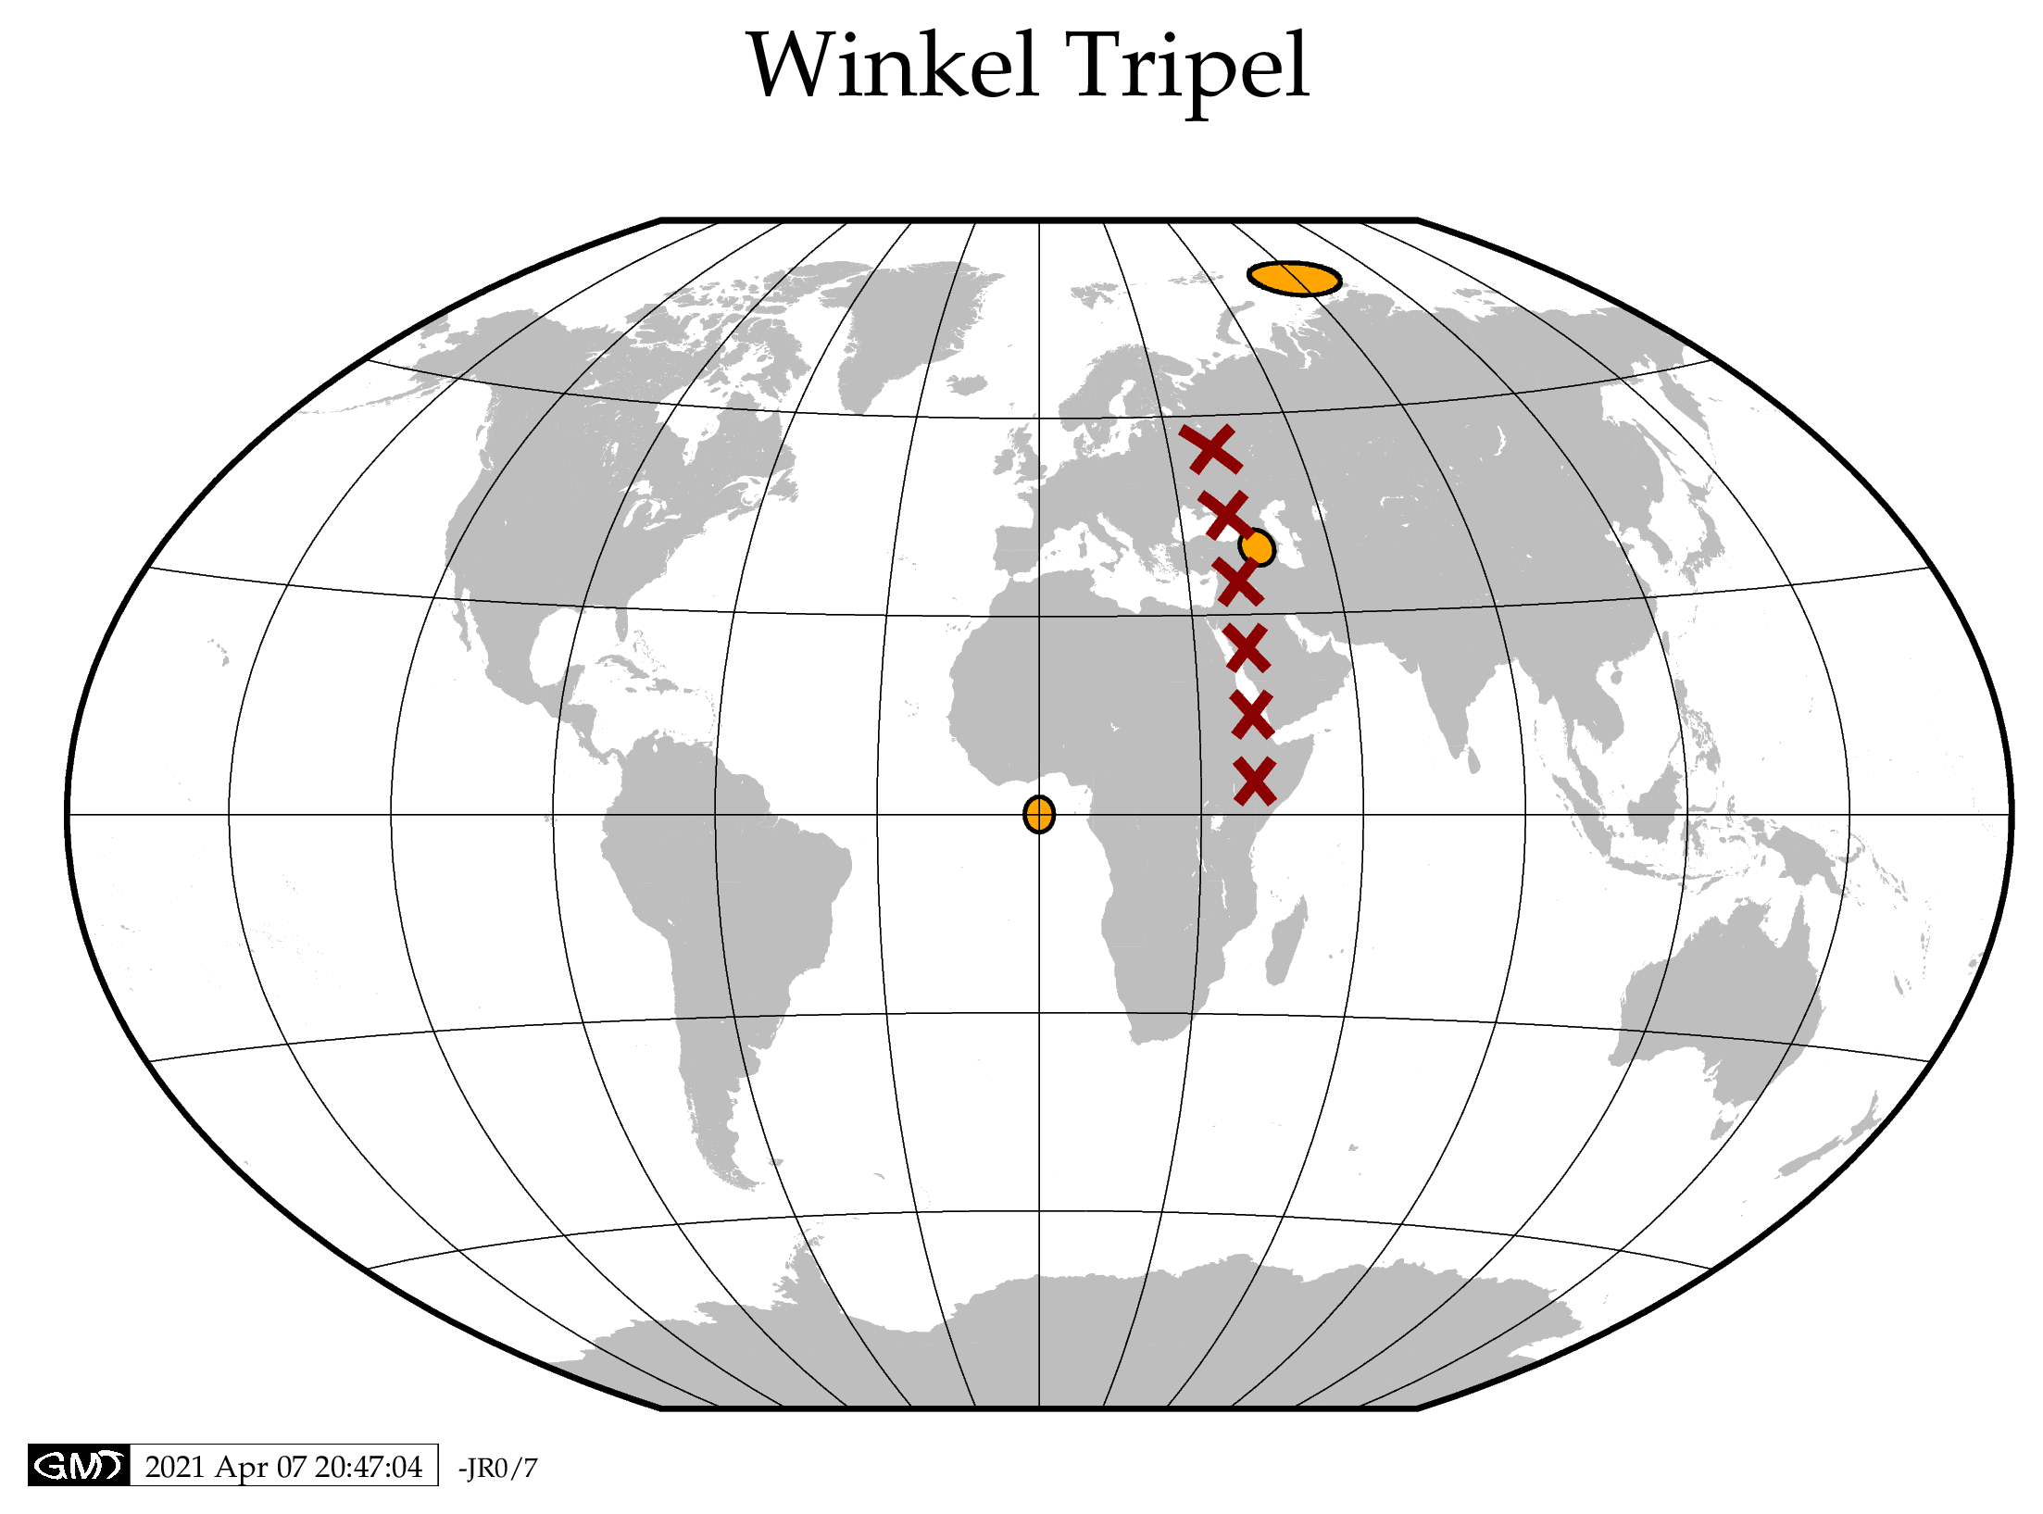
Compromise between angle, area, and distance constraints
Used by National Geographic Society 1997

Slide 18
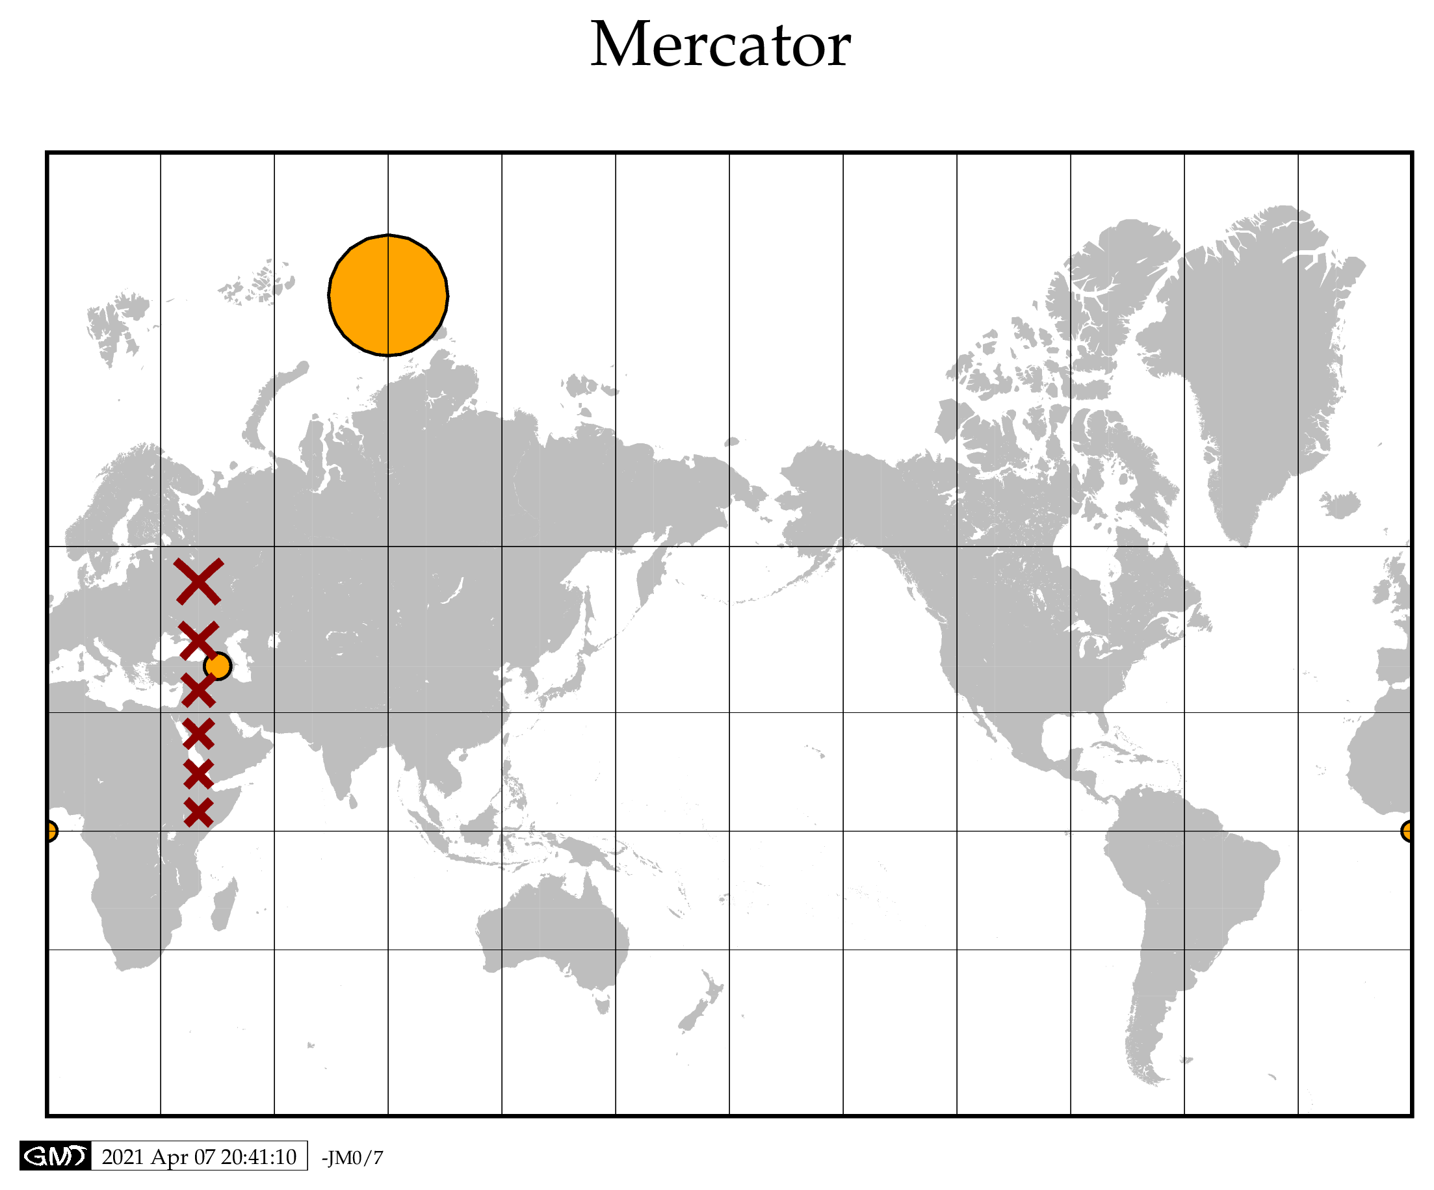

Slide 19
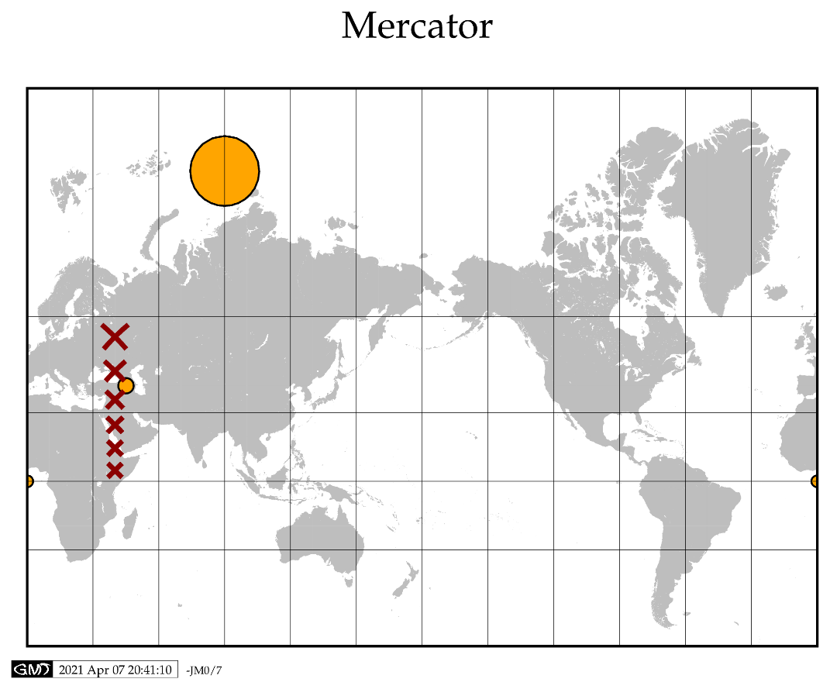

Slide 20
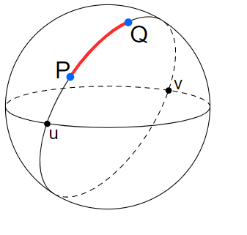
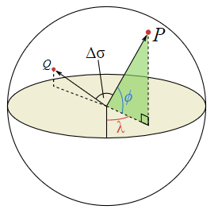
Geodesic computations

Slide 21
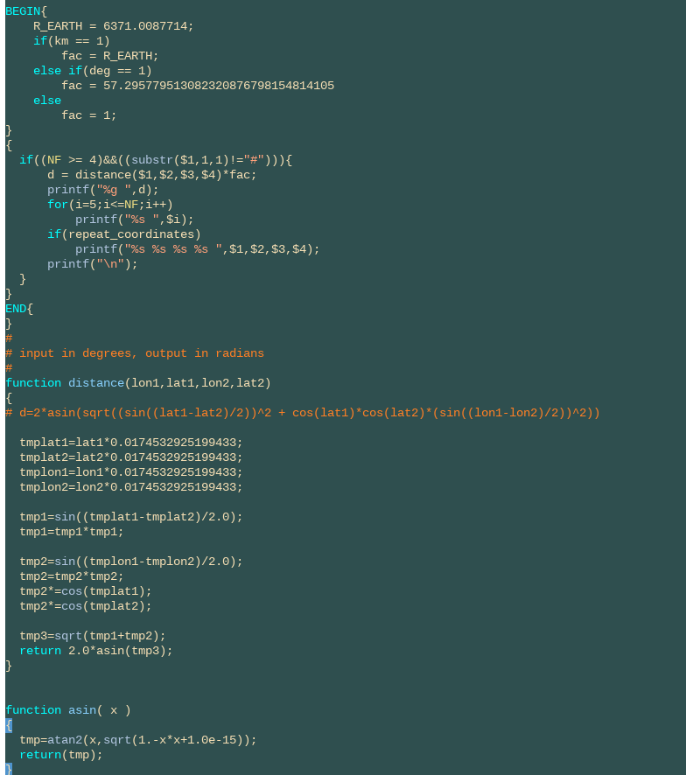
Geodesic computations

Slide 22
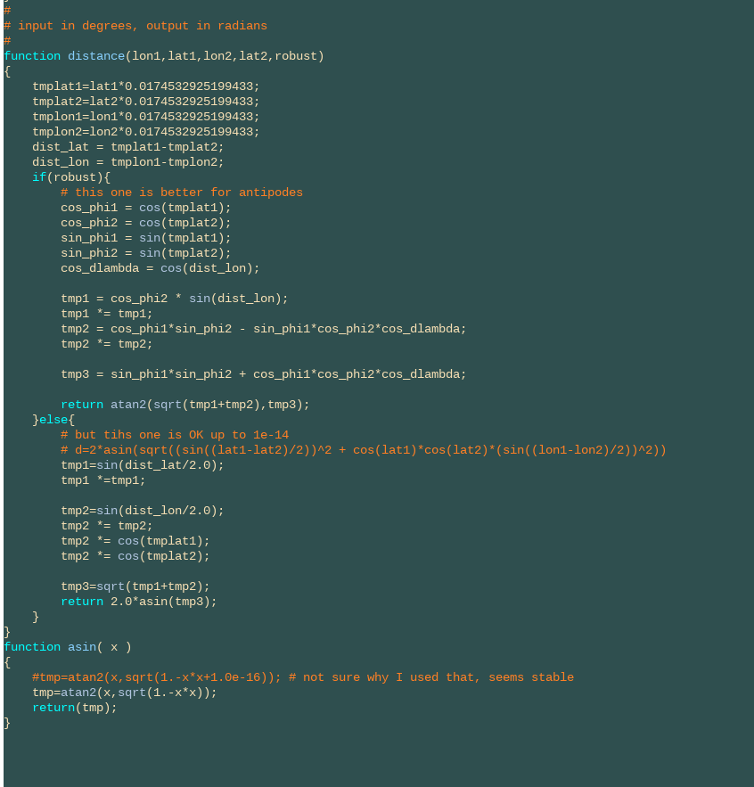
Geodesic computations

Slide 23
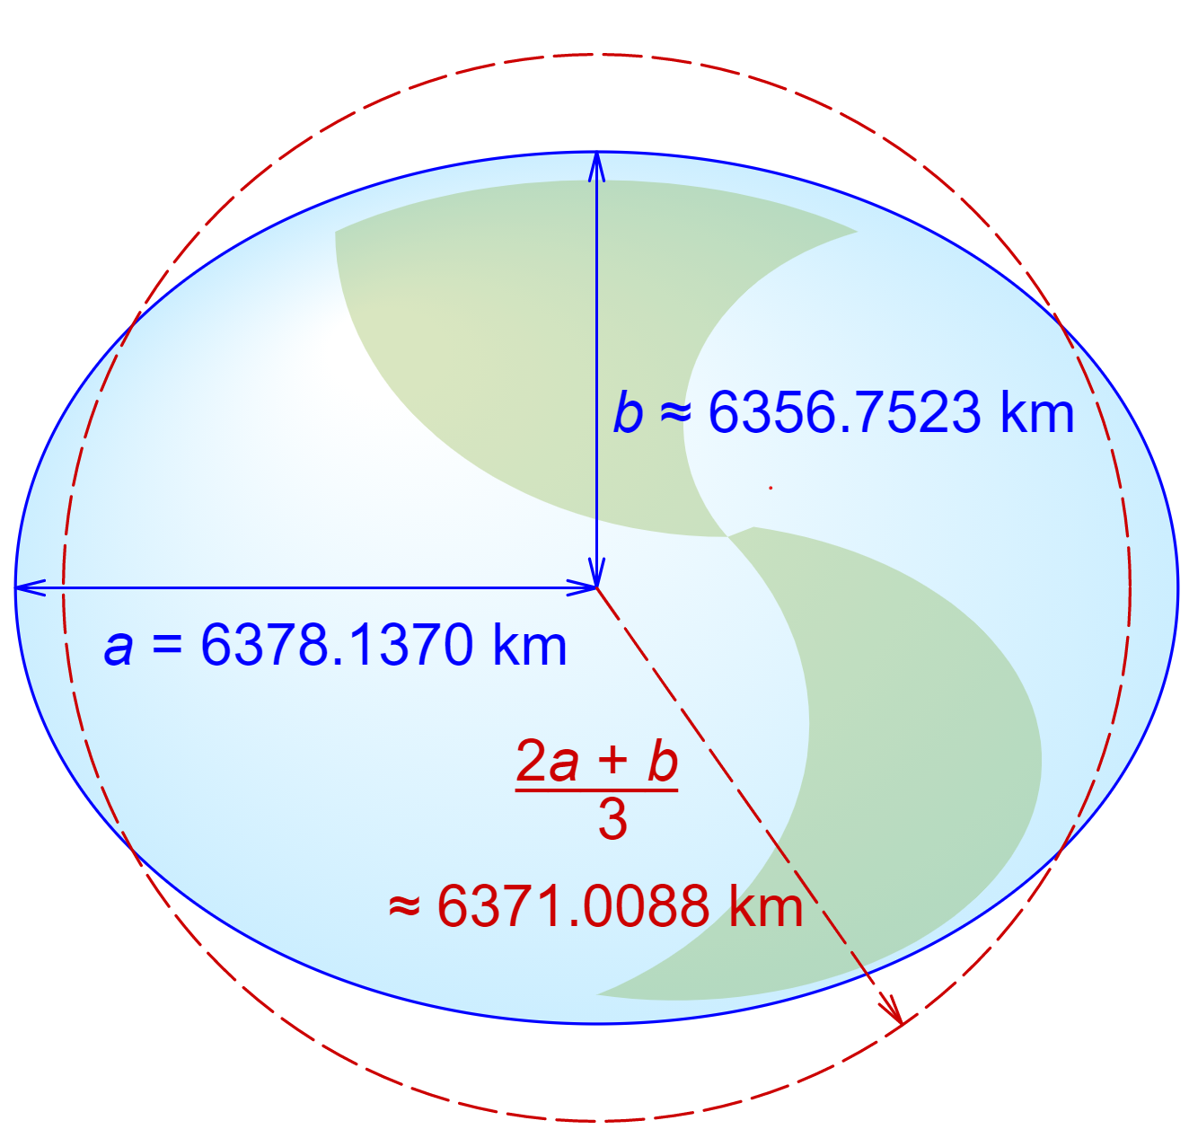
Geodesic computations

Slide 24
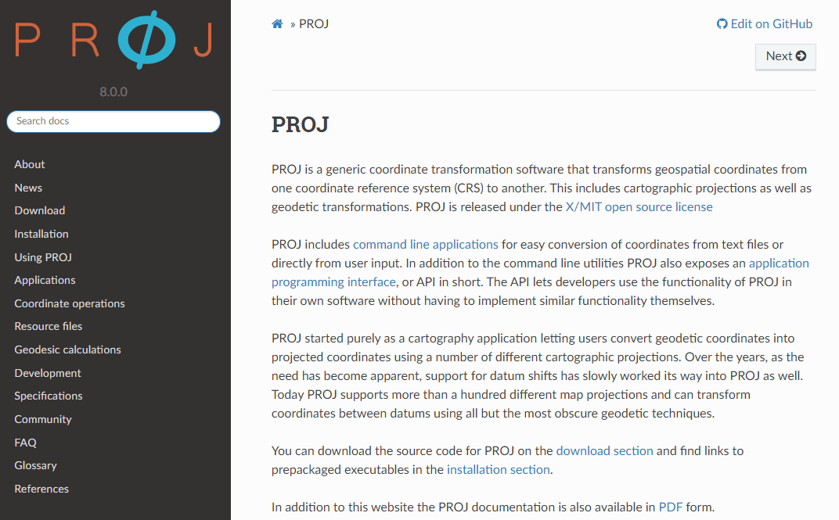

Slide 25
Running GMT
Plotting topography and seafloor age
Let’s write a script

Slide 26
Exercise 1/2
Plot earthquake data on an overview map, and use topography in background, and show plate boundaries
Select Italy a region
Data sources on, look on Canvas in “GMT related”
For topo, you can use the low res etopo1 grid (or obtain a nicer one)
For plate boundaries, you can use bird02
For earthquakes, you can use isc-gem-cat.xyzm (or obtain a nicer one)

Slide 27
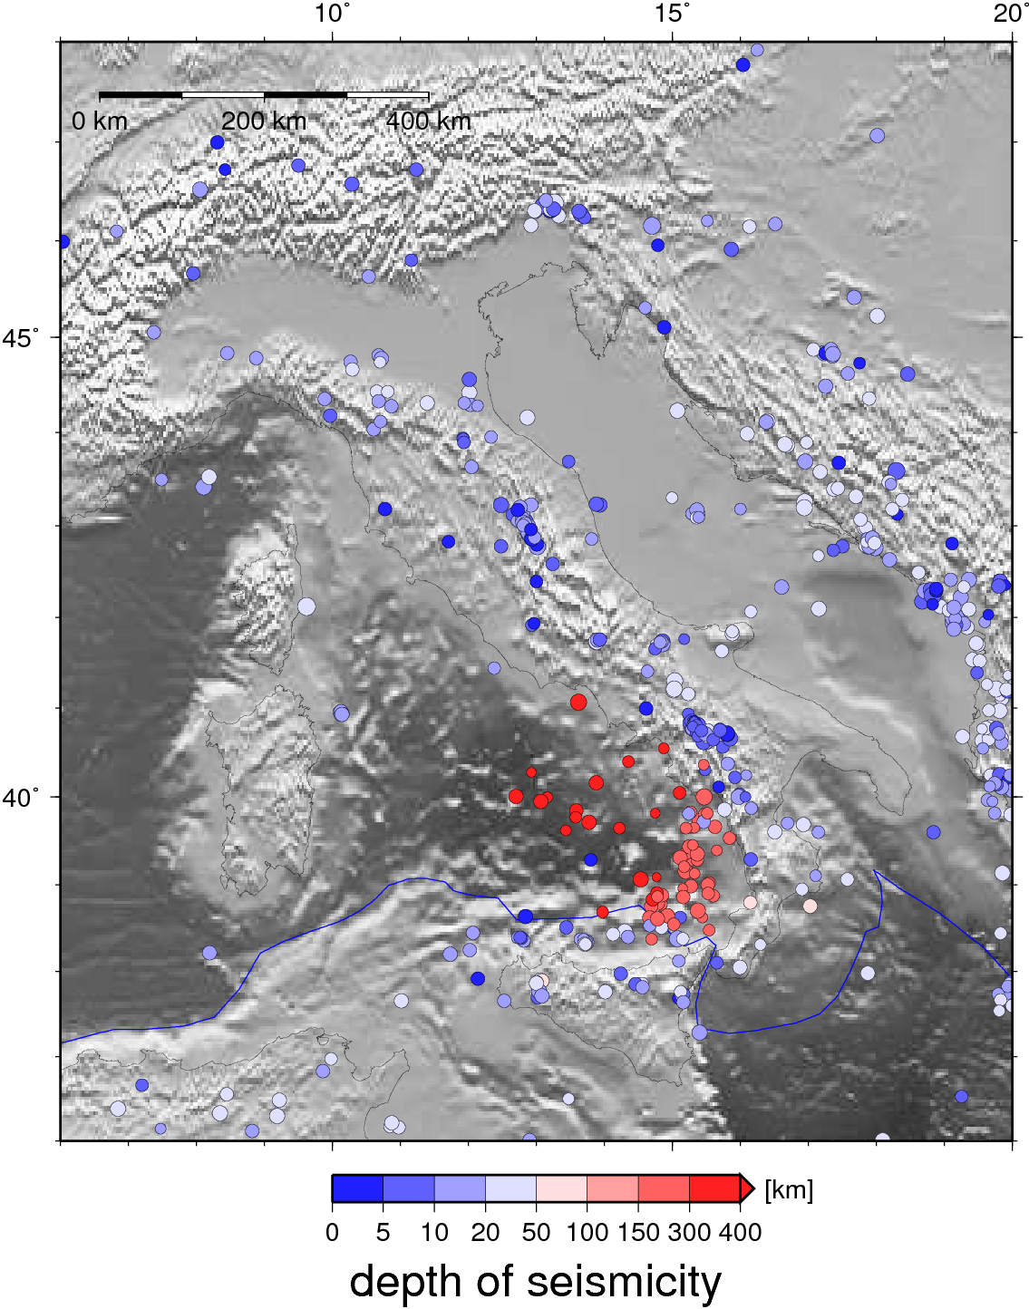
My exercise 1 solution

Slide 28
Exercise 2/2
Generate a regional focal mechanism map for Tonga with plate boundaries and coastlines
use only seismicity deeper than 100 km
plot shallow events on top
Plot CMTs color coded by depth
Add plate boundaries
For CMTs, you can use all.mdat on Canvas, and use gmtselect to make a subset
For plotting CMTs, use psmeca

Slide 29
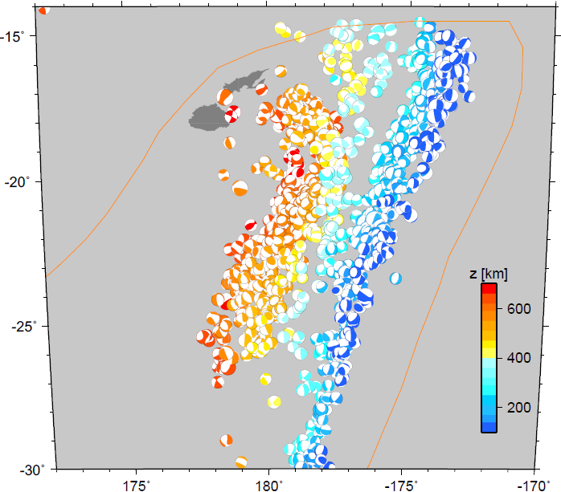
My exercise 2 solution

