Slide 1
Geoscientific data analysis using UNIX and GMT
3/8: GMT I
Thorsten Becker
The University of Texas at Austin
April 2021

Slide 2
The problem
Produce publication quality plots (including x – y) and geographic maps
Achieve flexibility and automated processing (which requires modularity and script based operation)
Do it the open source way (low cost, high transparency, high portability, high robustness)

Slide 3
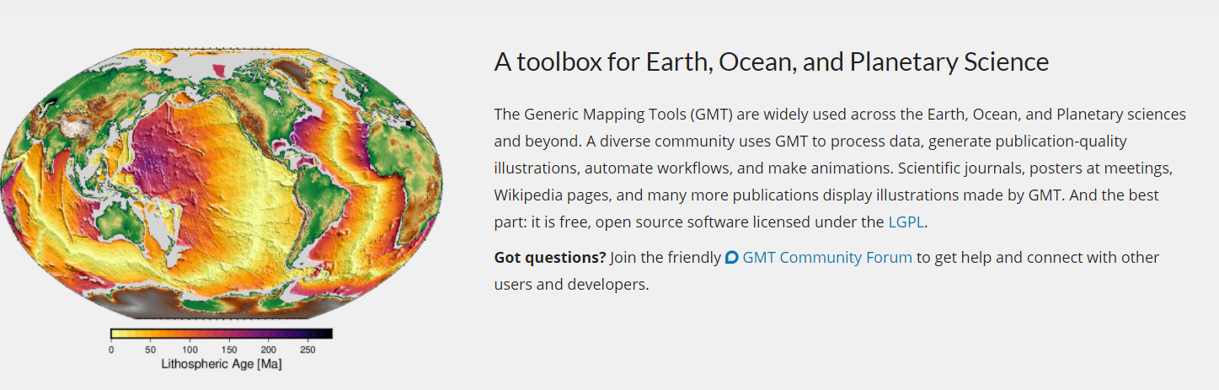
The solution
The Generic Mapping Tools (GMT)
  “~65 tools for manipulating geographic and Cartesian data sets (including filtering, trend fitting, gridding, projecting, etc.) and producing Encapsulated PostScript File (EPS) illustrations”
  It has a somewhat steep learning curve, and no graphical user interface
iGMT: a GMT GUI and script generator

Slide 4
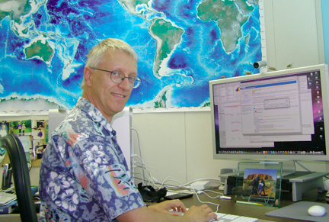

GMT
Written by Paul Wessel and Walter Smith, plus now a team
Version 4 is at 4.5.18, modern version is 6.1.1
UNIX based, C language, command line tool, GPLed
Interface for Matlab, Python and Julie
ASCII, NetCDF data input is projected, and produces EPS/PDF/PNG
Data processing, plotting, projections, etc.
Flexible, powerful, complicated
https://www.generic-mapping-tools.org/

Slide 5
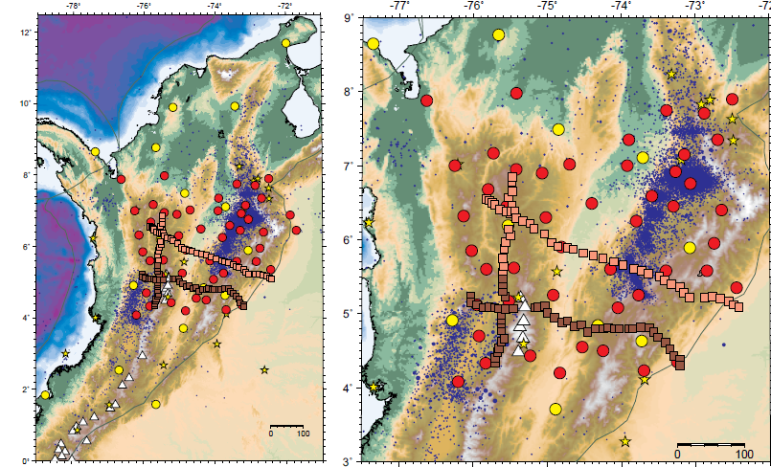
GMT produced examples

Slide 6
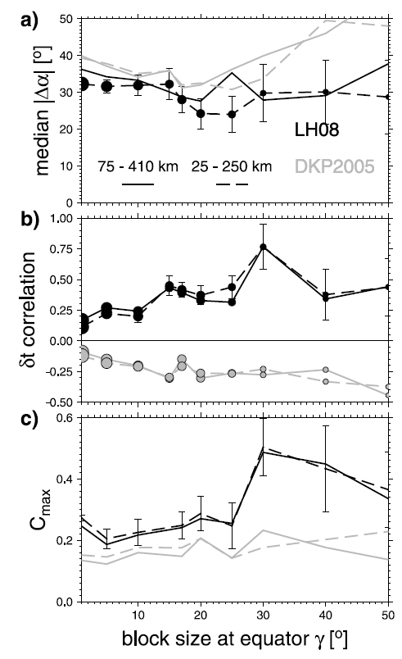

Slide 7
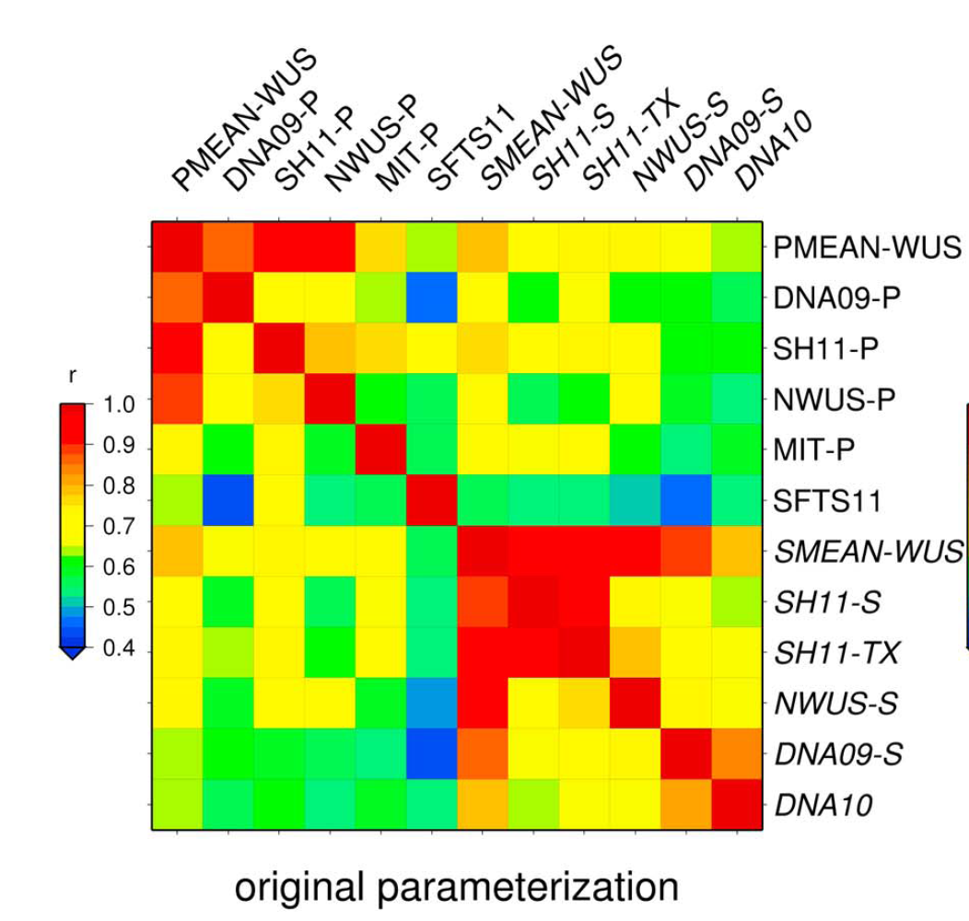

Slide 8
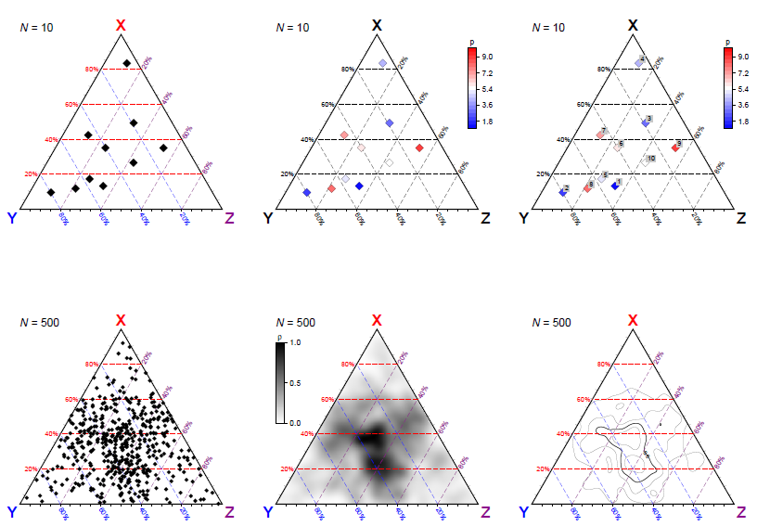
GMT script to plot these ternary diagrams

Slide 9
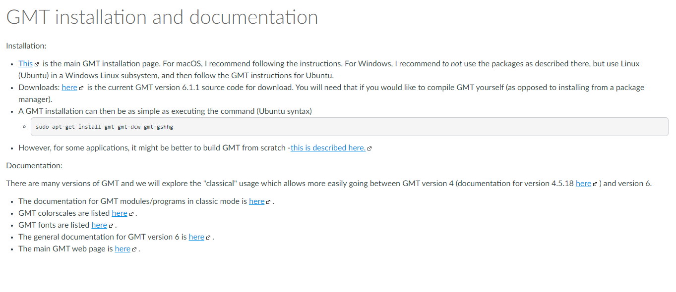
How to get download and install GMT

Slide 10
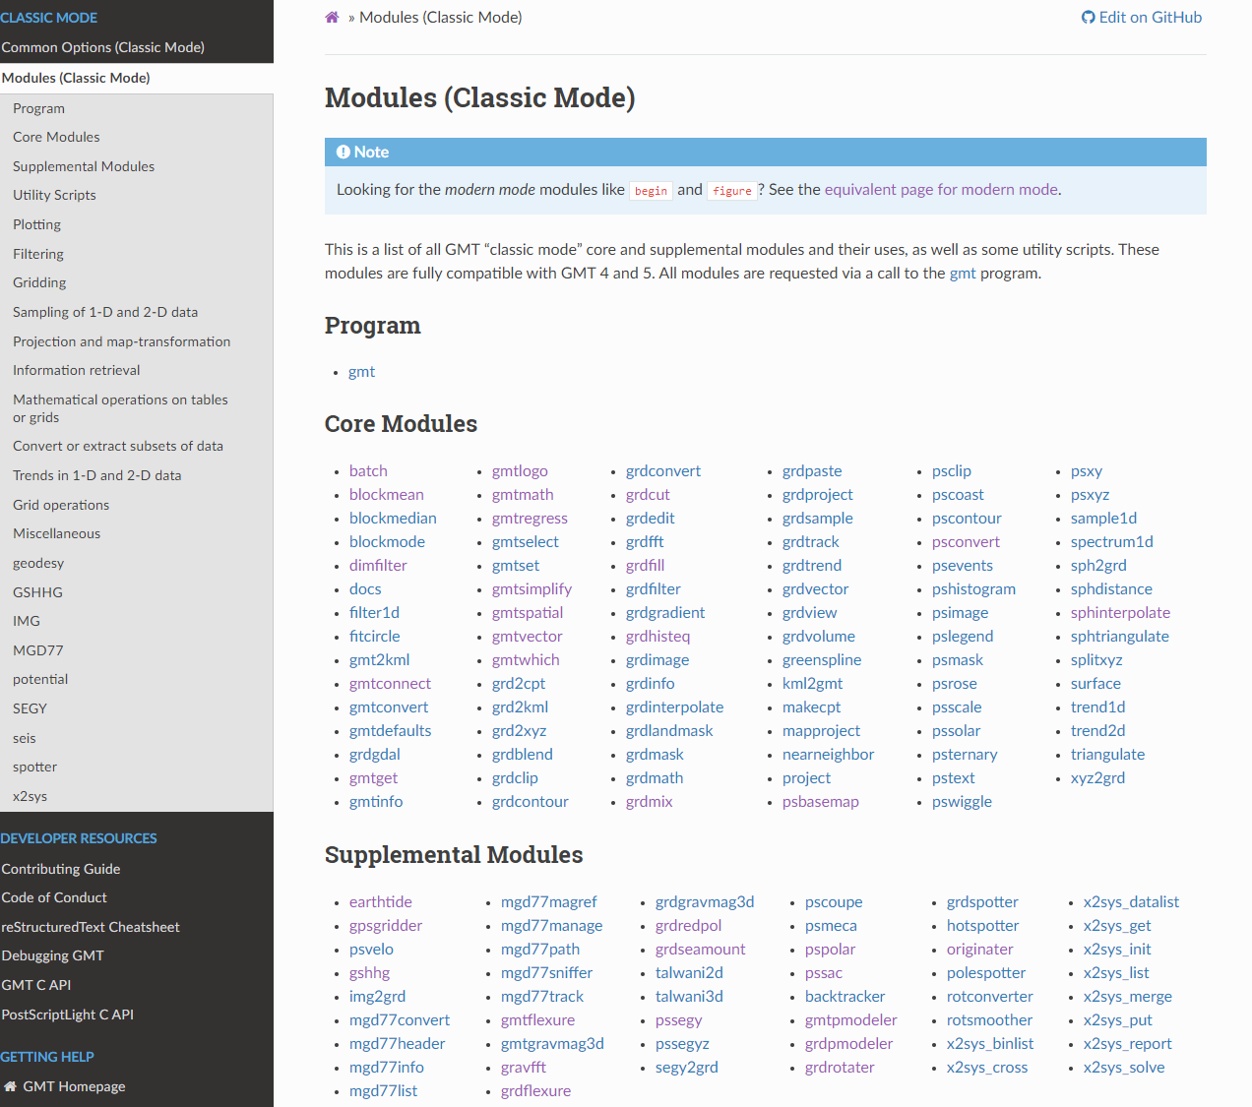
GMT documentation

Slide 11
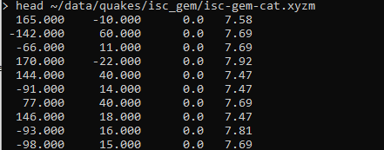
Running GMT
Plotting earthquakes
Let’s write a script

Slide 12
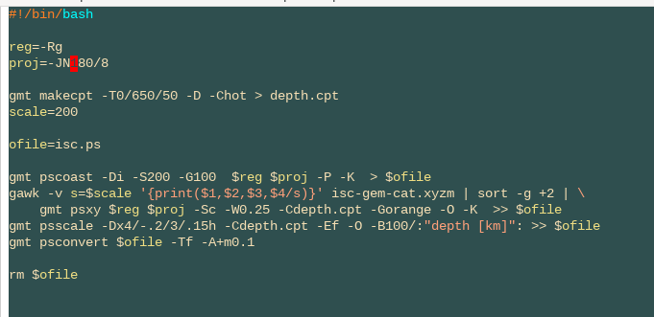
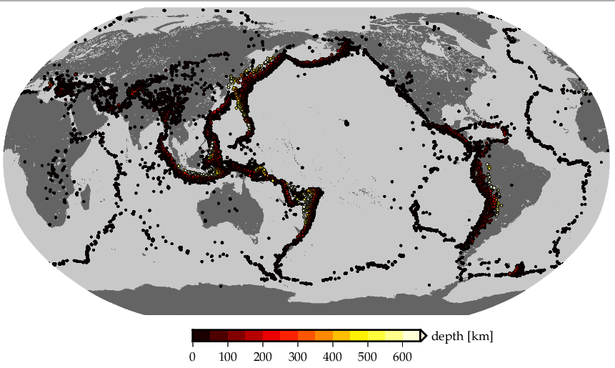
Running GMT

Slide 13


What is happening here?
UNIX uses shell/shell script interactions with the OS system, traditionally
This is a good thing, but can take some time to get used to
This is why we spent time talking about UNIX

Slide 14
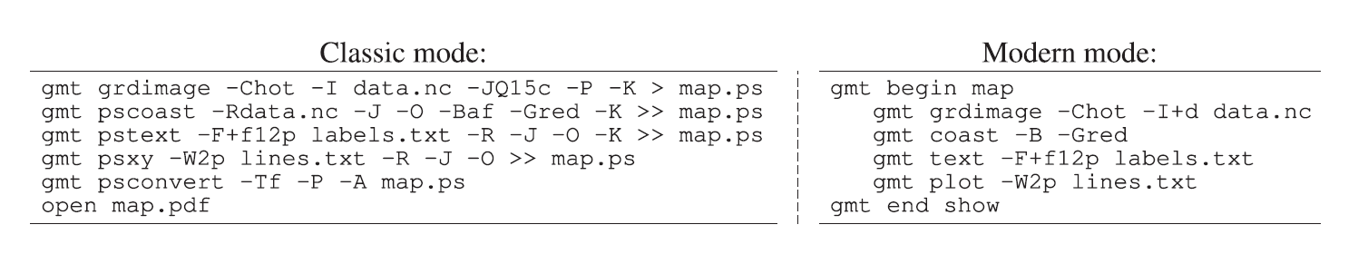
We will use GMT 6 classic mode for backward compatibility
Can set up links such that
  gmt program → program, e.g.
  psxy refers to gmt psxy, making things look like GMT4
Wessel et al. (2019)

Slide 15
Wessel et al. (2019)

Slide 16
Getting data into GMT
cat data_file.xy | gmt psxy -Rw/e/s/n -Jxw/yh -Sa0.1 -P > tmp.ps
Binary via NetCDF grd files
  grdconvert and grdreformat can convert ESRI and geodat files
Tools for import/export/handling
  grdinfo, grdmath
  xyz2grd, grd2xyz
  surface, nearneighbor
  Converters: kml2asci (not that great), ogr2ogr from GDAL better

Slide 17
Some GMT things
Region:
  -R125/130/20/30
  -Rg
  -RFR
Projection:
  -JM7i
  -JH127.5/6c
Line styles:
  -W2,45/50/50
  -Wthick,black,-
Boundary annotation:
  -Ba10f1
  -Ba5f.5g1:”x”:/a10f1:”y”::.”plot title”:WeSn
  -Bx -By

Slide 18
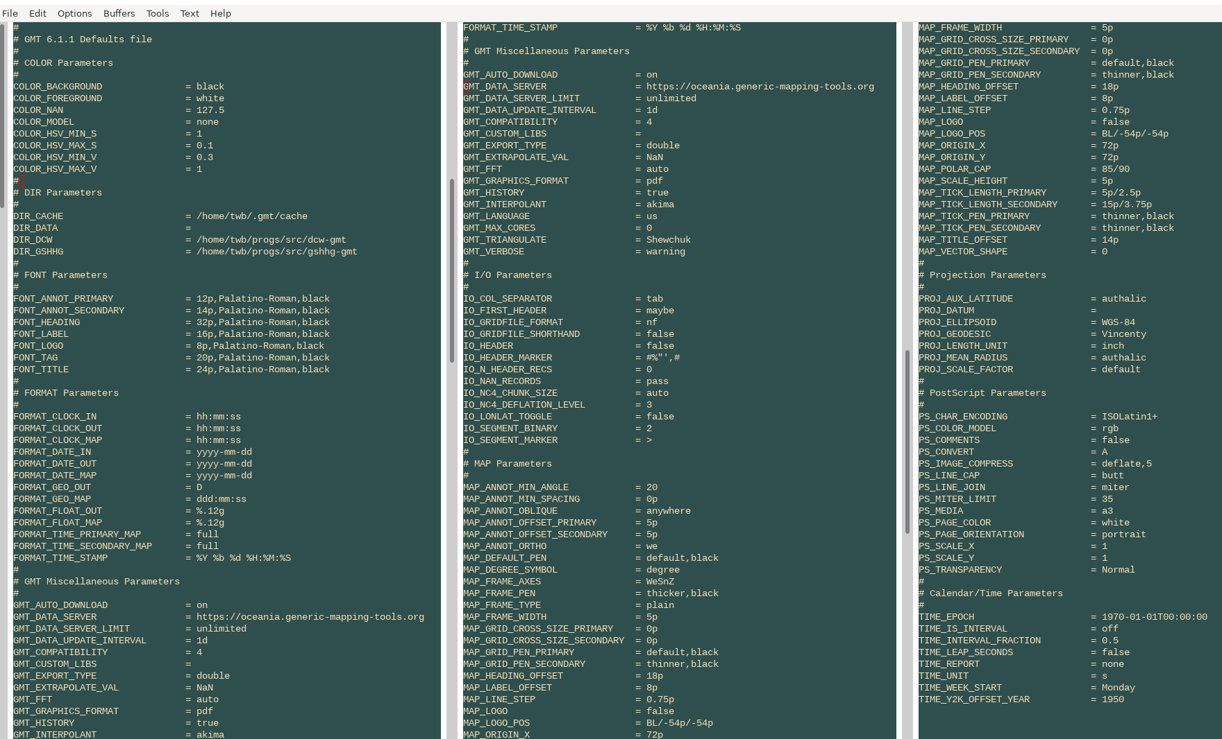
GMT settings

Slide 19
GMT problems and solutions
K-O
  Some-GMT-command -K > tmp.ps
  Some-other-command -O -K >> tmp.ps
  Yet-another-command -O -K >> tmp.ps
  Some-last-command -O >> map.ps
Use modern mode
Use interface
RTFM, the cookbook, or the tutorial
Get a working script and modify
(iGMT)

Slide 20

Some nitty gritty stuff
PS bounding box can be off – modifybb
PDF is more portable (but sometimes Illustrator chokes nonetheless) -
  epstopdf
  ps2pdf
  eps2eps (...)
PNG is sometimes more useful (but cannot edit anymore)
  convert -density 150 file.ps file.png

Slide 21
Some GMT caveats and comments
There are bugs, sometimes (e.g. supp packages)
Not necessarily spherical (surface vs. sphtriangulate)
Hidden parameters (in .gmtdefaults file)
Wrong scaling (-Jx100) will kill your machine
Non interactive, not fully 3D

Slide 22
Running GMT
Plotting topography and seafloor age
Let’s write a script

Slide 23
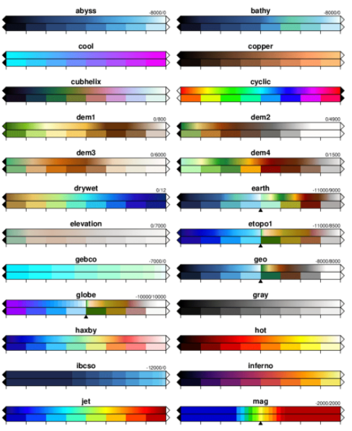
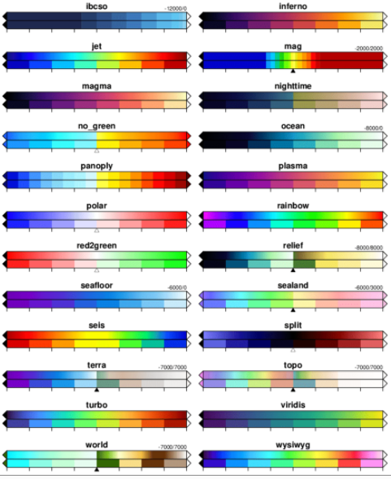
GMT Colormaps

Slide 24
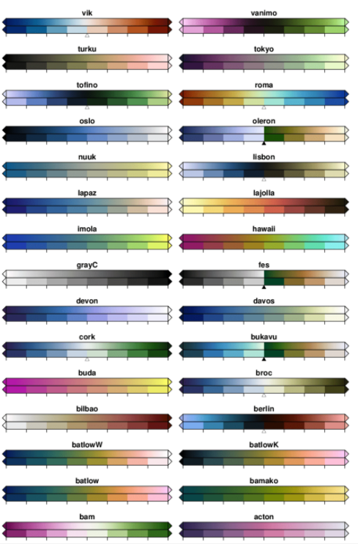
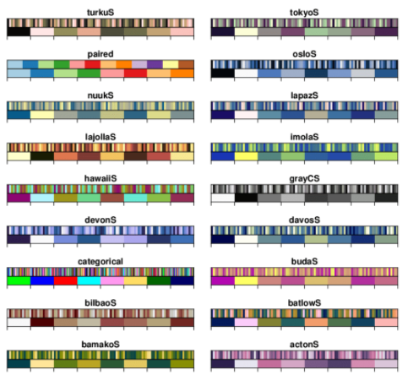
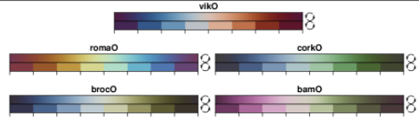
GMT Colormaps

Slide 27
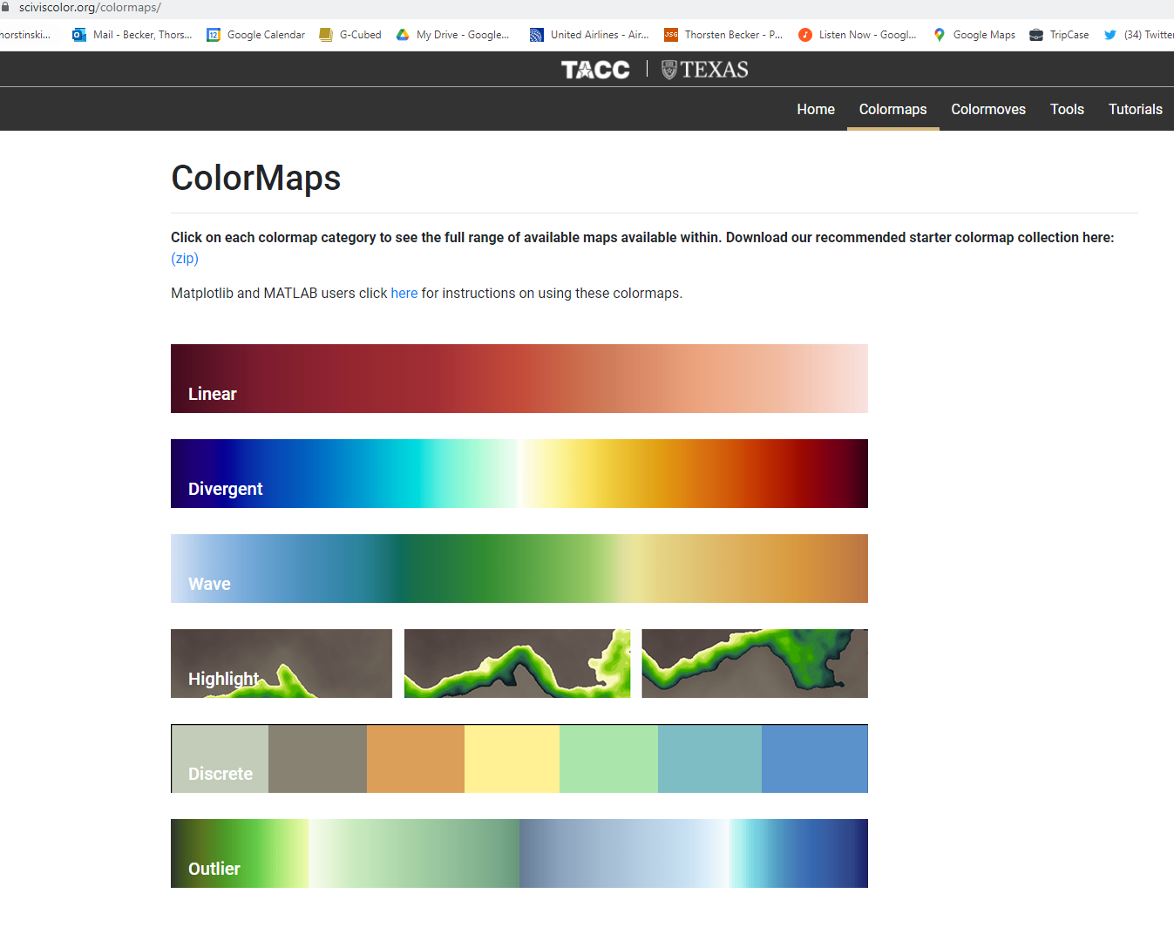
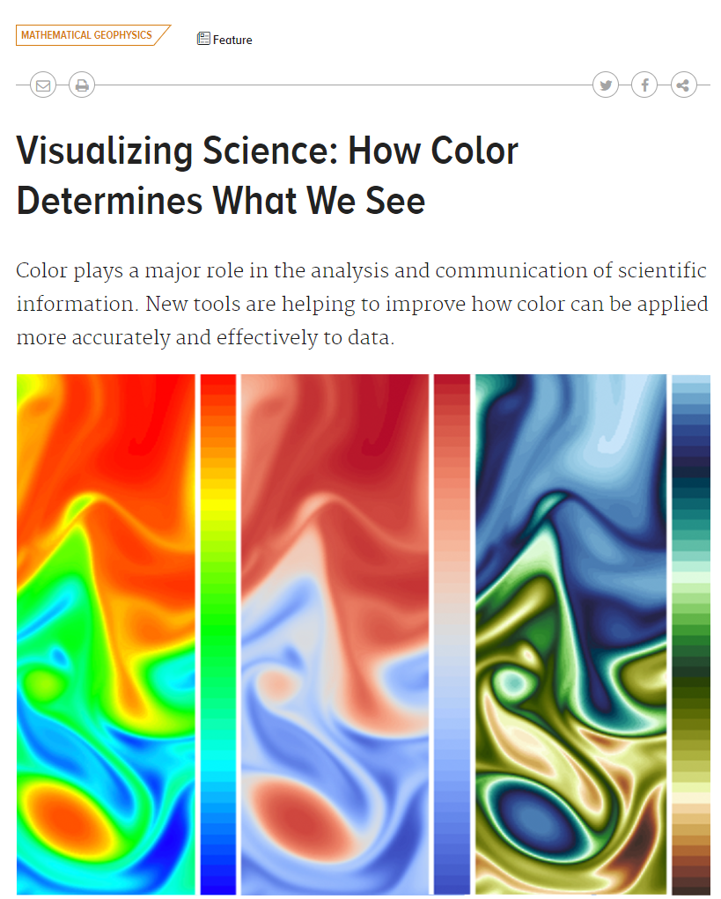
https://sciviscolor.org/colormaps/

Slide 28
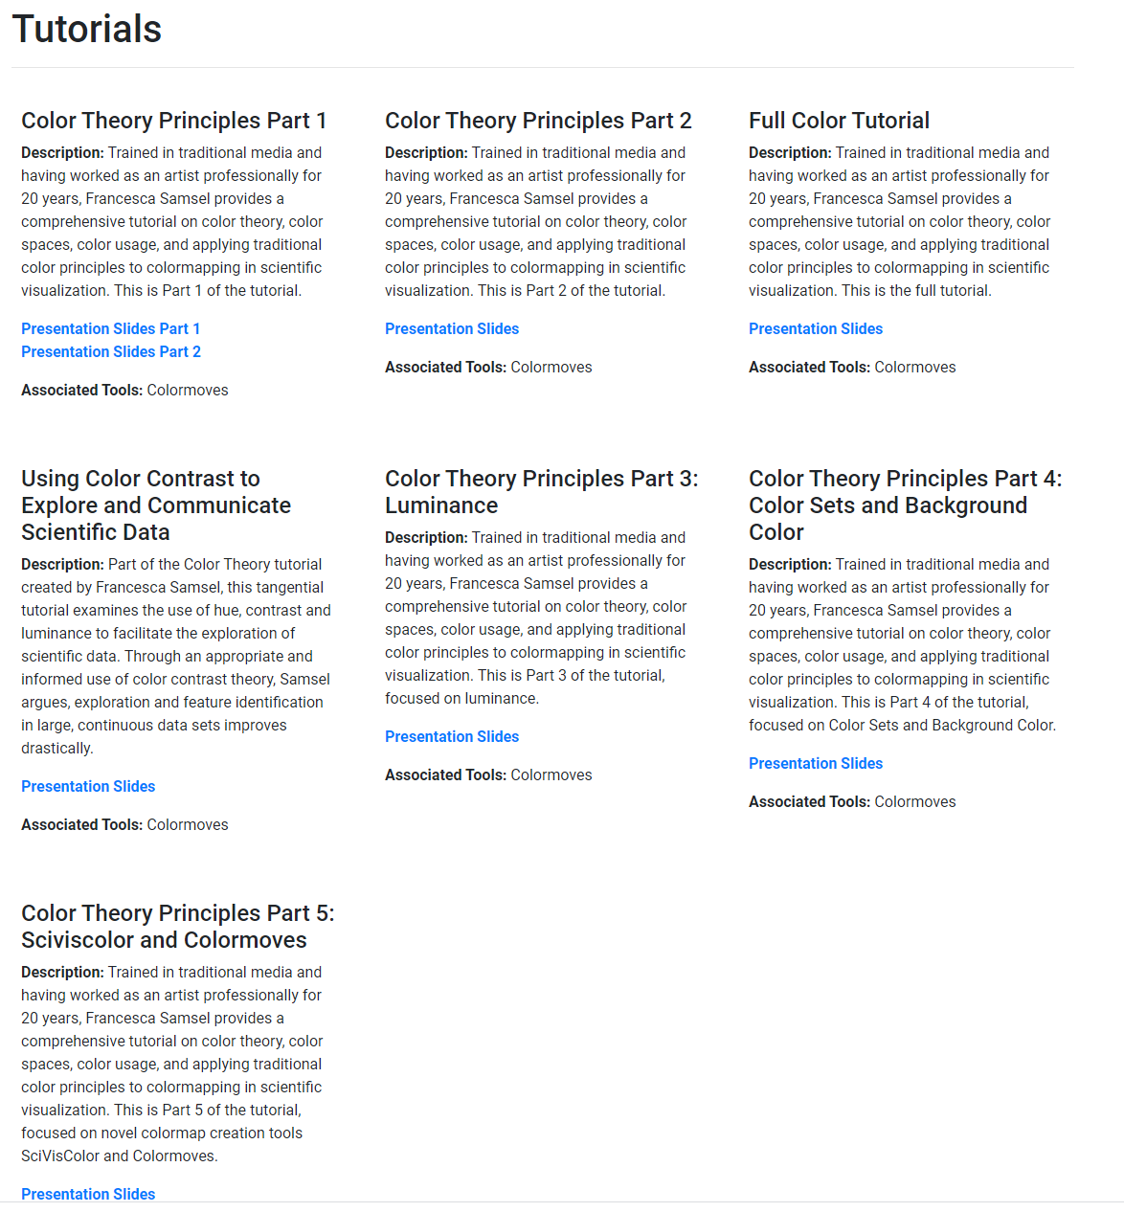
https://sciviscolor.org/tutorials/

Slide 29
https://sciviscolor.org/tutorials/

Slide 30
https://sciviscolor.org/tutorials/

Slide 31
