Slide 1
Geoscientific data analysis using UNIX and GMT
2/8: UNIX II
Thorsten Becker
The University of Texas at Austin
April 2021

Slide 2
Shells: Command history and other feature that save typing
use up, down, left, right arrows to navigate and edit commands on the command line
use a bunch of tricks to access and modify last commands, e.g.
!n: execute last command that starts with “n”
auto-completion (TAB key)
auto-correction
many more tricks

Slide 3
Shells: Can use variables, and many are predefined (csh example)
becker@jackie:~ > setenv region 0/360/-90/90
becker@jackie:~ > echo $region
0/360/-90/90
becker@jackie:~ > echo $HOME
/home/becker
becker@jackie:~ > echo $USER
becker
becker@jackie:~ > env
BIBINPUTS=.:/home/becker/TEX//:
CFLAGS_DEBUG=-g -DDEBUG -DDEBUG -DLINUX_SUBROUTINE_CONVENTION
LDFLAGS=-posixlib -nofor_main -Vaxlib -L/usr/lib/gcc/i386-redhat-linux/3.4.3/ -lg2c -lm
MANPATH=/home/becker/progs/man/:/home/becker/progs/man/:
DVIPSHEADERS=/home/becker/TEX//:
SUPPORTED=en_US.UTF-8:en_US:en
SSH_AGENT_PID=31881
HOSTNAME=jackie.usc.edu
DXROOT=
DXMEMORY=128
CONFC=ifort
HOST=jackie.usc.edu
SHELL=/usr/bin/tcsh
FFLAGS_DEBUG=-g -DDEBUG -fpp -nofor_main -DDEBUG
....

Slide 4
Shells: Startup/configuration
~/.login (= $HOME/.login) at startup
~/.cshrc every time you start a shell
those scripts are where you define environment variables and aliases you want to use in all sessions
alias rm 'rm -i'
setenv F77 ifort; setenv FFLAGS “-O3 -ipo”
~/.login is an example of a hidden file
see references on UNIX and dotfiles.com

Slide 5
Shells: A few lines from my .tcshrc
# set architecture flag, e.g., ip27 for IRIX and i686 for Pentium
#
setenv ARCH `uname -m | gawk '{print(tolower($1))}'`
#
# hostname without domain
#
setenv myhostname `hostname | gawk '{split($1,a,".");print(a[1])}'`
#
if ( $ARCH == "i686" ) then
#
# Pentium/Xeon Linux system
#
# GMT etc
setenv GMT_VERSION GMT3.4.5
#setenv GMT_VERSION GMT4.0
set local_gmt_path = /usr/local/src/${GMT_VERSION}/
set local_netcdf_dir = /usr/local/src/netcdf-3.5.0/
...
set rmstar
set corect=cmd
set autocorrect
set nobeep
set prompt=”%B%n@%m:%b%~\n> “
....

Slide 6
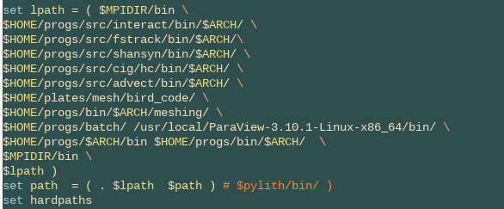
Paths: Where to find binaries ((t)csh example)

Slide 7
Shells: Job control
ps: list currently running processes
jobs: list current jobs (processes started from shell in background)
running commands in background
emacs & (or: emacs; CTRL-Z; bg)
echo mybigjob.exe | nohup (don't quit with shell)
kill %2 (kill the second job running, % are job IDs)
kill -KILL 12344 (kill process with PID 12344)
top: show machine load

Slide 8
Shells: Job control example
becker@jackie:~ > ps
PID TTY TIME CMD
1758 pts/5 00:00:00 tcsh
2500 pts/5 00:00:00 ps
becker@jackie:~ > ps aux | tail
becker 1413 0.0 0.0 4348 1004 ? S 15:10 0:00 /bin/sh /usr/bin/realplay /tmp/youfm_cms.ram
becker 1418 3.2 1.1 79664 12000 ? Sl 15:10 3:24 /usr/local/RealPlayer/realplay.bin /tmp/youfm_cms.ram
becker 1420 0.0 0.5 25720 5260 ? S 15:10 0:00 /usr/local/RealPlayer/realplay.bin /tmp/youfm_cms.ram
becker 1421 0.0 0.5 25720 5260 ? S 15:10 0:00 /usr/local/RealPlayer/realplay.bin /tmp/youfm_cms.ram
becker 1642 0.0 0.1 5200 1776 pts/3 Ss+ 16:03 0:00 -csh
becker 1703 0.0 0.1 6624 1764 pts/4 Ss+ 16:08 0:00 -csh
becker 1758 0.0 0.1 5328 1984 pts/5 Ss 16:14 0:00 -csh
becker 1888 0.0 1.6 27332 17228 ? S 16:26 0:01 /usr/lib/acroread/Reader/intellinux/bin/acroread -display :0.0 -name main -visual default +useFrontEndProgram -xrm *useNullDoc:false -progressPipe 3 -xrm *noPrivateColormap:true -xrm *exitPipe:4
becker 2501 0.0 0.0 3032 772 pts/5 R+ 16:54 0:00 ps aux
becker 2502 0.0 0.0 4212 532 pts/5 R+ 16:54 0:00 tail
becker@jackie:~ > kill 1413
...

Slide 9
Shells: Cluster job control
on large, parallel machines one typically runs batch schedulers or queing systems
this allows distributing jobs and utilizing resources efficiently
PBS
qsub myjob.exe -tricky_options -q large
qstat | grep $USER
qdel job-ID
SLURM (TACC)
sbatch
squeue
scancel

Slide 10
Shells: Parallel processing
#!/bin/bash
...
process file1 &
process file2 &
process file3 &
wait
...

Slide 11
Shells: Job automation
at
echo "echo It\'s 1 a clock and time for lunch" |\
at 1pm
cron crontab file, crontab -l, crontab -r
# field allowed values
# ----- --------------
# minute 0-59
# hour 0-23
# day of month 0-31
# month 1-12 (or names, see below)
# day of week 0-7 (0 or 7 is Sun, or use names)
# every day at 5am, check my calendar
4 5 * * * $HOME/progs/batch/check_calendar
# every Sun night at 4am, clean the tmp directory (WARNING!)
17 4 * * Sun rm -rf $HOME/tmp/* 2> /dev/null
# every week, 6pm Sa backup the home directories
15 18 * * Sat $HOME/progs/batch/backup_home_rsync 0

Slide 12
Network commands
ssh: log into a different machine
ssh –p 2222 twb@walter.ig.utexas.edu
can set this up to avoid having to type password (private / public key authorized_keys)
scp: copy files
scp –P 2222 file.dat twb@walter.ig.utexas.edu:~/tmp/
scp –P 2222 twb@walter.ig.utexas.edu:~/tmp/\* .
ping: check connection speed/status
wget: download files/directories from the web
wget -r --no-parent --reject "index.html*" http://topodata.org/data/
curl: download large files, allowing for interruptions in connection

Slide 13
UNIX tools: compression and dealing with big files
gzip: compress ASCII files, which can be huge, to binary
compress: gzip file
uncompress: gunzip file.gz
can write gzipped from within C, can use gunzip on the fly (zcat): this allows using nice ASCII tools such as awk while storing things compactly
bzip2: smaller files, takes longer

Slide 14
UNIX tools: dealing with big and lots of files
tar: combine lots of files into an archive
tar --create --verbose --compress --file my_dir_cfiles.tgz \ dir/*.c
gunzip my_dir_cfiles.tgz
tar tf my_dir_cfiles.tar
tar xf my_dir_cfiles.tar
rsync: copy file systems (for backup)

Slide 15
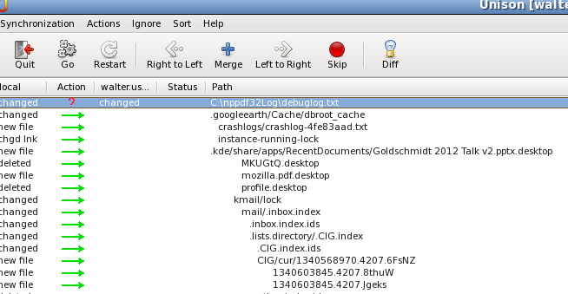
UNIX tools: storage and backup
Unison file synchronizer (to sync laptop and workstation)
backup all the time (it's easy to screw up big time), or have your admin backup for you

Slide 16
Please don't forget to backup

Slide 17
UNIX tools: A few tricks
unpacking on the fly:
gunzip -c newsoftware.tgz | tar xv
interpreting commands on the fly:
echo $variable_a `cat file.dat | gawk -f mean.awk`
tcsh interactive functionality:
foreach f ( *.ps)
convert $f $f:r.gif
end

Slide 18
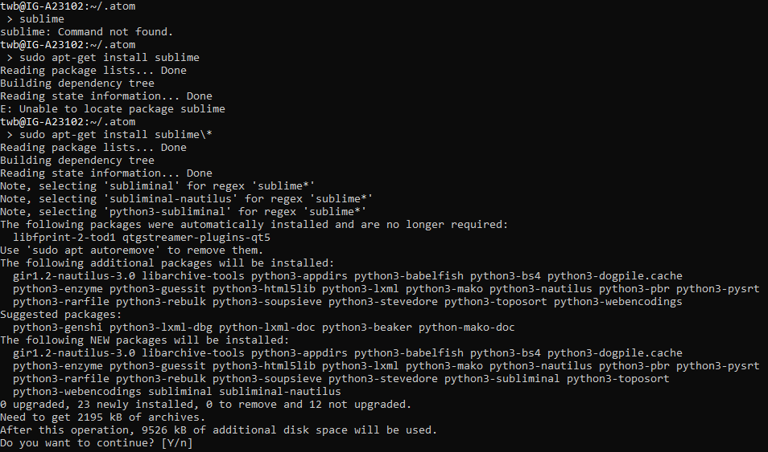
Software installation
Package managers
Fedora: yum
Ubuntu: apt-get

Slide 19
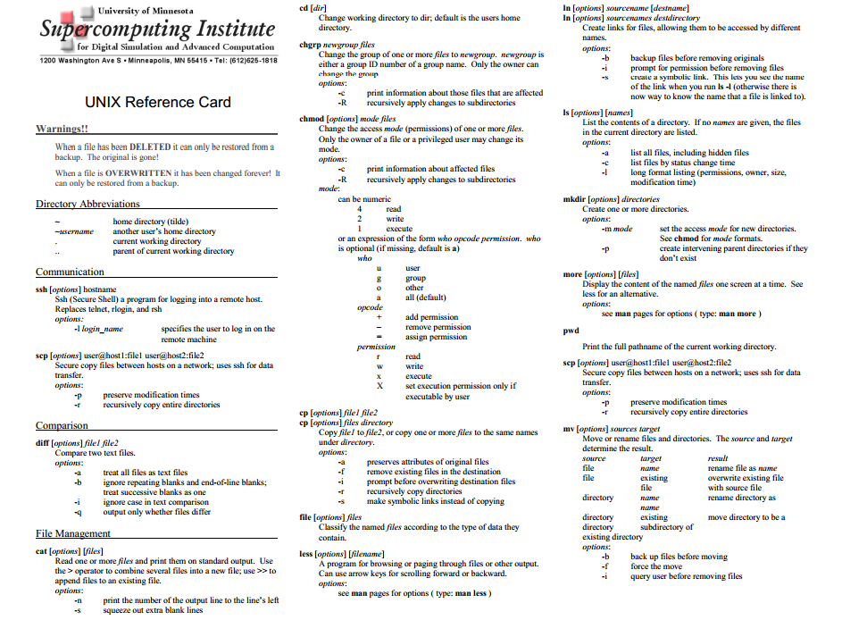

Slide 20
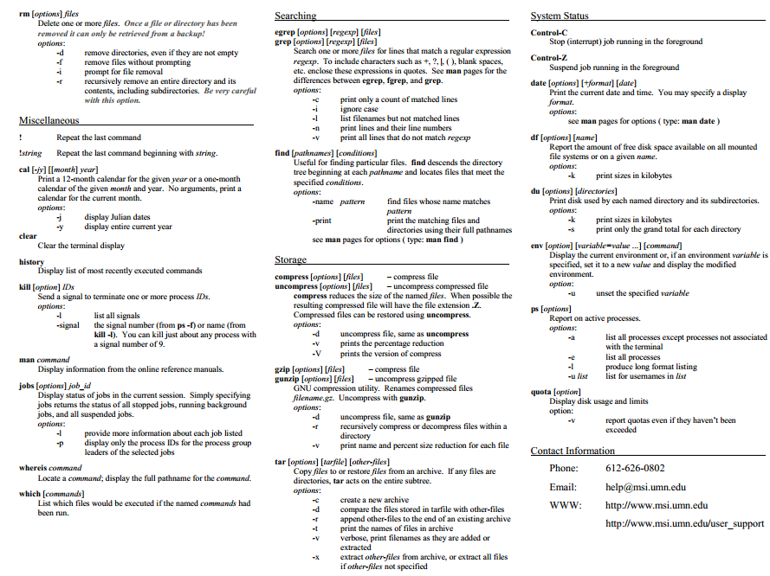

Slide 21
UNIX: UNIX/LINUX references
UNIX reference card
Robbins: UNIX in a nutshell
Siever at al: LINUX in a nutshell
Online list of UNIX commands
Local computing center documentation and lecture notes
google on UNIX: commands, shell scripts, EMACS, awk, ...

Slide 22
Scripts: Scripts and GUIs
scripts are the opposite of point-and-click
need to work hard once to generate template
benefit forever if you want to produce more products (e.g. plots) using different parameters, or if the data has changed
automate research galore (needed to explore parameter space)
scripts can serve as documentation of steps taking to analyse data and produce results
scripts can help with reproducibility

Slide 23
Scripts: An example script
#!/bin/bash
#
# run run_fstrack for different models
#
models=${1-"pmDsmean_nt pmDnngrand_nt saf1 saf2 saf3 "}
strains=${2-"2 1 0.5"}
# PBS queues to use
q1="becker64";q2="scec"
c=0
for m in $models;do
cd $m
for s in $strains ;do
if [ $c -eq 1 ];then
queue=$q1;c=0
else
queue=$q2;c=1
fi
# regional
../run_fstrack 1 0 0 0 $s 1 2 1 -14 0 60 "" 1 $queue
done
cd -
done

Slide 24
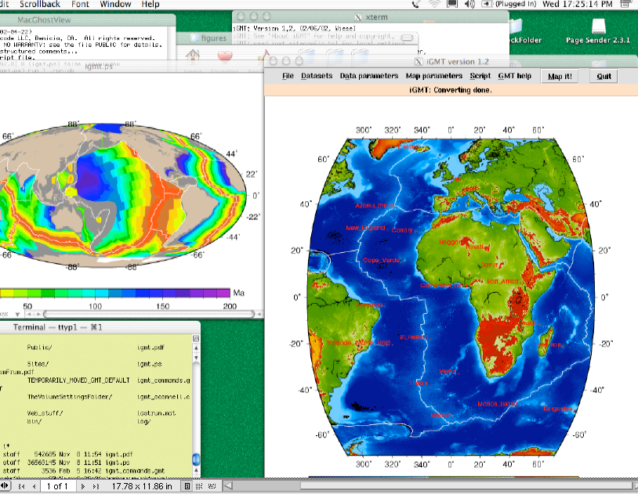
Scripts: Visual scripting languages: Tcl/TK (e.g. iGMT), GTK, Tkinter, Qt

Slide 25
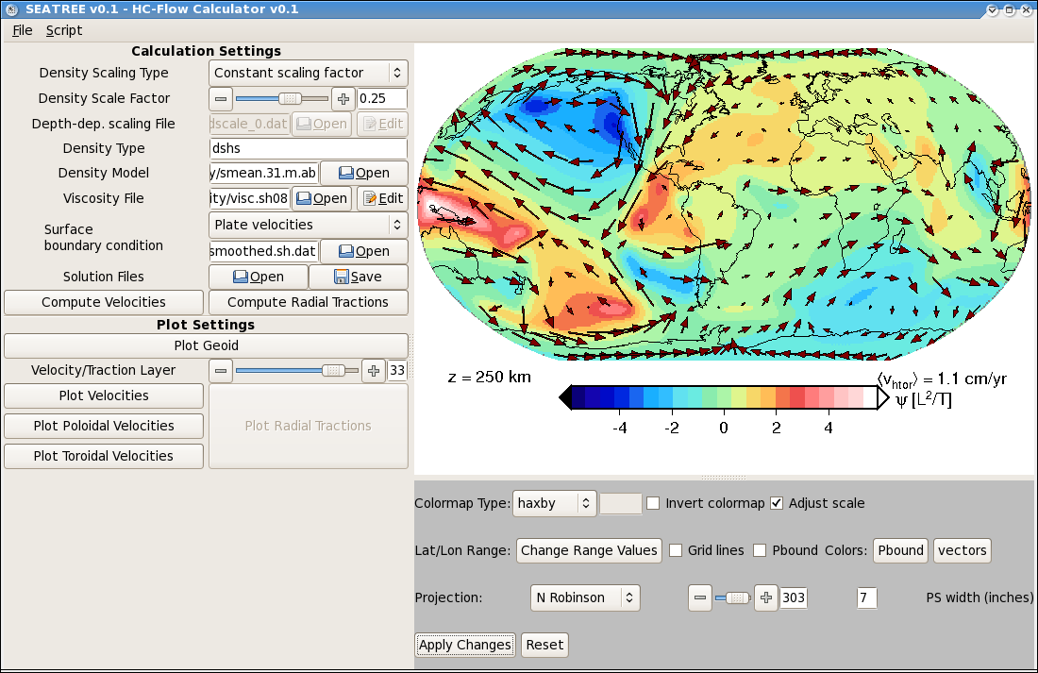
GUIs: Python and Gtk: SEATREE

Slide 26
Scripts: scripting languages
Shells: csh, tcsh, bash, zsh
Data processing: perl, awk, sed
Python
Julia, Matlab
Tk, TclTk, Gtk (don’t write GUIs)
Scripted programs
Gnuplot
GMT
Paraview
Script whenever you can (because you'll want to reproduce things exactly)

Slide 27
Scripting
Can be the way to go if individual processing steps are not time-sensitive
If speed is an issue, need to compile from higher level language such as script
For basic LINUX automatization tasks, bash and awk are very useful
Python seems to be a nice middle ground for some advanced projects
Julia more powerful

Slide 28
Bash script programming
#!/bin/bash
#
# run run_fstrack for different models
#
models=${1-"pmDsmean_nt pmDnngrand_nt saf1 saf2 saf3 "}
strains=${2-"2 1 0.5"}
# PBS queues to use
q1="becker64";q2="scec"
c=0
for m in $models;do
cd $m
for s in $strains ;do
if [ $c -eq 1 ];then
queue=$q1;c=0
else
queue=$q2;c=1
fi
# regional
../run_fstrack 1 0 0 0 $s 1 2 1 -14 0 60 "" 1 $queue
done
cd -
done

Slide 29
Bash scripting
Command line arguments
file=${1-”tmp.grd”}
If, case statements
if [[ $file = ”tmp.ps” && $i -eq 1 ]];then
...
fi
Loops
while [ $i -le $n ];do
...
((i=i+1))
done

Slide 30
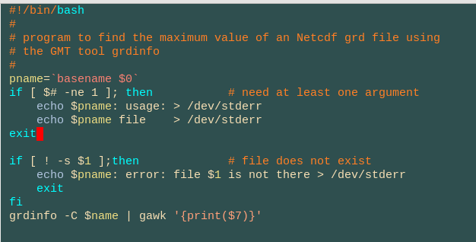
Bash scripting
Command evaluation
variable = `grd2max $file.grd`
where grd2max is another script:

Slide 31
Bash scripting
Functions
Traps
tmpn=`mktemp`
trap "rm -f $tmpn*" EXIT
Problems:
Sensitive to white space (if [ $i -eq 5] won't work)
Usually only deals with integers (= vs. -eq comparison)
((i=k+j)) works if $i, $k, $j are integers
zsh can deal with floating point numbers

Slide 32
Experimentation time 1/2
Write a script that outputs:
1
2
3
4
5
OK
Write a script that works such that (replace USER with user’s name!)
>hello_user.sh
Hello USERNAME!
Your home is: /home/USER
Today's date is: Sun Jun 24 18:19:42 CDT 2012
Write a script that takes input n
myscript n
and writes
1
2
...
n
OK

Slide 33
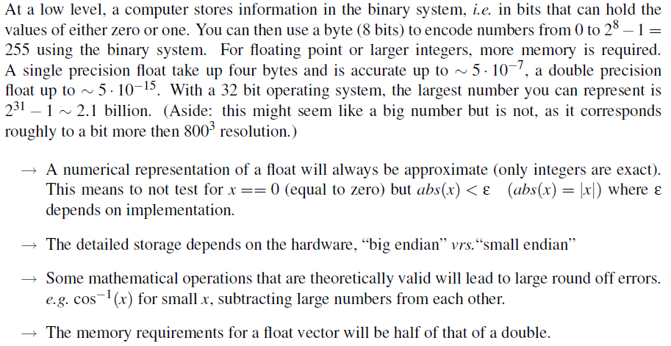
Computing fundamentals

Slide 34
Memory

Slide 35
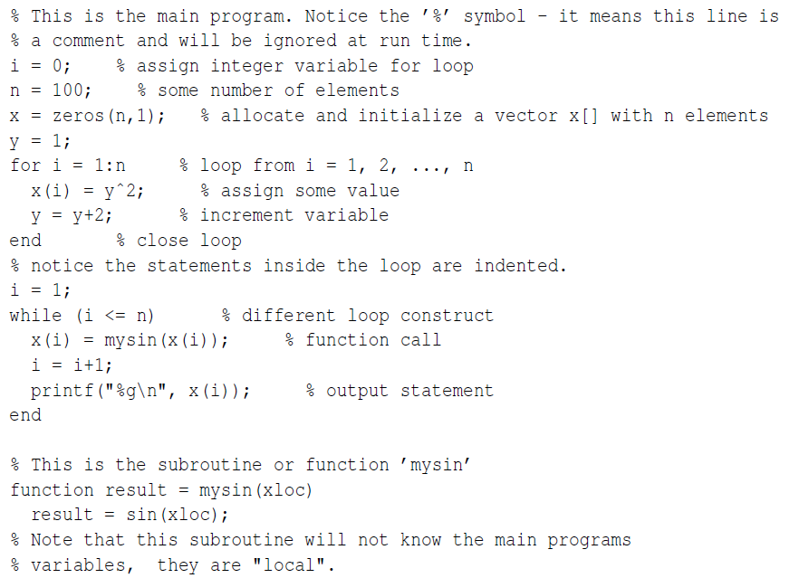
Elements of a computer program

Slide 36
Programming philosophy

Slide 37
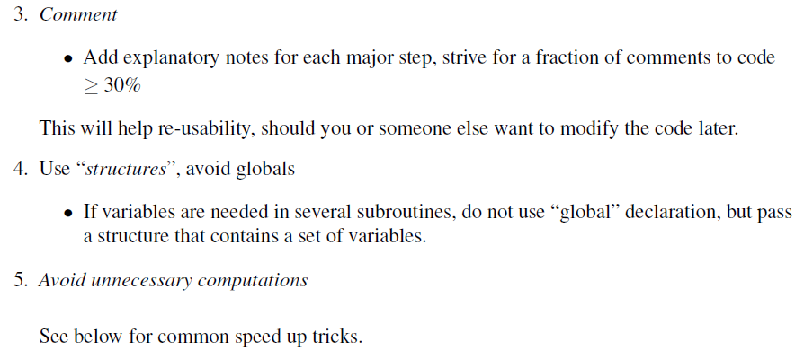
Programming philosophy

Slide 38
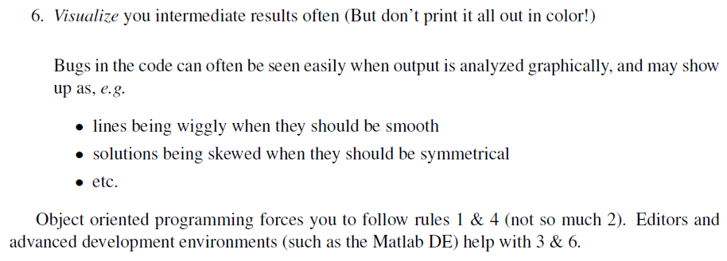
Programming philosophy

Slide 39
Programming: Philosophy
strive for transparency by commenting and documenting the hell out of your code
create modularity by breaking tasks into reusable, general, and flexible bits and pieces
achieve robustness by testing often
obtain efficiency by avoiding unnecessary computational operations (instructions)
maintain portability by adhering to standards
D. Knuth: The art of computer programming

Slide 40
Tuning: How to design good code
strive for transparency, modularity, robustness, efficiency, portability
benchmark (verify) and test (unit testing)
document
make things sharable (no funny stuff)
share. open is good (at least for finding bugs)

Slide 41
Tuning: How to design efficient code
watch array ordering in loops x[i*n+j]
avoid things like:
f1=cos(x)*sin(y);f2=cos(x)*cos(y);
use BLAS, LAPACK, PetSC –other libraries
experiment with compiler options which can turn good (readable) code into efficient
look into hardware optimized packages
design everything such that you can run in parallel (0th order) on one file system
parallelize

Slide 42
Programming: Traditional languages in the natural sciences
Fortran: higher level, good for math
F77: legacy, don't use (but know how to read)
F90/F95: nice vector features, finally implements C capabilities (structures, memory allocation)
C: low level (e.g. pointers), better structured
very close to UNIX philosophy
structures offer nice way of modular programming, see Wikipedia on C
I recommend F95, and use C happily myself

Slide 43
Programming: Some Languages that haven't made it to scientific computing
C++: object oriented programming model
reusable objects with methods and such
can be partly realized by modular programming in C
Very few codes use it (Aspect one example)
Java: what's good for commercial projects (or smart, or elegant) doesn't have to be good for scientific computing
Concern about portability as well as general access

Slide 44
Programming: Compromises
Python
Object oriented
Interpreted
Interfaces easily with F90/C
Numerous scientific packages
Julia
Powerful, easy to parallelize, interfaces with GPUs

Slide 45
Programming: Other interpreted, high-abstraction languages for scientists
Bash, awk, zsh, python: script languages
Bash: A shell can be scripted
AWK: interpreted C, good for simple data processing
Matlab (or octave), Julia
language is some mix between F77 and C, highly vectorized
might be good enough (or perfect) for your tasks
interpreted (slower), but can be compiled
IDL: visualization mostly, like Matlab
Mathematica: symbolic math mostly

Slide 46
Programming: Trade-offs for scientific computing
abstraction,
convenience
Bash, awk
Java
python
Matlab
Julia
F95
C
F77
assembler
efficiency,
speed

Slide 47
Programming: Most languages need to be compiled to assembler language
$(F77) $(FFLAGS) -c main.f -o main.o
there are standards, but implementations differ, especially for F77/F90/F95, not so much for C
the compiler optimization flags, and the choice of compiler, can change the execution time of your code by factors of up to ~10, check out some example benchmarks for F90
the time you save might be your own
don't expect -O5 to work all the time

Slide 48
AWK programming
In many ways, like C
Very useful for small computations, in particular when operating on ASCII tables
Based on line by line processing
$1, $2, $3… $(NF) are the column entries
echo 5 6 7 | gawk '{print($2*$3)}' will return 42
Knows math (sin,cos,atan2,…)
Knows string functions (match, gsub, ….)

Slide 49
AWK programming
Special variables
NR
NF
FILENAME
FS

Slide 50
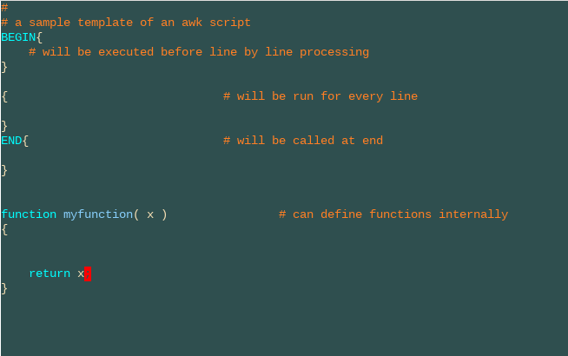
AWK programming

Slide 51
Experimentation time 2/3: write an awk script that computes the mean of a data set in an ASCII file extra credit: allow for selection of the column

Slide 52
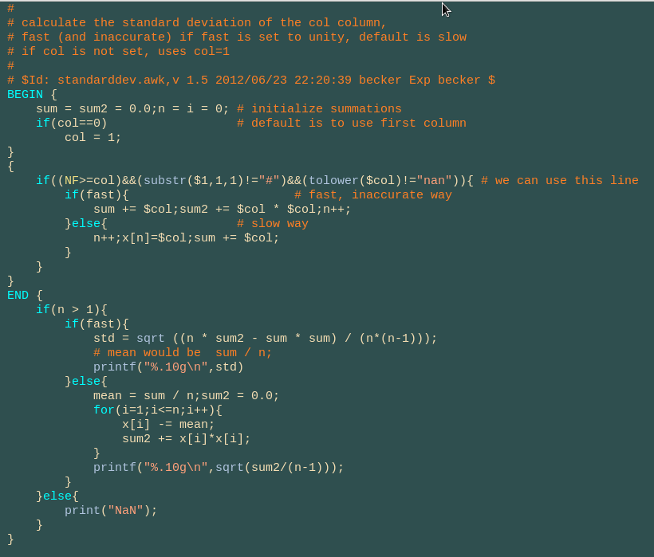
AWK programming

Slide 53
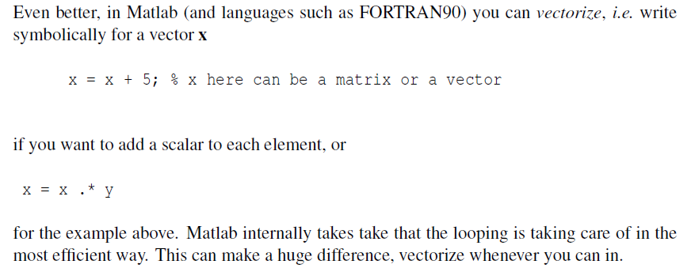
Tuning: How to design efficient code

Slide 54
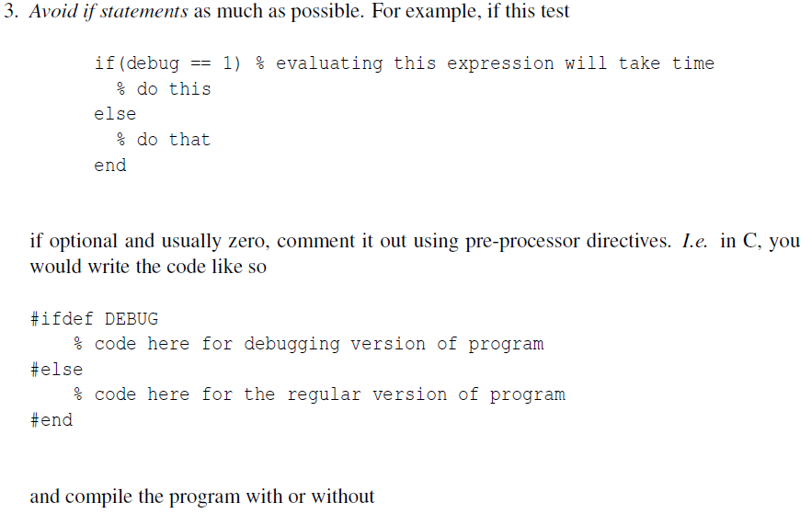

Slide 55
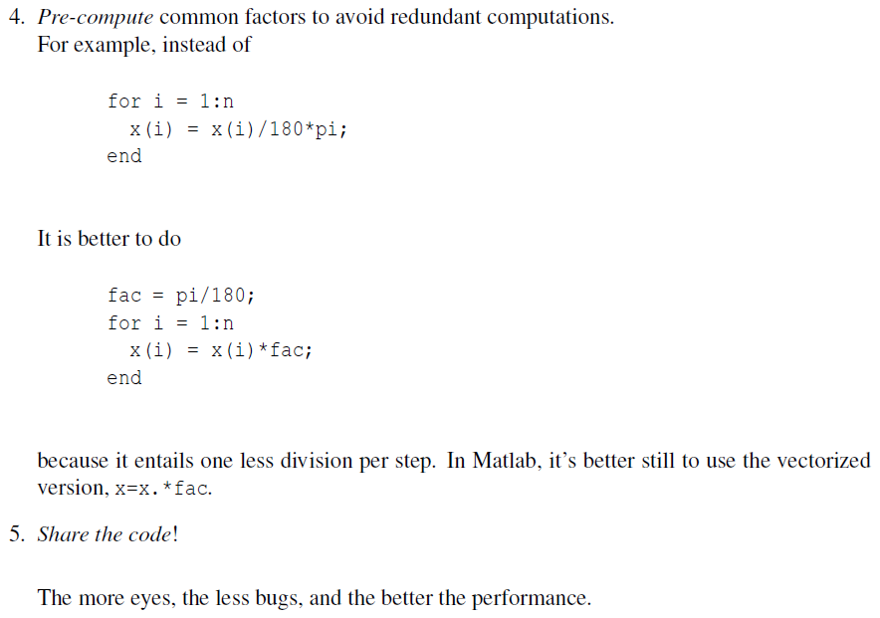

Slide 56
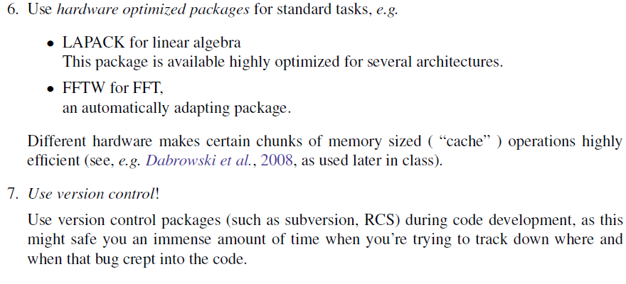
Tuning: How to design efficient code

Slide 57
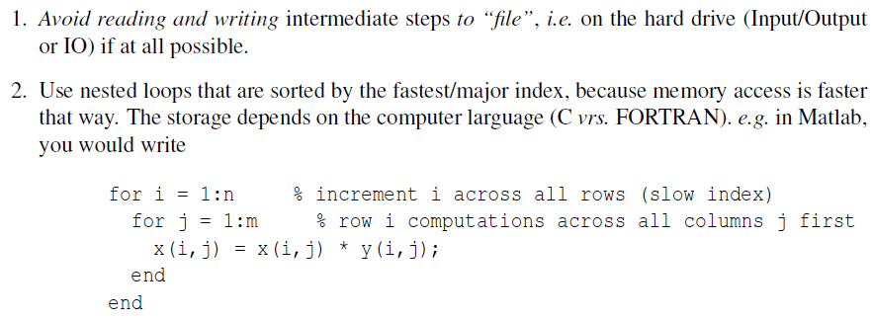
Tuning: How to design efficient code

Slide 58
Tuning: Tuning programs
use compiler options, e.g. (AMD64 in brackets)
GCC: -O3 -march=pentium4 (-m64 -m3dnow -march=k8) -funroll-loops -ffast-math -fomit-frame-pointer
ifc: -O3 -fpp -unroll -vec_report0
PGI: -fast -Mipa (-tp=amd64)
use profilers to find bottlenecks
use computational libraries

Slide 59
Algorithms: Collection of subroutines: Numerical recipes
THE collection of standard solutions in source code
usually works, might not be best, but OK
NR website has the PDFs, I recommend to buy the book
criticism of numerical recipes
website on alternatives to numerical recipes
use packages like LAPACK, if possible
else, use NR libraries but check
MATLAB wraps NumRec, LAPACK & Co.

Slide 60
Tuning: Linear algebra packages, examples
EISPACK, ARPACK: eigensystem routines
BLAS: basic linear algebra (e.g. matrix multiplication)
LAPACK: linear algebra routines (e.g. SVD, LU solvers), SCALAPACK (parallel)
parallel solvers: MUMPS (parallel, sparse, direct), SuperLU
PETSc: parallel PDE solvers, a whole different level of complexity

Slide 61
Tuning: Examples for some other science (meta-)packages
netlib repository
GNU scientific library
GAMS math/science software repository
FFTW: fast fourier transforms
hardware optimized solutions
ATLAS: automatically optimized BLAS (LAPACK)
GOTO: BLAS for Intel/AMD under LINUX
Intel MKL: vendor collection for Pentium/Itanium
ACML: AMD core math library

Slide 62
Experimentation time 3/3 - Assignment Download the ISC-GEM-CAT file and write an awk script that extracts lon-lat-depth-magnitude for a given time interval, say 2000/01 – 2010/12

Slide 63
Other material

Slide 64
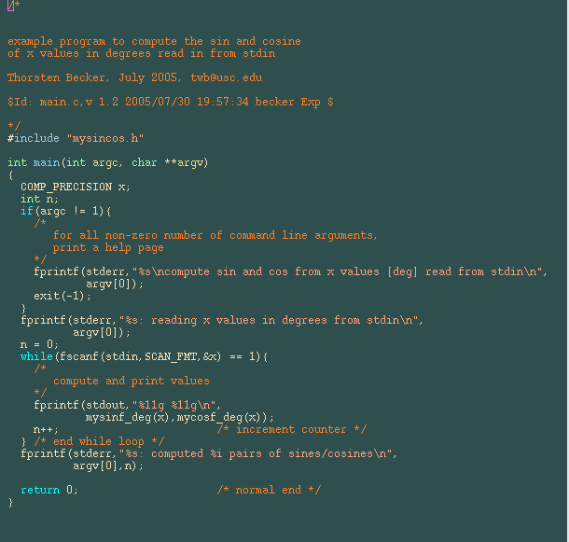
C-Programming
Exampleproject: main.c

Slide 65
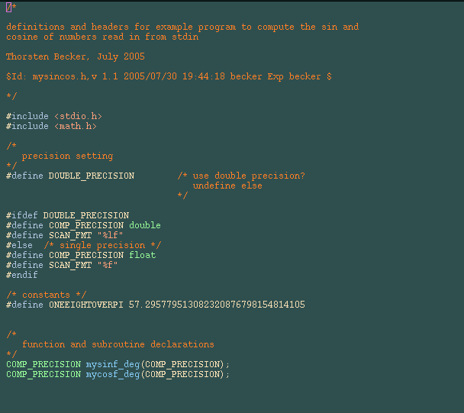
C-Programming
Exampleproject: mysincos.h

Slide 66
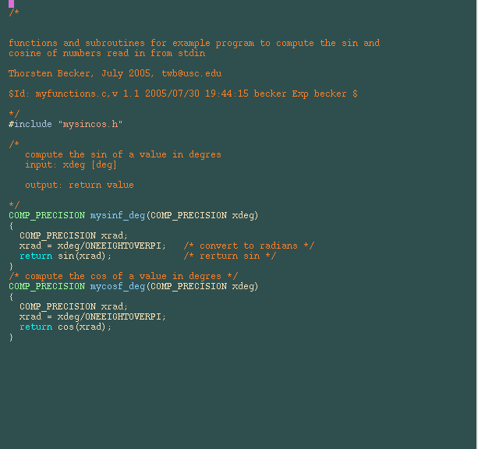
C-Programming
Exampleproject: myfunctions.c

Slide 67
Building: How to compile the example project
becker@jackie:~/dokumente/teaching/unix/example >
ls
bin/ main.c makefile myfunctions.c mysincos.h objects/ RCS/
becker@jackie:~/dokumente/teaching/unix/example >
cc main.c -c
becker@jackie:~/dokumente/teaching/unix/example >
cc -c myfunctions.c
becker@jackie:~/dokumente/teaching/unix/example >
cc main.o myfunctions.o -o mysincos -lm
becker@jackie:~/dokumente/teaching/unix/example >
echo 0 90 -90 | mysincos
mysincos: reading x values in degrees from stdin
0 1
1 6.12303e-17
-1 6.12303e-17
mysincos: computed 3 pairs of sines/cosines

Slide 68
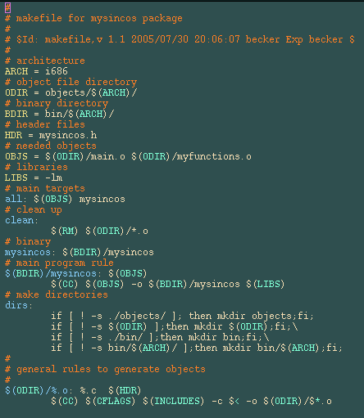
Building:
Automating the build process with make: makefile

Slide 69
Building: Building with make
becker@jackie:~/dokumente/teaching/unix/example > make dirs
if [ ! -s ./objects/ ]; then mkdir objects;fi;
if [ ! -s objects/i686/ ];then mkdir objects/i686/;fi;\
if [ ! -s ./bin/ ];then mkdir bin;fi;\
if [ ! -s bin/i686/ ];then mkdir bin/i686;fi;
becker@jackie:~/dokumente/teaching/unix/example > make
icc -no-gcc -O3 -unroll -vec_report0 -DLINUX_SUBROUTINE_CONVENTION -c main.c \
-o objects/i686//main.o
icc -no-gcc -O3 -unroll -vec_report0 -DLINUX_SUBROUTINE_CONVENTION -c myfunctions.c \
-o objects/i686//myfunctions.o
icc objects/i686//main.o objects/i686//myfunctions.o -o bin/i686//mysincos -lm
becker@jackie:~/dokumente/teaching/unix/example > make
make: Nothing to be done for `all'.
becker@jackie:~/dokumente/teaching/unix/example > touch main.c
becker@jackie:~/dokumente/teaching/unix/example > make
icc -no-gcc -O3 -unroll -vec_report0 -DLINUX_SUBROUTINE_CONVENTION -c main.c \
-o objects/i686//main.o
icc objects/i686//main.o objects/i686//myfunctions.o -o bin/i686//mysincos -lm

Slide 70
Building: Version control
RCS, SCCS, CVS, SVN, git: tools to keep track of changes in any documents, such as source code or HTML pages
different versions of a document are checked in and out and can be retrieved by date, version number etc.
I recommend using github for everything

Slide 71
Building: Version control is worth it
small learning curve, big payoff
EMACS can integrate version control, make, debugging etc. consistently and conveniently
opening files, checking in/out can be done with a few keystrokes or menu options

Slide 72
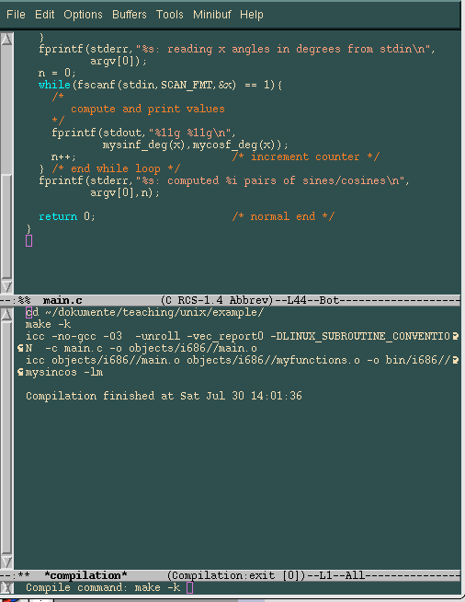
Building: EMACS modes
EMACS is just one example of a programming environment
e.g. there is a vi mode within EMACS
dotfiles.com on .emacs

Slide 73
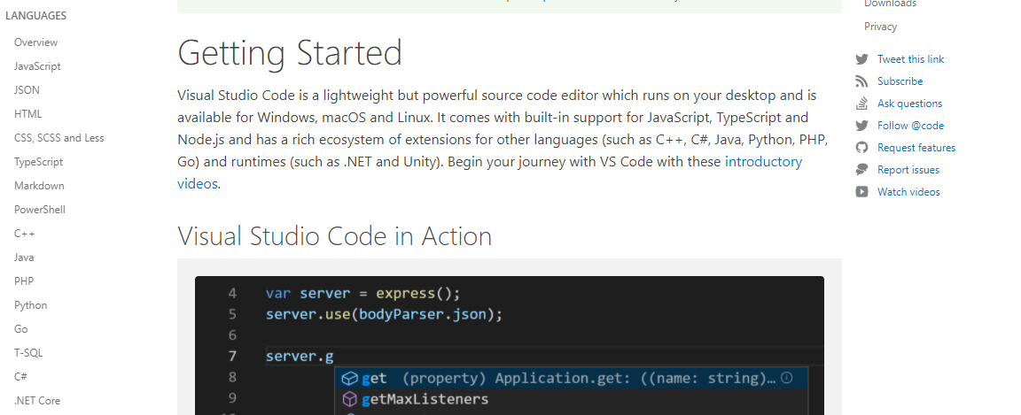
IDEs: Visual Study Code

Slide 74
Tuning: Calling F90 from C
some subroutines are Fortran functions which you might want to call from C
this works if you pointerize and flip
call func(x) real*8 x as func(&x) from C
storage of x(m,n) arrays in Fortran for x(i,j) is x[j*m+i] (fast rows) instead of x[i*n+j] (fast columns)
C x[0,1,2,...,n-1] will be x(1,2,...,n) in Fortran
don't pass strings (hardware dependent)
BTW: Fortran direct binary I/O isn't really binary

Slide 75
Algorithms: Take a class or read a book on inverse theory
Standard texts
Menke (good, hands on, expensive)
Parker (mathematical)
Newer texts
Gubbins
Tarantola
Class notes
Marc Spiegelman's MMM: great for PDEs
WHOI 12.747 class notes on with focus on geoscience and oceanography (encompasses some of the Numerical Recipes material)

Slide 76
Visualization: General 2-D
matlab, octave, IDL, and 1000 others
I recommend:
GNUPLOT: nice 2-D PS plots, scriptable
plot 'a.dat' using 1 : ($3/10) title 'data' w lp
GMT: made for mapping, but can produce outstanding quality EPS figures (with some work)
Matplotlib for python
those are script driven programs, no real GUI (but there is iGMT and some stuff for gnuplot)
both are available as C source code

Slide 77
Visualization: Geographic data
matlab, IDL, and GIS systems
Free matlab interfaces to python matplotlib
Low level routines (proj etc.)
I recommend:
GMT: tons of projections, tool of choice for professional quality plots
I use GMT even for x – y plots
iGMT: can help you obtain initial scripts to modify by hand later
Link to my PDF lecture notes on GMT

Slide 78
Visualization: 3-D
Commercial
Matlab
IDL (not so good)
free software with available source code:
paraview: VTK based parallel tool
I recommend paraview
There is plenty of stuff around (don't write your own)

