Slide 1
Geoscientific data analysis using UNIX and GMT
1/8: UNIX I
Thorsten Becker
The University of Texas at Austin
April 2021

Slide 2
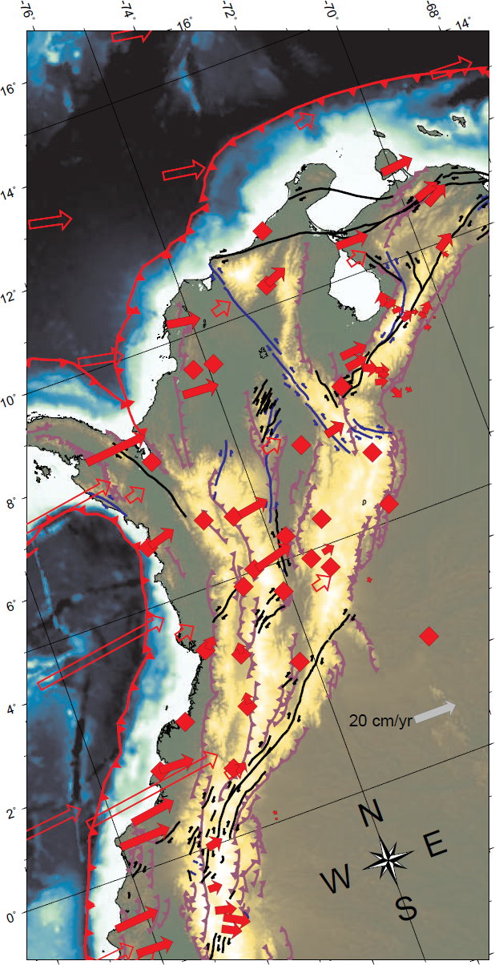
What
I do

Slide 3
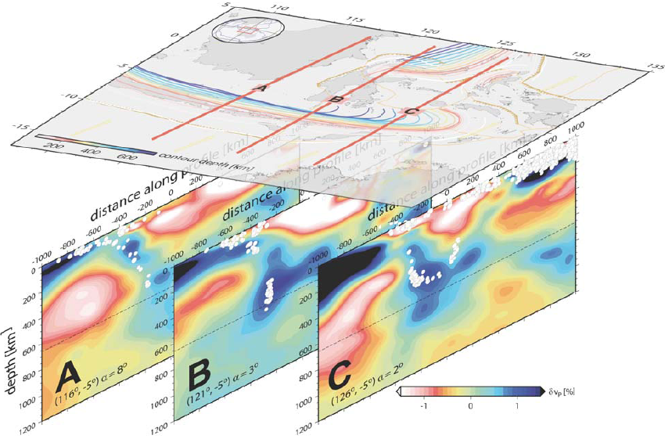

Slide 4
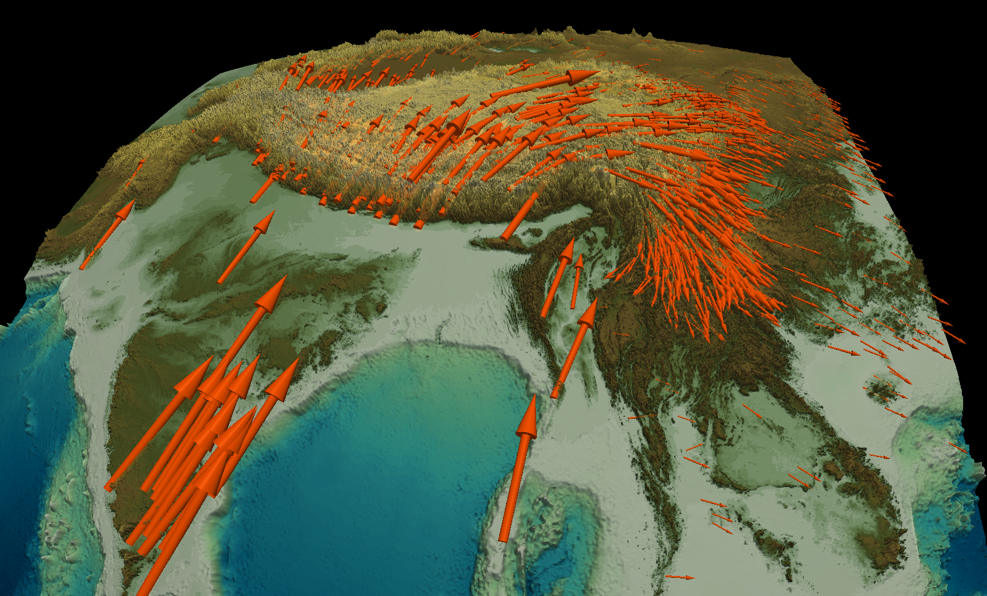

Slide 5
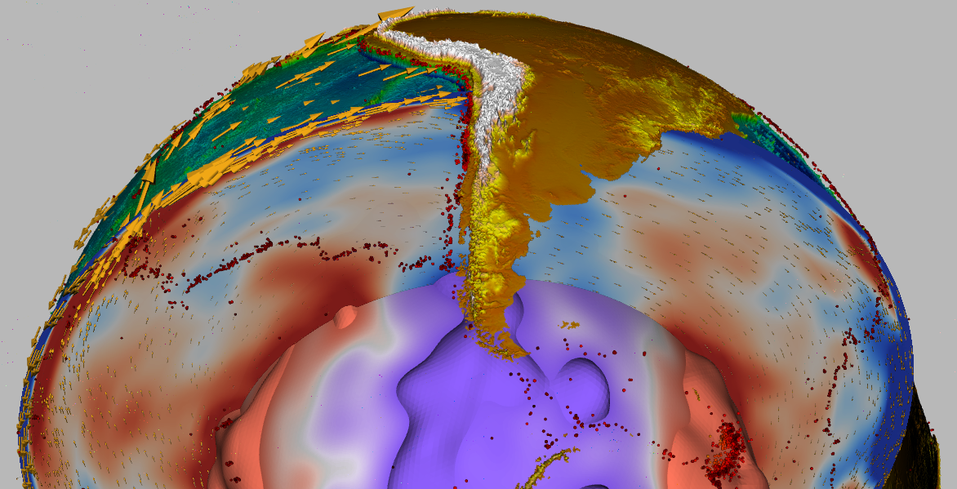

Slide 6
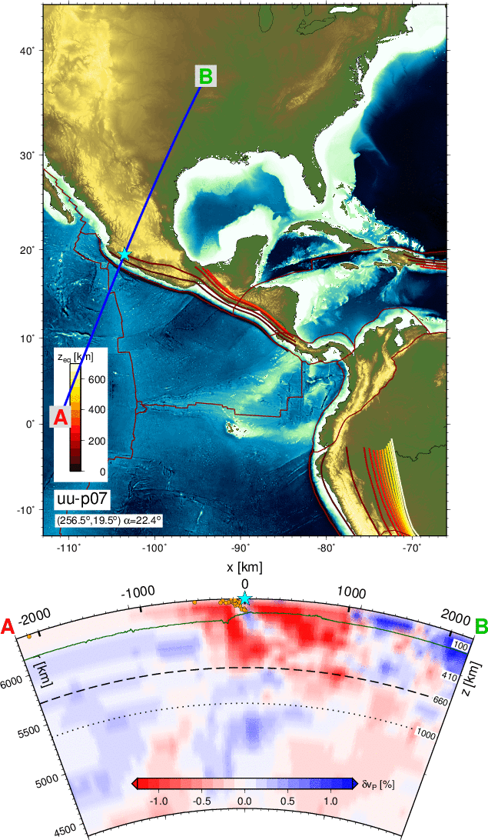
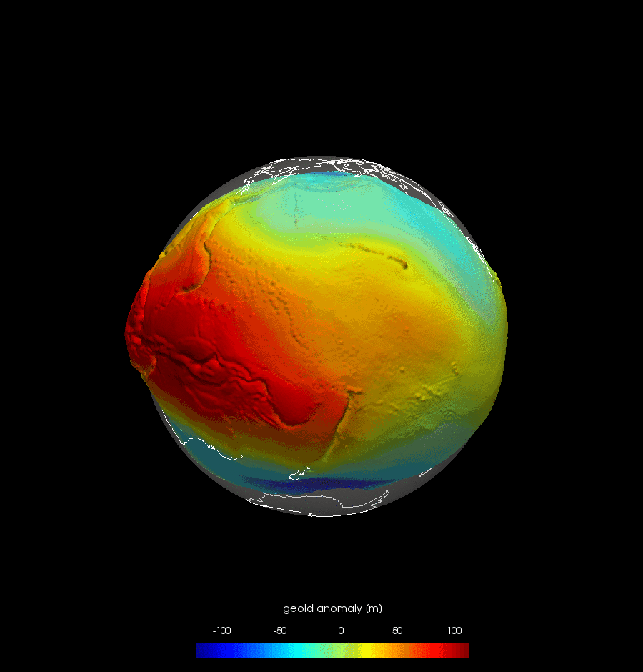
Scripting:
Simple
movies
for data
analysis

Slide 7
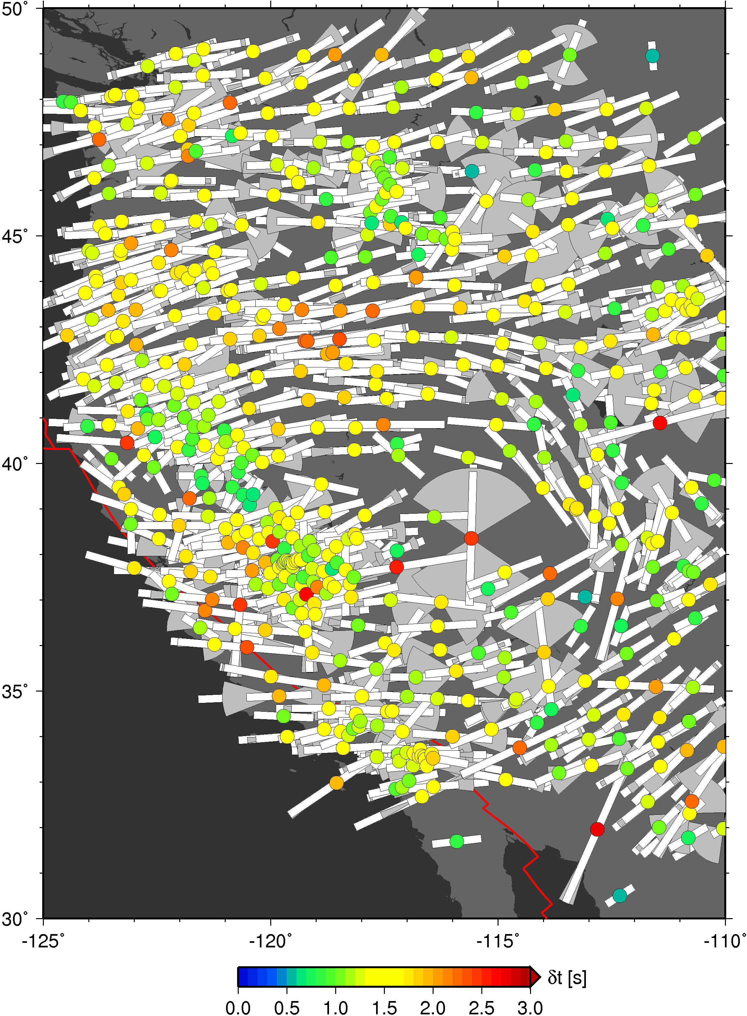
Scripting:
Automated
shear
wave
splitting

Slide 8
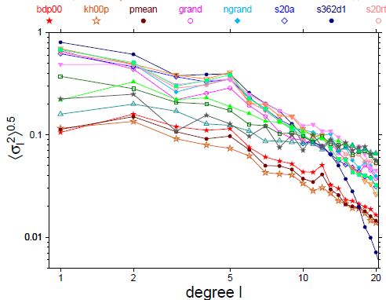
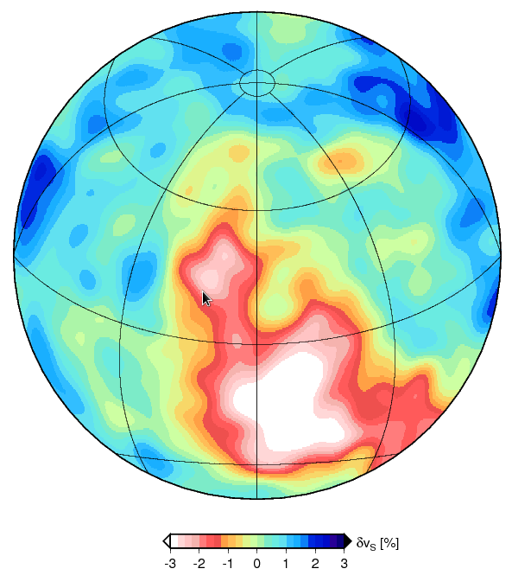
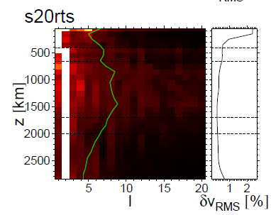
Data/model analysis

Slide 9
Purpose of this short course
Introduce a scientific/numeric workflow setting centered around LINUX/UNIX
Provide skills and tools for making maps and analyzing Earth science data with GMT
Comment on some other analysis, visualization and typesetting tools

Slide 10
Contents
UNIX I: commands, shells, file handling, editors
UNIX II: awk, sed and shell scripting
GMT I: Location maps and projections
GMT II: X-Y plots, curve fitting, and filtering - gnuplot
GMT III: Focal mechanisms, velocities, strain
GMT IV: Plotting and analyzing 2-D data
Movies, Paraview and 3-D visualization
GMT V/Other topics: Participant driven

Slide 11
Purpose of this segment
Introduce UNIX-based (e.g. LINUX, Mac OSX) computing and scientific work flow environments by providing pointers for further information
Describe what I think are best practices in moderate to high-performance computing
  I will make judgments and provide specific recommendations
  I cannot possibly provide a comprehensive, fair, or entirely up to date overview

Slide 12
UNIX: What is UNIX?
An operating system that originated in the 70ies
build for multi-user, multi-tasking, scalable (that was new way back then)
runs on all computing hardware, including iPOD
many flavours, free:
  LINUX (including Ubuntu subsystem in Windows),
  BSD (a version made it into OSX)
they are all kind of the same thing, your mileage may vary (e.g. directory structure)
there is convergence between LINUX, Mac OS, and Windows look and feel – near complete

Slide 13
UNIX: Why use UNIX?
can use same tools and programs on laptop, workstation, and supercomputer (less important if virtualization is available)
flexible, modular, powerful
seamless integration of python, C and F90 programs, shell commands, and post-processing (UNIX is written in C)
all important numerical tools and libraries are available
LINUX is open (security!), and ubiquitous

Slide 14
UNIX: Why (not) use UNIX?
UNIX
UNIX
WINDOWS
power
effort
WINDOWS
time

Slide 15
UNIX: This overview
describes typical scientific workplace set-up in natural sciences
tries to not
  spend a lot of time on point-and-click GUIs
  discuss cutting-edge programs (with unclear support situation and user base)
will be out of date tonight when it comes to specific software
Might be a bit old school

Slide 16
Structure of a UNIX system
Hardware (RAM, disks, CPUs)
Kernel (services, daemons)
File system
  /home/user
  /usr, /opt/
  /media/
  /dev/null, /dev/stdin, /dev/stderr
Shell / terminal (ksh, bash, csh, tcsh, zsh)
X server
  File manager, editors
  Window system
  Other software

Slide 17
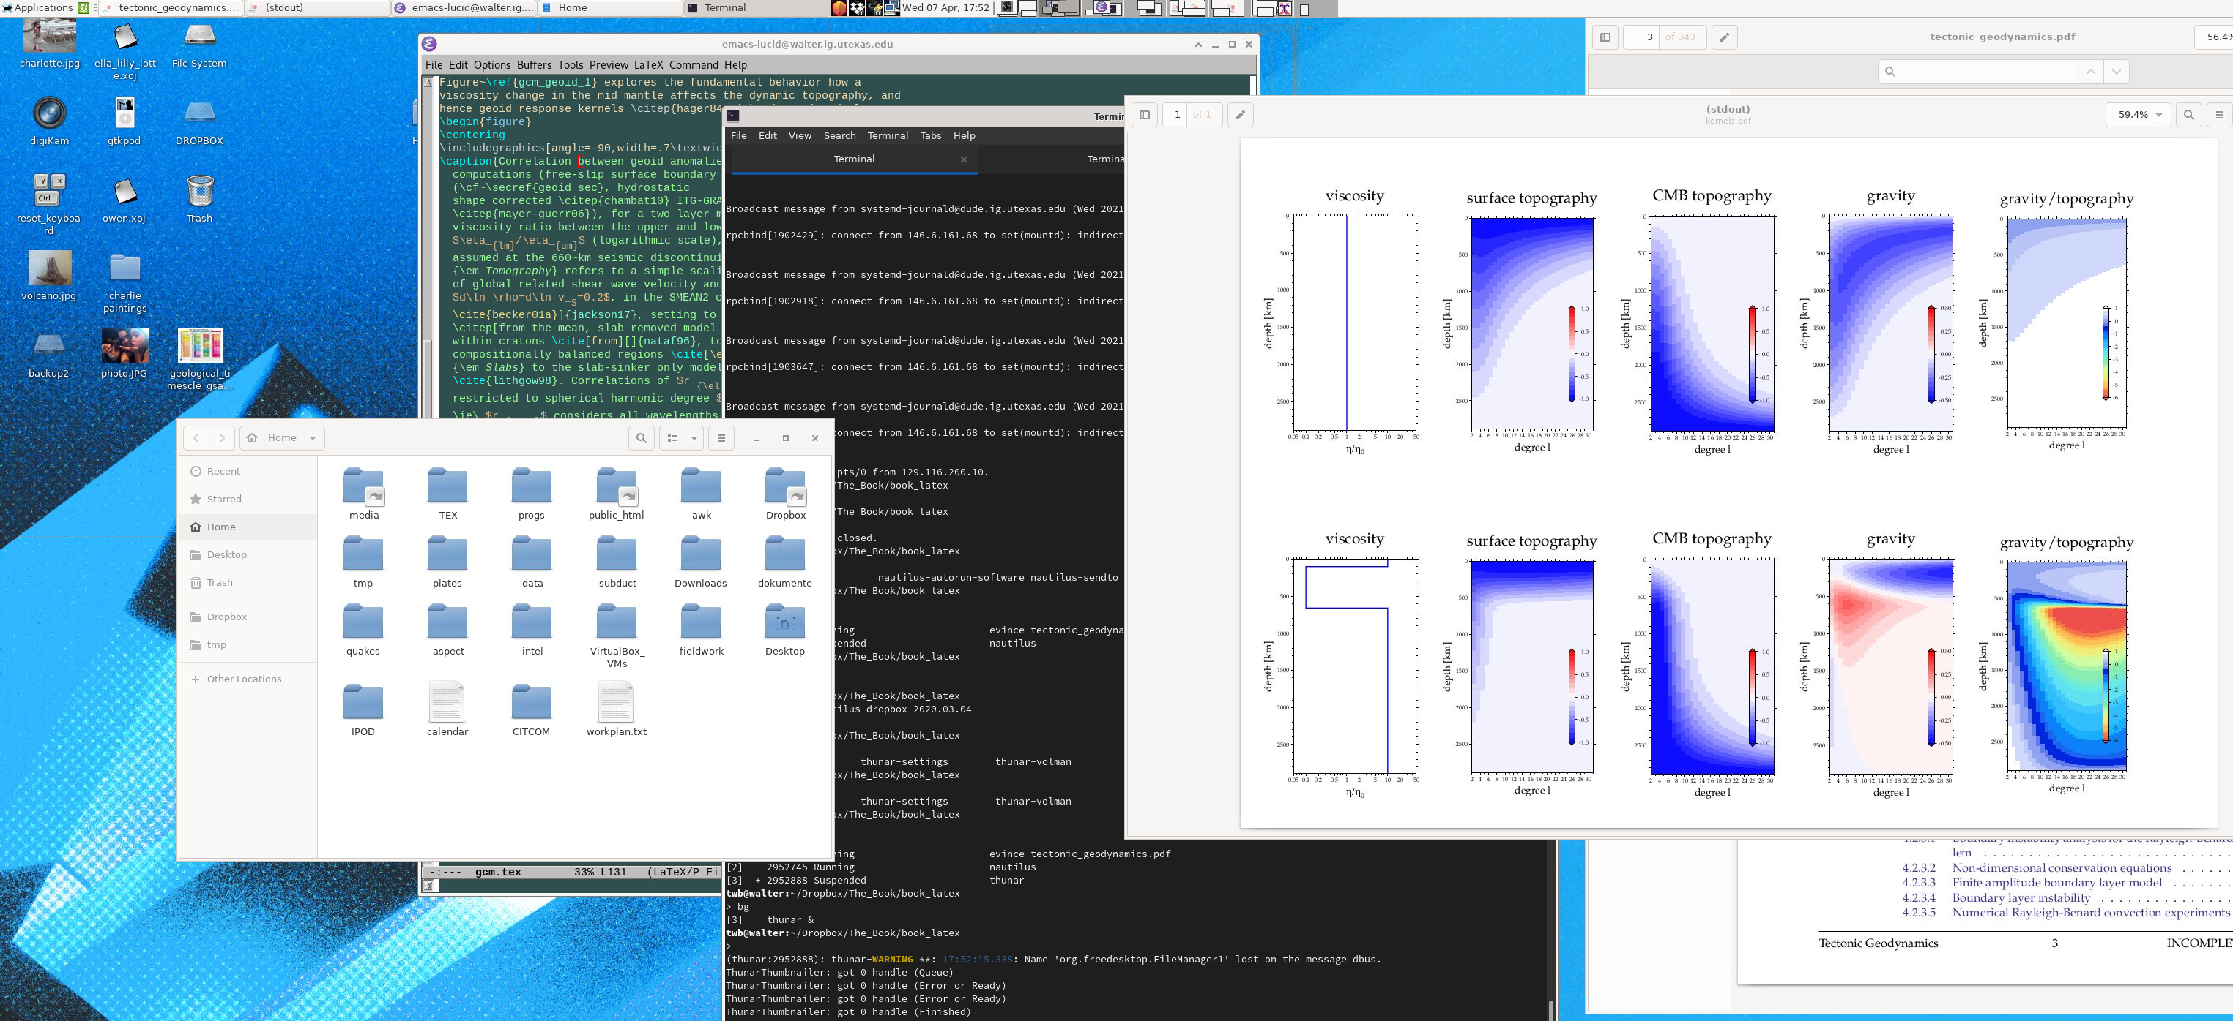
File system: Graphical
window managers and tools
GNOME, KDE, XFCE, …
Provide support and interface with other apps (search, web, access files on other servers, etc.)

Slide 18
How to run UNIX
Run Windows with Ubuntu subsystem
Run OS-X – comes with BSD based UNIX
Log into a LINUX machine
Run VirtualBox/VMware Linux subsystem (on Mac, Windows…)
Install LINUX on your computer
Run Docker subsystem (on Mac, Windows)

Slide 19
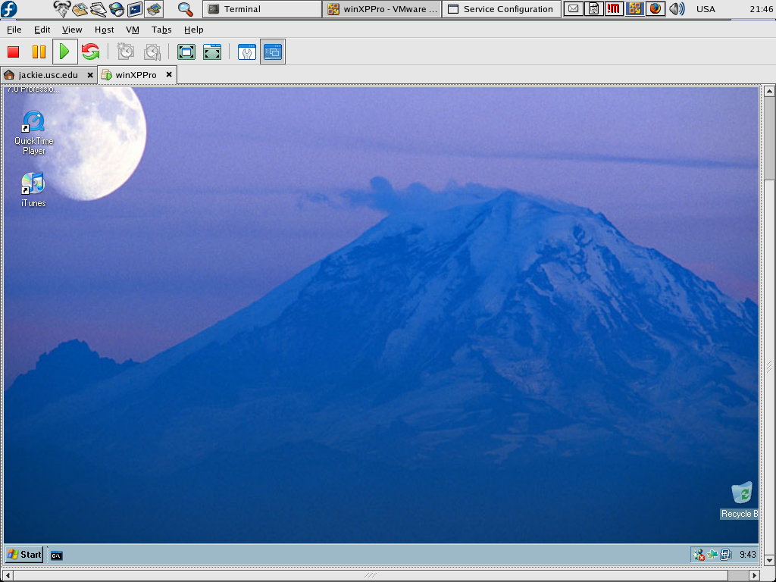
Virtualization: run any OS
on whatever - VirtualBox

Slide 20
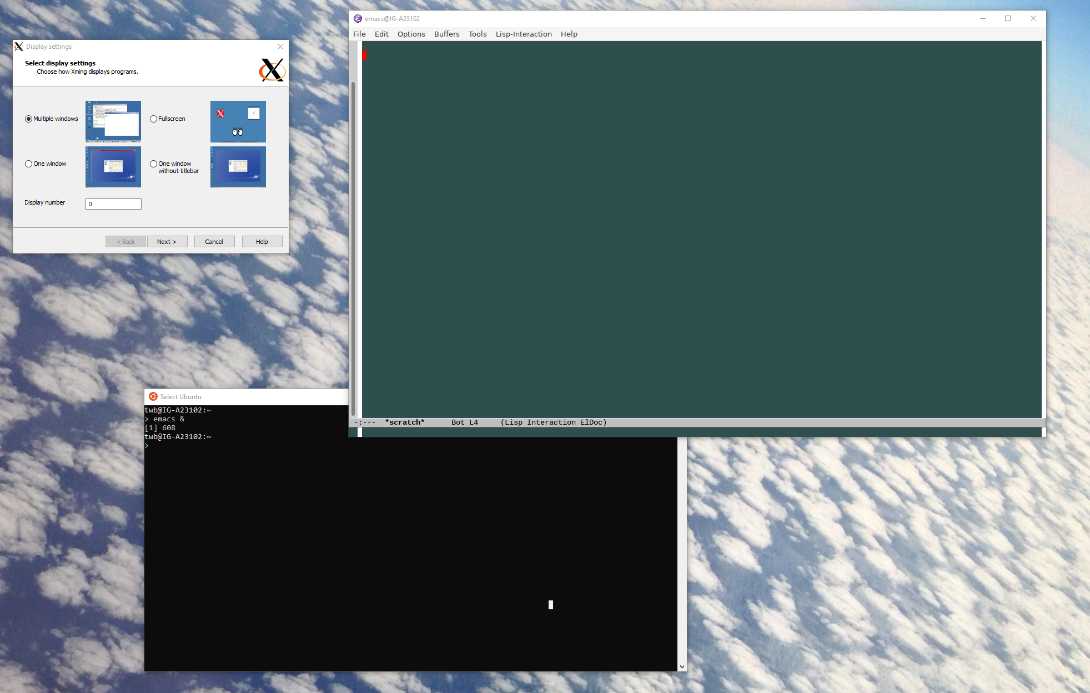
Virtualization: run Ubuntu in Windows – XServer

Slide 21
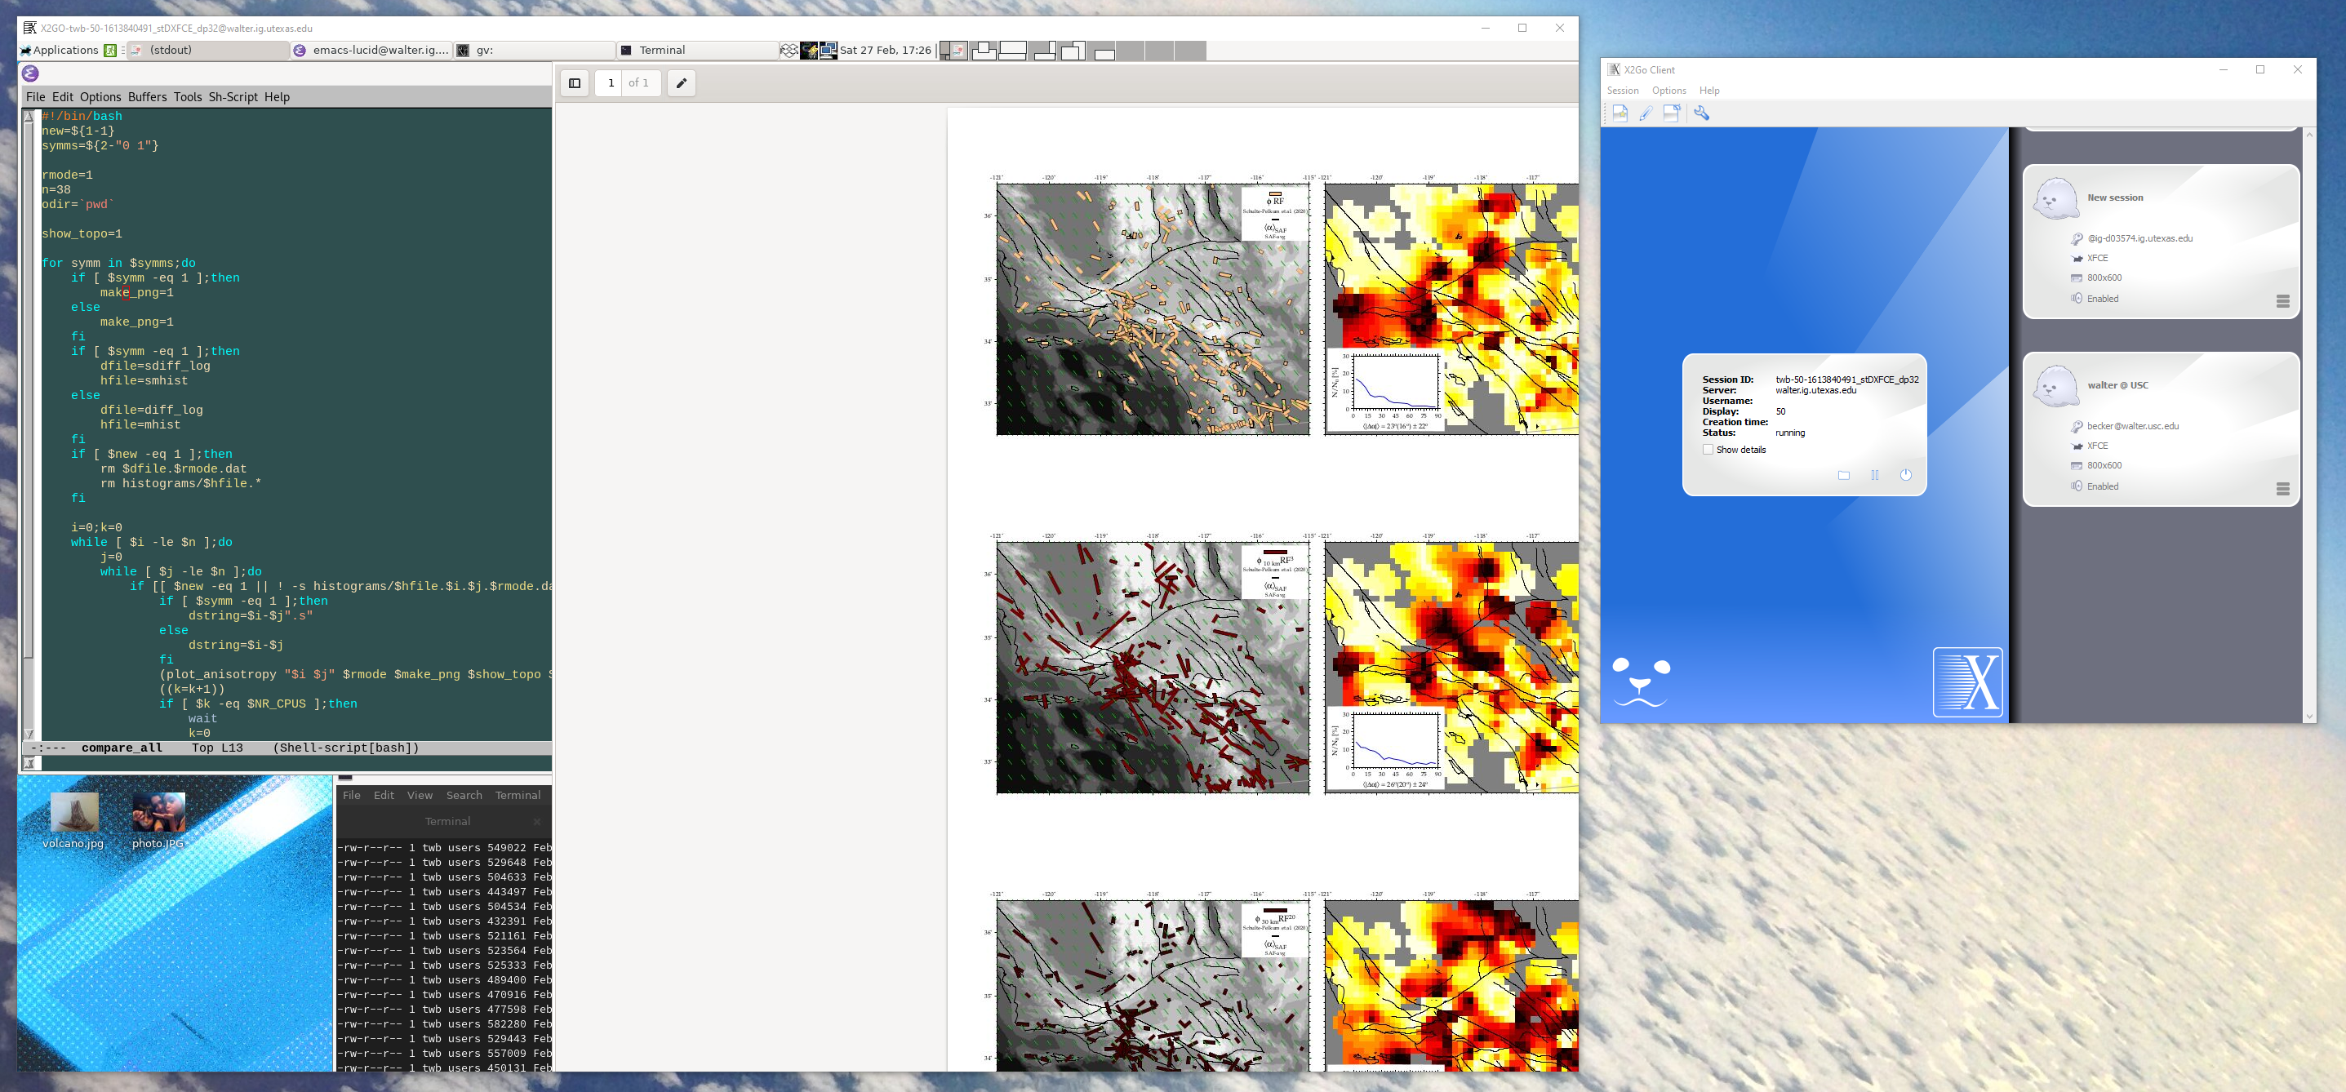
Remote desktop: x2go export your workplace everywhere

Slide 22
Remote desktop: x2go export your workplace everywhere
x2go for UTIG (04/2021):
Use XFCE or MATE, not GNOME
Latest version for Windows not working, instead use https://code.x2go.org/releases/binary-win32/x2goclient/releases/4.1.2.0-2018.06.22/

Slide 23
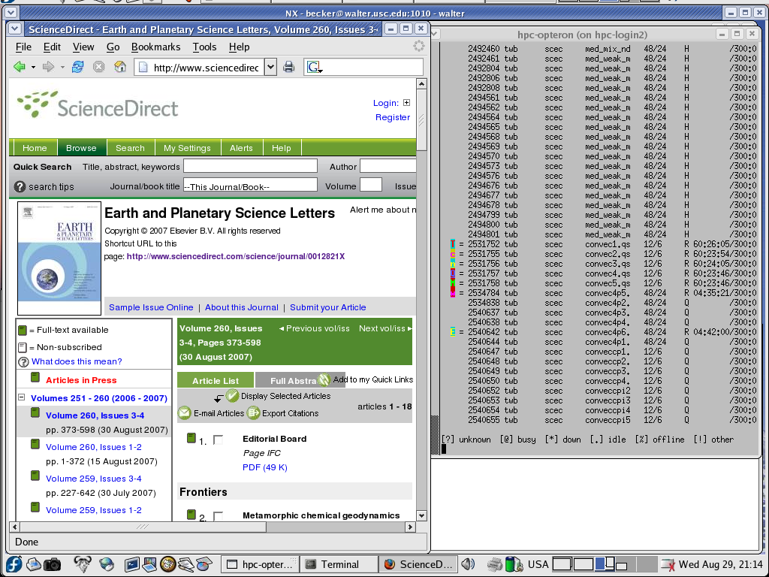
Remote desktop: NX export your workplace everywhere

Slide 24
A full LINUX distributions comes with a range of fairly useful GUI based, open source software
OpenOffice – for editing text (like Word), making presentations (like Powerpoint), and running spreadsheets (like Excel)
GIMP – interactive image manipulation
The only real problem is Illustrator
  Affinity!
My suggestions for a single platform:
  OS-X: you have Linux already
  Windows:
    run Ubuntu subsystem
    run Linux in a virtual machine
  Undecided: Use a Mac (if you can afford it)

Slide 25
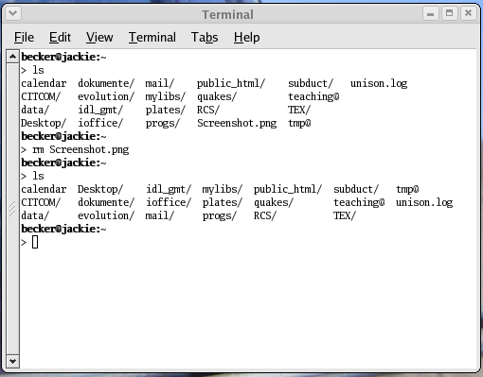
File system:
But where is UNIX? The shell
open a shell (terminal) to get a command line
type commands, such as ls to list the contents of a directory
Even if you regularly use
Mac OS-X or GNOME, some
knowledge of the background
can save the day!

Slide 26
Experimentation time 1/3
(q, CTRL-C to stop, CTRL-Z to pause)
echo hello world
passwd
date
hostname
arch
uname -a
uptime
whoami
who
id
last
w
time sleep 5
history
last
w
top
echo $SHELL
echo {con,pre}{sent,fer}{s,ed}
ls
man ls
clear
cal, cal 2022
df, df -h
du -sh .

Slide 27
Experimentation time 2/3
(q, CTRL-C to stop, CTRL-Z to pause)
mkdir tmp
cd tmp
touch tmp.txt
ls
ls –la
cd ..
ls
rm tmp/
rm –r tmp (careful – all will be gone)

Slide 28
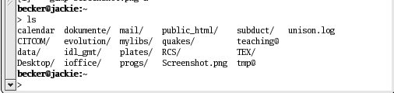
File system: Hardcore:
The actual file system
user versus super-user (administrator) setup
sudo
tree structure of files within directories:
  /usr/local has software
  /dev has devices
  /home/$USER has all the user's files, which might be subdivided into folders like
  /mnt/data/ or /media might hold shared data/storage

Slide 29
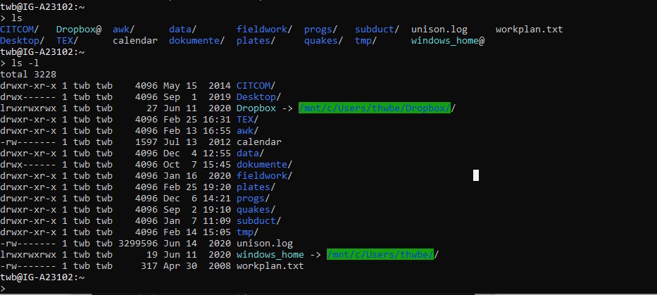

Slide 30
File system:
ls: list contents of directories
becker@jackie:~ > ls
calendar data dokumente idl_gmt mail plates public_html RCS subduct TEX unison.log
CITCOM Desktop evolution ioffice mylibs progs quakes Screenshot.png teaching tmp
becker@jackie:~ > ls -F -l
total 6500
-rw-r--r-- 1 becker users 1638 Jun 17 07:39 calendar
drwxrwxr-x 4 becker users 4096 Jun 17 07:39 CITCOM/
drwxr-xr-x 35 becker users 4096 Jul 12 15:22 data/
drwx------ 2 becker users 4096 Jul 26 17:20 Desktop/
drwxr-xr-x 25 becker users 4096 Jul 12 07:48 dokumente/
drwx------ 7 becker users 4096 Jun 17 11:53 evolution/
drwxr-xr-x 3 becker users 20480 Jul 27 15:00 idl_gmt/
drwxr-xr-x 3 becker users 4096 Jun 17 07:39 ioffice/
drwx------ 2 becker users 4096 Jul 7 12:21 mail/
drwxr-xr-x 15 becker users 4096 Jun 17 07:46 mylibs/
drwxr-xr-x 12 becker users 4096 Jun 17 07:46 plates/
drwxr-xr-x 12 becker users 4096 Jun 17 07:46 progs/
drwxr-xr-x 27 becker users 12288 Jul 18 19:20 public_html/
drwxr-xr-x 4 becker users 4096 Jun 17 07:47 quakes/
drwxrwxr-x 2 becker users 4096 Jun 17 07:39 RCS/
-rw-r--r-- 1 becker users 35775 Jul 27 16:15 Screenshot.png
drwxrwxr-x 5 becker users 4096 Jun 17 07:47 subduct/
lrwxrwxrwx 1 becker users 19 Jun 17 07:39 teaching -> dokumente/teaching//
drwxr-xr-x 29 becker users 4096 Jul 26 17:39 TEX/
lrwxrwxrwx 1 becker users 12 Jun 16 17:28 tmp -> /mnt/dos/tmp/
-rw------- 1 becker users 6508582 Jul 27 15:01 unison.log

Slide 31
File system: Naming conventions
suffixes indicate type of file: file.dat, file.c, file.f, file.f90, file.awk, file.txt, file.tex, file.ps (and determines helper applications)
UNIX is case sensitive
normally, use lower case for files and directories
some symbols (e.g.: *, %, ?) are special, if you want those literally you got to quote (\*, \%, \?)
different quotes (”, ', `) have different meanings

Slide 32
File system: Permissions
-rw-r--r-- 1 becker users 1638 Jun 17 07:39 calendar
{
{
{
u
g
{
user
group
size
ctime
filename
a
first character: - (file), d (directory), l (link)
r: read w: write x: execute or list
u: user g: group a: all o: other
  chmod u+x file
  chmod a+r *.dat
  chmod -R o-rwx my_stuff
whoami, id: output of user and group

Slide 33
File system:
Commands have options
command output and workings can be modified by adding -x (or x for tar)
ls:
  ls -F
  ls -la
usually, you can do “command --help” to learn more
often, there are long version: ls --all --full
man pages (RTFM): “man command”

Slide 34
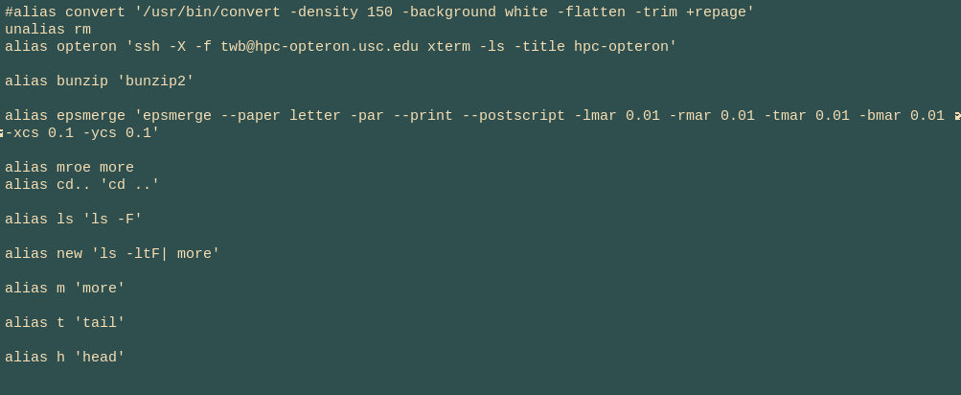
File system:
If you like some options
Use an alias

Slide 35
Editors:
Editing text or ASCII data files
vi(m): old school: fast, efficient, bizarre
  controlled by typing commands like !w, /text
  good for minor editing tasks, required for admins
emacs: best overall tool
  GUI, menus
  flexible, expandable
  Bizarre
gedit: people like it because it's close to Word
tons of others (sublime, atom), but don't use Word or such, since UNIX expects pure ASCII characters

Slide 36
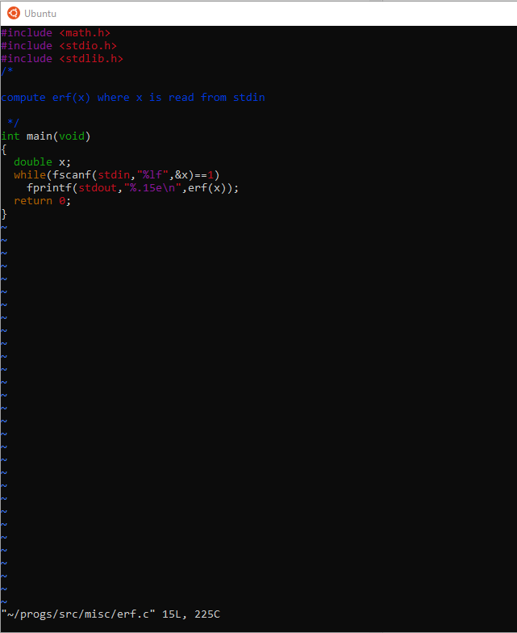
Editors:
What vim looks
like

Slide 37
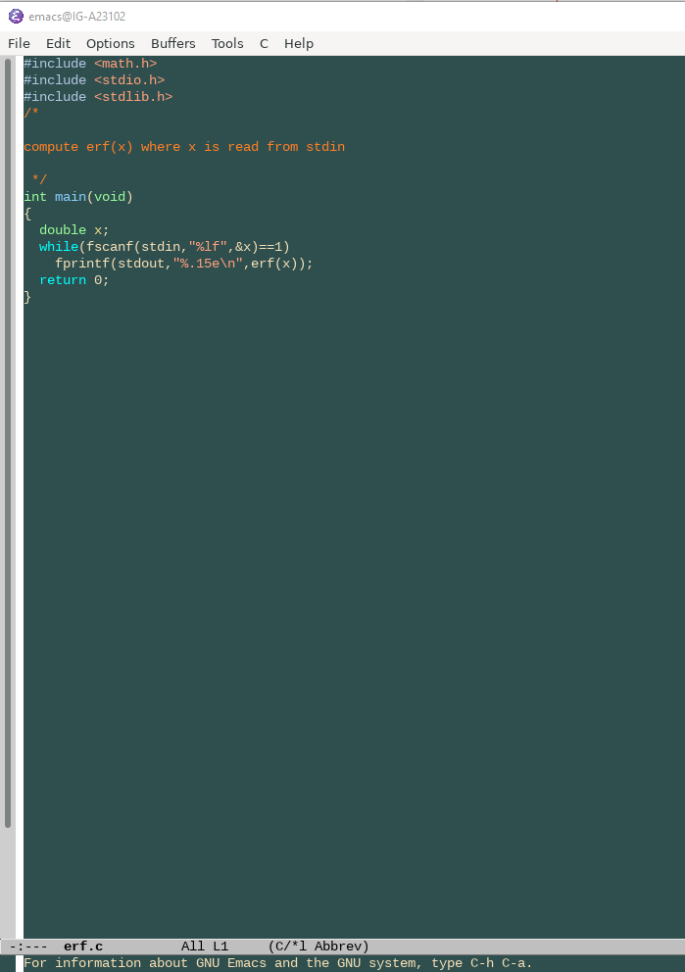
Editors:
What (x)EMACS
looks like

Slide 38
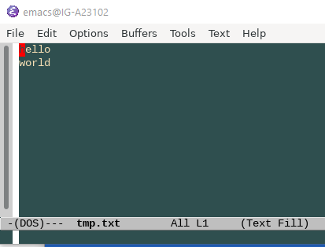
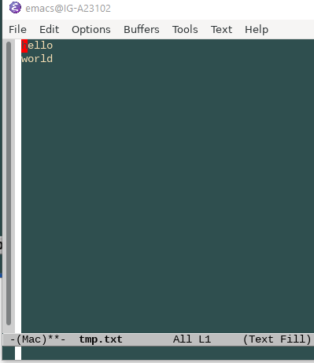
Handling files
Different formats
  dos2unix
  unix2dos
Be careful with CR / return characters

Slide 39
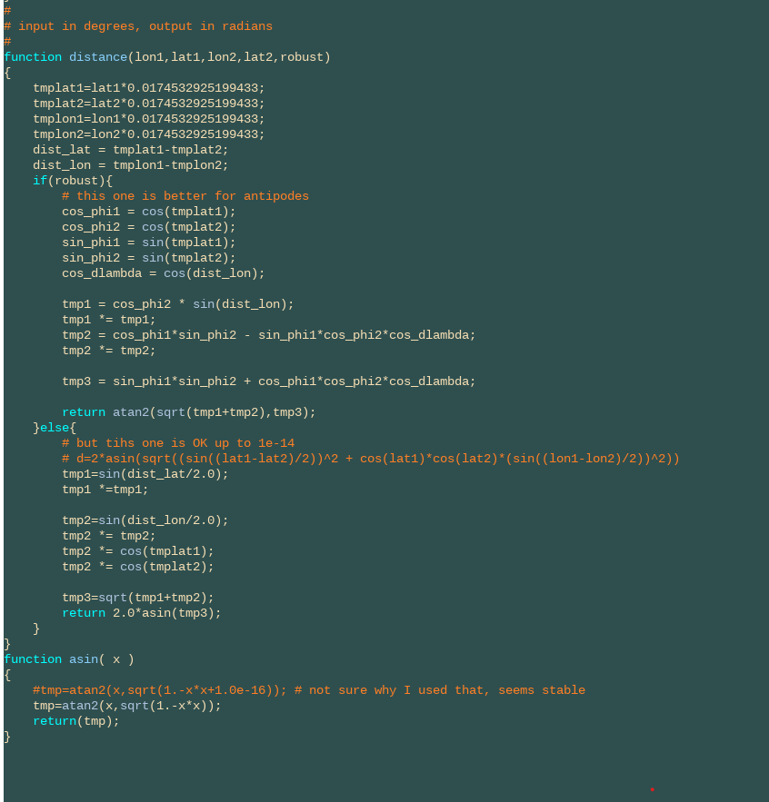
Syntax highlighting

Slide 40
File system:
File system commands I
cp: copy files (will normally overwrite!)
  cp filea fileb
rm: remove files (for real!)
  rm goneforever.dat
  rm -i goneforever.dat
mkdir: make directories
  mkdir new_dir/
  mkdir –p new/newer/newest
cd: change directories (cd ..; cd -; cd ~)
pwd: print current directory

Slide 41
File system:
File system commands II
mv: move one file or directory elsewhere/rename (be careful!)
  mv filea fileb
ln: create (symbolic) links (shortcuts in Windows)
  cd new_dir
  ln -s ../old_dir/script .
  soft vs. hard: deletion of hard link deletes file

Slide 42
UNIX tools: Command line tools
for file management
more, less: display files page by page interactively
cat: display file
head: display first few lines of file
tail: guess
paste: align files with columns row by row
    paste file1.dat file2.dat
wc: count words, lines, and bytes of file

Slide 43
Combining tools: Pipes and redirection (bash example)
>: redirect stdout, <: stdin, 2>: stderr
>>: append, |: pipe
  cat file1.dat > combined.dat
  cat file2.dat >> combined.dat
  cat file1.dat | wc
myconvectioncode.exe < input.dat
echo Whatever! > /dev/null
mycode > log.dat 2> error.dat

Slide 44
UNIX tools: grep and sort
grep: find patterns in file
  grep my_function *.c | more
  grep -ni my_function.*c (disregard case and list line numbers)
diff: compare content of files (see meld)
  diff file1.txt file2.txt
sort: sort row data (careful with convention)
  sort -g +2 file.dat
uniq: only print unique lines
  sort -n splitting.dat | uniq > stations.dat

Slide 45
UNIX tools: awk and sed
(more next session)
awk: (or gawk) powerful language for ASCII data and text manipulations
  like C, interpreted at run time
  the best thing since sliced bread
    cat file.dat | gawk '{print($2,cos($5))}' or
    gawk '{print($2,cos($5))}' file.dat
sed: streaming text editor
  sed 's/Trump/Biden/g' file.dat > new_file.dat
perl: more powerful, more complex (don’t use – might as well use python)

Slide 46
File system:
Using regular expressions
* (all): cp *.dat new_dir/
[pat] (pattern): cp file[1-5].dat new_dir
? (single letter/number): cp file??.dat new_dir
rm -rf * (DON'T TRY IT, IT WORKS)

Slide 47
Shells: The environment
shells: interpret your commands when logged in and using a terminal session
csh, tcsh: nice for interactive stuff, syntax close to C, command completion, auto correction
bash, ksh: nice for programming
shells use mostly same commands, but there are differences in the script languages, e.g.
  export var=100 (bash)
  setenv var 100 (csh)

Slide 48
Experimentation time 3/3
echo a b > file1.txt
echo c b > file2.txt
cat file1.txt
cat file?.txt
grep b file*.txt
ln -s file1.txt file3.txt
diff file1.txt file3.txt
rm file3.txt
diff file1.txt file2.txt
paste file1.txt file2.txt
ls -la
sleep 5
Run the command in the background
using &.
Run sleep 15 in the foreground, suspend
it with Ctrl-z and then put it into the
background with bg.
Type jobs. Type ps.
Bring the job back into the foreground
with fg.
Run sleep 15 in the background
using &, and then use kill to terminate
the process by its job number.
Repeat, except this time kill the process
by specifying its PID.

