Slide 1
Hazard maps and risk mitigation
UT GEO 302P – Spring 2021
Part II – Lecture #7, April 1, 2021
Prof. Thorsten Becker
Reading: Ch. 5

Slide 2
How useful are hazard maps?
Stein et al. (2012)

Slide 3
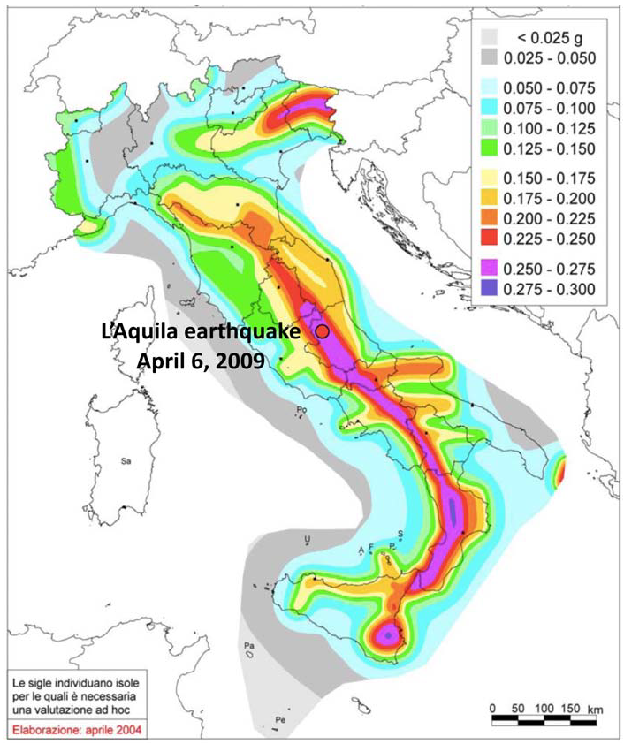
How useful are hazard maps?

Slide 4
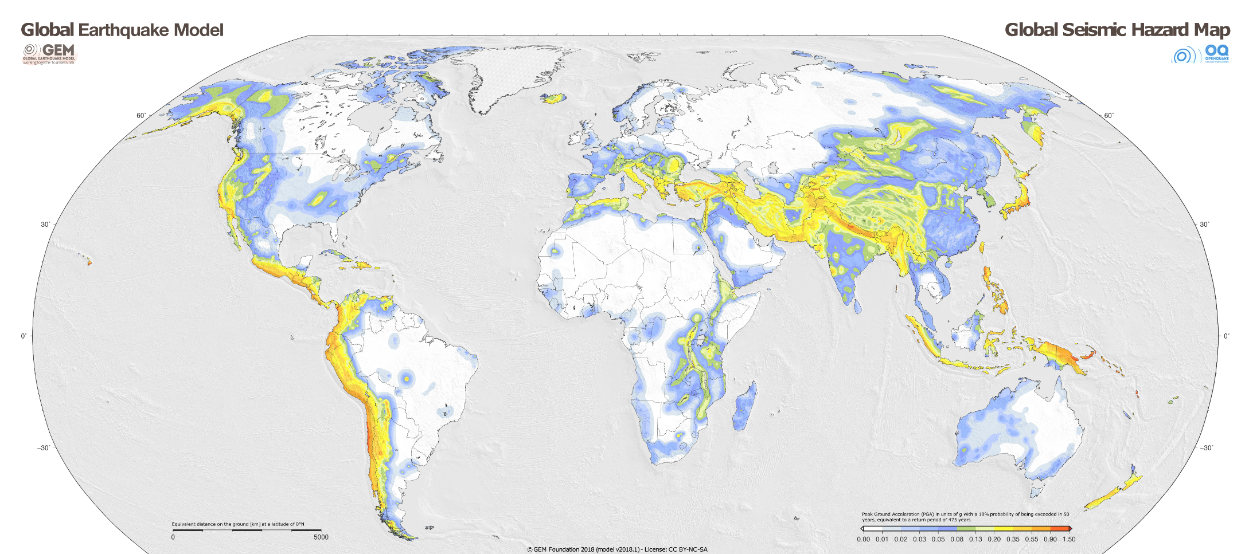

Slide 5
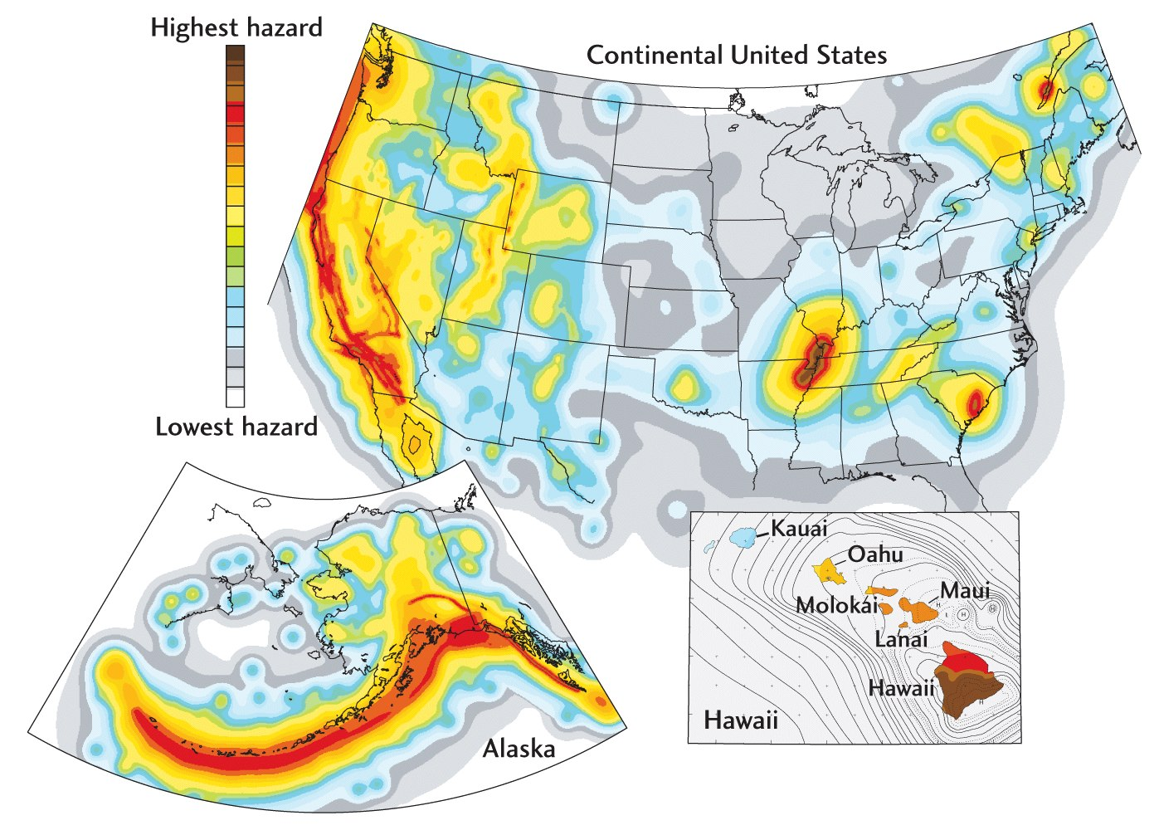
US Hazard

Slide 6
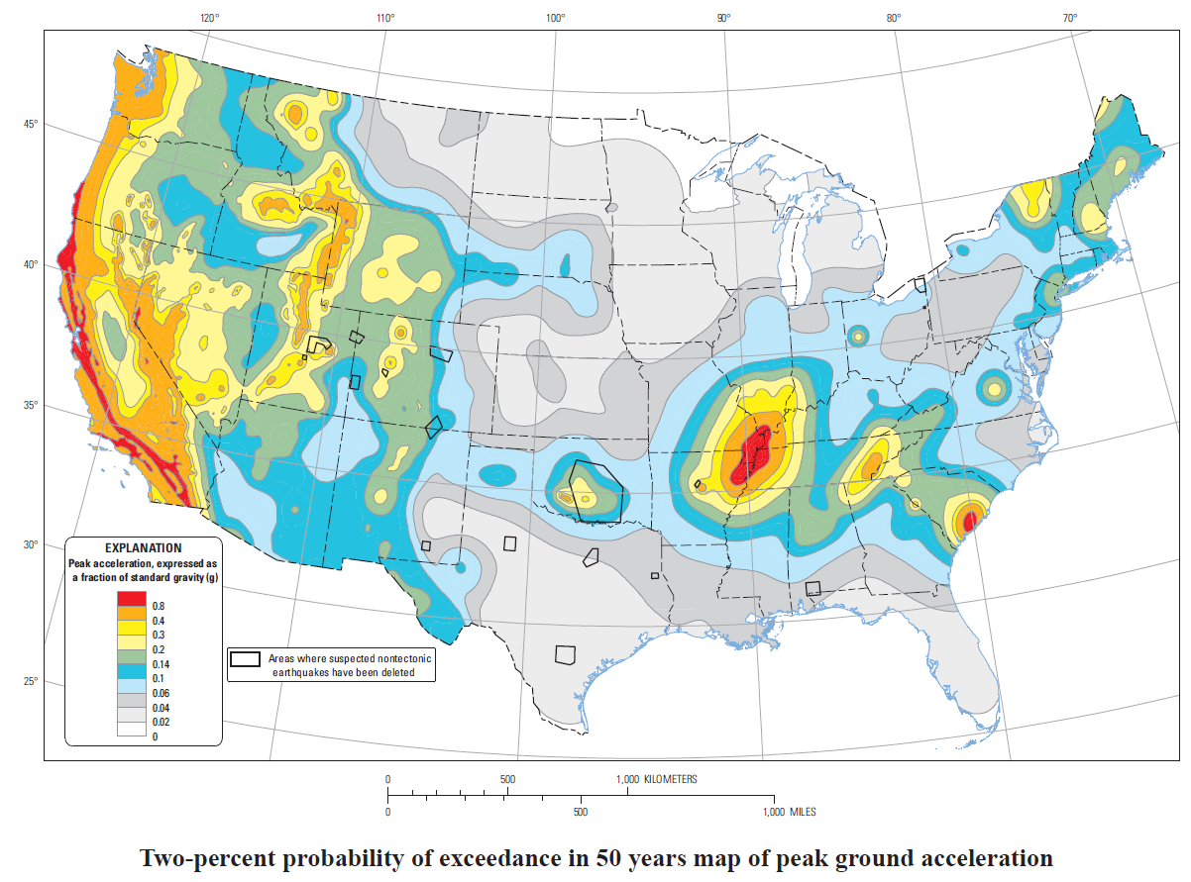
Latest SHA for lower 48

Slide 7
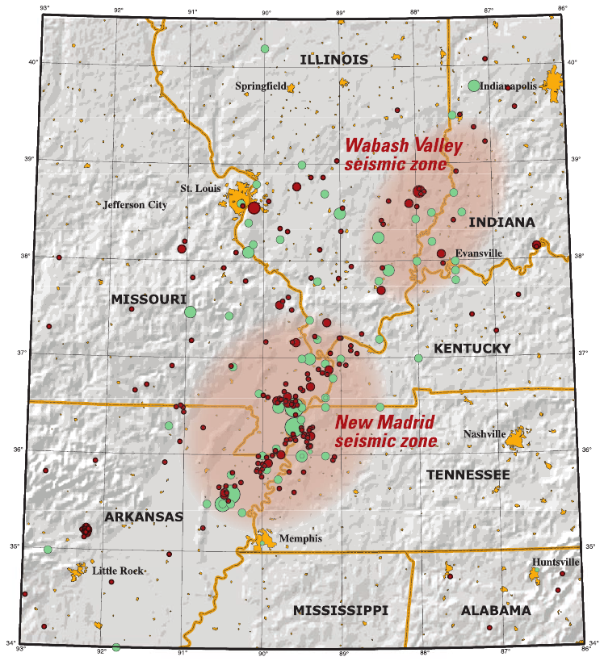
New Madrid seismic zone
1699 – reports of ground shaking
1811 Dec 16 (2:15am) M7.5 in NE Arkansas (rang bells in DC)
1811 Dec 16 (7:15 am) M7 aftershock
1812 Jan 23 M7.3 near New Madrid
1812 Feb 7 M7 near New Madrid

Slide 8
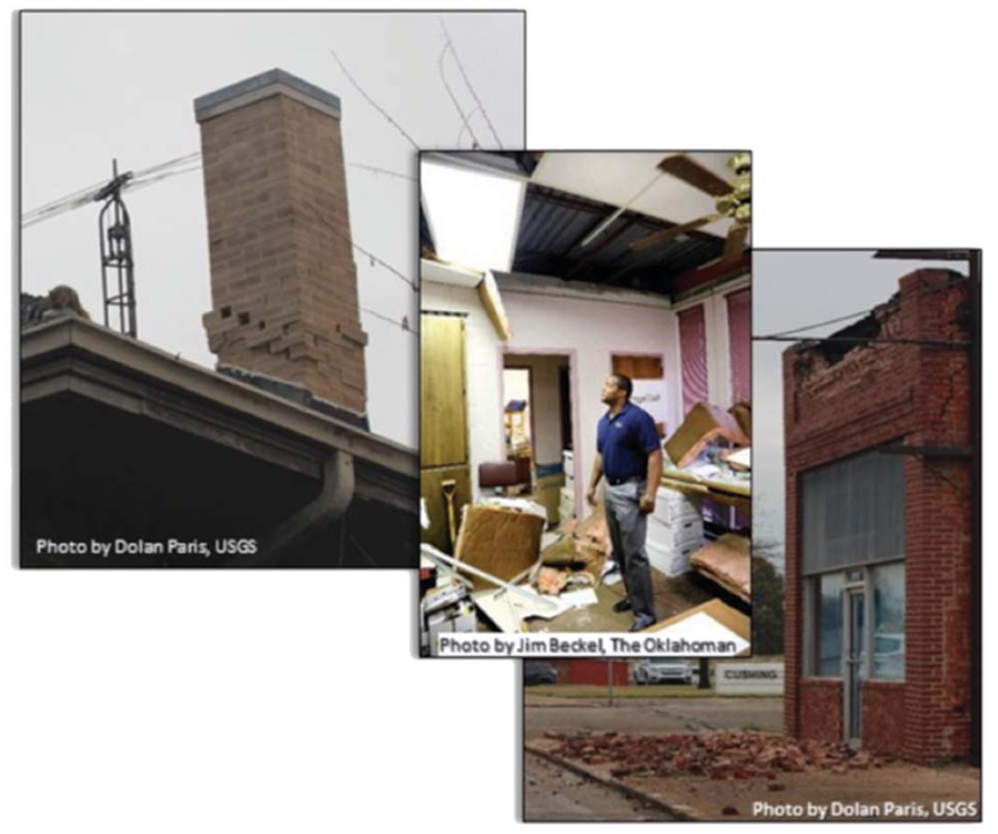
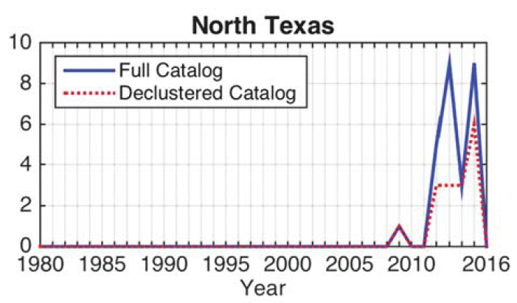
Anthropogenic / induced seismicity
Deep wastewater disposal
Gas storage
Hydrologic fracturing
Cushing OK M5 2016
(Pawnee M5.8)

Slide 9
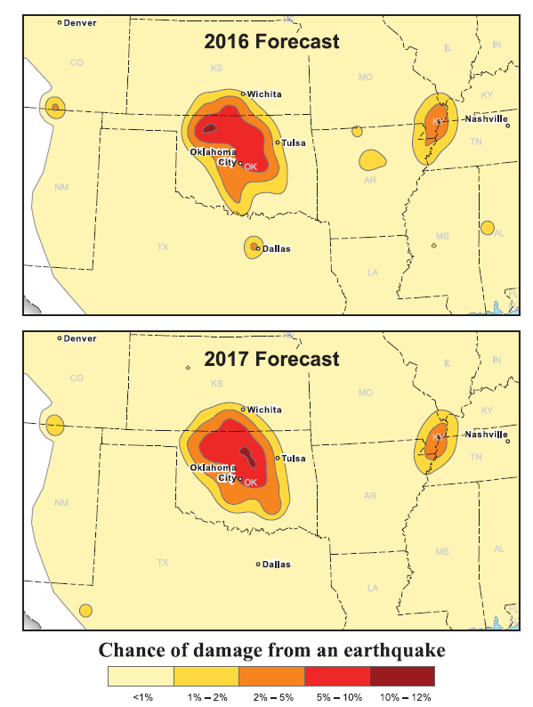
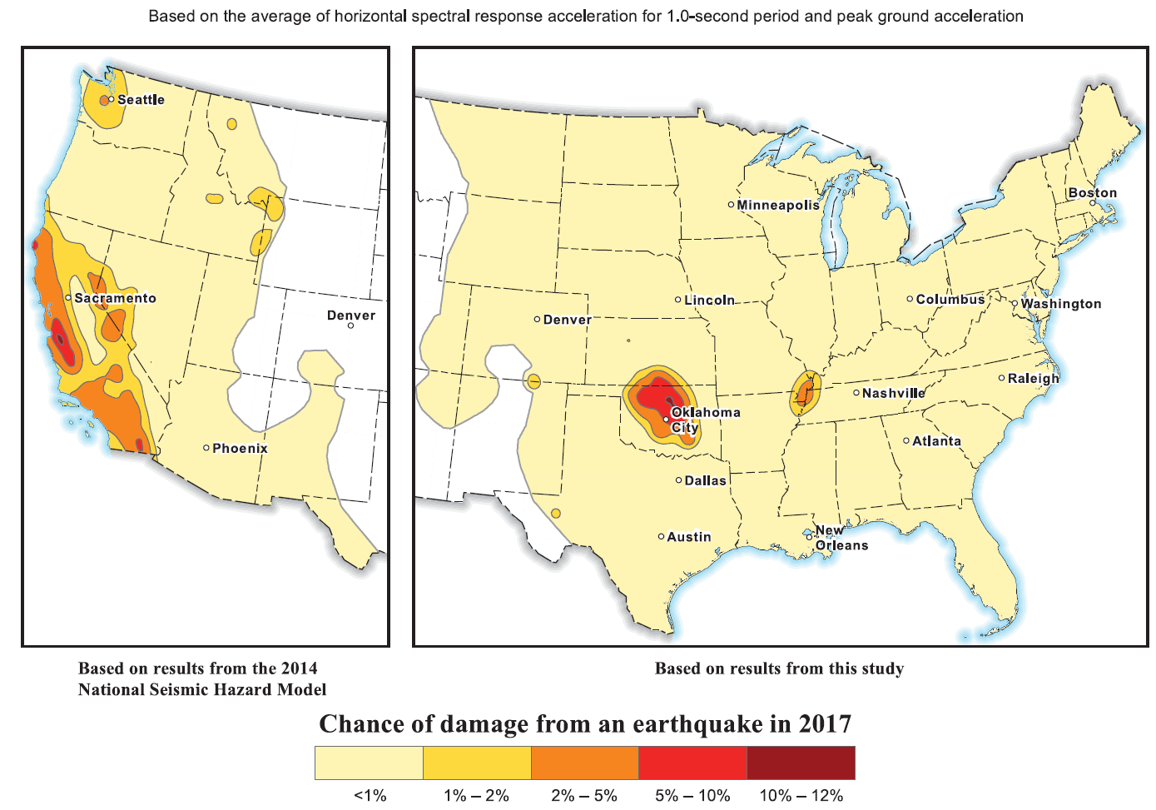

Slide 10
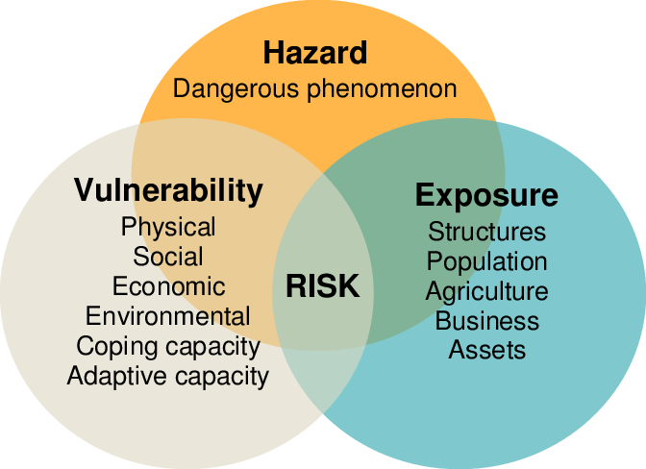
Hazard and risk
Risk = hazard x exposure x vulnerability

Slide 11
Exposure

Slide 12
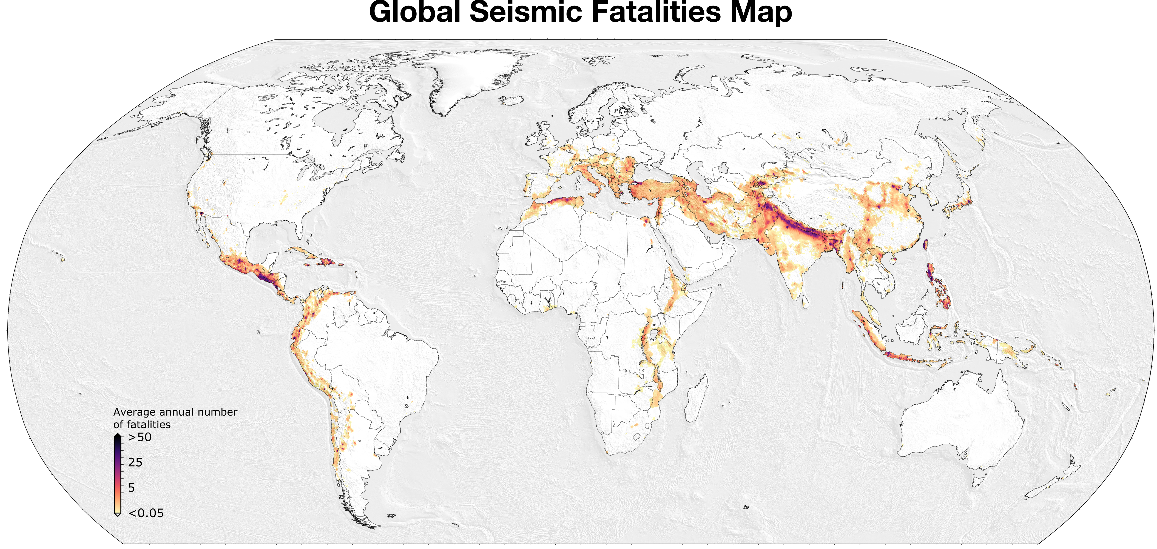
risk = hazard x exposure x vulnerability

Slide 13
risk = hazard x exposure x vulnerability

Slide 14
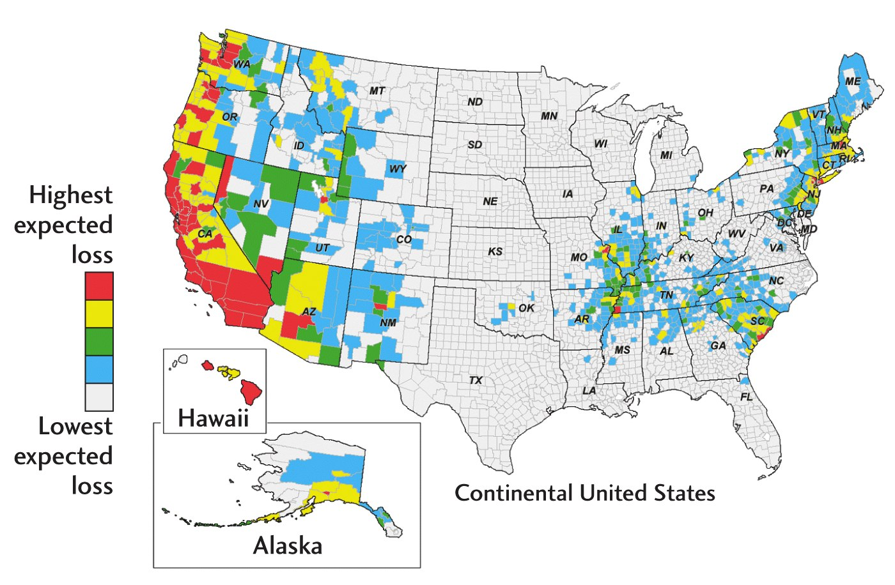
Risk =
Hazard x vulnerability

Slide 15
Risk mitigation:
Earthquake engineering
Earthquakes don’t kill people - buildings do
Earthquake Engineering (EE): The application of civil engineering to reduce life and economic losses due to earthquakes
From an engineering perspective, seismic risk is:
The probability of losses occurring due to earthquakes within the lifetime of a structure
These losses can include human lives, social and economic disruption, as well as material damage

Slide 16
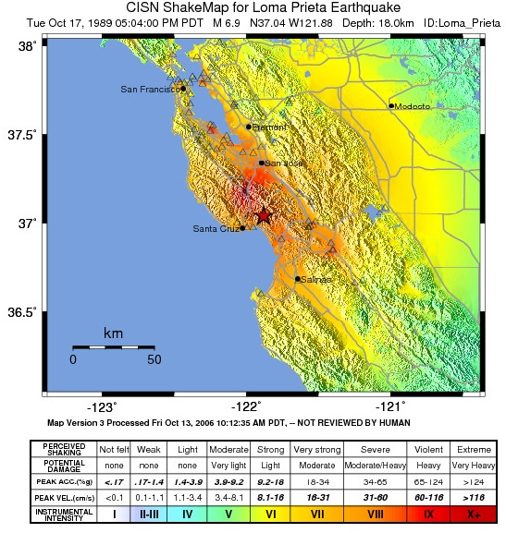
Engineering based on case studies: Building performance for Loma Prieta M6.9, 1989

Slide 17
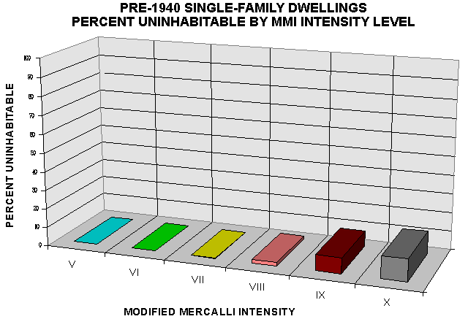
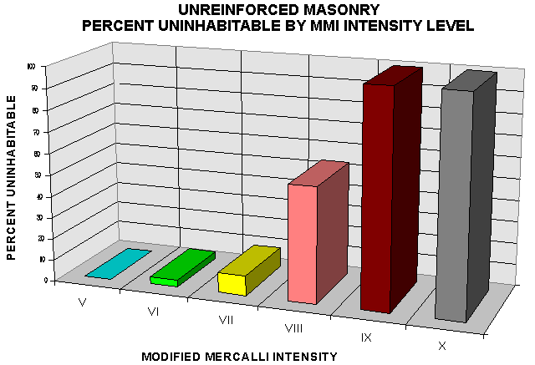
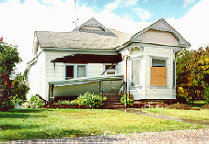
Single storey wood structure

Slide 18
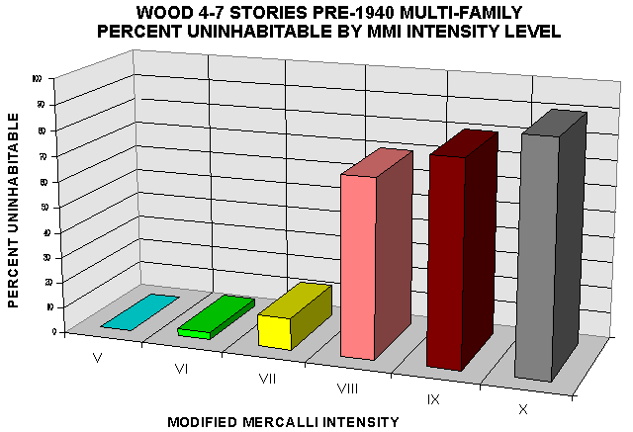
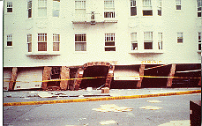
Old multi storey wood structure

Slide 19
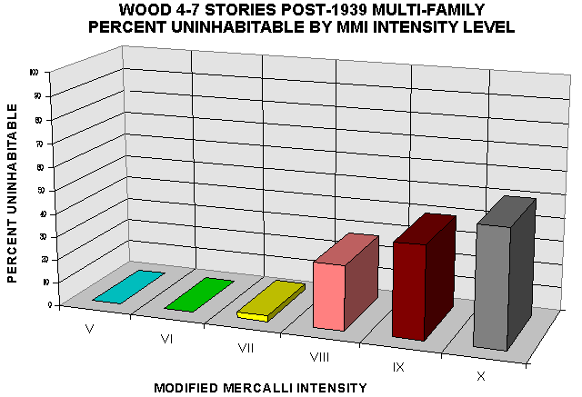
New multi storey wood structure

Slide 20
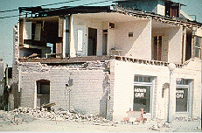
Unreinforced masonry

Slide 21
Lessons from Loma Prieta (and else)
Unreinforced masonry is the worst
Single storey wood can perform well
Building codes work, if they are followed

Slide 22
Potential damage to structures

Slide 23
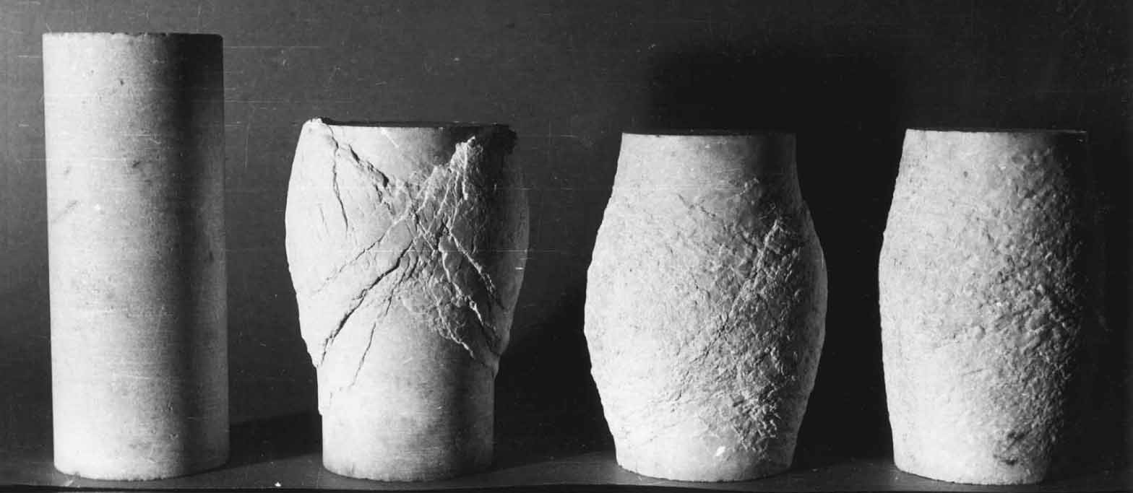
Micro-level: Which material behavior would be preferred in an earthquake?

Slide 24
Sometimes ductile/plastic deformation desired
Large elastic (reversible) deformation may lead to brittle failure (i.e. loss of all strength)
E.g. rebar can strengthen elastic behavior of concrete and postpone brittle failure
Ductile/viscous/plastic deformation take up energy in a dissipative (non reversible) way
Consider rubber band – stretch too much, it yields (but doesn’t immediately snap)

Slide 25
Steel rebar reinforced concrete

Slide 26
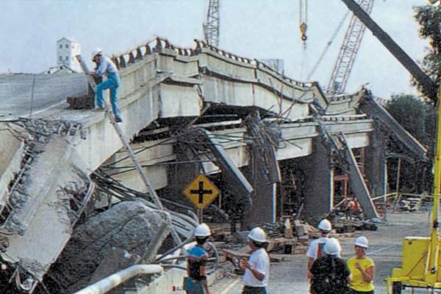
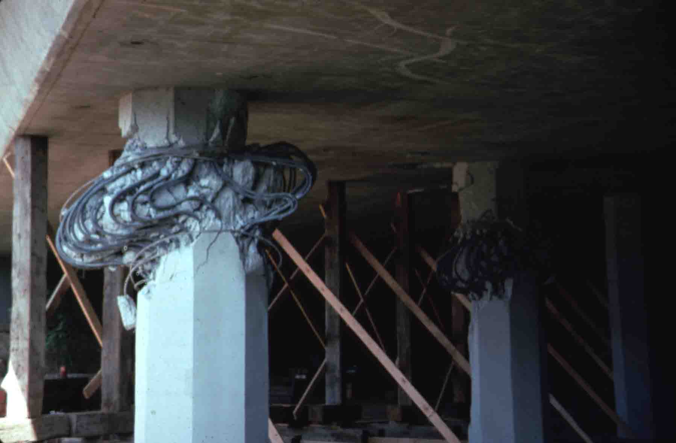
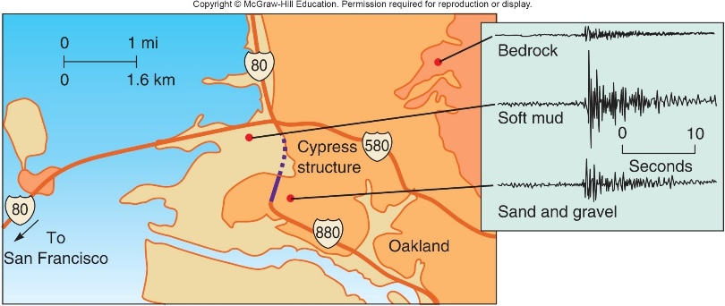
Effect of verticals on concrete columns reinforced with rebar

Slide 27
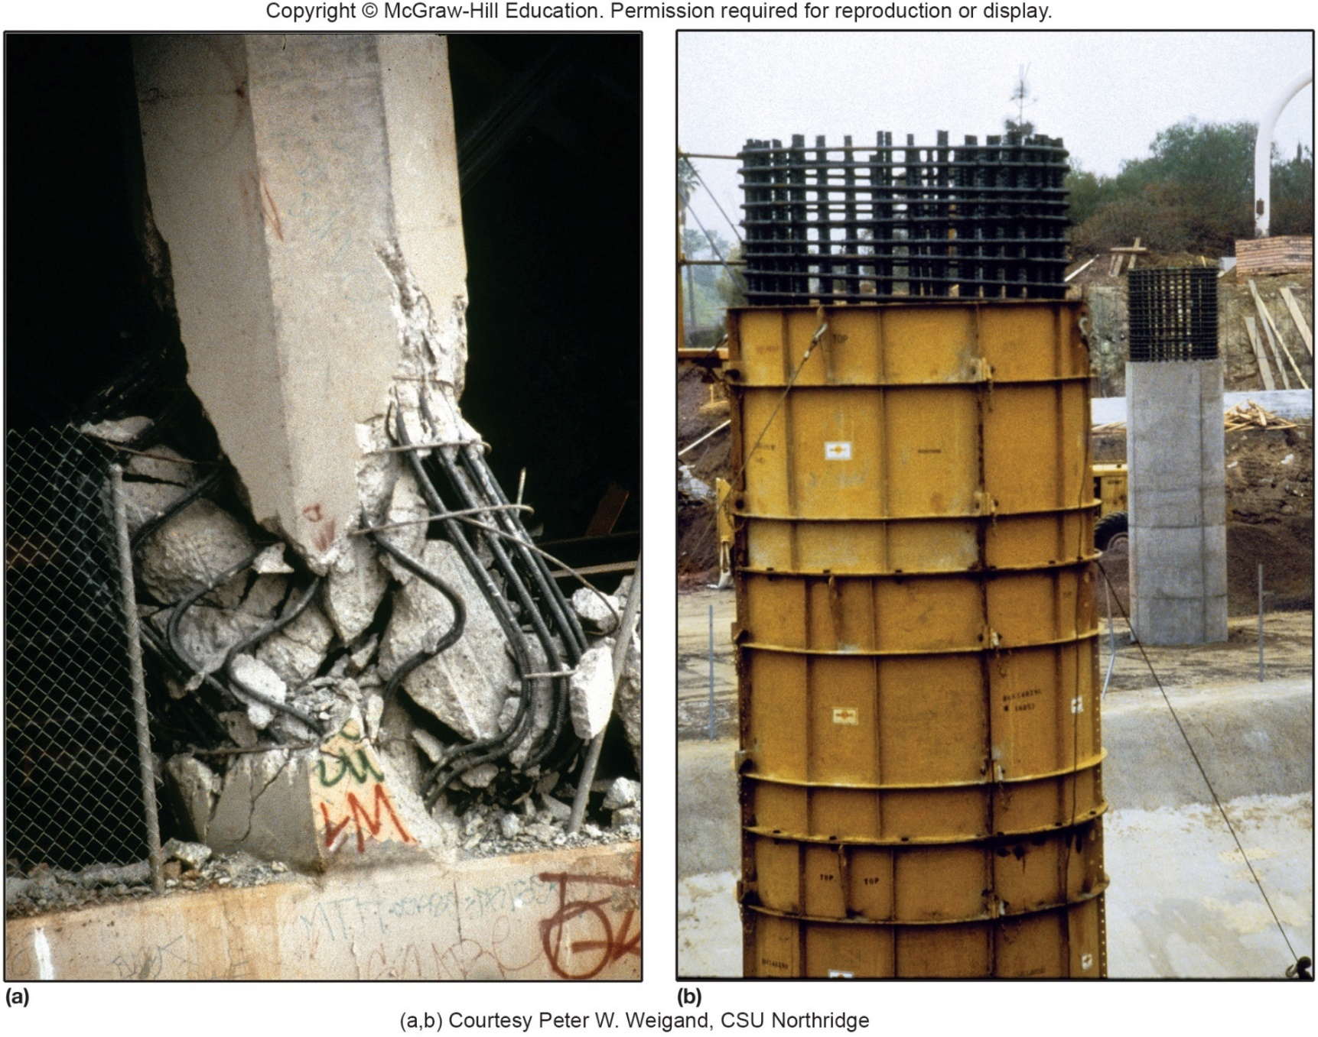

Slide 28
Macro-scale: Fundamental periods and resonance
L
T = period
g = grav. acc.
T = 2π sqrt(L/g)
fundamental period ~ normal frequency ~ eigen frequency

Slide 29
Natural vibrations of a building
Depends on its mass and its stiffness
The period of the fundamental mode of a multi-story building is approximately: T = 0.1 N
T is the period in seconds
N is the number of stories (floors).
The frequency, f, in cycles per second is: f = 1 / T

Slide 30
Consider power spectrum of shaking
Mexico City (M8.1, 1985): medium sized buildings (on soft ground) fared worst, with periods of ~2 s

Slide 31
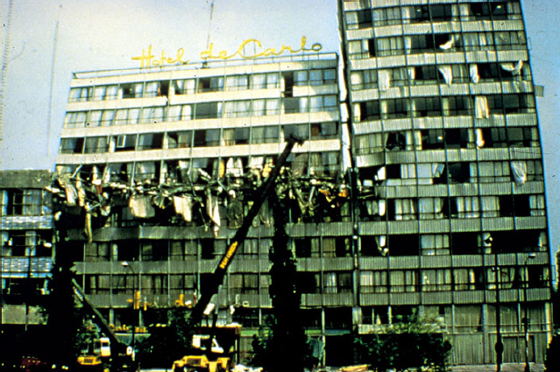
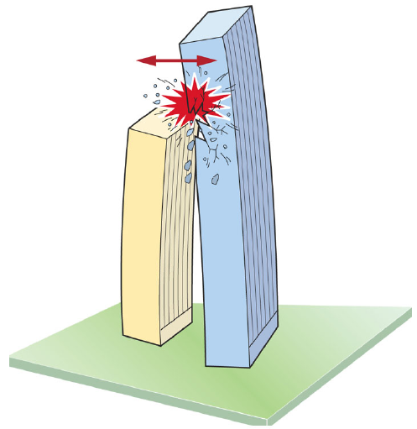
Mismatch of normal modes

Slide 32
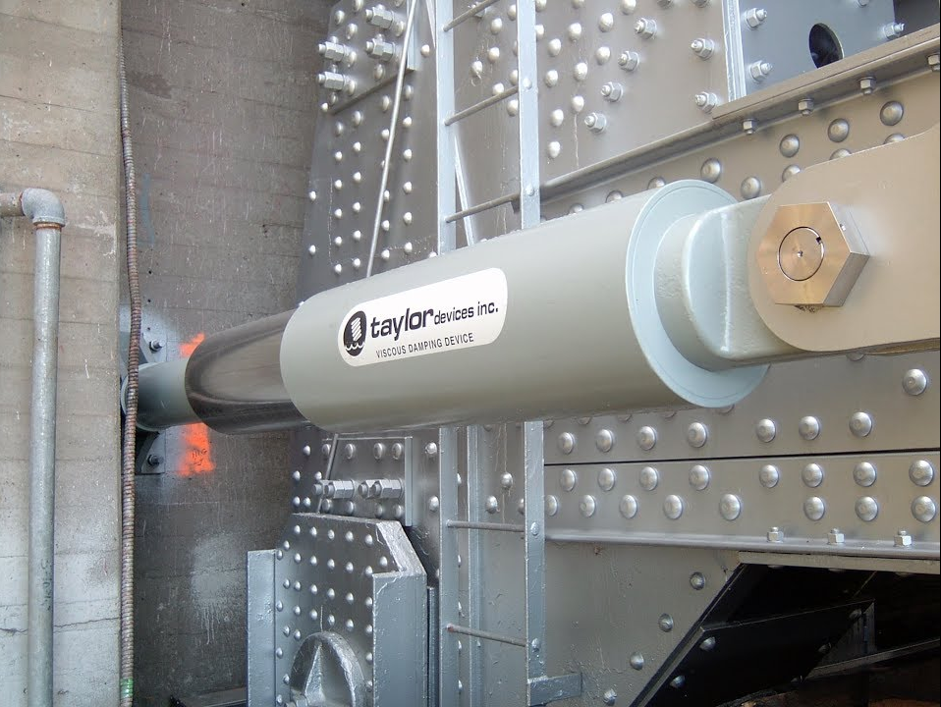
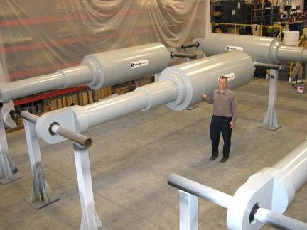

Slide 33
Concepts of EE
Modify coupling of ground shaking to building response
change response stiffness (less shaking, but higher stresses, cf. Hook’s law)
Reduce danger of stress points
Reduce amount of elastic energy by dissipation

Slide 34
Fix problems: Mitigation measures
Wooden structures walking off foundations

Slide 35
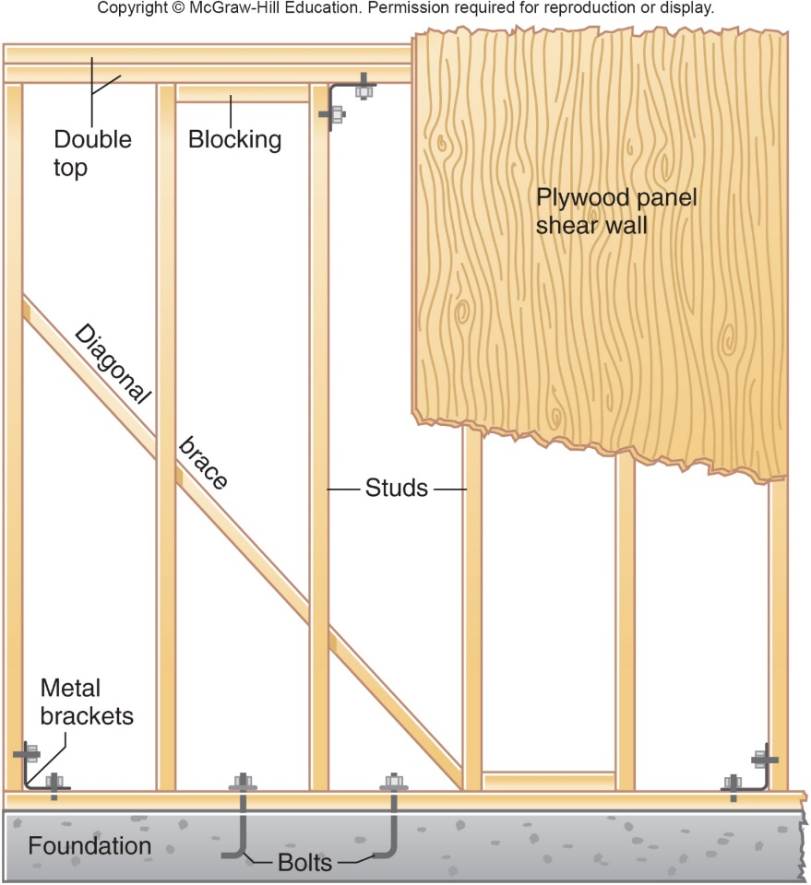
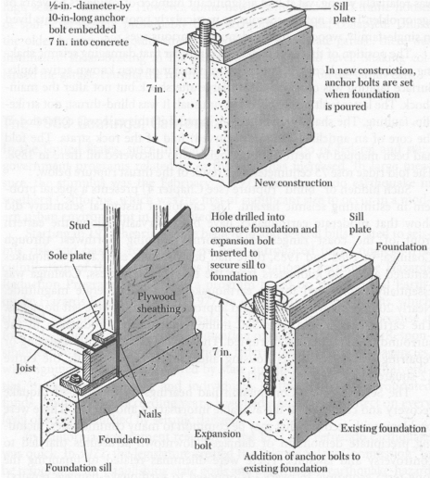
Mitigation measures
Bolting and shear walls

Slide 36
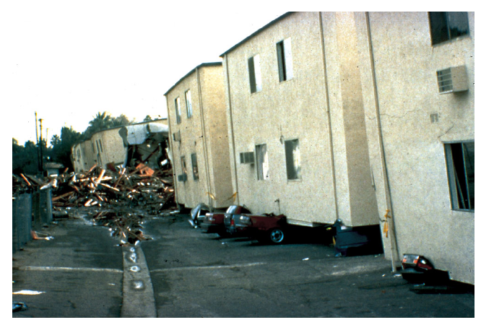
Northridge 1994, Mw 6.9 – Soft storey collapse

Slide 37
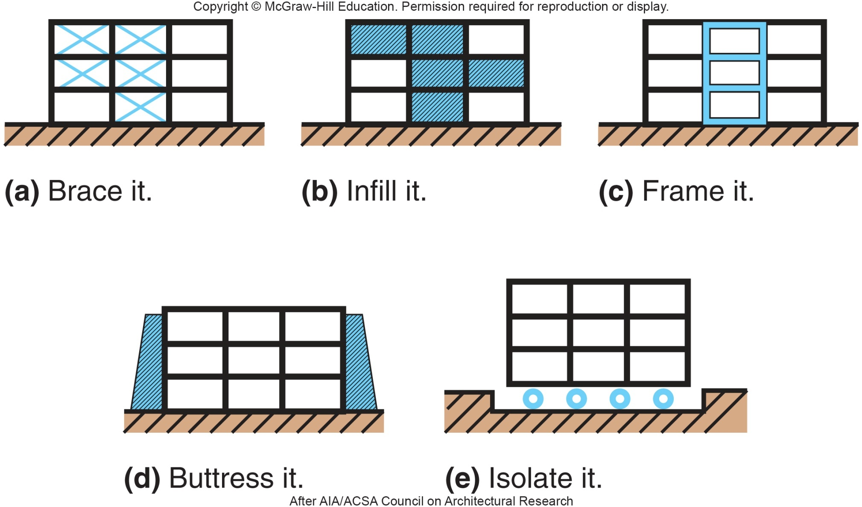

Slide 38
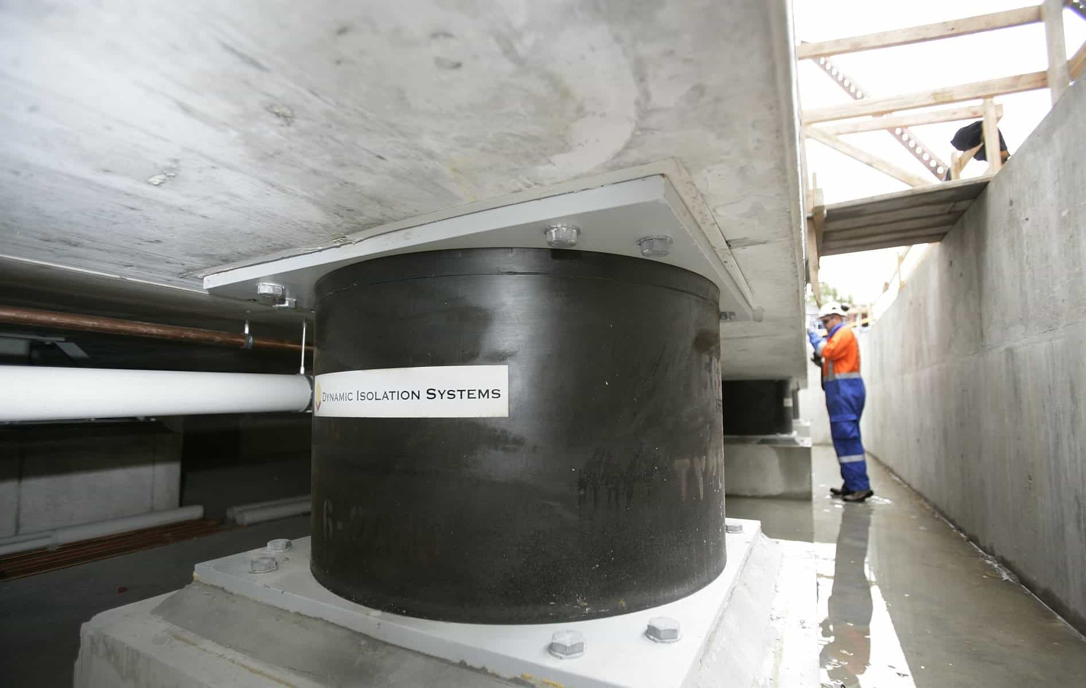
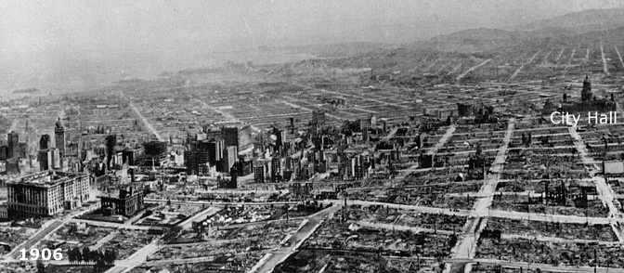

Slide 39
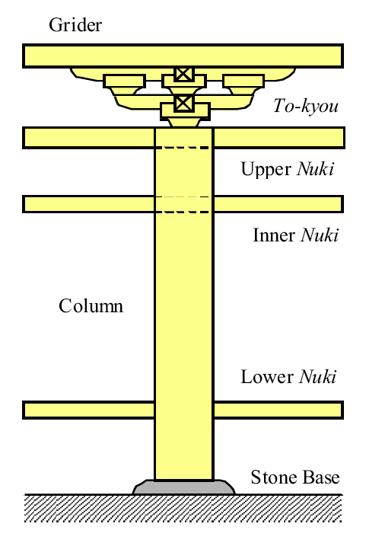
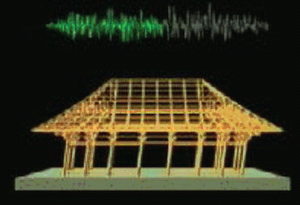
Japanese temple
Columns not attached to bottom
Simple base insulation

