Slide 1
Seismic hazard assessment
UT GEO 302P – Spring 2021
Part II – Lecture #6, March 30, 2021
Prof. Thorsten Becker
Reading: Ch. 4, 5

Slide 2
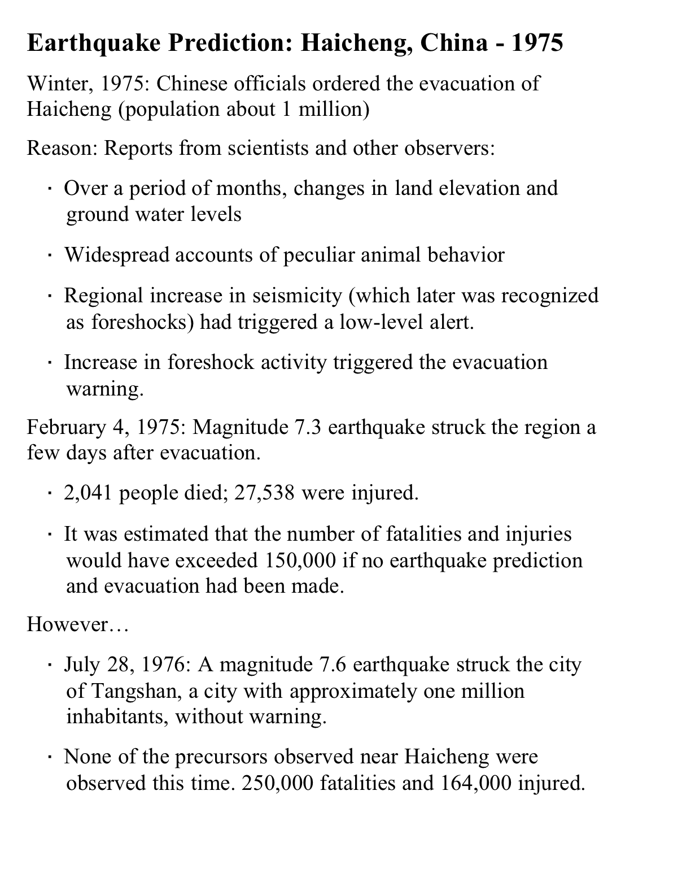

Slide 4
Selected destructive earthquakes in China since then:
2014 Ludian M6.1 600 fatalities
2013 Ya’an M6.9 200 fatalities
2010 Yushu M6.9 2700 fatalities
2008 Wenchuan M7.9 90,000 fatalities
2003 Bachu M6.3 270 fatalities
1996 Lijang M7.0 310 fatalities
1988 Lancang M7.7 1000 fatalities

Slide 5
Dealing with earthquakes
Earthquake prediction
Earthquake early warning (risk)
Seismic hazard assessment

Slide 6
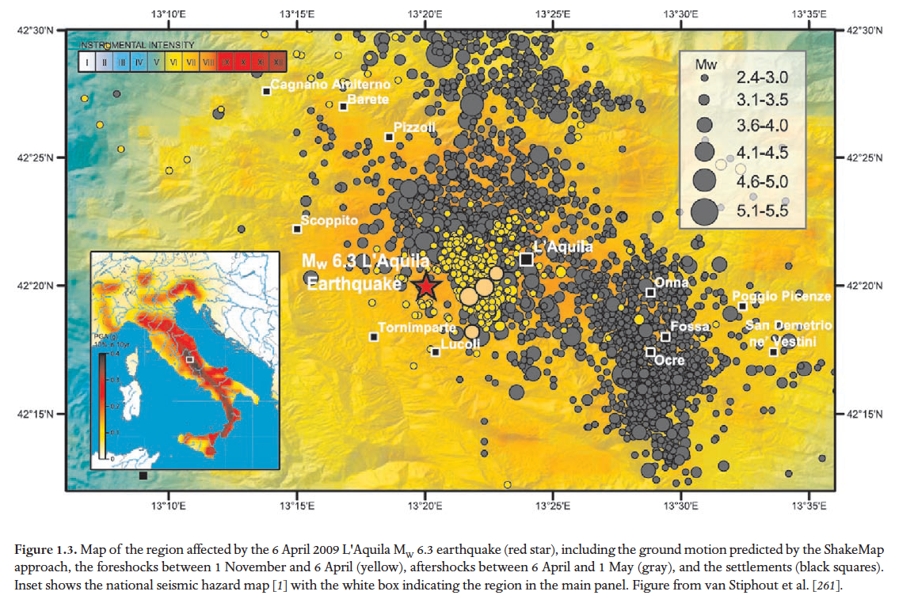
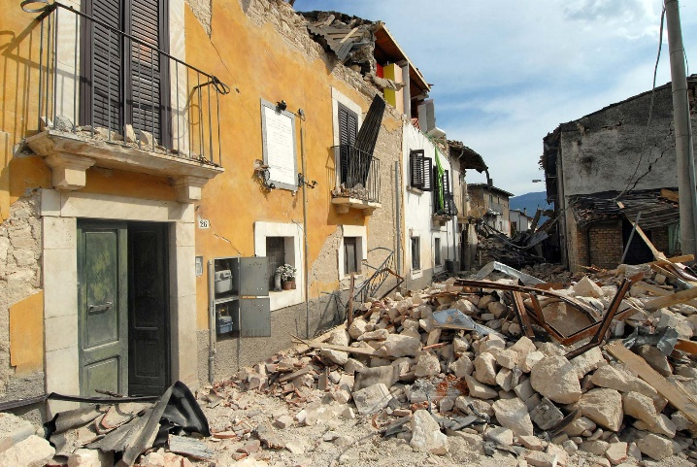
L’Aquila 2009 Mw 6.3, Italy
foreshocks
More than 300 fatalities

Slide 7
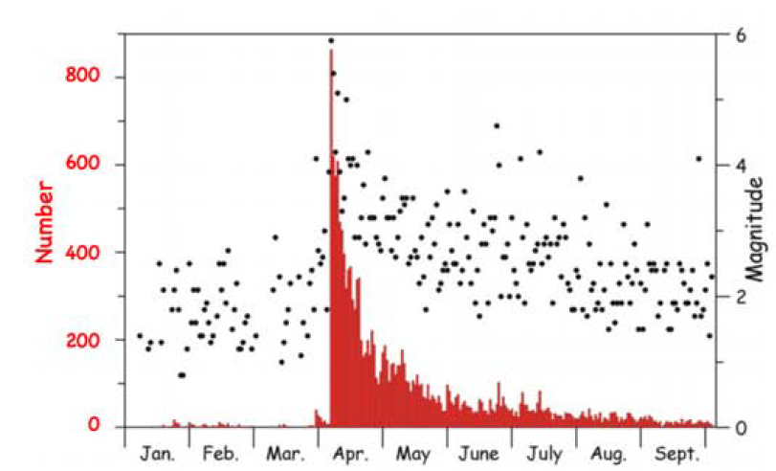
Regional seismicity increase over time ahead of the M6.3 event
foreshocks
aftershocks

Slide 8
What to do with anomalous (?) seismicity?

Slide 9
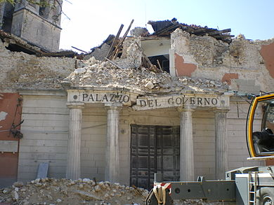
L’Aquila 2009 Mw 6.3
precursory increase in seismic activity (foreshocks), but no warning issued
In 2012, six scientists convicted of involuntary manslaughter for “inexact, incomplete, and contradictory” statements, six years in prison
Sentence overturned in 2014

Slide 10
Earthquake prediction
There have been numerous suggestions for precursory phenomena
  Seismicity increase or decrease before the main event
  Changes in seismic wave speeds
  Animal behavior
  Changes in water levels
  Electro-magnetic signals
  ...
No means of robust spatio-temporal prediction have been found, yet
Earthquake cycle is useful concept, but
  in practice too irregular (see stick slip discussion) to do much for prediction (specific time, place, magnitude),
  helpful for forecast (statistical likelihood)

Slide 11
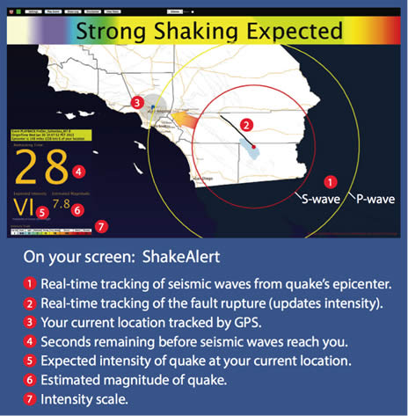
Earthquake early warning
(EEW)

Slide 12
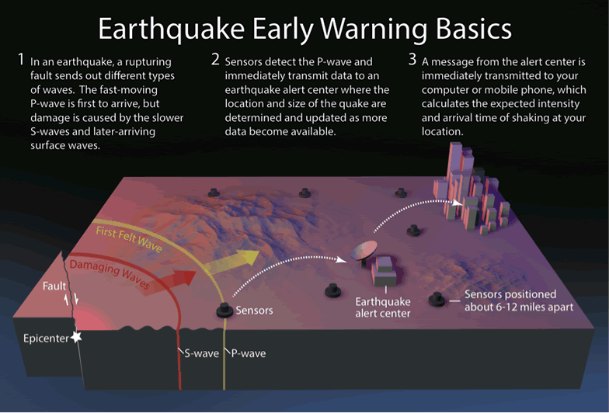
Note: radio-waves faster than
seismic waves!

Slide 14
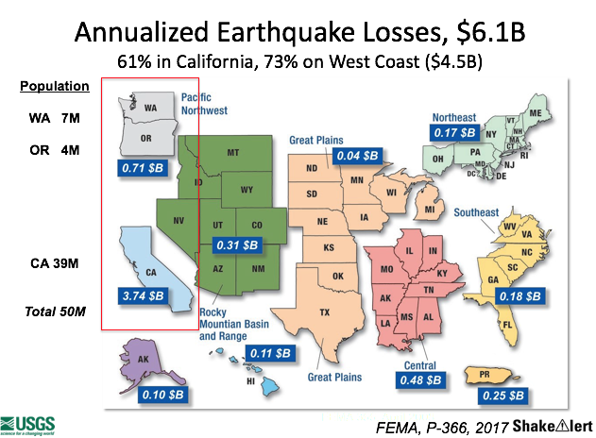
Earthquake Early Warning for the US
Now deployed on west coast of US
Lead times can be short because events of concern are within network (different for Japan and Mexico)
Questions about false positives vs. false negatives

Slide 15
Seismic hazard and forecasting
The exact site and timing and size of earthquakes cannot be predicted, but their likely (in a probabilistic, long term sense) location and occurrence can be assessed
The rough timing (or faults being early/late in cycle) can be estimated based on past earthquake occurrence
This is called a forecast, as opposed to prediction, and is part of a seismic hazard estimate

Slide 16
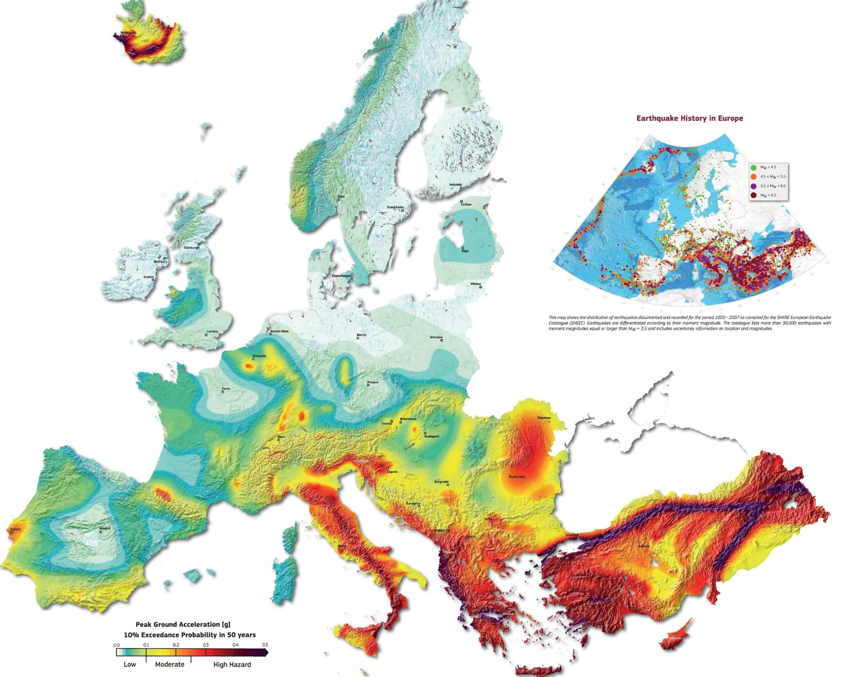
Hazard map for L’Aquila

Slide 17


Slide 18
Seismic hazard assessment (SHA)
We seek a statistical statement such as
    “the probability of exceeding 50% of g in 50 years is 1%”
This requires
  Earthquake generation (fault activity) model
  Earthquake effects model

Slide 19
1)How do we estimate the statistical likelihood of an earthquake for a given region?
Desired statement is roughly
  At location x,y,z we expect N earthquakes of size M per 50 years.

Slide 20
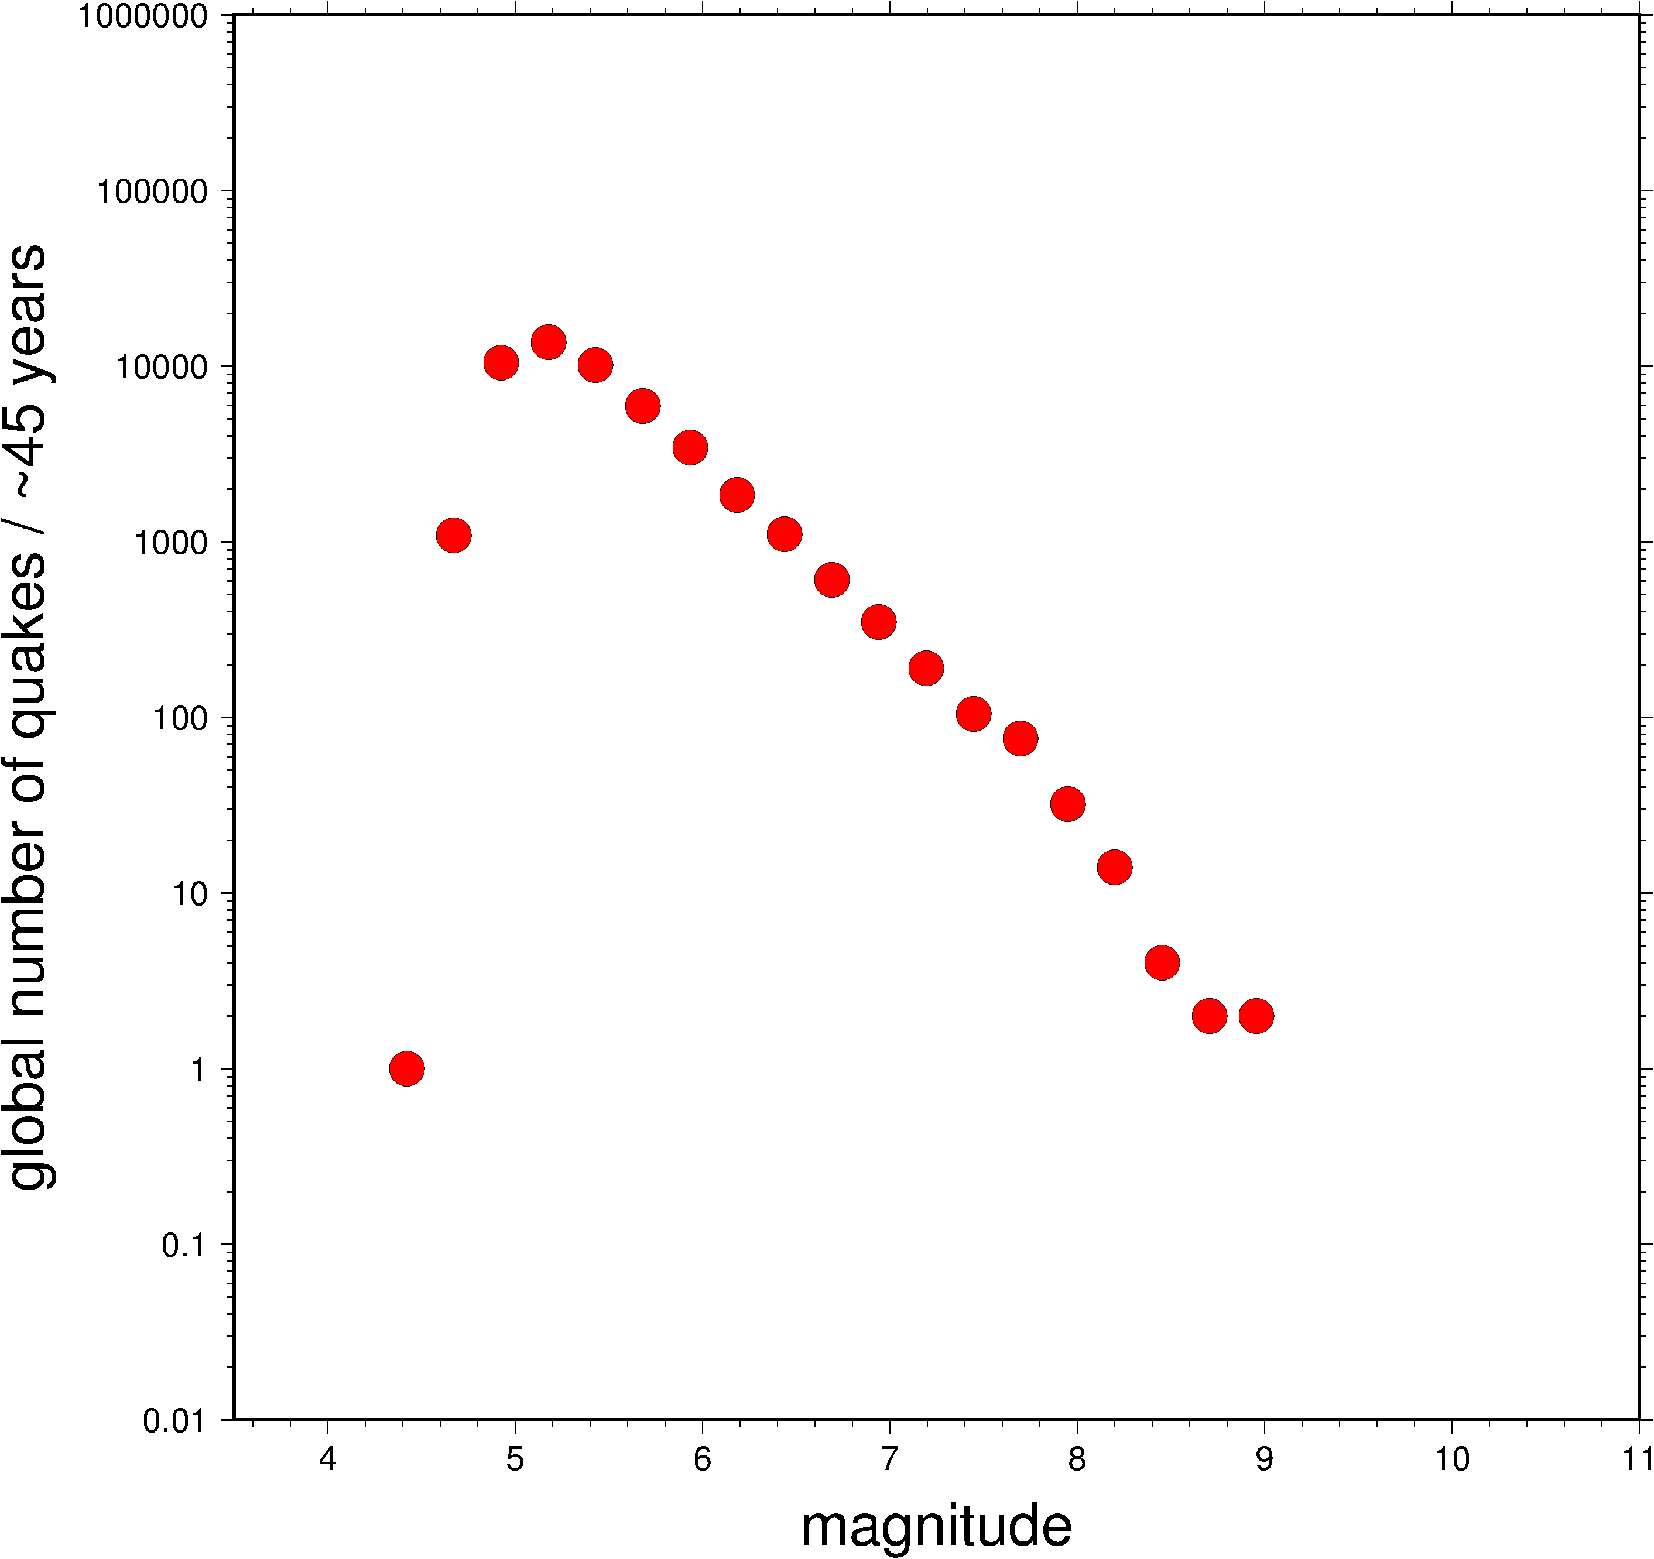
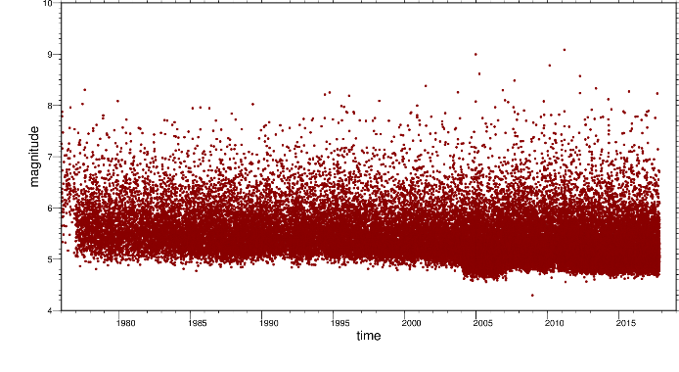
Time-independent earthquake rates:
Magnitude -frequency distribution
Global earthquake catalog since 1976

Slide 21
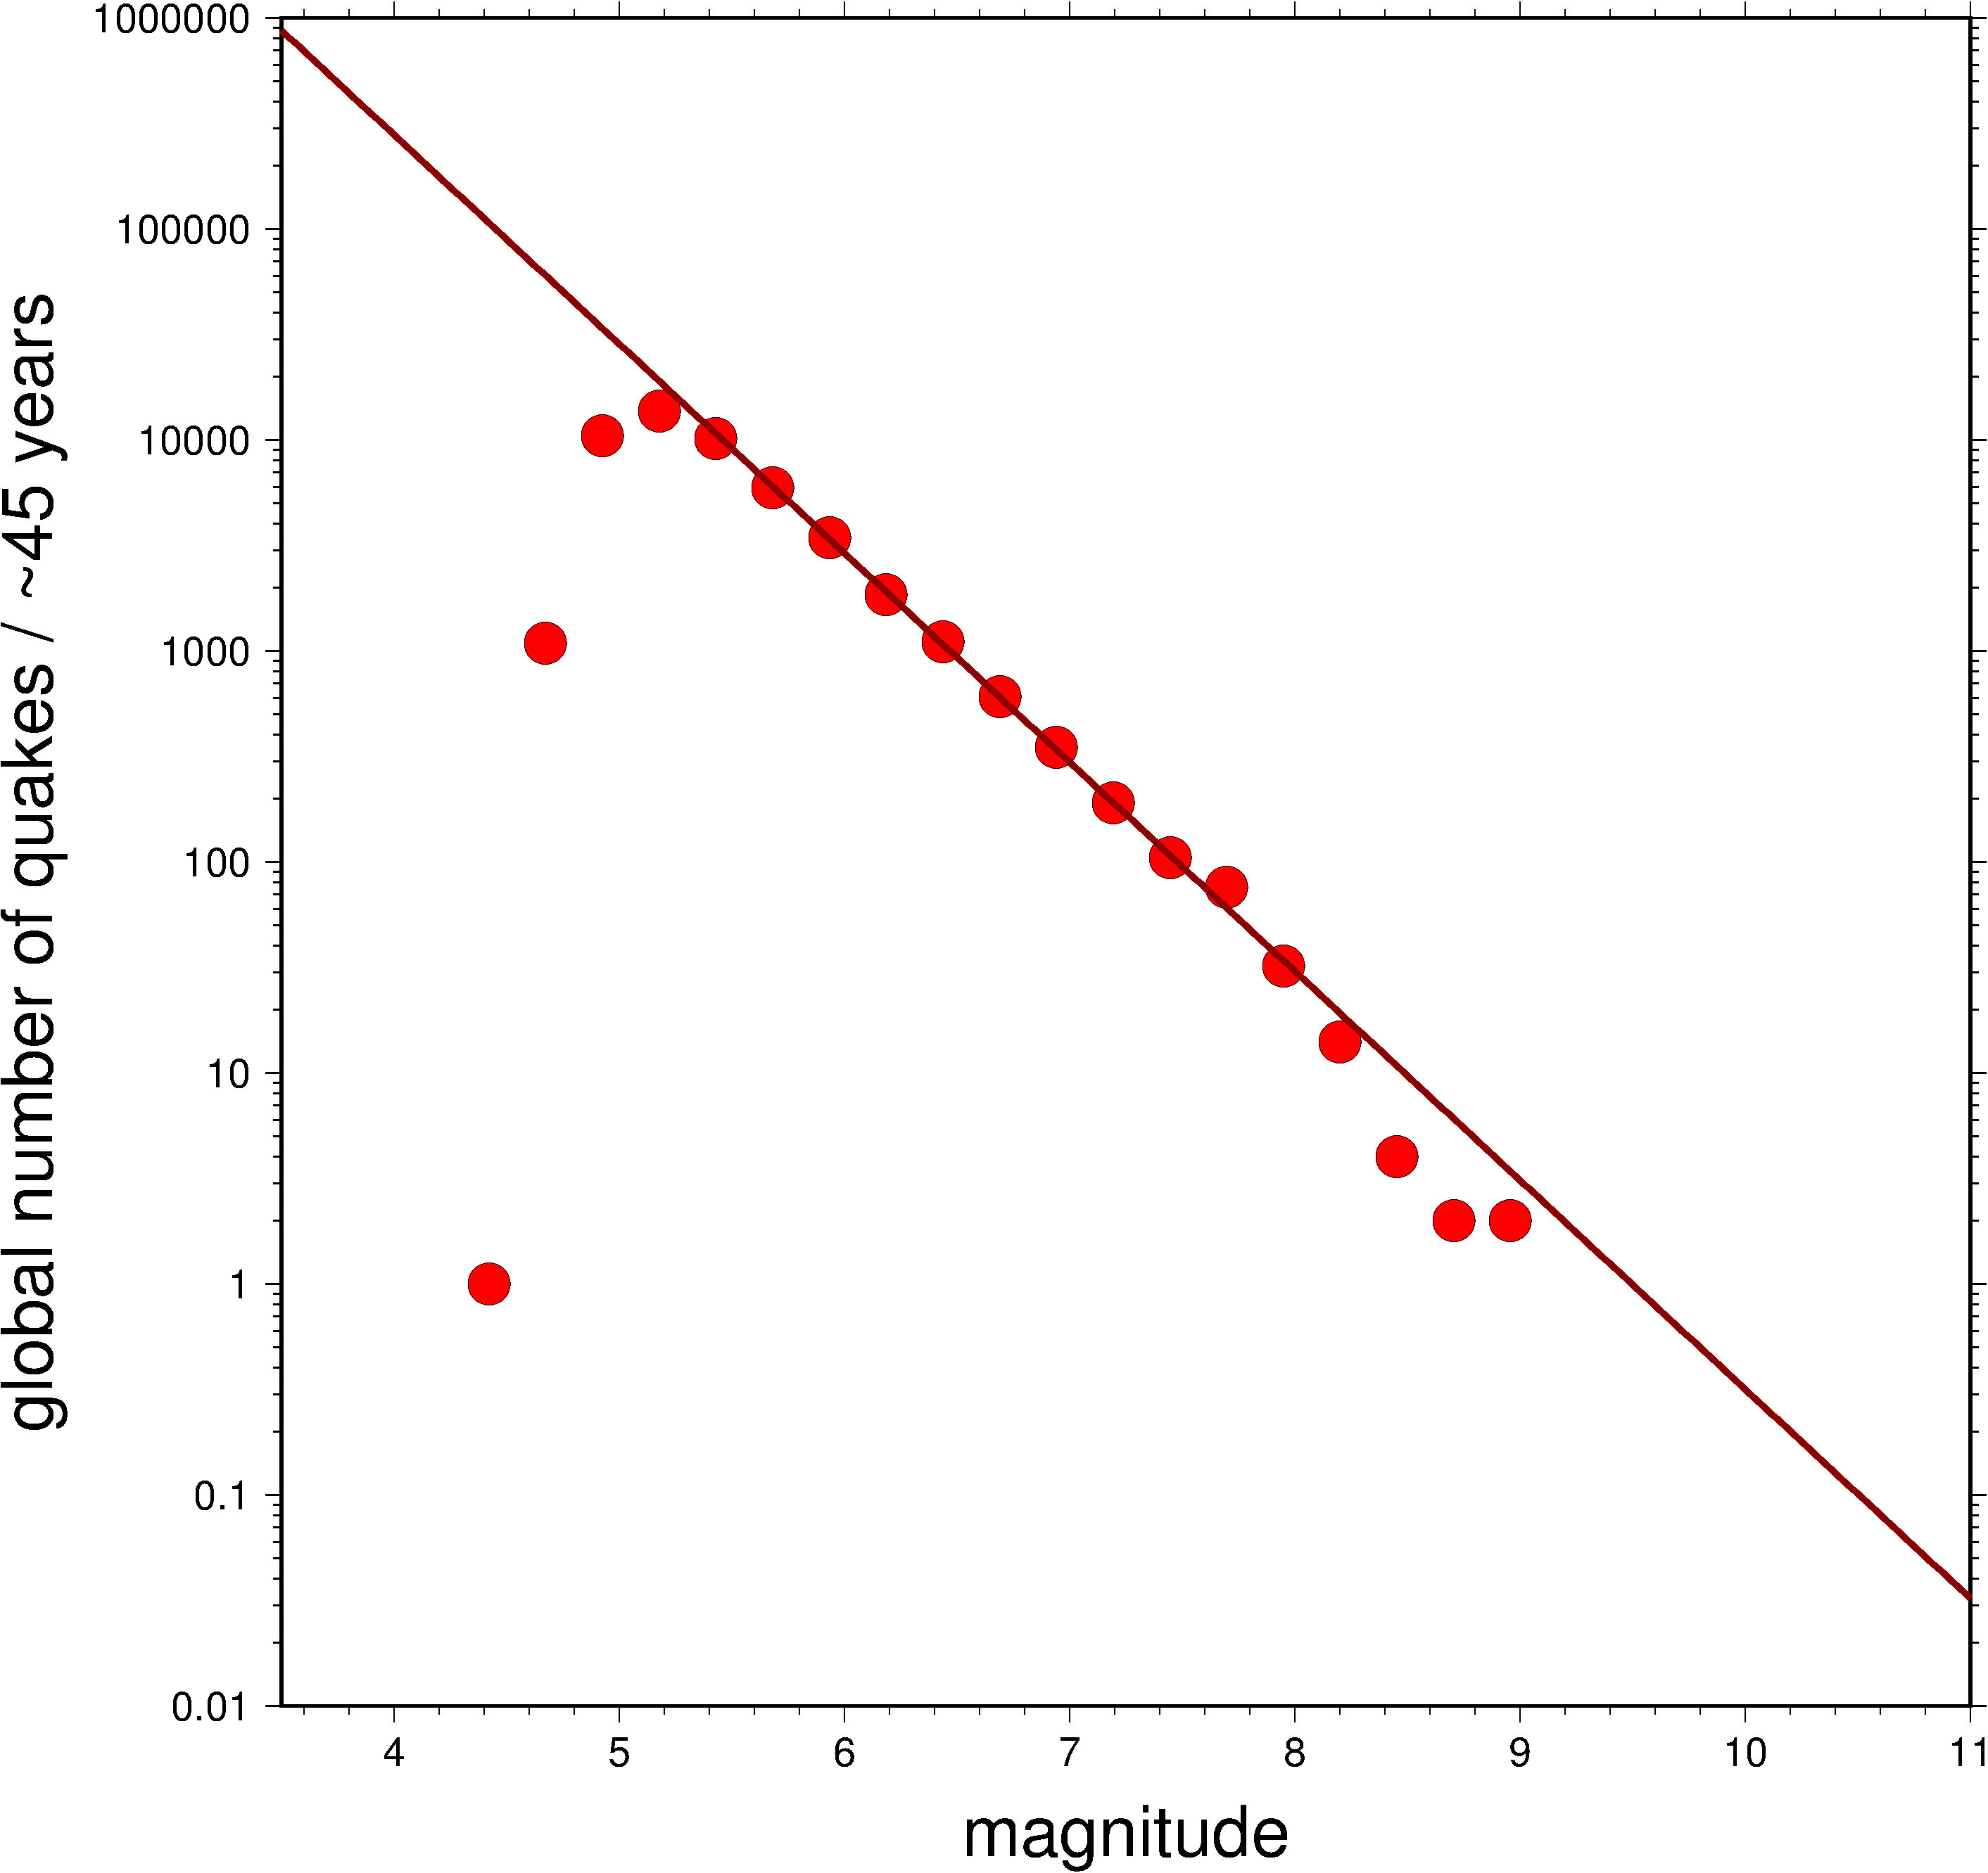
Gutenberg
Richter (GR) law
“b value” = − 0.99
Global earthquake catalog since 1976

Slide 22
Is the GR relationship universal, stationary, and without bounds?

Slide 23
Upper bound on the GR distribution
Largest earthquake
  fault area A (= W L)
  Seismic moment: M₀ = μ A u = μ W L u
  Shear modulus: μ (~100 GPa)
  Length: L ~ 2 π × 6371 km (circumference of Earth)
  Width: W ~ 100 km (lithosphere)
  Slip: W (vast overestimate, more like 10⁻⁴ L)

Slide 24
Upper bound on the GR distribution
Largest possible earthquake is roughly magnitude ~ 10
  M₀^{max}
    ~LW² μ
    ~2 π 6371 km x (100 km)² x 100 GPa ~ 4 × 10²⁸ Nm
  M ^{max} = 2/3 log₁₀(M₀^{max}) – 9.1 ~ 9.97

Slide 25
Bounds on the GR distribution
Largest earthquake
  L ~ 2 π × 6371 km (circumference)
  W ~ 100 km (lithosphere)
  u ~ W
  M^{max} = 2/3 log₁₀(M₀^{max}) – 9.1 ~ 10
Smallest earthquake
  Unclear based on physics, perhaps GR continues to M = −4
  In practice, completeness of network detection usually limited to M > 2 or so
  Completeness is spatially variable

Slide 26
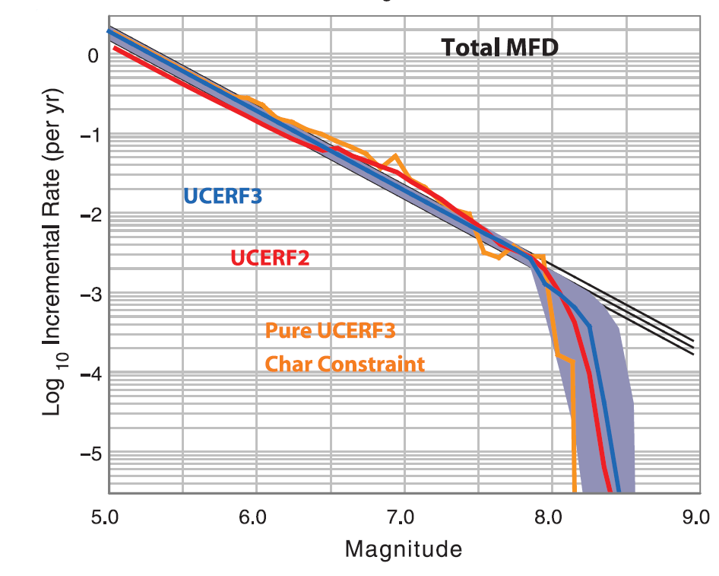
Time-independent California earthquake hazard models based on Gutenberg Richter
estimates
of maximum
event for region

Slide 27
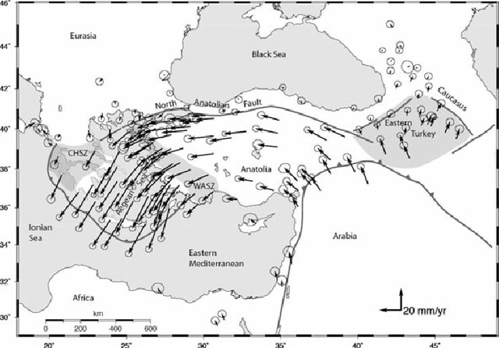
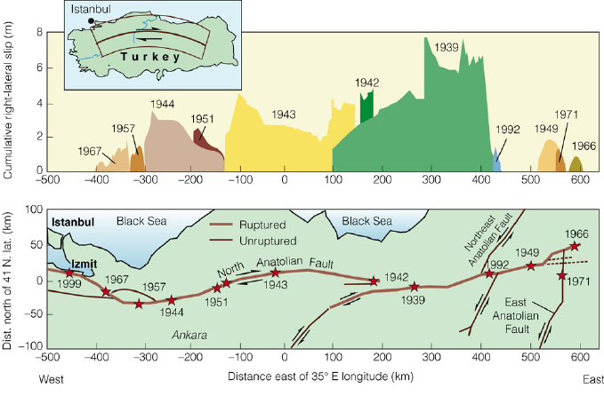
Time-dependent hazard:
Seismic gaps and fault slip deficit
GPS determined long term plate motions
Earthquake slip in the historical record

Slide 28
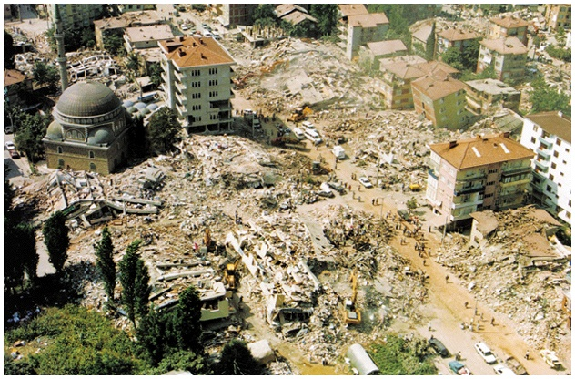
Westward progression of earthquakes along North Anatolian Fault
Closing Seismic gaps and catching up to slip deficit
M_{w} = 7.6, 1999 Izmit

Slide 29
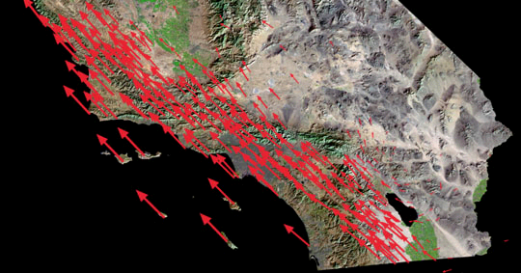
Use GPS to determine smaller scale fault slip rate (loading), not just single plate boundary
partitioning of 37 mm/yr across five faults

Slide 30
Time-dependence:
Seismic cycle along plate boundary
An example computation:
M7 Earthquake has typical slip of ~5 m
Plate on one side of fault moves with 5 cm/yr with respect to other side of fault
Recurrence time of earthquake should be what?

Slide 31
Time-dependence: Estimating recurrence times
Velocity = distance / time
Time to accumulate distance = distance / velocity

Slide 32
Time-dependence: Estimating recurrence times
Velocity = distance / time
Time to accumulate distance = distance / velocity
Seismic recurrence period = slip / velocity
  T = 5 m / (5 cm/yr) = 1 m / (0.01 m/yr)
  T = 100 yr

Slide 33
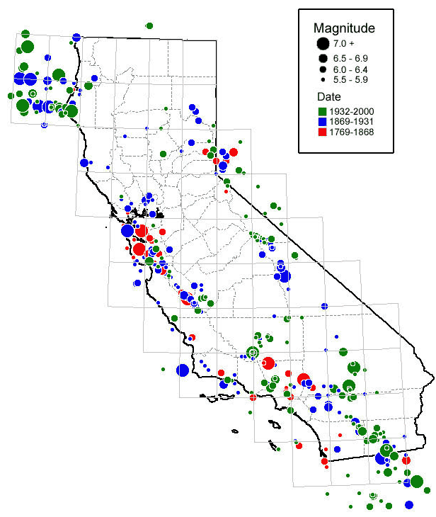
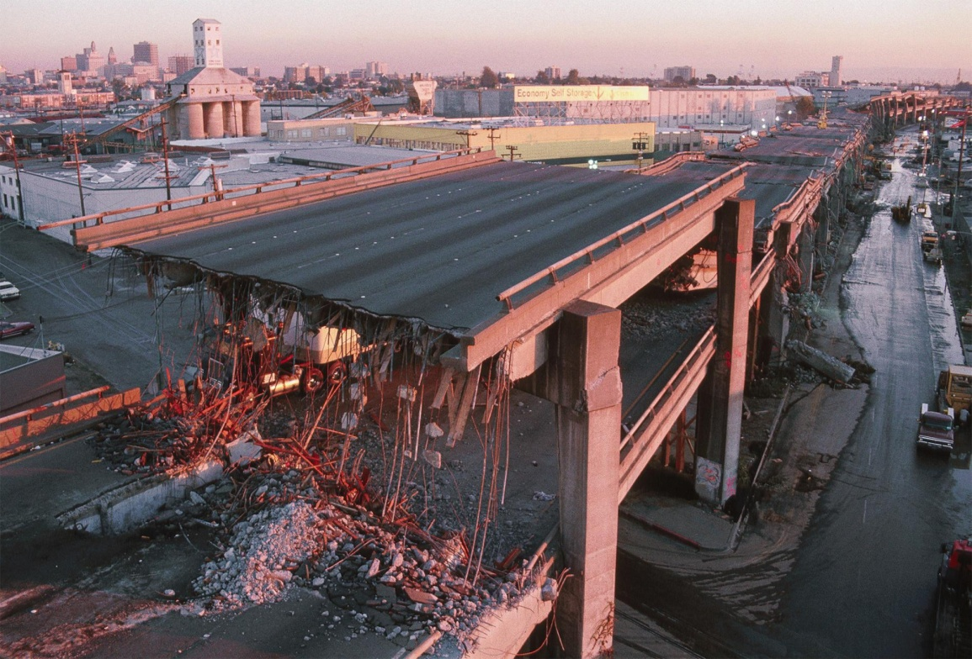
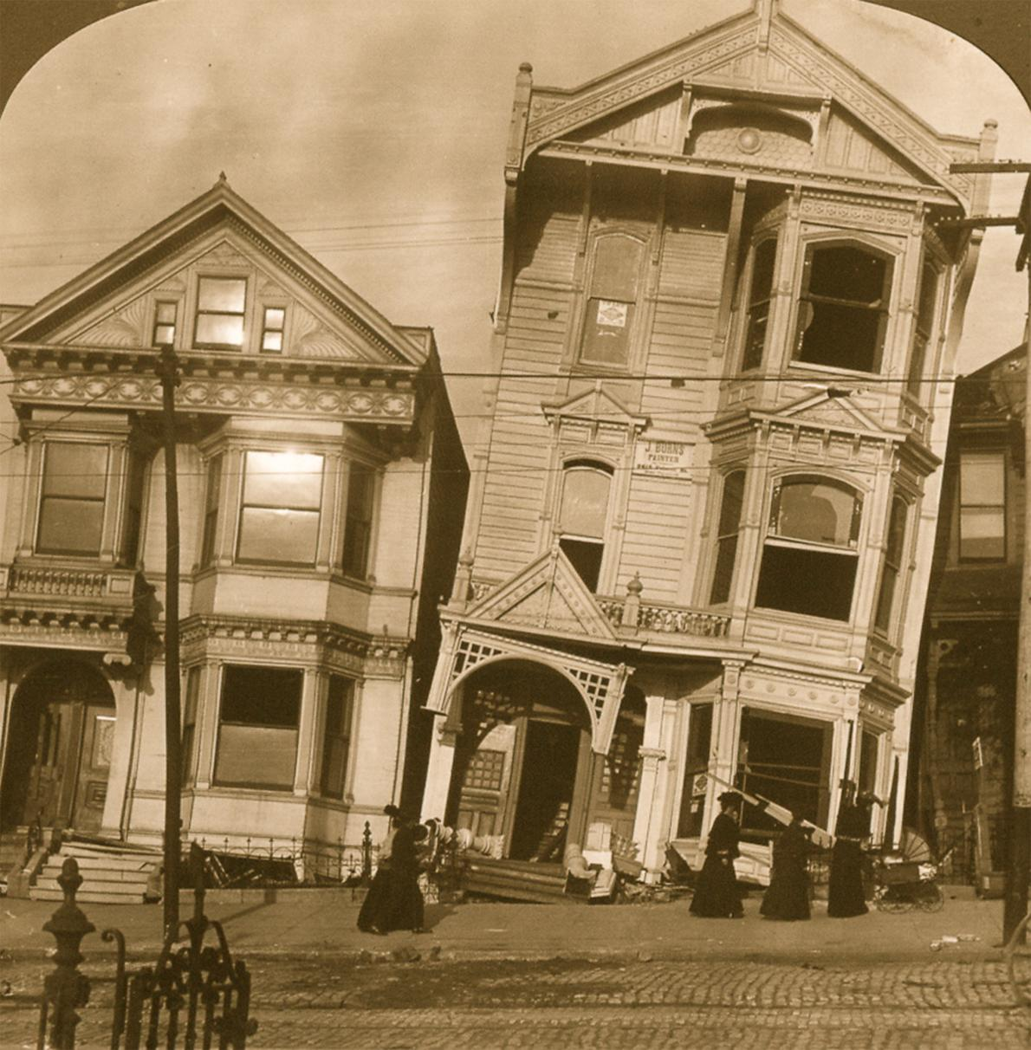
Slip rate note sufficient, need to also know when the last earthquake happened: Historical earthquake record
Loma Prieta 1989 M 6.9
San Francisco 1906 M 7.8

Slide 34
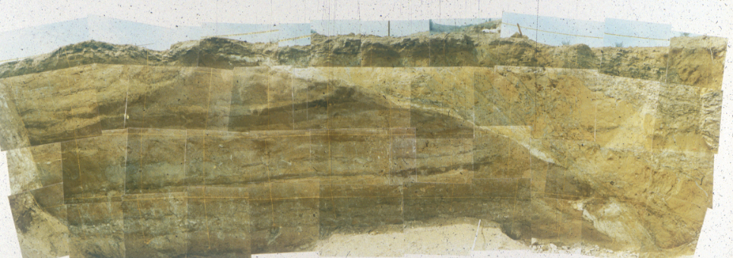
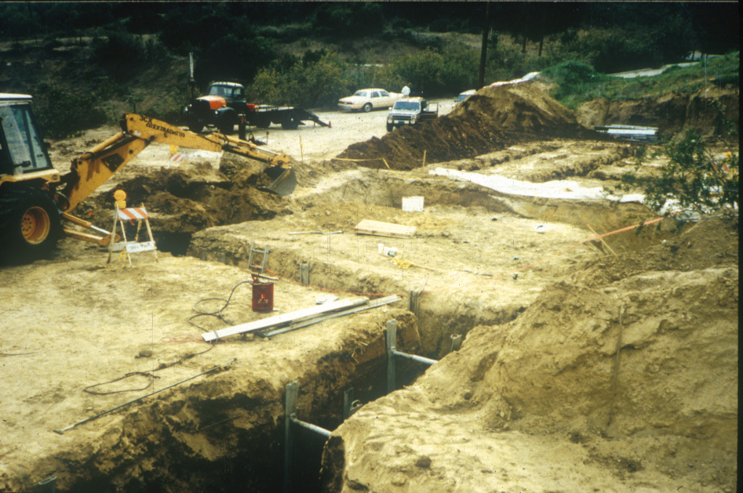
Paleoseismology for geological earthquake record
(back ~10 …100 kyr)
Dig trench across fault, date offset
of sedimentary layers

Slide 35
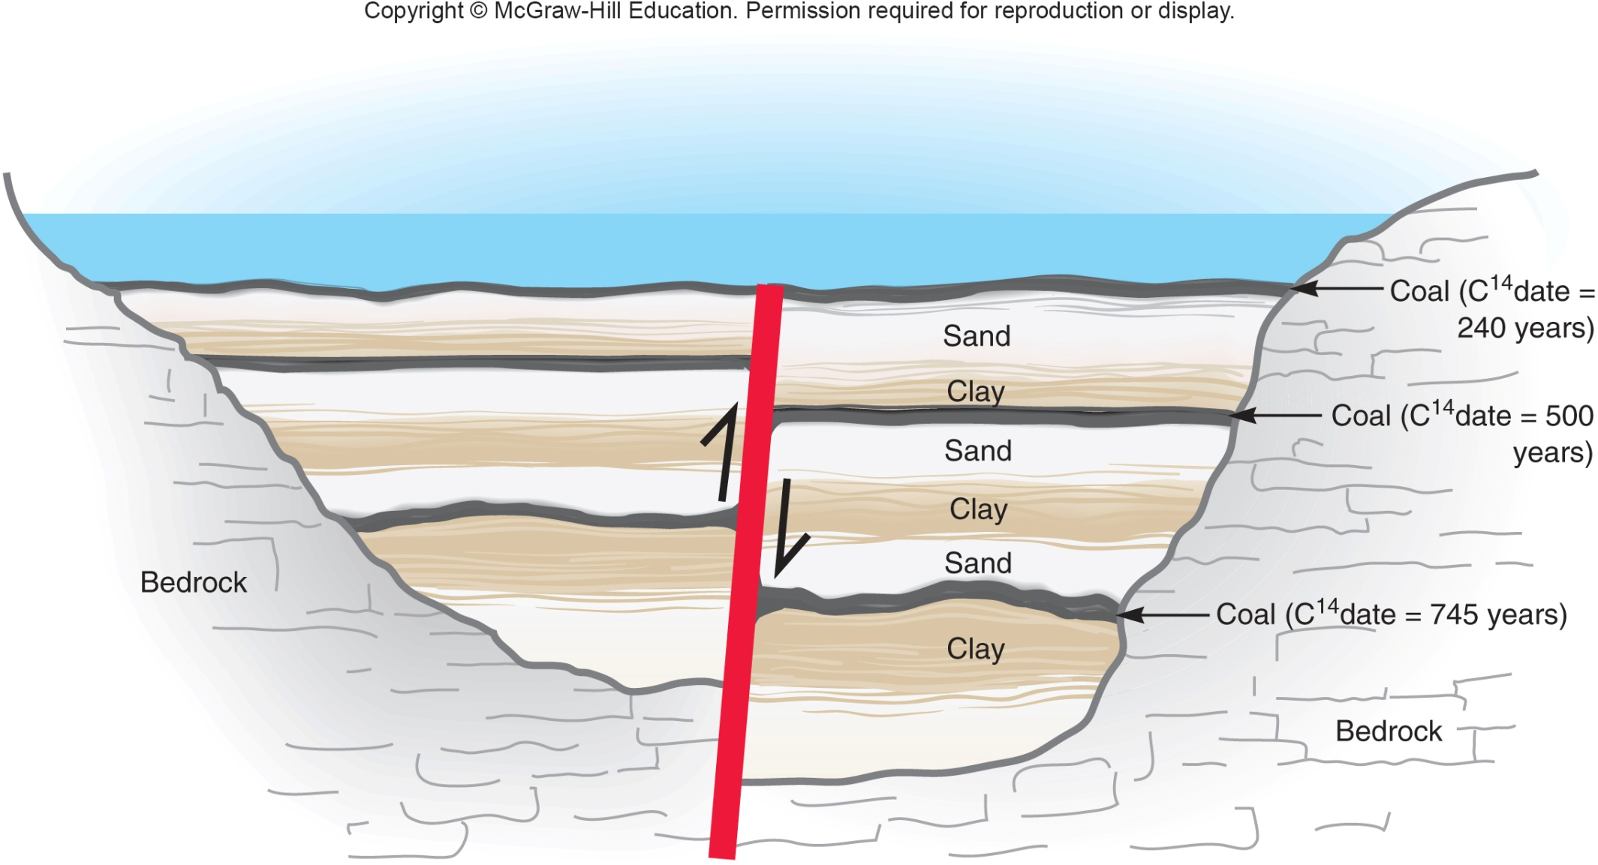
Paleoseismology

Slide 36
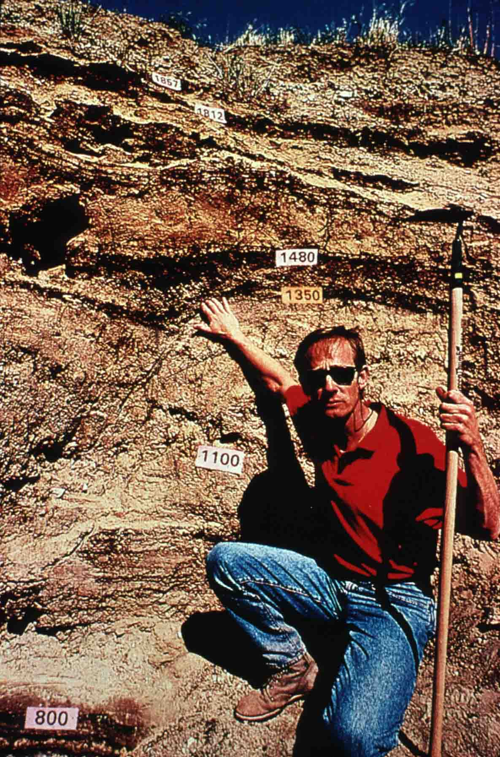
Chronology of "Big Ones" - southern California
575 AD
gap = 90
665
gap = 195
860
gap = 105
965
gap = 225
1190
gap = 55
1245
gap = 225
1470
gap = 275
1745
gap = 112
1857
“waiting”….. 164 years (2021)
When?
Average = 1857 + 160 = 2017
Earliest = 1857 + 55 = 1912
Latest = 1857 + 225 = 2082

Slide 37
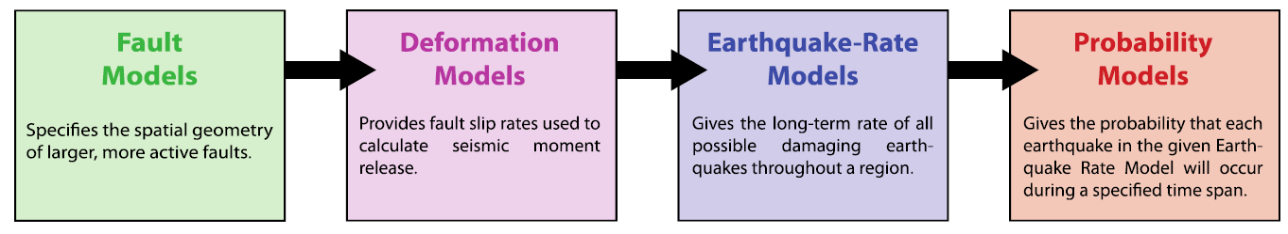
Establishing a rupture model for seismic hazard analysis

Slide 38
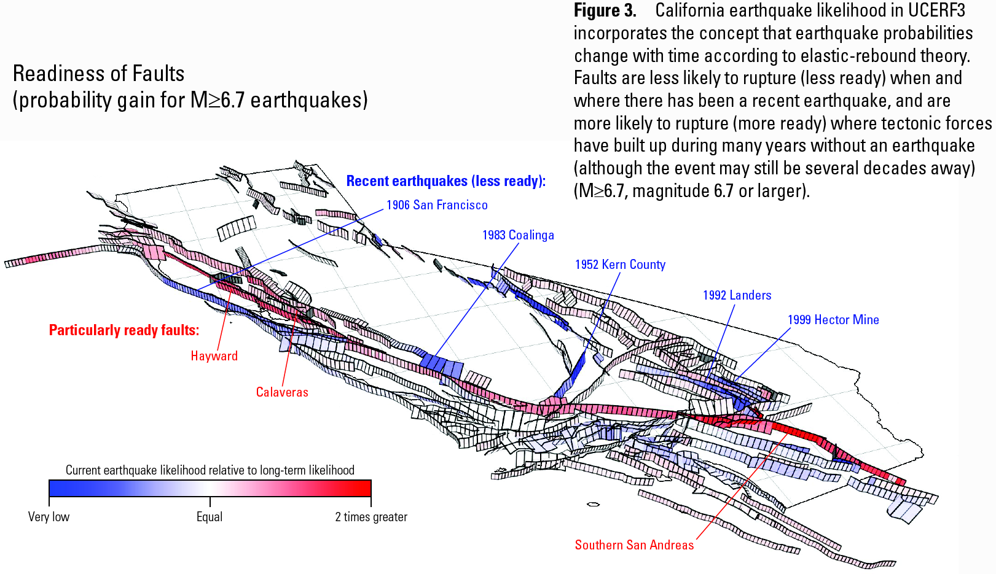

Slide 39
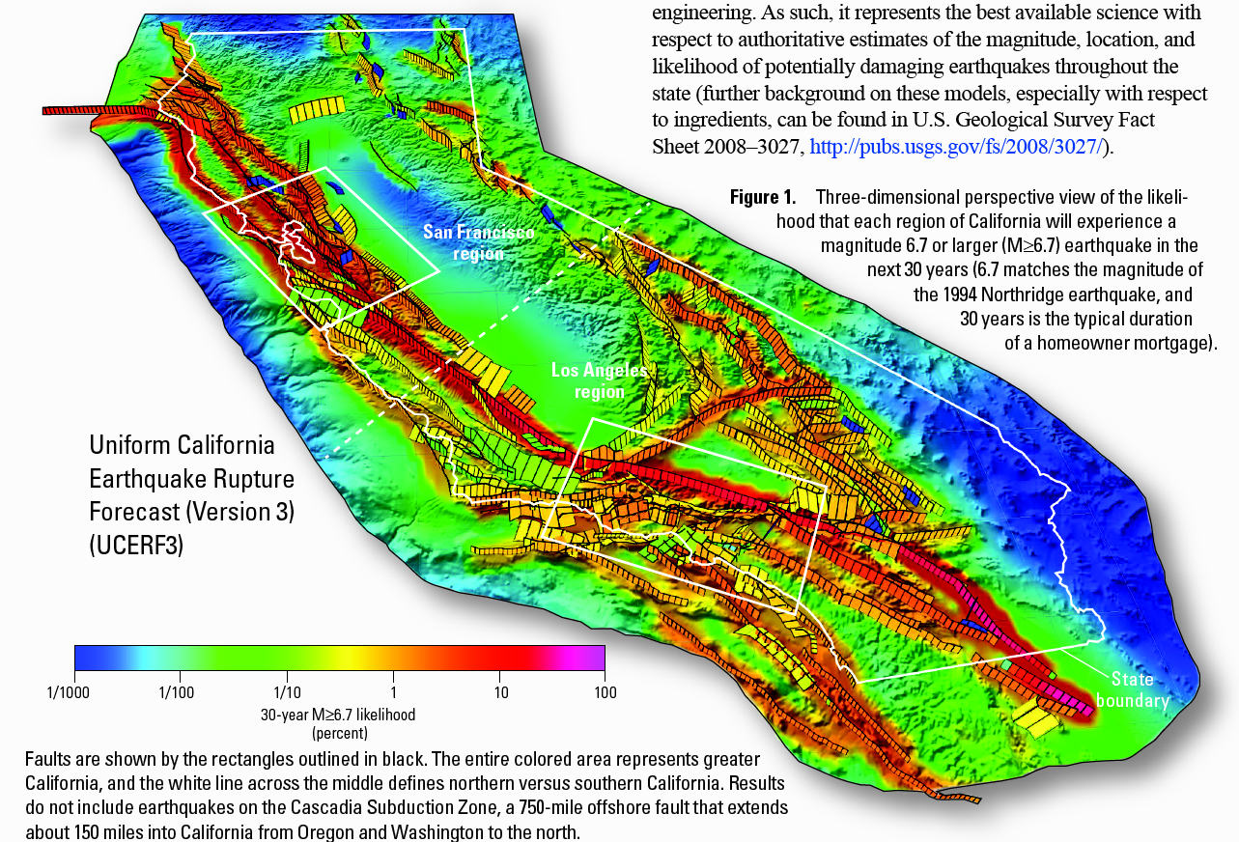
Uniform California Rupture Forecast v. 3

Slide 40
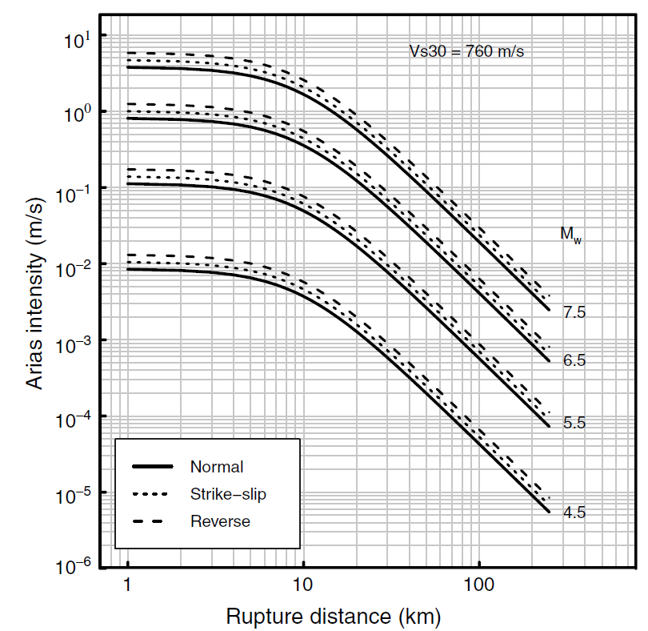
How to determine the effects of earthquakes:
Ground shaking estimates
General attenuation curves
(shaking as a function of distance and magnitude)

Slide 41
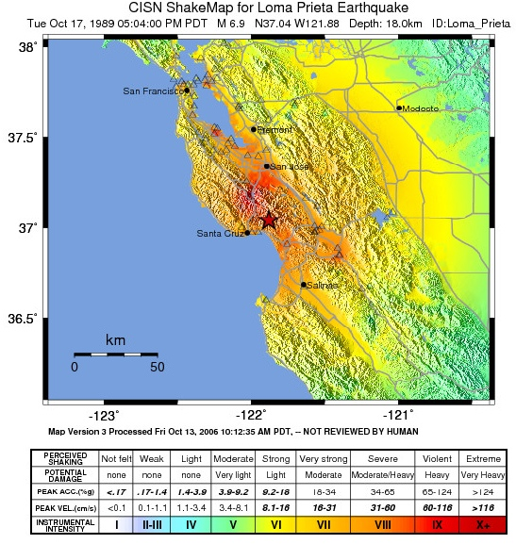
How to determine ground shaking?
Observed shaking for Loma Prieta
General attenuation curves
Site effects

Slide 42
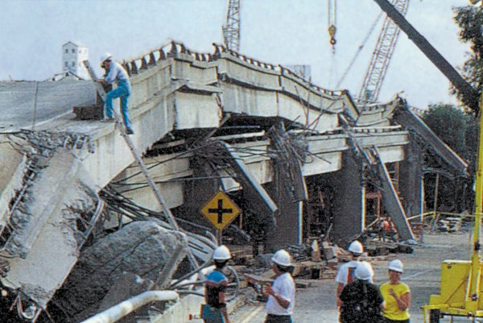
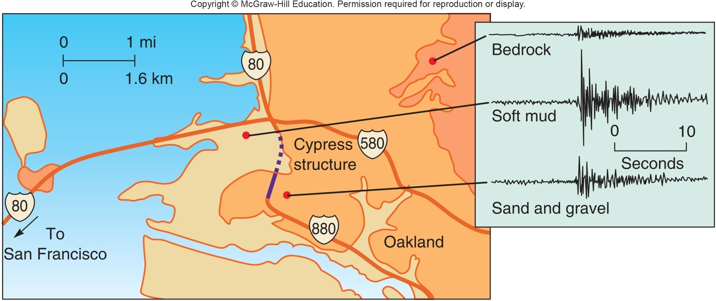
Loma Prieta M 6.9 1989
Cypress structure failure due to site amplification
(and structural problems)

Slide 43
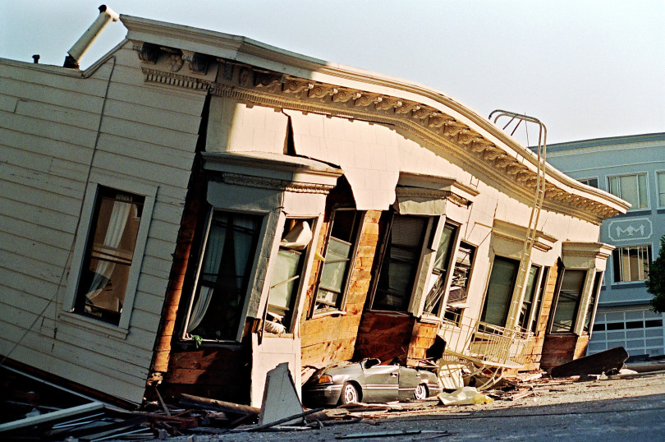
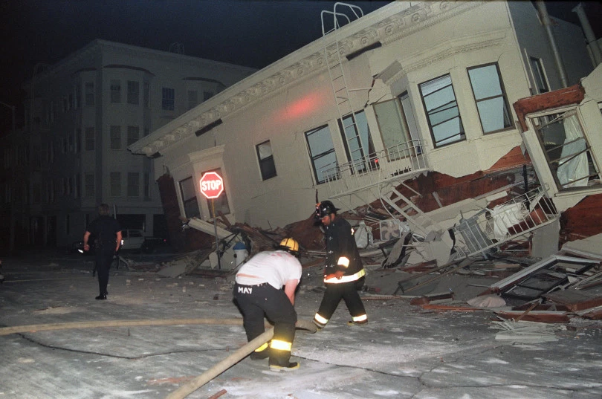
Loma Prieta M 6.9 1989
Extensive damage in San Francisco’s Marina district
due to liquefaction and site amplification

Slide 44

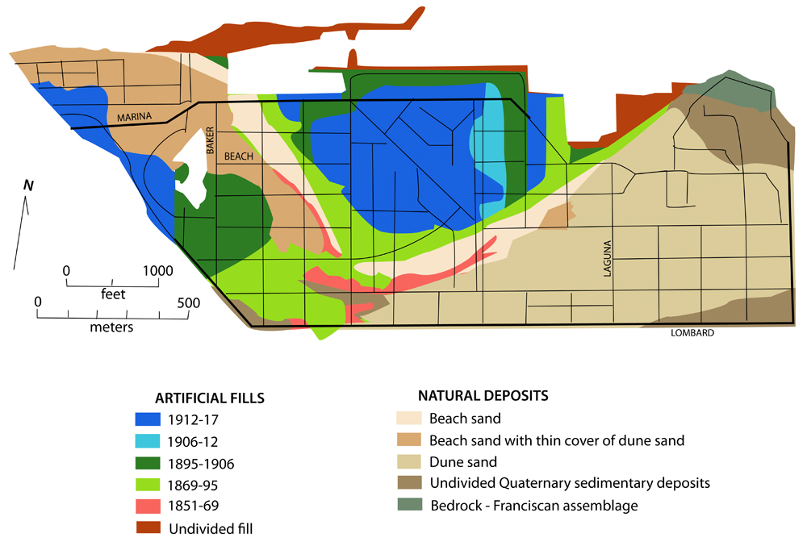
Landfill in Marina

Slide 45
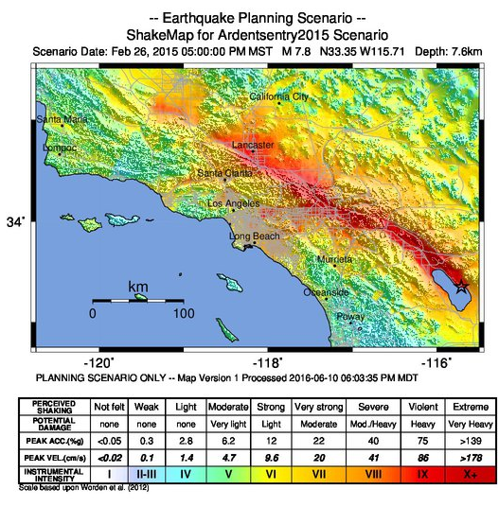
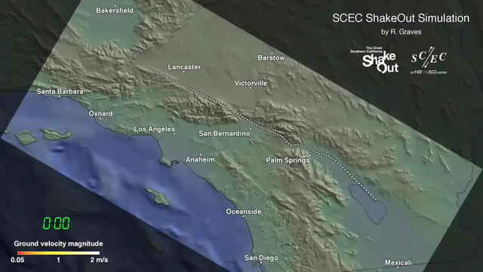
Alternative to case histories: Scenario earthquakes to explore site effects

Slide 46
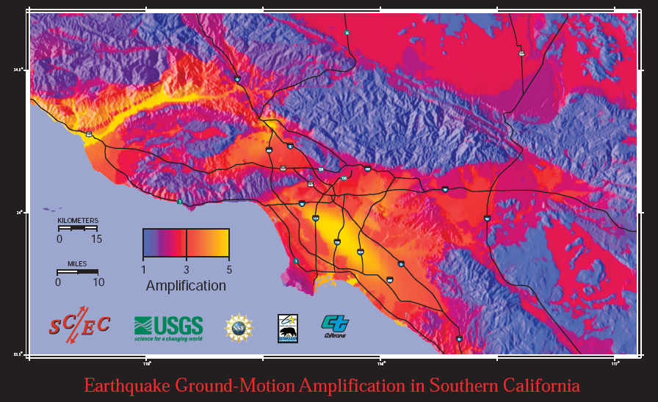

Slide 47
Steps of seismic hazard assessment
Earthquake
Forecast Model
Attenuation
Relationship
Site
Response
Intensity
Measures

Slide 48
Seismic hazard assessment (SHA) – probabilistic and deterministic components
Earthquake generation model
  Statistical
    Gutenberg Richter
    Past seismicity (geology, paleoseismology, historical, instrumental)
  Mechanical
    Past seismicity (geology, paleoseismology, historical, instrumental)
    Fault zone geometries (surface and depth)
    Fault loading rates (GPS and geologic)
Earthquake effect model
  Distance from mapped faults and earthquake type (attenuation)
  Type of bedrock and site effects
  Deterministic assessment using scenarios

Slide 49


