Slide 1
Earthquake Hazards
UT GEO 302P – Spring 2021
Part III – Lecture #4, March 23, 2020
Prof. Thorsten Becker
Reading: Ch. 3 & 4

Slide 2
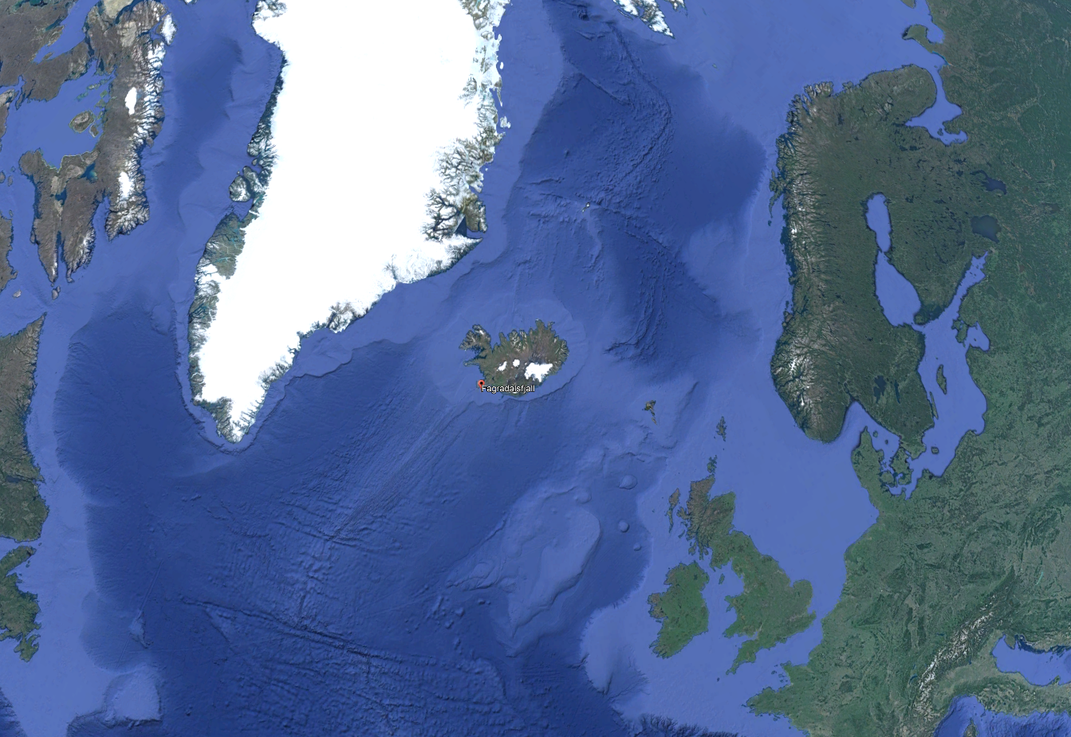
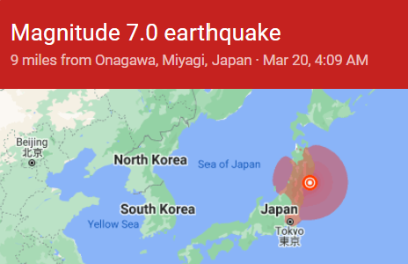

Last week

Slide 3
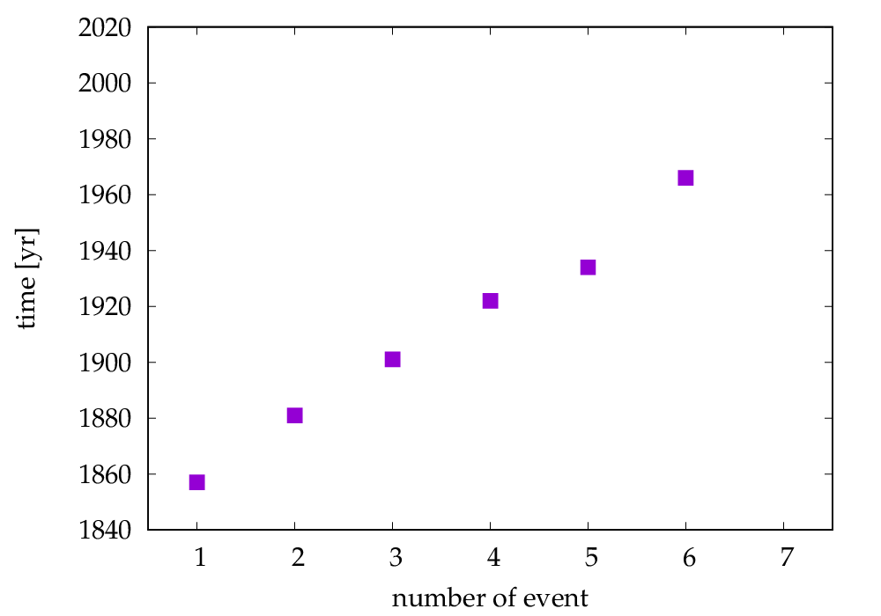
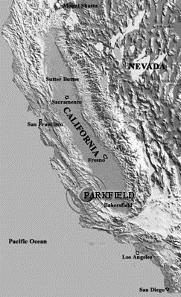
The Parkfield M6 sequence
?

Slide 4
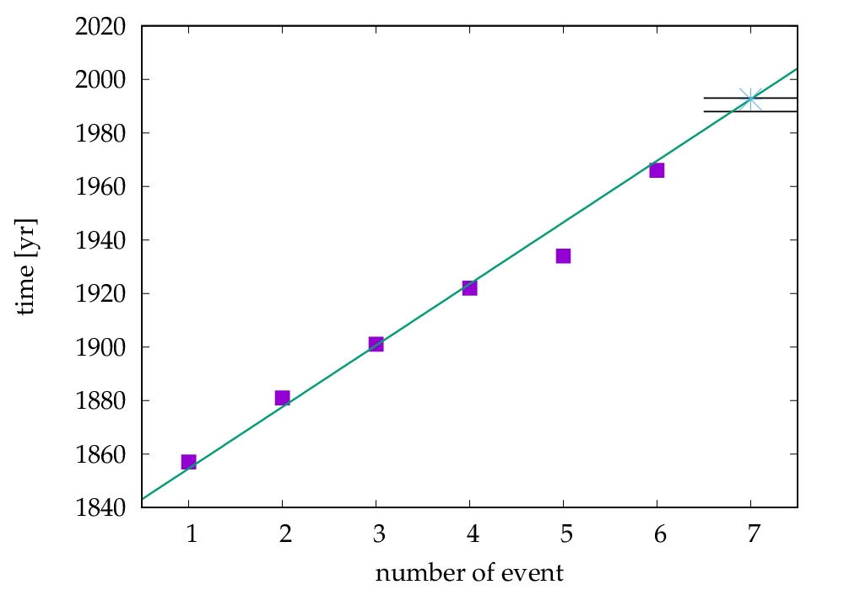
The Parkfield CA prediction: expect M6 between 1988-1993

Slide 5
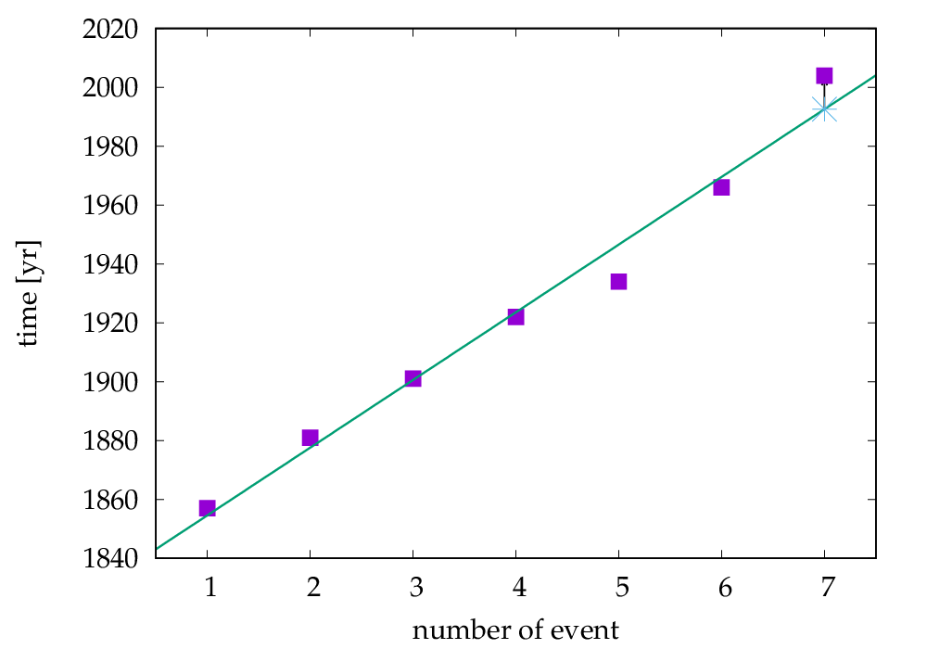
2004 M6 was 11 years too late

Slide 6
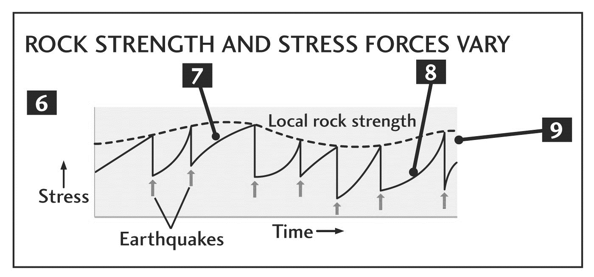
2004 M6 was 11 years too late
(49% of ~23 yr period)

Slide 7
Seismic hazard
Earthquakes cannot be predicted (yet) in terms of their time and space of occurrence
This means we need a probabilistic forecast of earthquake hazards
Seismic hazard: the likelihood and intensity of strong ground motion and other damaging effects at any location.

Slide 8
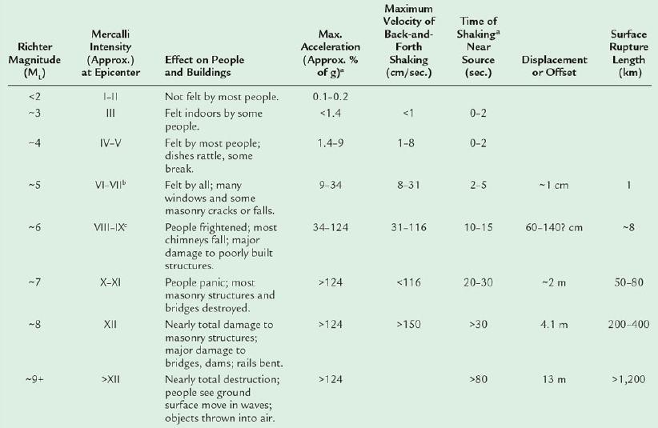
Seismic hazard
The likelihood of strong ground motion and other damaging effects at any location.
Example:
  How likely is it to exceed 50% of the gravitational acceleration, g, in the next 50 years?

Slide 9
Hazard and risk
Seismic hazard: the likelihood and intensity of strong ground motion and other damaging effects at any location
    How likely is it to exceed 50% of g in the next 50 years?
Seismic risk: the likelihood of seismically induced loss of life and property at any location
  How likely are losses of life (or $) in the next 50 years?

Slide 10
Hazard and risk
Seismic hazard: the likelihood and intensity of strong ground motion and other damaging effects at any location
Seismic risk: the likelihood of seismically induced loss of life and property at any location
  Risk = hazard × exposure × vulnerability

Slide 11
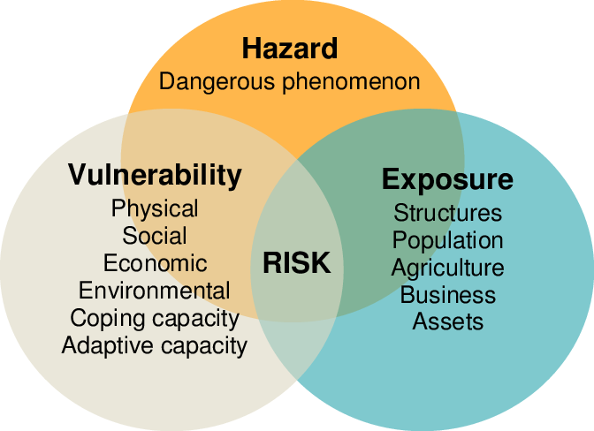
Hazard and risk
Seismic hazard: the likelihood and intensity of strong ground motion and other damaging effects at any location
Seismic risk: the likelihood of seismically induced loss of life and property at any location
  Risk = hazard × exposure × vulnerability

Slide 12
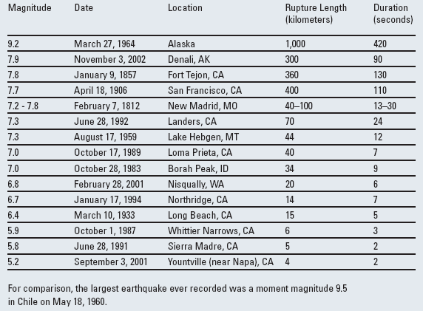
Historical perspective on US hazard
What is the hazard in the US?
Why most in CA and AK?

Slide 13
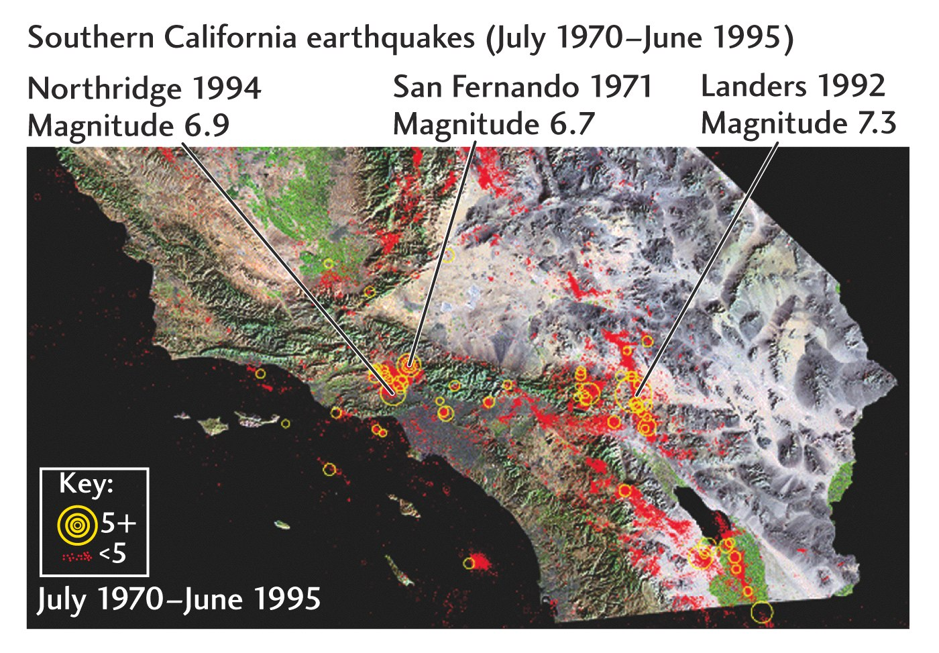
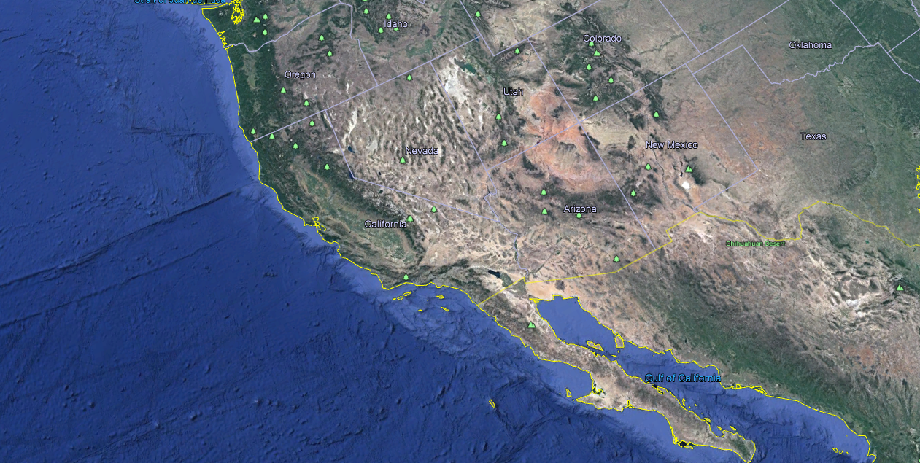
Why do the
quakes happen
where they do?

Slide 14
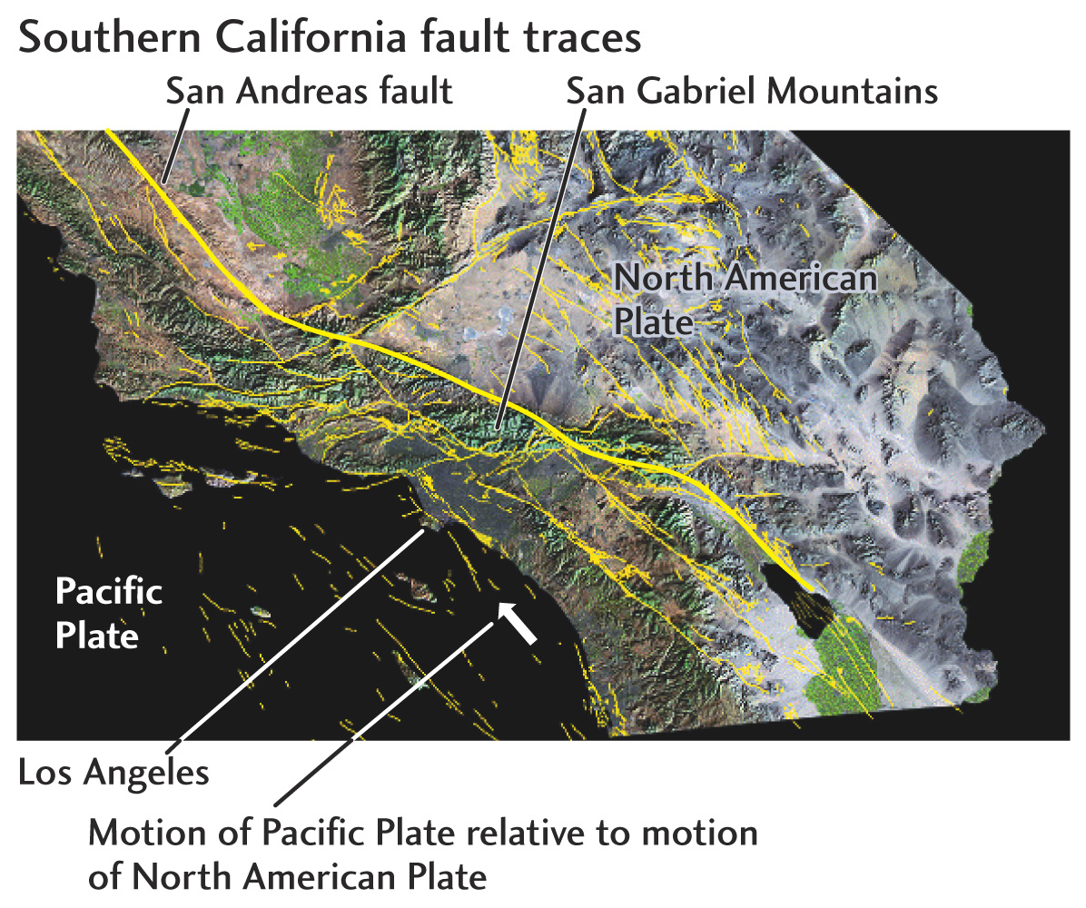
Earthquakes happen
on faults…
Assess hazard by
generating seismicity catalogs
mapping faults

Slide 15
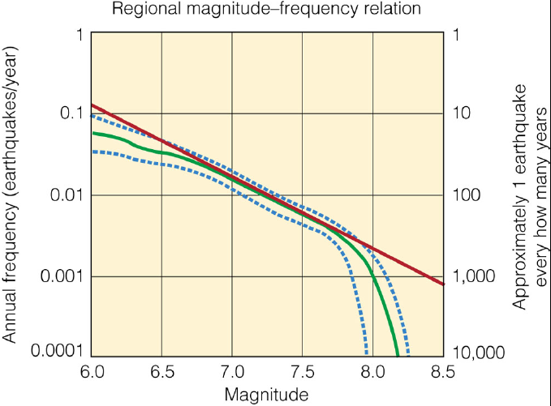
How do we convert the knowledge about spatio-temporal seismicity characteristics into useful information for society?
Spatial information
frequency-magnitude information

Slide 16
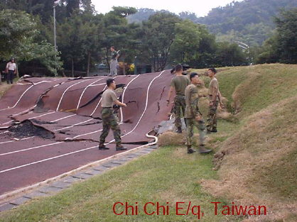
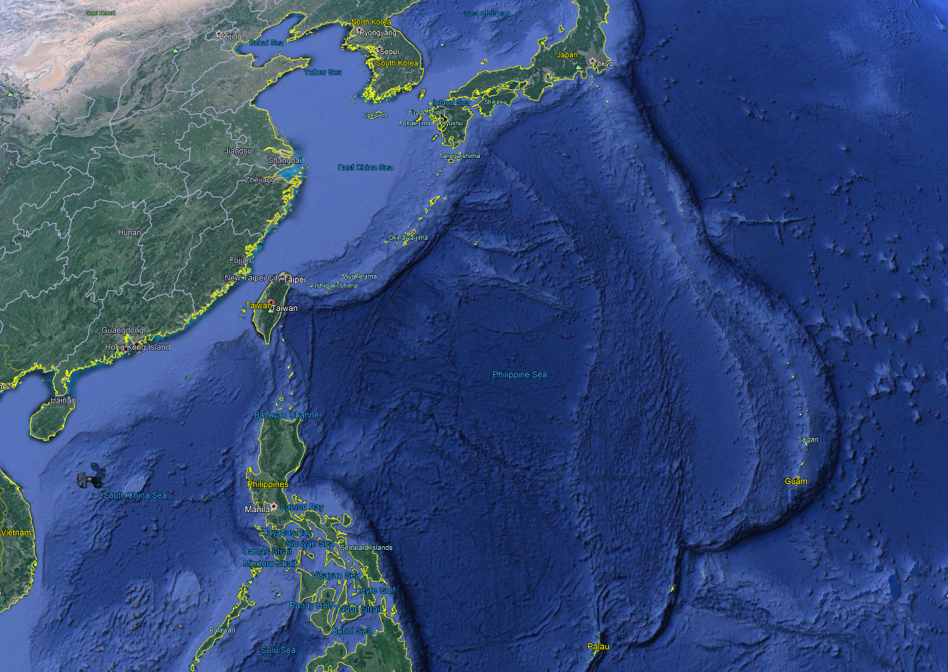
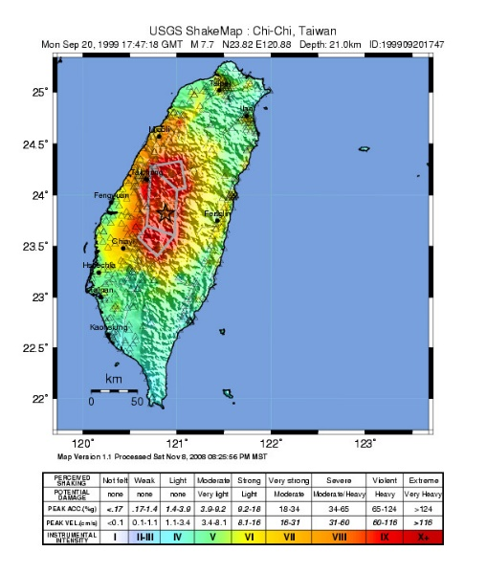
Understanding different types of hazards
Primary hazards: Damage through fault offsets
Chi Chi earthquake Taiwan,
1999, Mw = 7.7 (2415 deaths, $10b damage)

Slide 17
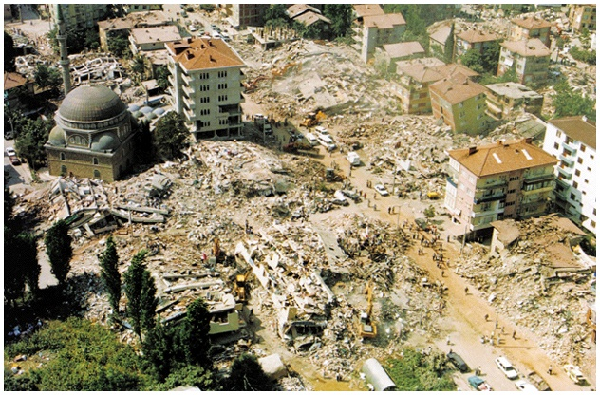
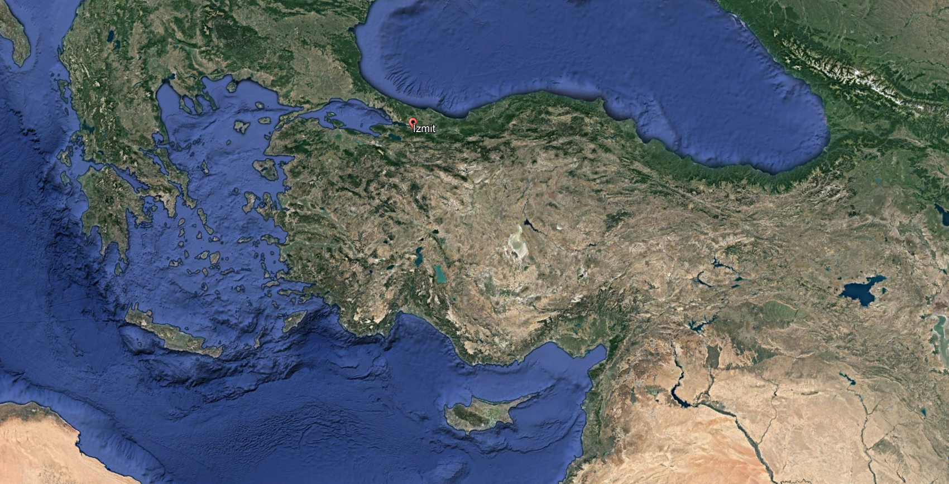
Primary hazards: Ground shaking
M_{w} = 7.6, 1999 Izmit:
shaking damage in Golcuk
(45,000 deaths,
20,000 buildings collapsed,
120,000 buildings damaged
beyond repair)

Slide 18
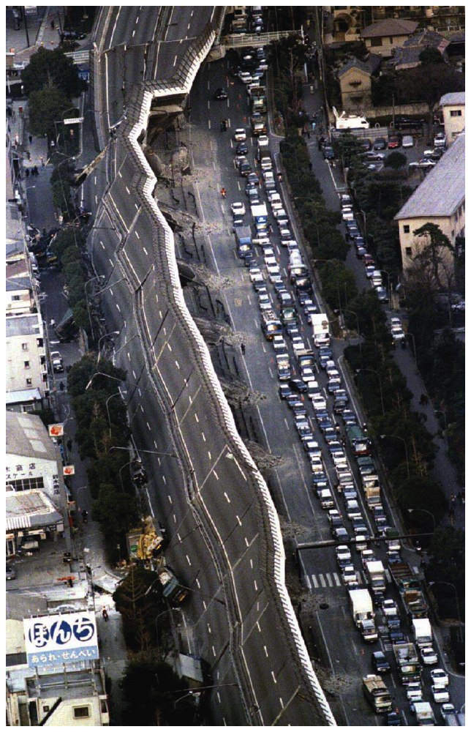
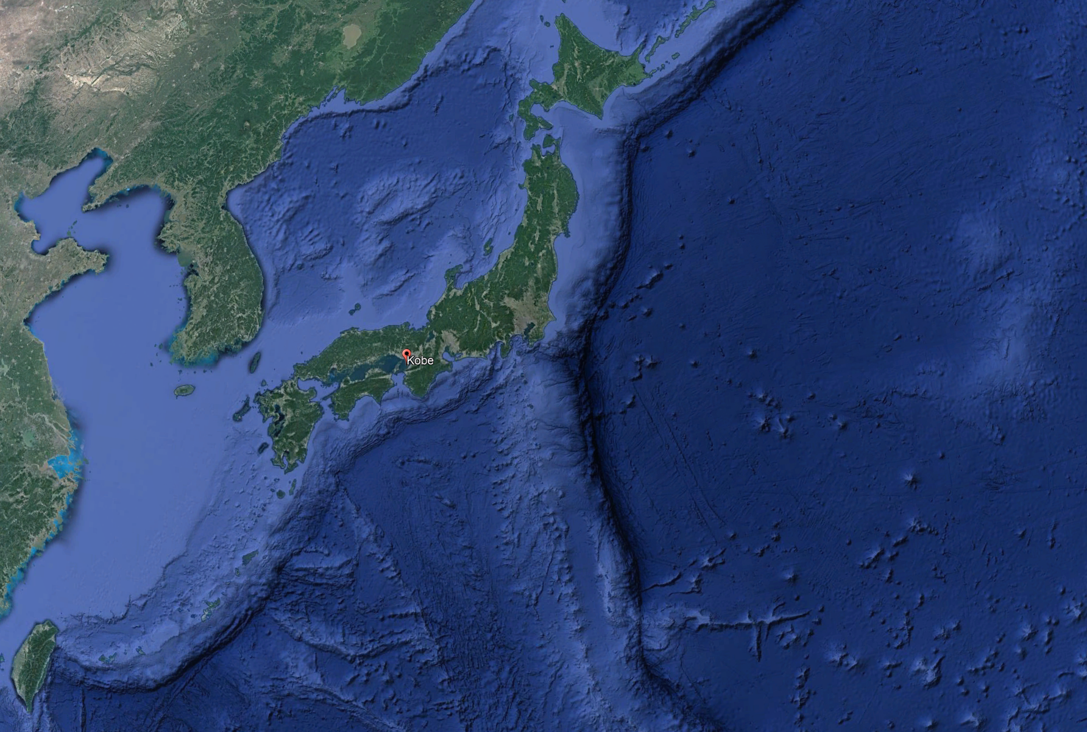
Kobe, Japan 1995
M_{w} = 7
6,434 people died
~$90b, 2.5% of GDP at the time
Widespread structural failure, even for highest standard building codes

Slide 19
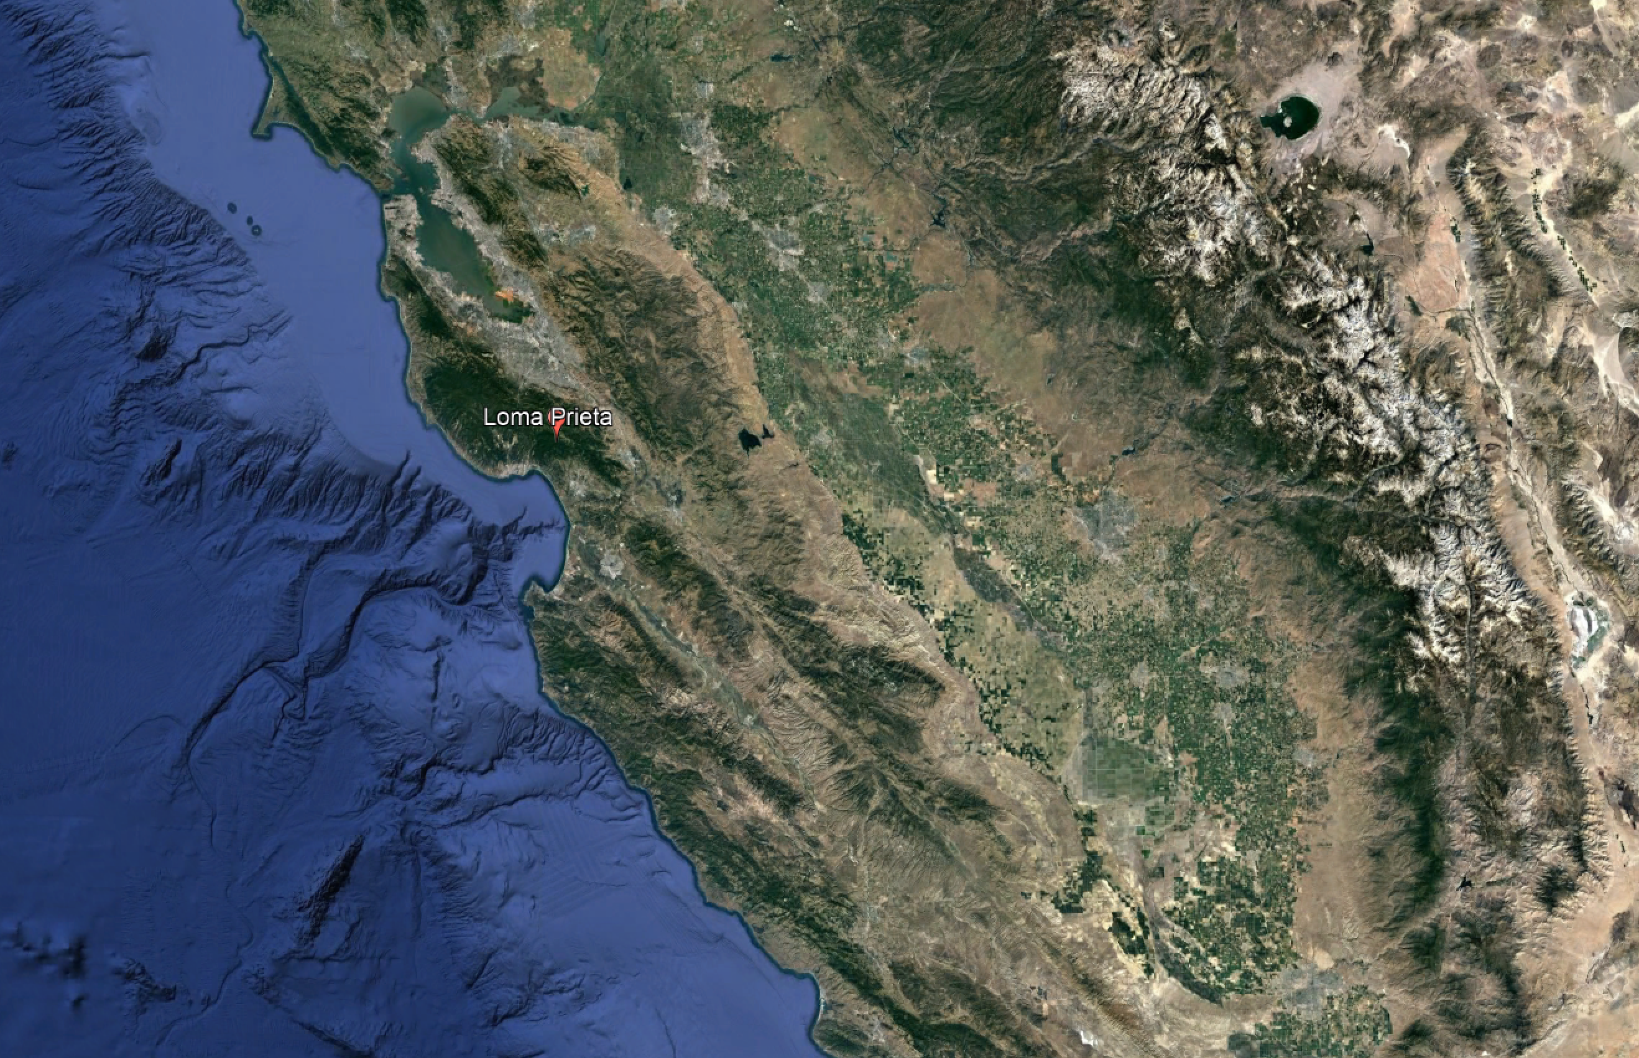
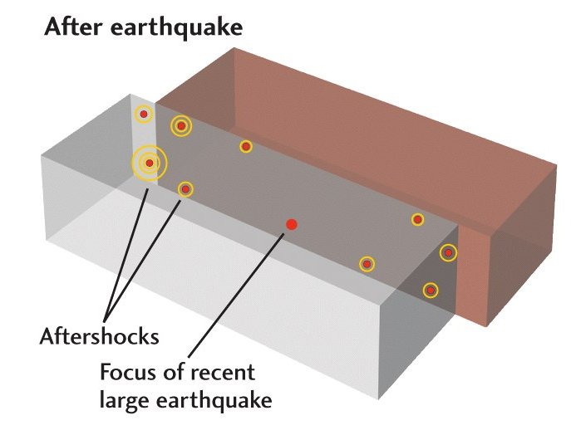
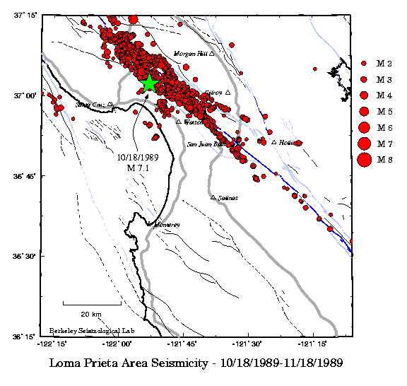
Hazard due to mainshock and aftershocks
Loma Prieta M 7.1 1989

Slide 20
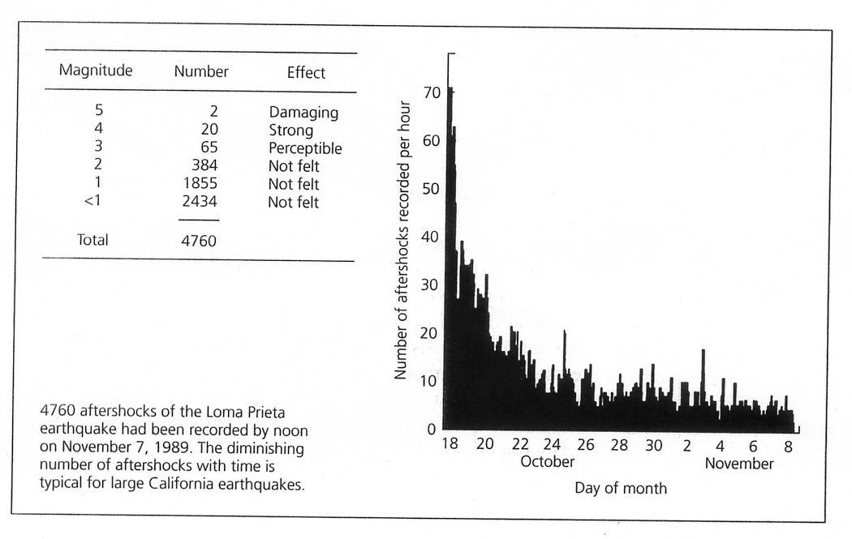
Loma Prieta M 7.1 1989 aftershocks
frequency – magnitude relationship
for aftershocks

Slide 21
Loma Prieta M 7.1 1989 aftershocks
Aftershocks of the
1989 Loma Prieta M7
Time-dependence
(decay of number of aftershocks/time)
frequency – magnitude relationship
for aftershocks

Slide 22
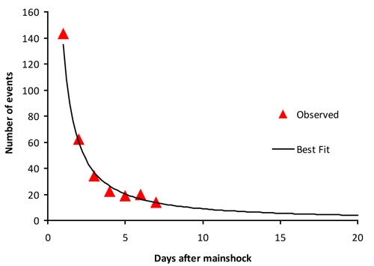
Omori’s law
Aftershocks of
2011 Tohoku-oki M9
70
Aftershocks of the
1989 Loma Prieta M7
N(aftershocks) ~ 1/time
N(aftershocks) ~ 1/time
70/2 = 35
70/4 = 17.5
70/20=3.5
70/8=8.8
70/10=7.0

Slide 23
Aftershock statistics
Omori’s law:
  number decreases as 1/time since mainshock
Bath’s law:
  largest aftershock is ~1.2 M units smaller than mainshock

Slide 24
Earthquakes don’t kill people,
buildings do.

Slide 25
What to do in an earthquake?

Slide 26
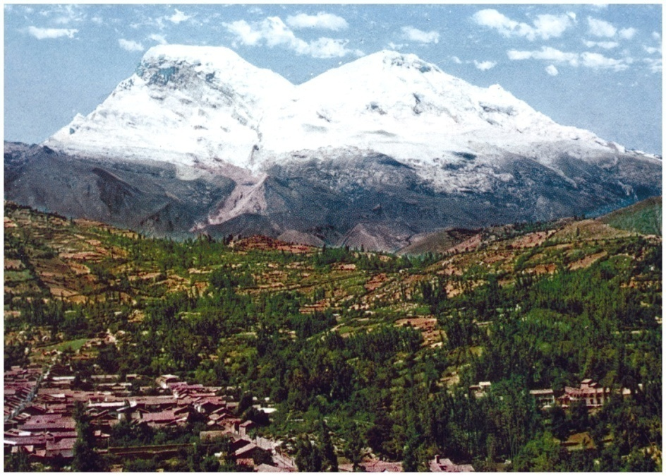
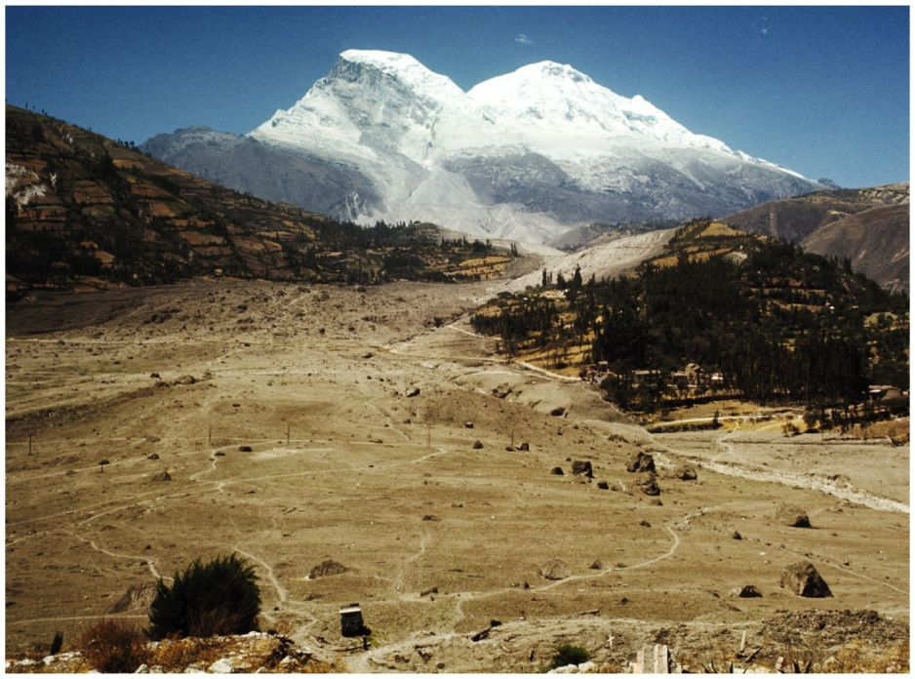
Secondary hazards: Landslides
Nevado de Huascaran, Peru, 1970
Triggered by Ancash M = 7.9, off the coast

Slide 27
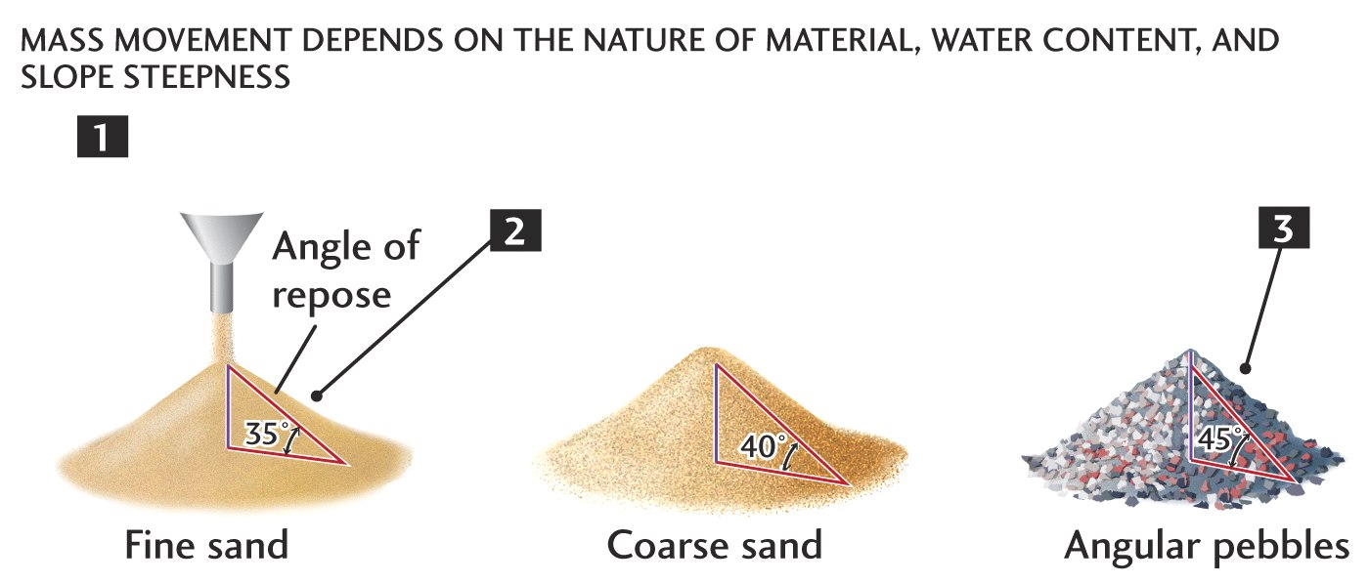
Earthquakes perturb (critically stable) hillsides

Slide 28
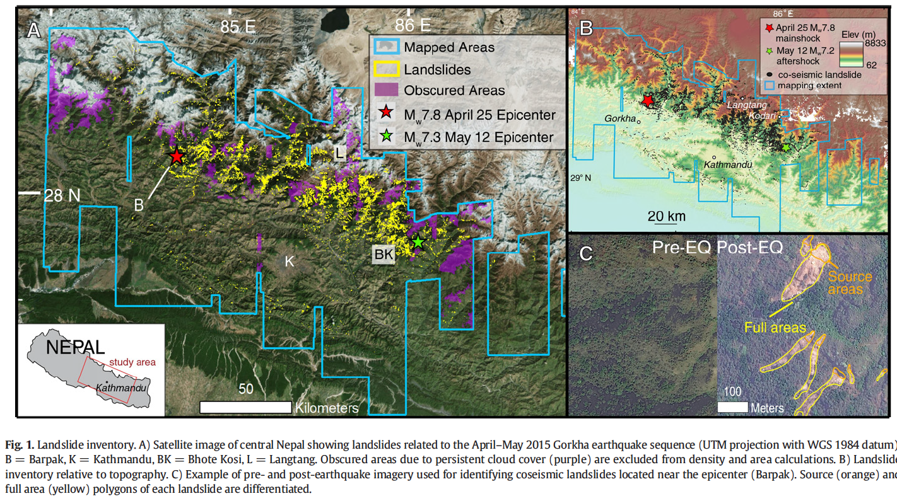
Major hazard for mountainous regions, including Pacific NW
Landslides due to M7.8 Ghorka, 2015
Roback et al. (2018)

Slide 29
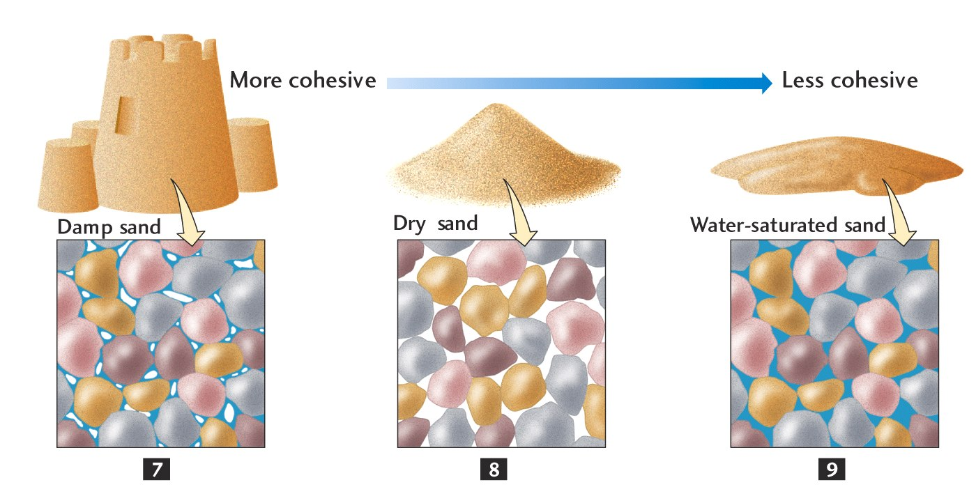
Water saturation important factor

Slide 30
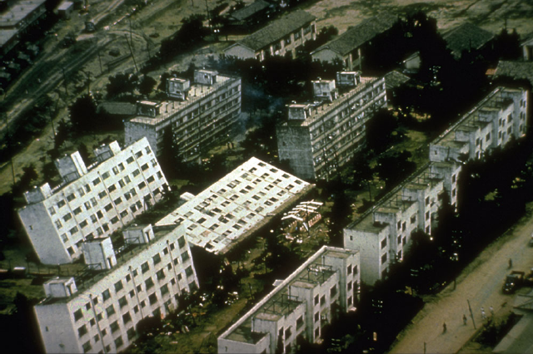
Differential settling due to liquefaction

Slide 31
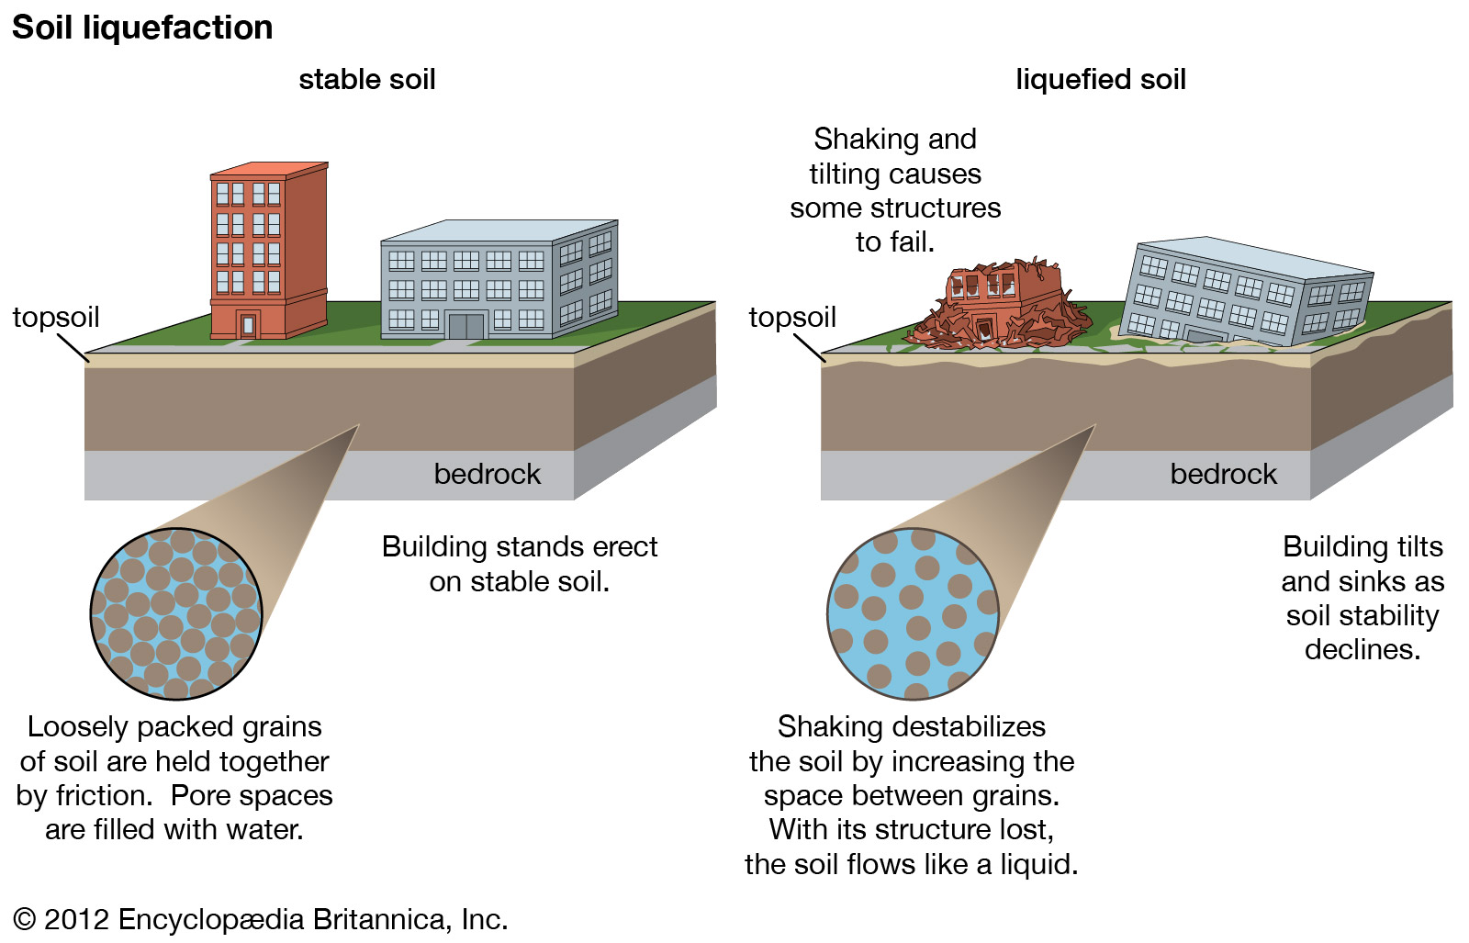

Slide 32
Secondary hazards: Liquefaction
Requires loose soils (sand or silt) and fluids
When shaken above a certain, critical level, soils may then lose all strength and flow
Areas with high ground water and loose soils (saturated) at risk, earthquake shaking is the trigger

Slide 33
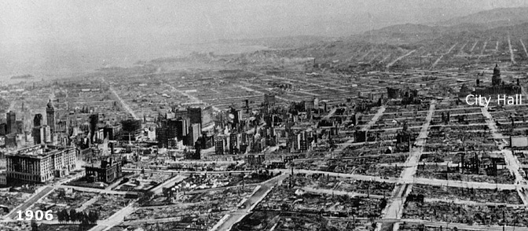
Secondary hazards: fires
San Francisco, 1906, Mw = 7.8

Slide 34
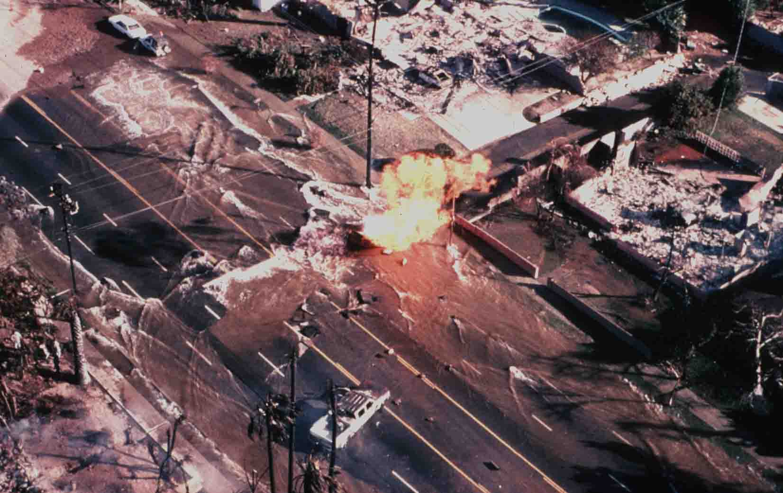
Secondary hazards: fires
Northridge, 1995, Mw = 6.7

Slide 35
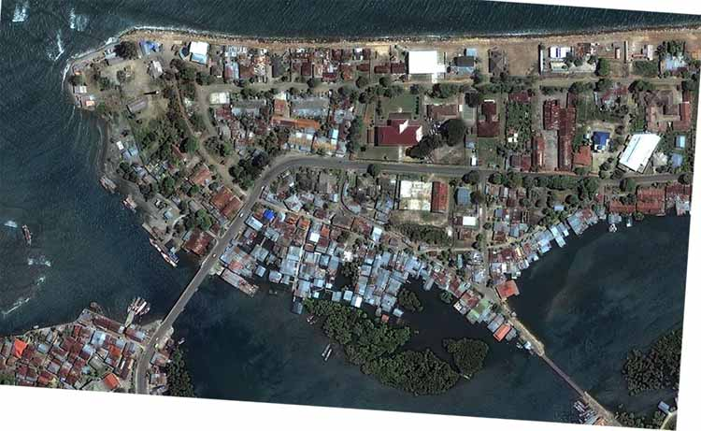
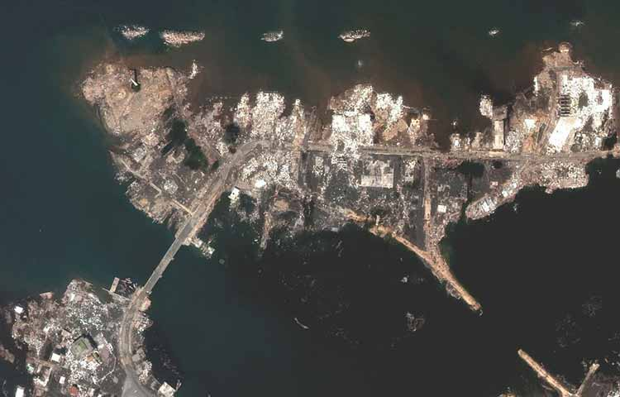
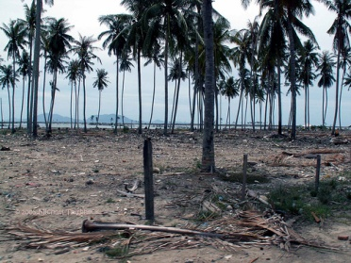
Secondary hazards: Tsunamis
Lecture #5 will be on tsunamis.
Banda Aceh 2004, Mw = 9.3

Slide 36
Seismic hazards
Primary hazards
  Ground shaking – regional impact
    Mainshock and aftershocks
  Surface displacement due to fault offset
Secondary hazards
  Tsunamis – hemispheric impact
  Landslides
  Soil liquefaction
  Fire
  Epidemics

Slide 37
Assessing hazards:
Ground shaking is measured from intensity (MMI) or peak ground acceleration (PGA)
What governs this distribution?
M_{w} = 7.3, 1992 Landers, California

Slide 38
Predicting ground shaking for a potential earthquake, need to know:
Earthquake size
Earthquake distance (depth)

Slide 39
What is the largest possible earthquake for a given site?
Two approaches…

Slide 40
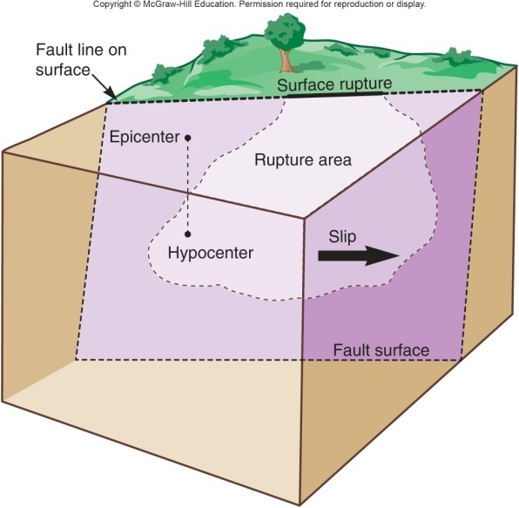
What is the largest possible earthquake for a given site?
Statistical: Gutenberg-Richter
Deterministic: Find the biggest fault (and convert to moment)
Biggest possible event M~10.5

Slide 41
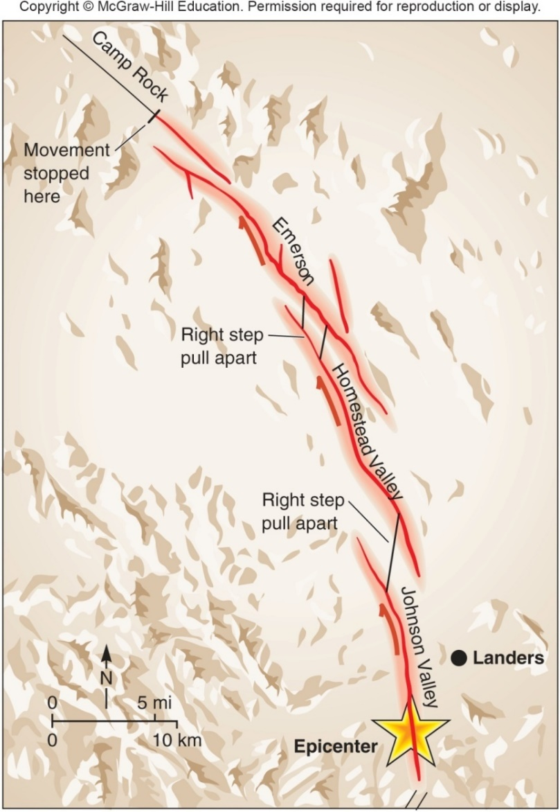
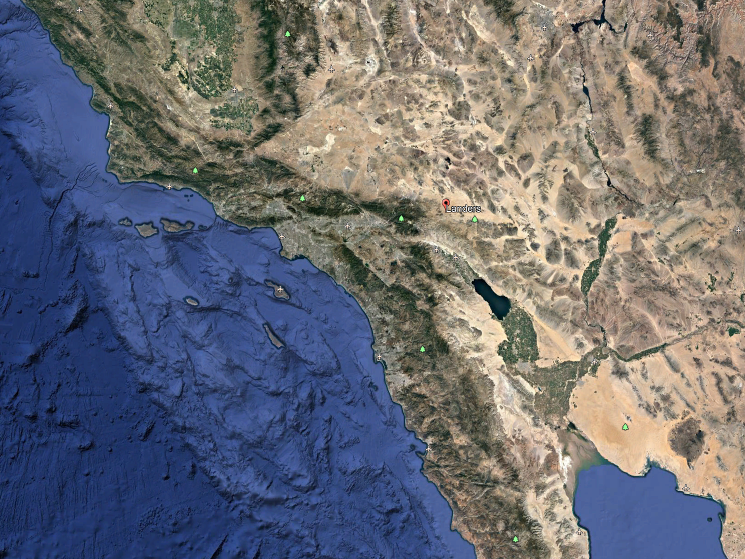
Determining the biggest local fault:
Lessons from Landers 1992

Slide 42
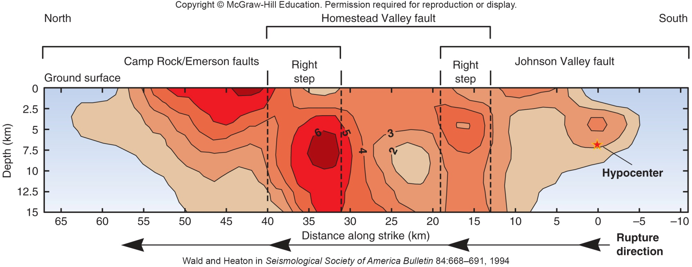

Faults can link up – earthquakes can jump from fault to fault
3 x M6.8 ~ M_{w} = 7.3

Slide 43
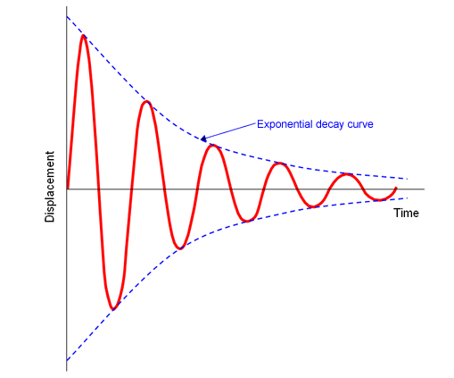
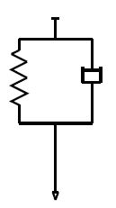
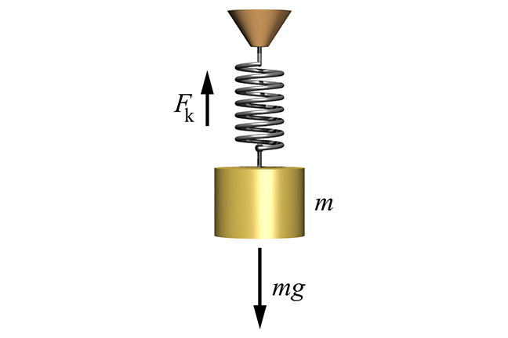
Decay of shaking with distance
Geometric effect (wave energy distributed over larger volume)
Attenuation (= damping)
  due to dissipation (non elastic)
  depends on frequency

Slide 44
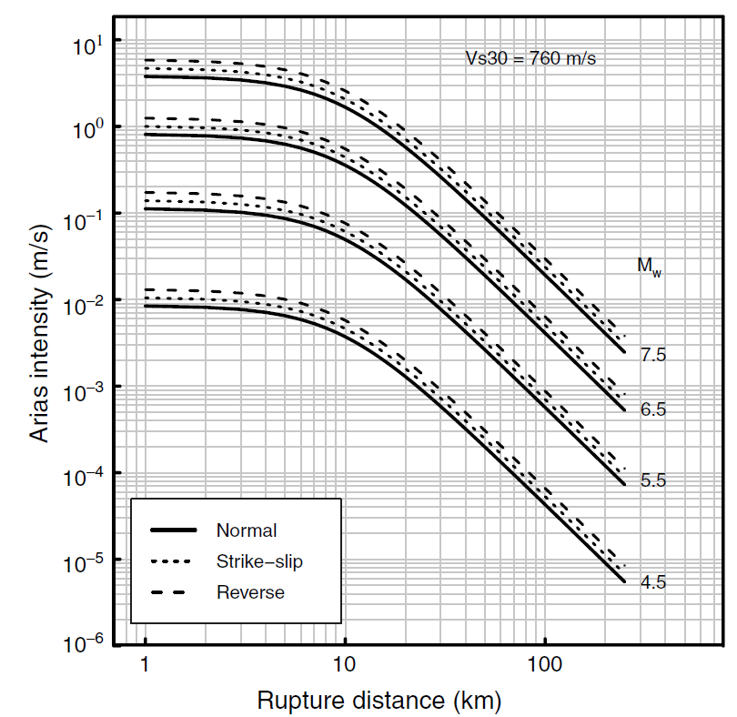
Attenuation relationships
Describe decrease of shaking
intensity with distance
Li et al. (2012)
for Taiwan

Slide 45
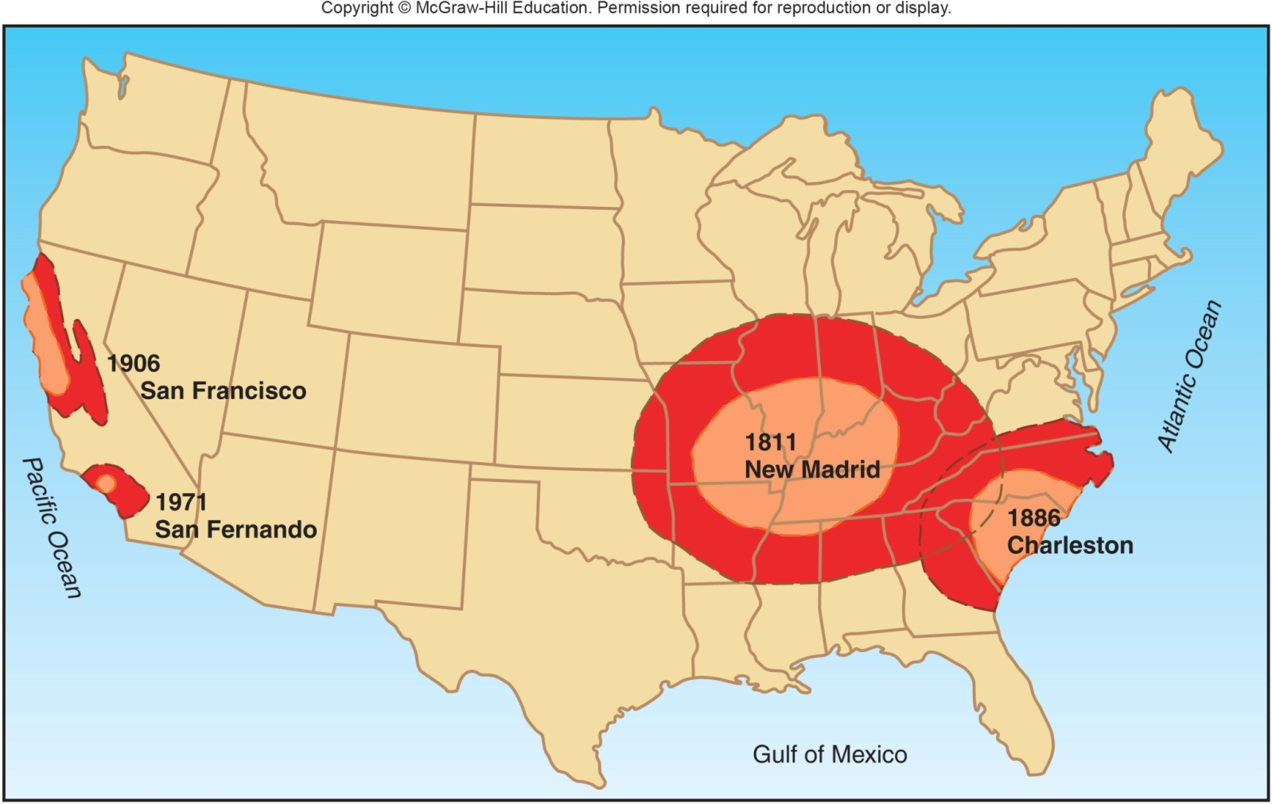
Significant shaking for similar size earthquakes: differences in attenuation because of geology

Slide 46
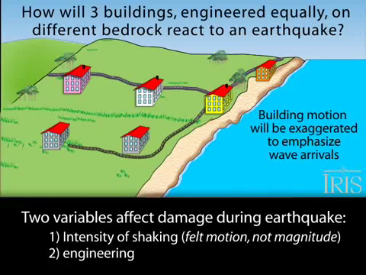
Ground motion amplification

Slide 47
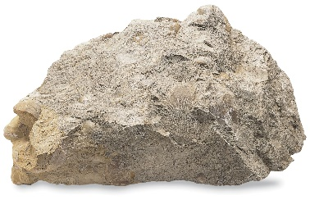
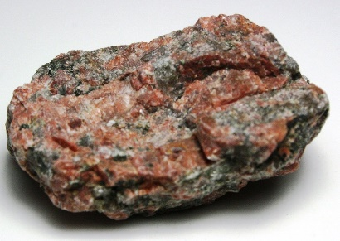
Ground motion amplification
Seismic wave (force)
weak rock – large shaking
Seismic wave (force)
strong rock – small shaking

Slide 48

Ground motion amplification

Slide 49

Ground amplification:
Attenuation relationships for different rock types
V_{S}30 = integrated shear wave velocity over top 30 m – a proxy for rock strength
Li et al. (2012)
for Taiwan

Slide 50

Site effects: Homogeneous half-space response to earthquake source

Slide 51


Los Angeles sedimentary basin

Slide 52

Site effects: LA basin response to source

Slide 53


Resonance

Slide 54

Resonance
many systems can oscillate, at given (“natural”) frequency (also called eigenfrequency)
when forced at frequencies that are too high or too low, compared to that frequency, amplitudes of oscillation don’t grow
when forced close to natural frequency, oscillations can amplify the amplitude of forcing greatly
Natural structures (e.g. sedimentary basins) and man made structures (e.g. high rise buildings) have natural frequencies

Slide 55
Physics of ground shaking
Locally, the intensity is mainly determined by the earthquake size, type, and distance from hypocenter
Other contributions arise from
  regional damping/attenuation (tectonic setting)
  local site effects
    Amplification
    Basin resonance
  physics of rupture (one size earthquake can cause different shaking patterns, e.g. depending on direction/directivity)

