Slide 1
Earth’s interior
UT GEO 302P – Spring 2021
Part II (Earthquakes) – Lecture #2, March 9, 2021
Thorsten Becker
Reading: Ch. 2

Slide 2
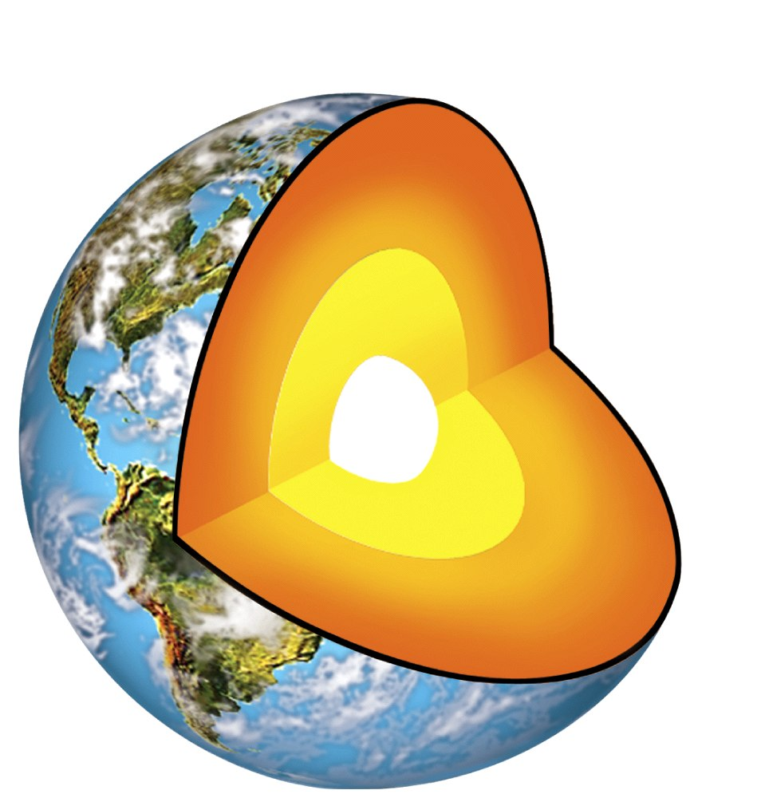
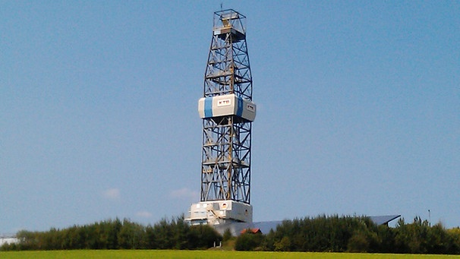
How can we figure out the interior structure of the Earth?
deepest drilling ~ 10 km
Earth’s radius ~ 6371 km

Slide 3
How can we figure out the
interior structure of the Earth?
Seismology:
  use seismic wave propagation for imaging
  Important to understand the source and impact of earthquakes as well (ground shaking)
Other geophysical techniques

Slide 4
Sources of seismic waves
Earthquakes: rapid motion on fault surfaces

Slide 5
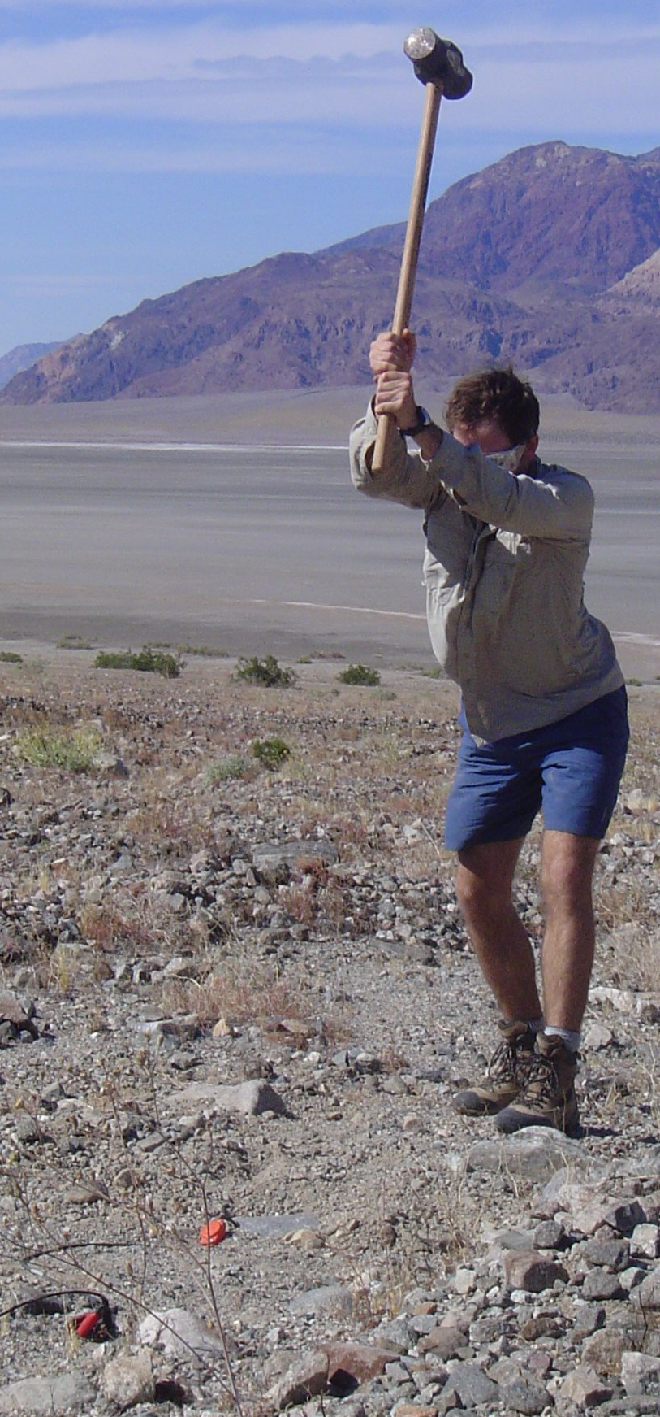
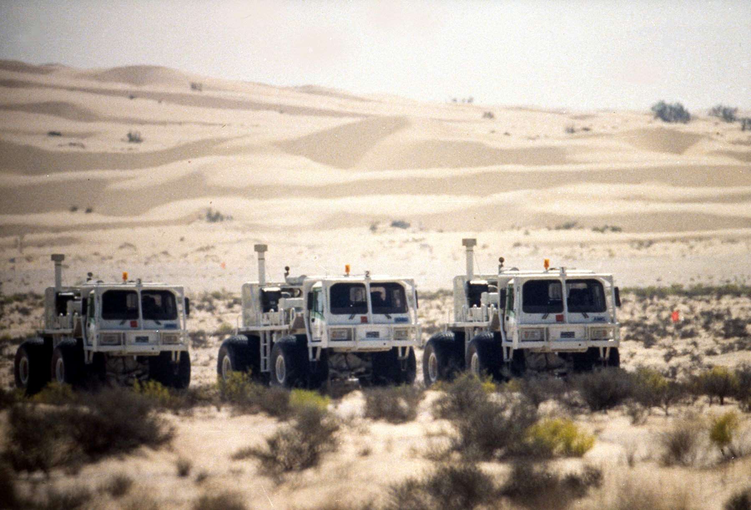
Man-made sources
(active seismics)
Hammer
Explosives
Vibroseis

Slide 6
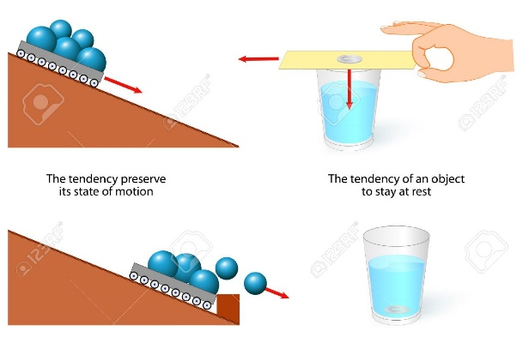
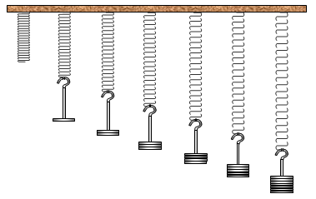
Seismic waves depend on…
Elasticity Inertia

Slide 7
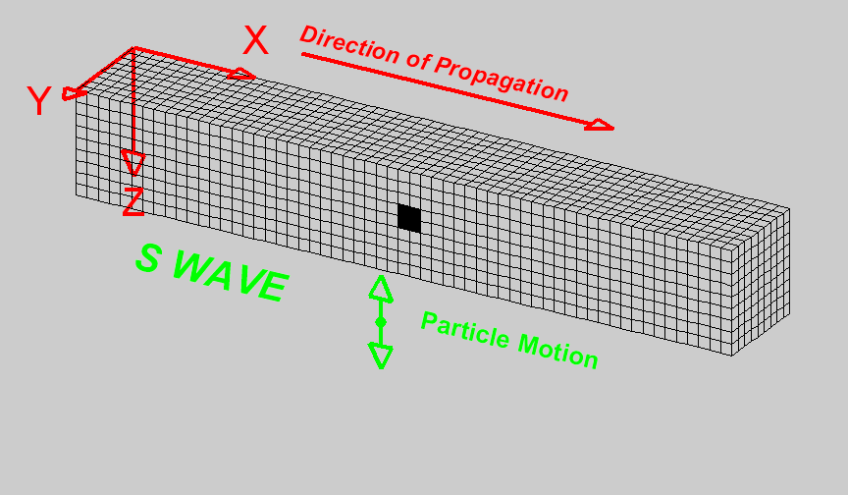
Wave propagation

Slide 8
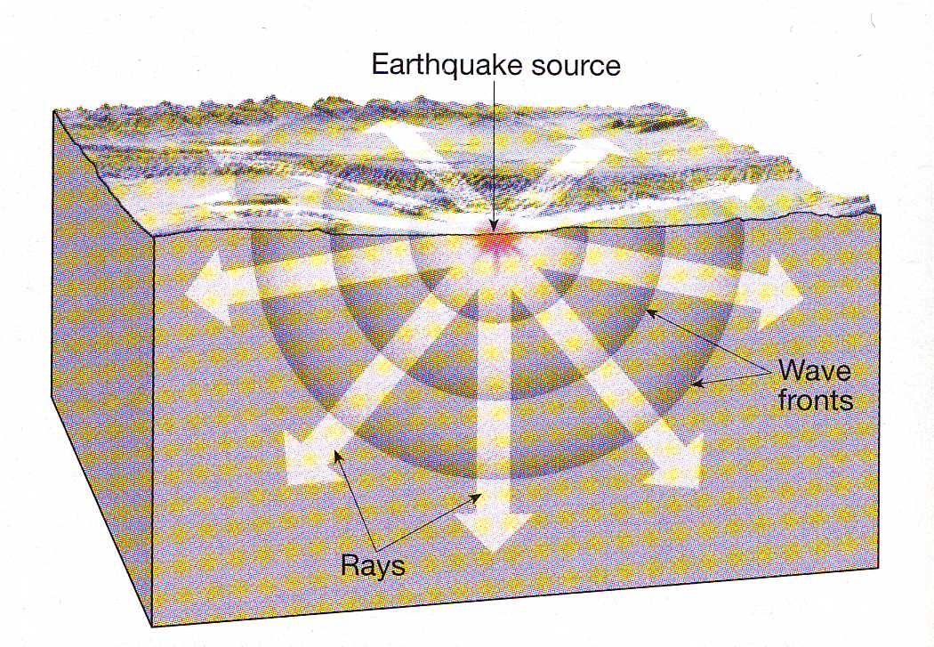
Wave fronts vs. rays
source of wave
ray = direction
of propagation
wave front =
location of
particle motion

Slide 9
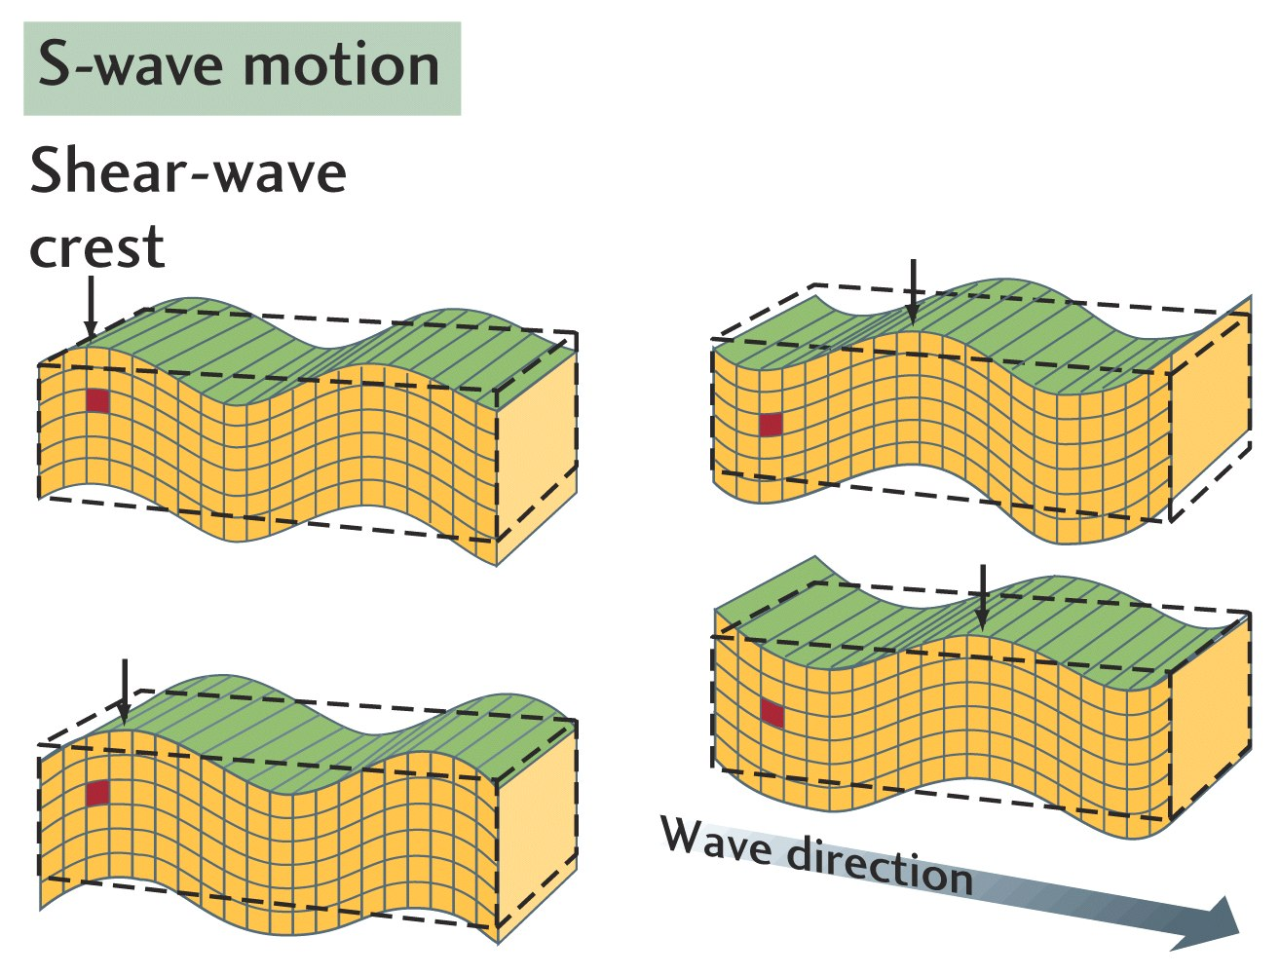
seismic body waves
(in elastic medium)

Slide 10
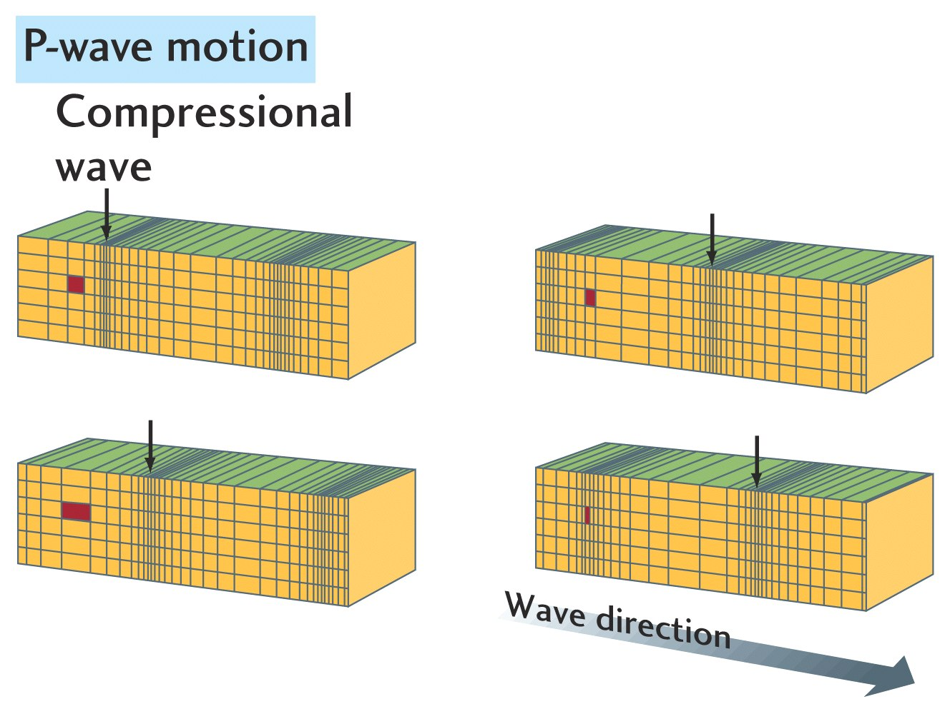
seismic body waves
(in elastic medium)

Slide 11
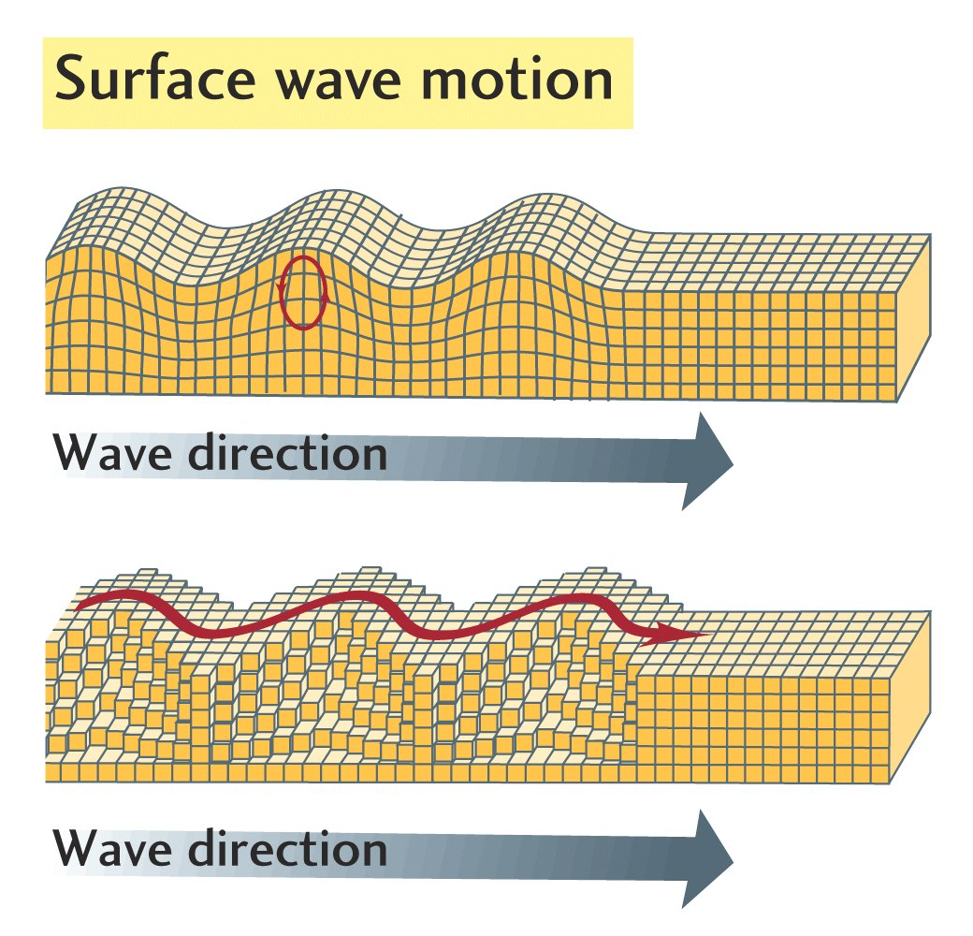
Rayleigh wave
Love wave

Slide 12
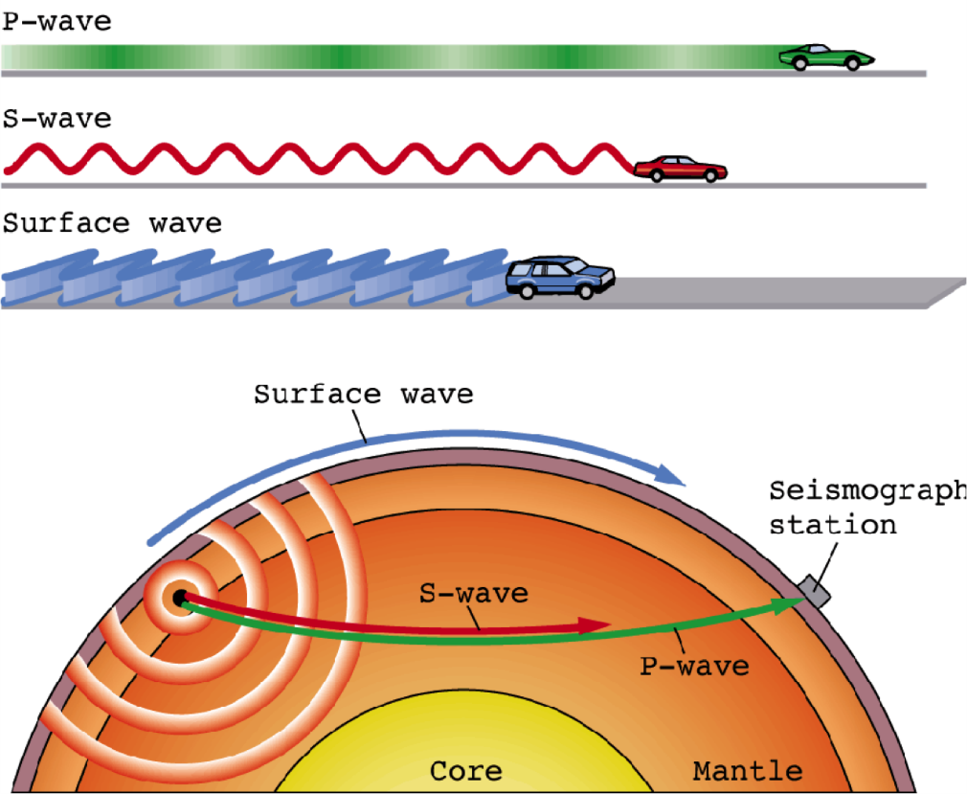
Body and surface waves
^{body waves} {
in order
of velocity
(propagation
speed)

Slide 13
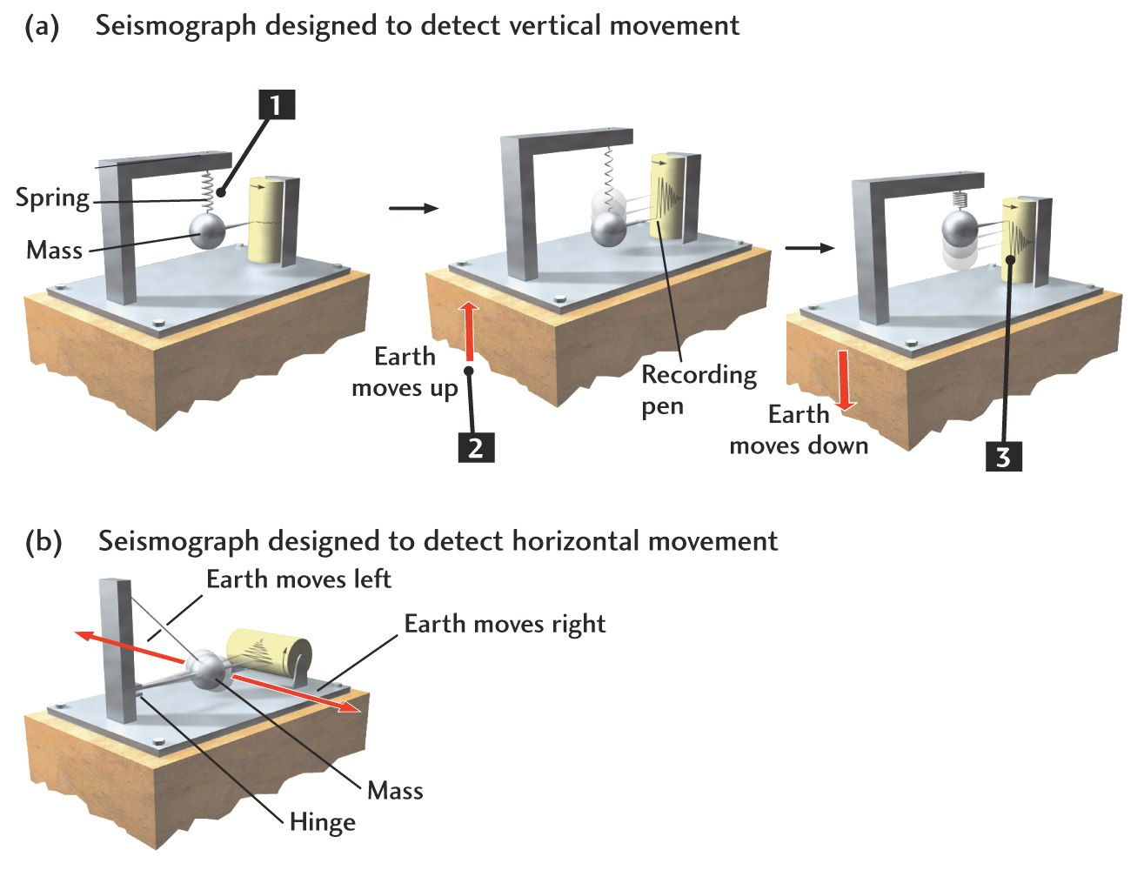
Detection of waves: seismographs
Inertia keeps mass in place

Slide 14
Different components of ground motion

Slide 15

Passive seismic survey

Slide 16
Seismograms: recordings of ground motion caused by earthquakes
Indonesia earthquake recorded in California

Slide 17
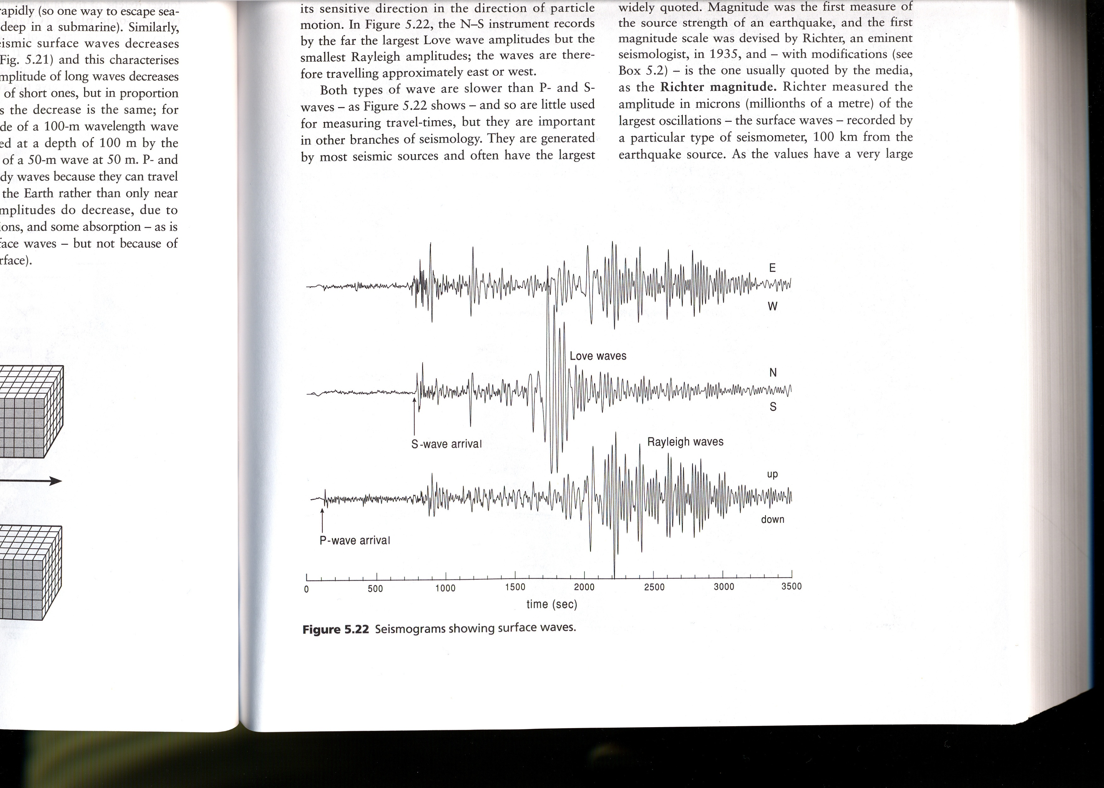
Guess the wiggles!

Slide 19
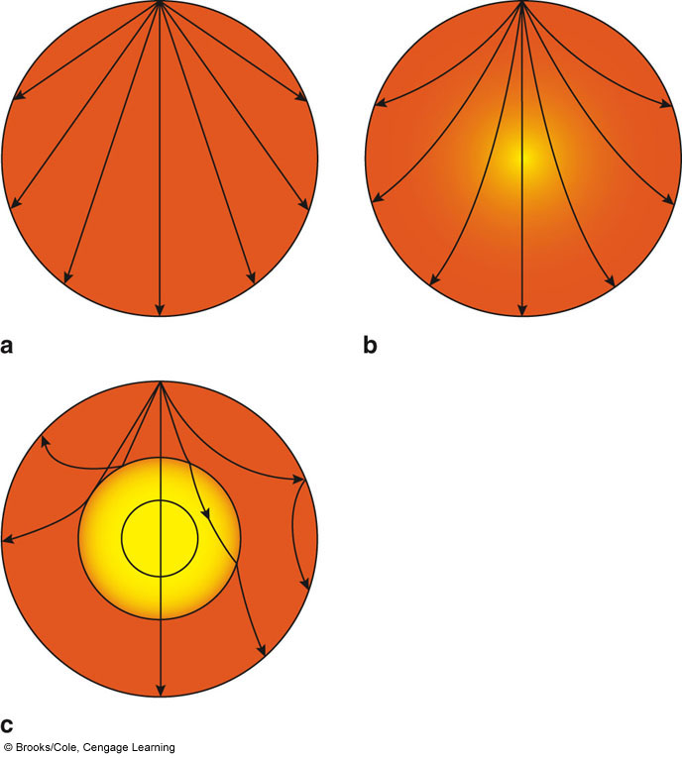
Wave propagation
Homogenous medium
(same velocity everywhere)

Slide 20
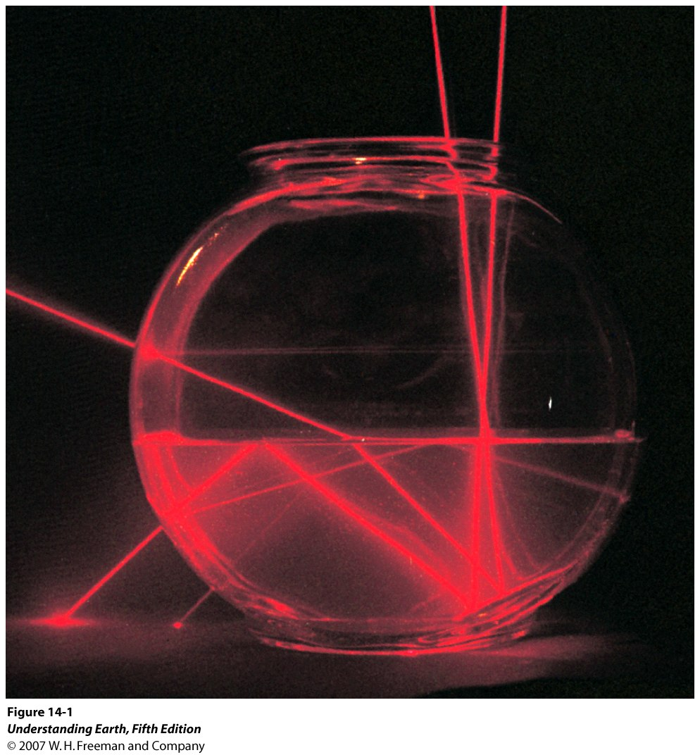
refraction
reflection
Heterogenous medium
(light in water is slower)

Slide 21
Snell’s law says that
rays get reflected (bounced back at an interface between two layers) at the same angle to the normal as they arrive
rays get refracted (change their path within the second medium) away from the normal if velocities increase, and vice versa

Slide 22
Body wave refraction
(smooth velocity change)

Slide 23
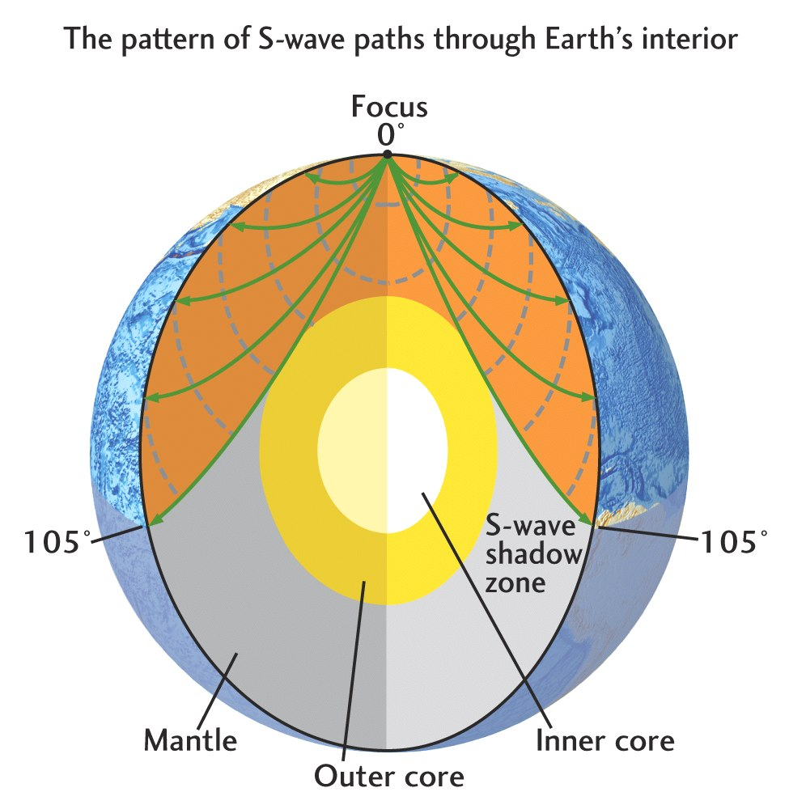
effect of sharp velocity
change with depth

Slide 24
Outer core is fluid!
S waves rely on elastic resistance to shear deformation
fluid has no resistance to shear
no S waves in outer core

Slide 25
Mantle
Crust
Liquid iron
outer core
Solid iron
inner core
compositional
layers

Slide 26
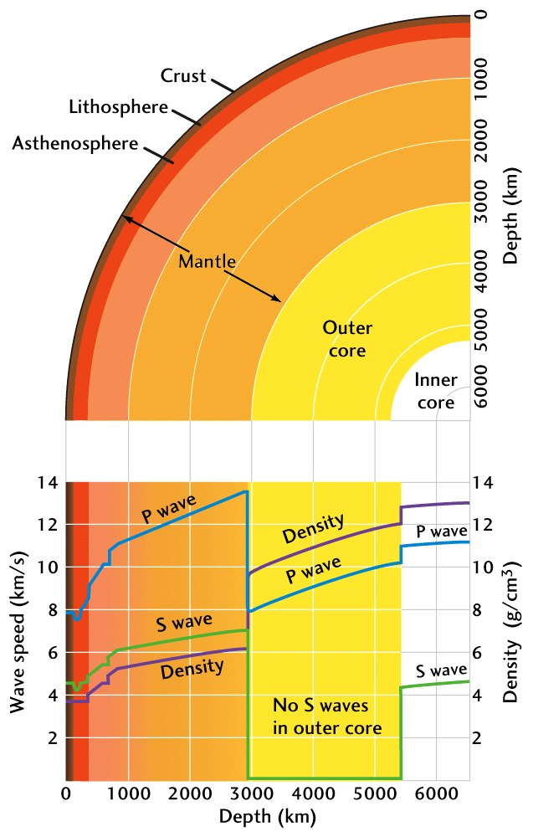
1-D Earth structure
compositional layers:
  crust (light rocks - granite), mantle (denser rocks - olivine), core (iron)
density and wave speeds increase because of pressure
additional effect of phase
  outer/inner core
  upper mantle phase transition (olivine goes to closer packing)

Slide 27
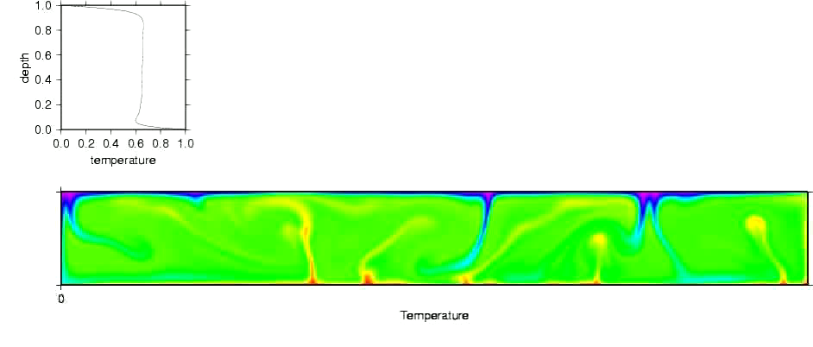
Thermal (and mechanical) boundary layers of the high Rayleigh number convecting mantle
lithosphere
( = plates)
asthenosphere
( = rest of mantle)
flow strength of rocks depends on temperature
colder rocks harder to deform / deform more slowly
convective temperature profile explains lithosphere
mechanical
~layers

Slide 28
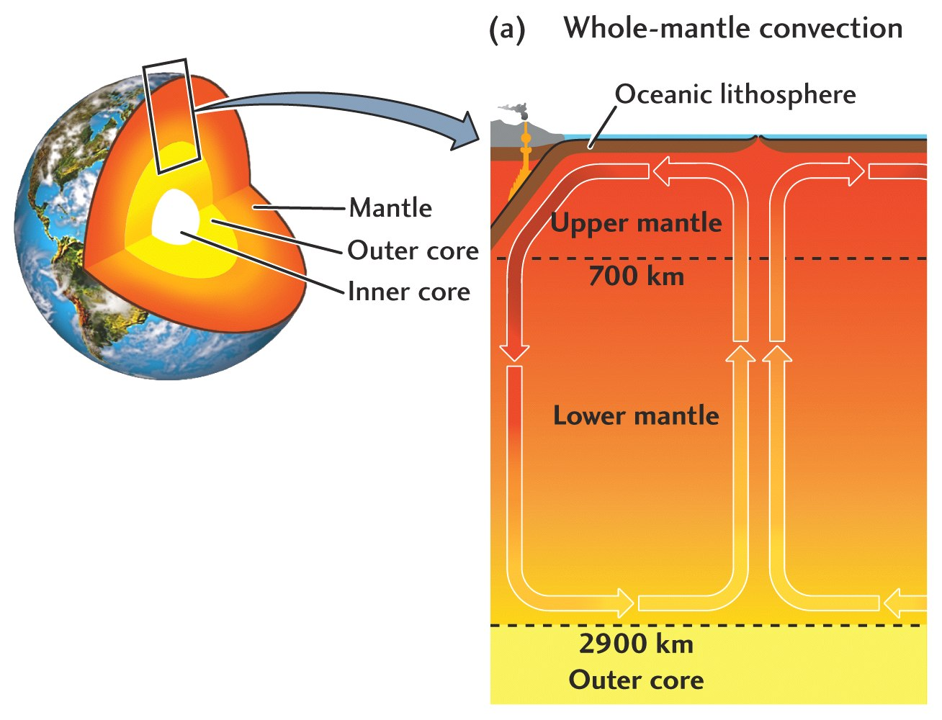
Plates are part of the convecting mantle
(= lithosphere)

Slide 29
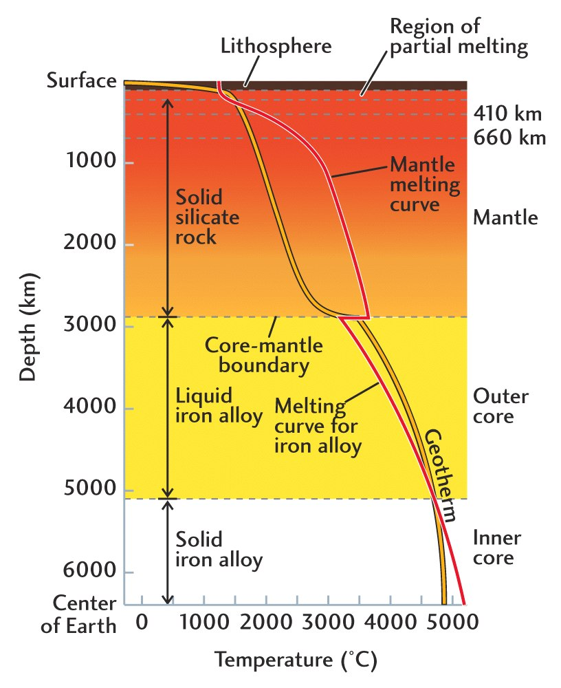
Mantle temperatures and melting
Convection controls boundary layer temperature increase
Pressure increase leads to gentle (adiabatic = no heat exchange) temperature gradient
only small parts of regular mantle are partially molten
if regions are anomalously hot, wet, or rising fast (without heat exchange) can generate melt
(liquidus)

Slide 30
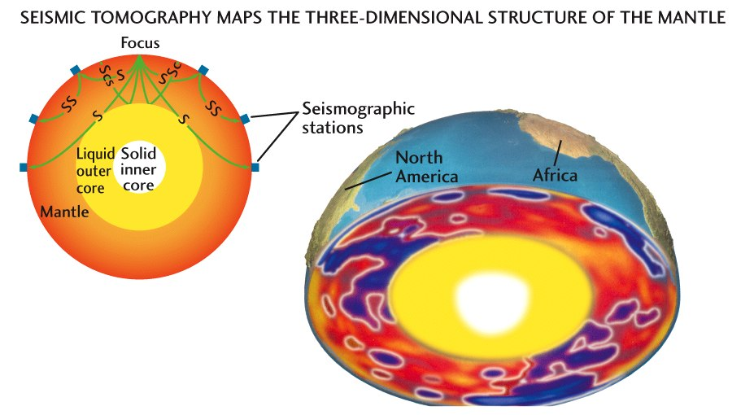
CT scanner like technique,
Imaging 3-D seismic wave speed
variations

Slide 31
3-D variations of seismic wave speeds (red = slow (i.e. hot), blue = fast (i.e. cold))

Slide 32
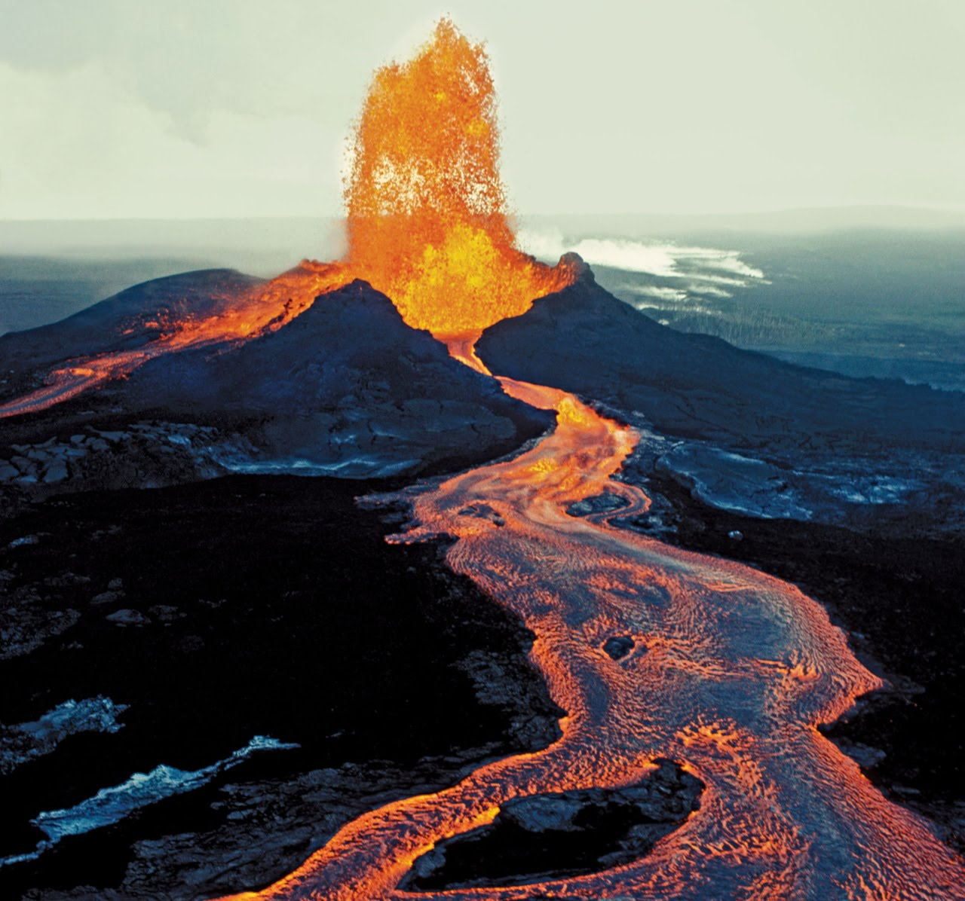
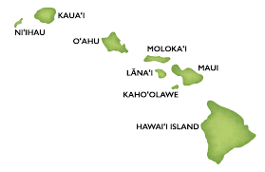
Example of anomalously hot
mantle: Hawaiian islands

Slide 33
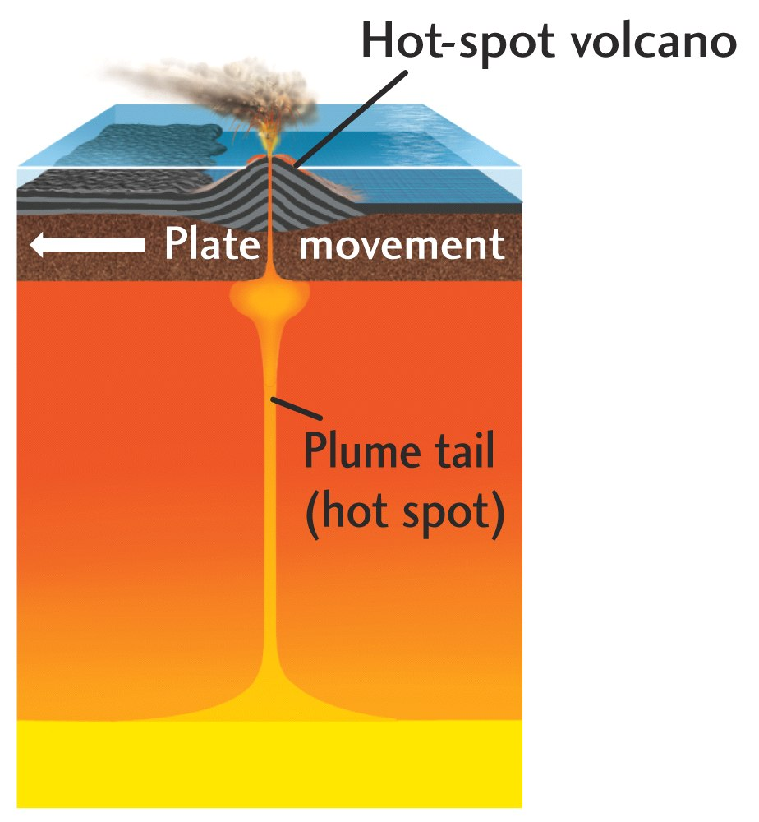
Mantle plumes and
hot spots

Slide 34
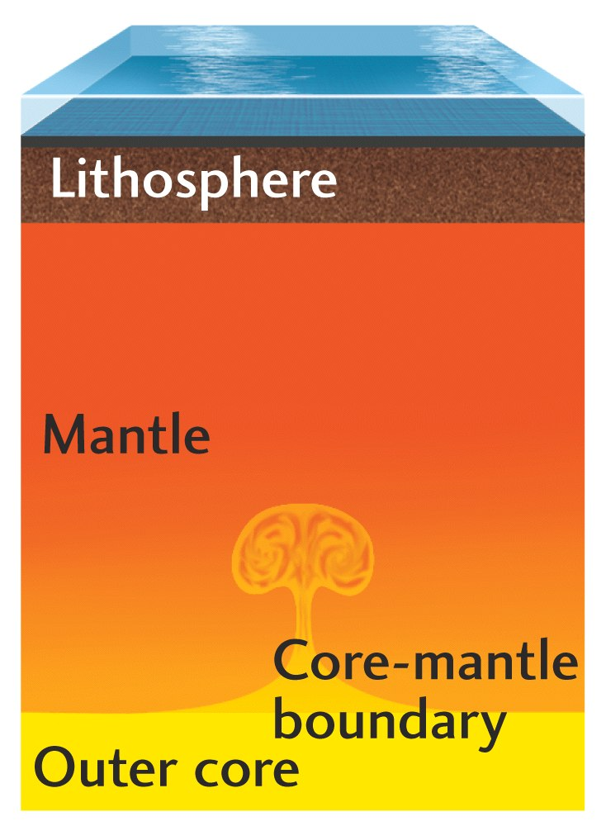
Plume rising from lower thermal boundary layer
(core mantle boundary)

Slide 35
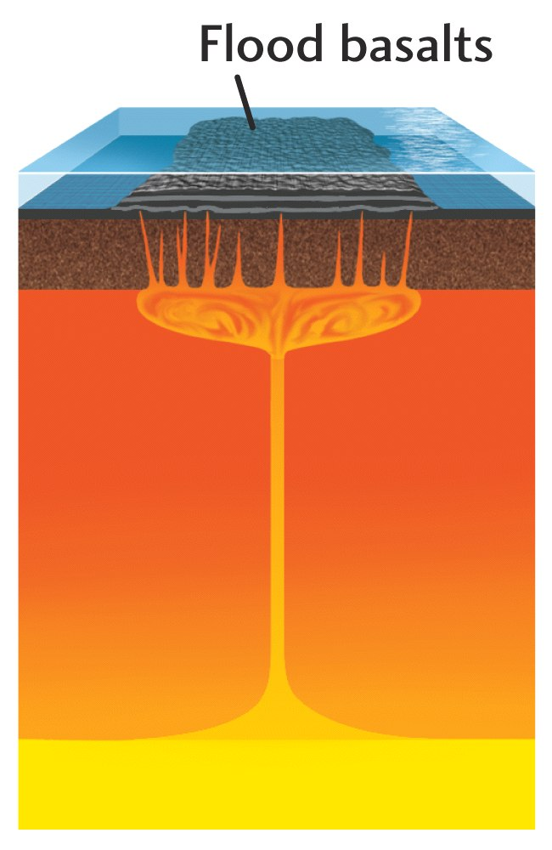
Plume head hits litho-sphere

Slide 37
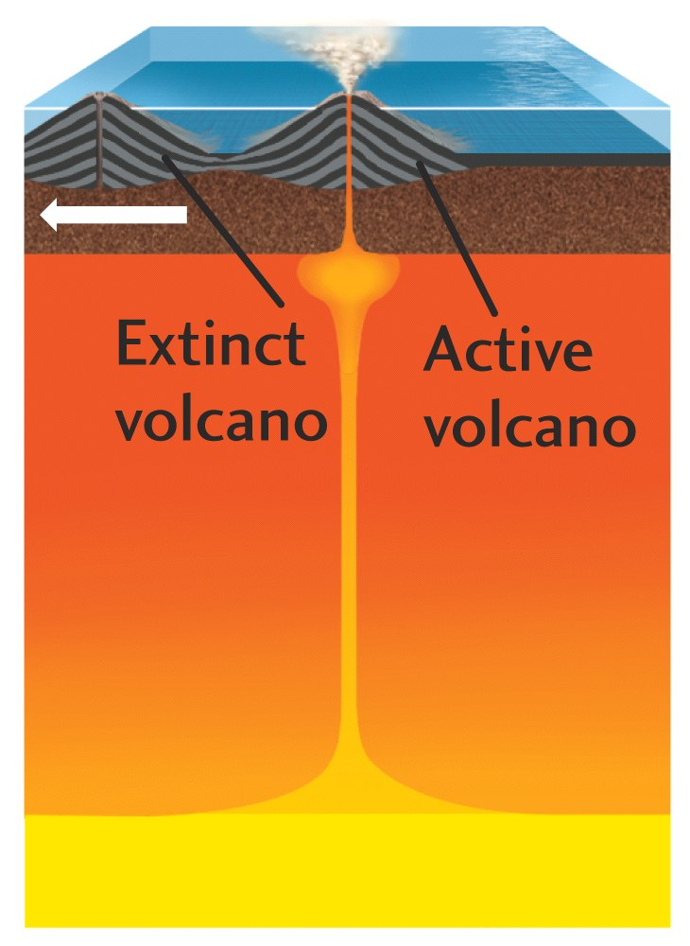

Slide 38
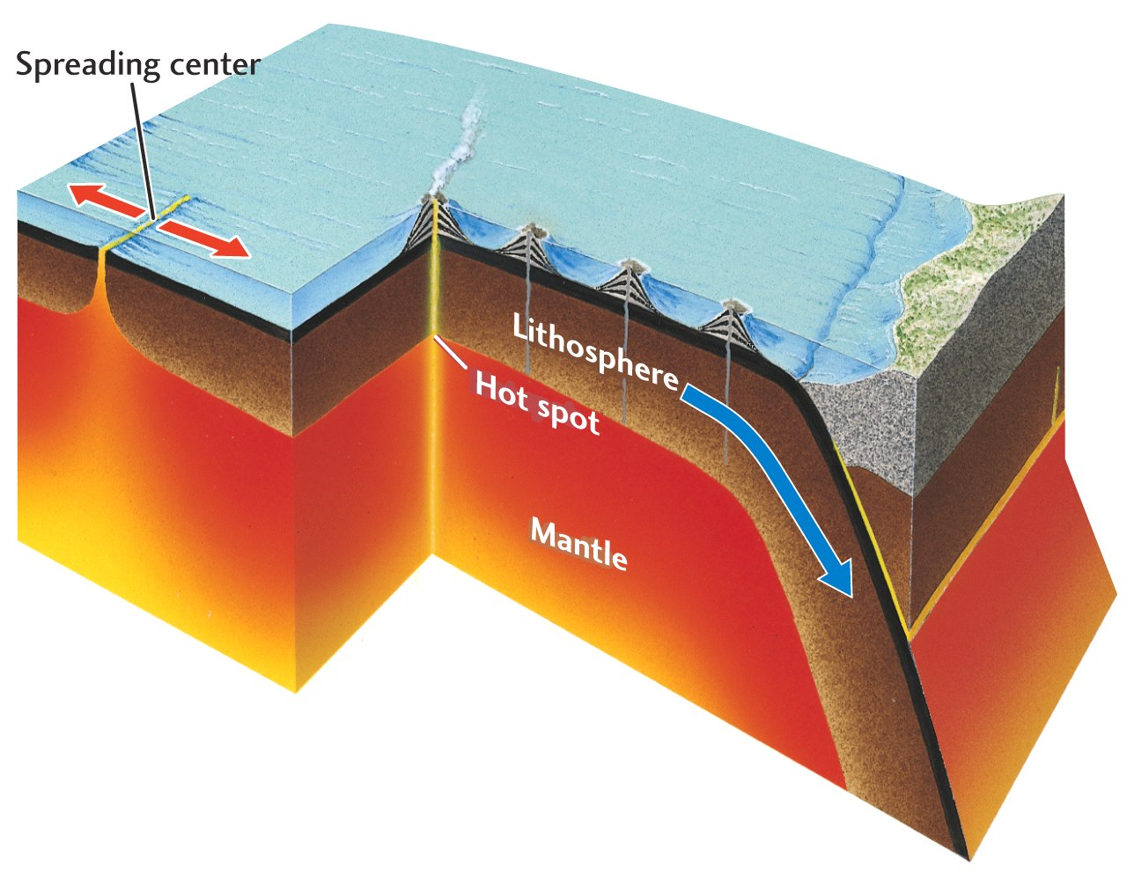

Slide 39
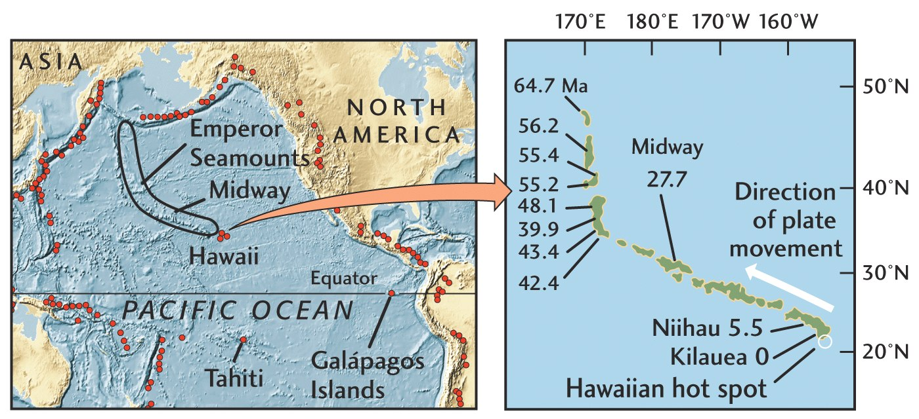

Slide 40
Hotspot lavas tell us about the core-mantle boundary
mantle
inner
core
outer
core
mantle
core

Slide 41
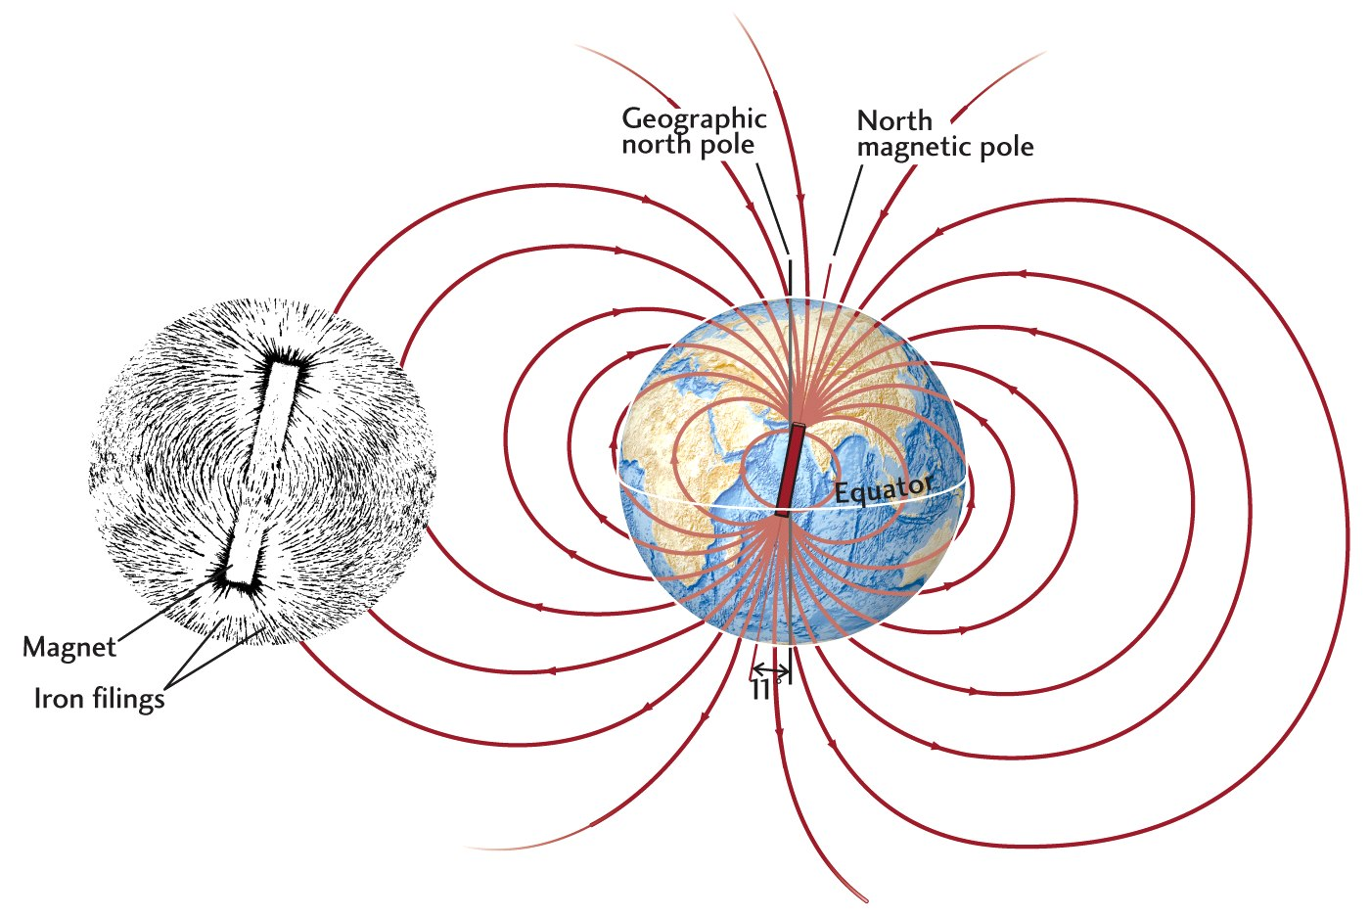
Core processes and the magnetic field

Slide 42
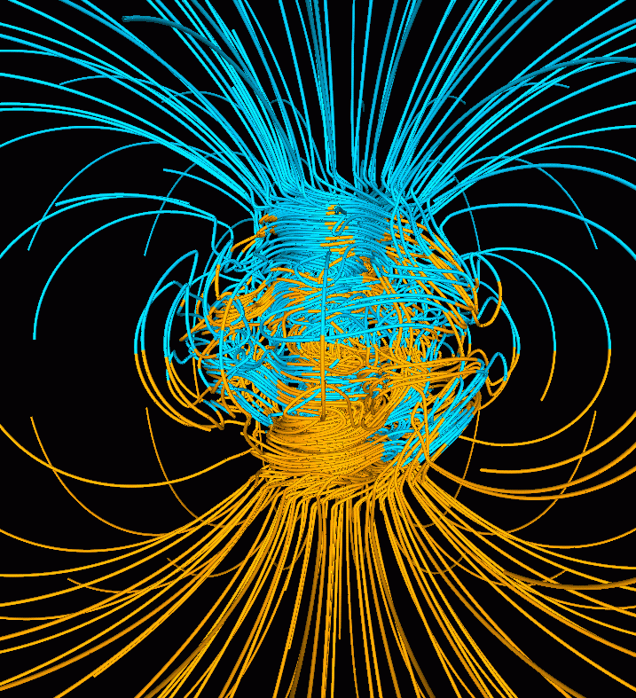
Geodynamo
Earth’s surface
Earth’s field cannot be frozen in like a magnet, too hot (Curie temperature) and changing over time
The Earth’s magnetic field is generated by convective motions in Earth’s liquid, iron outer core
The field is complicated and varies on short time-scales
Core-mantle boundary

Slide 43
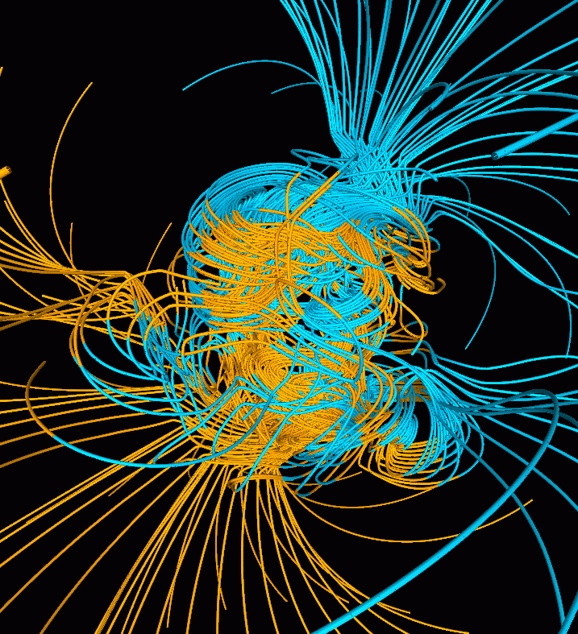
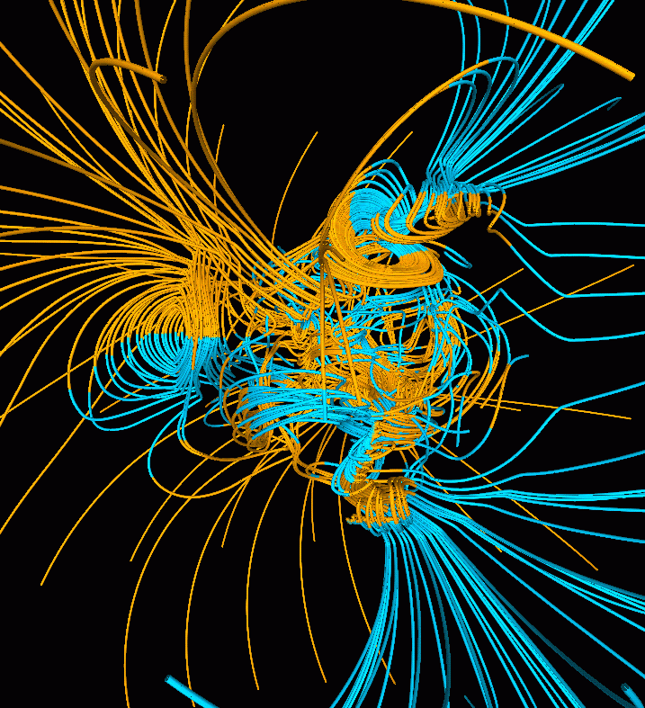
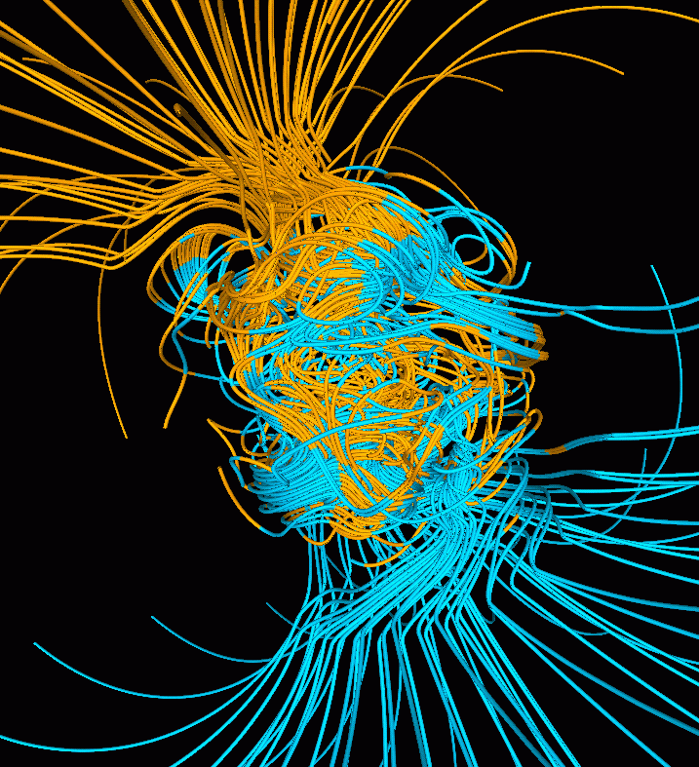
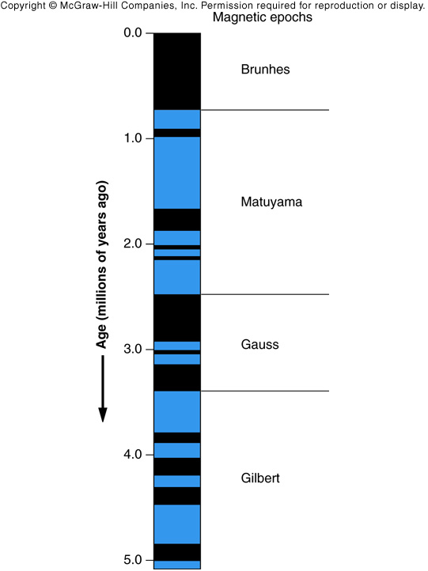
Magnetic field reversal
(chaotic process)

Slide 44
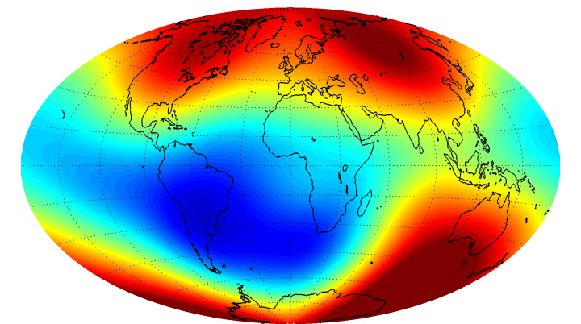
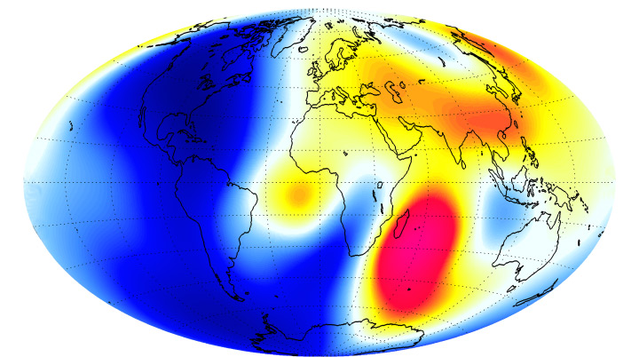

Current magnetic field strength

Slide 45
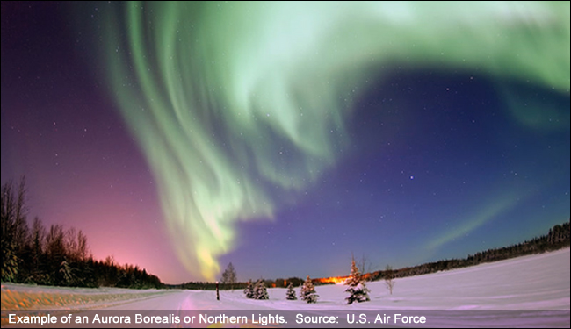
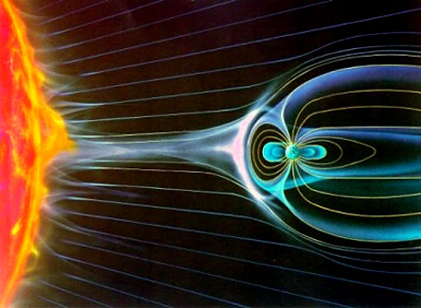
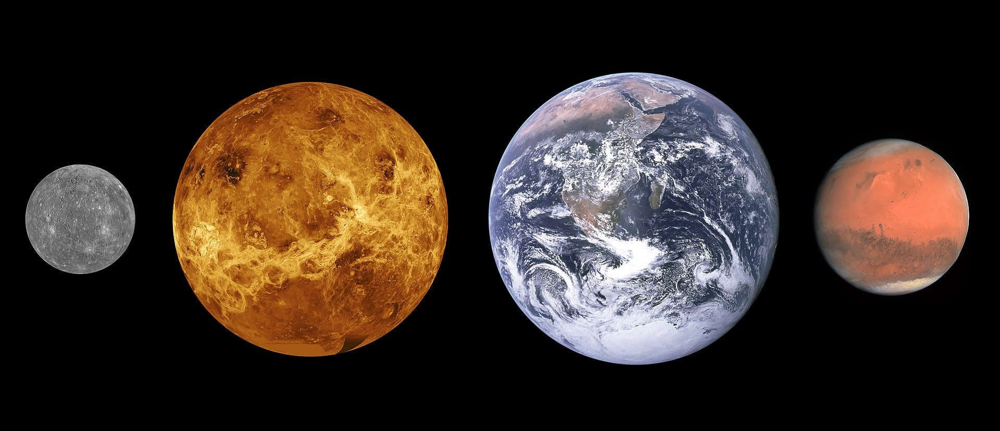
Magnetic fields
shields us from
solar wind and
so helps maintain
oceans and
atmosphere
envelope
Aurora
Borealis

Slide 46
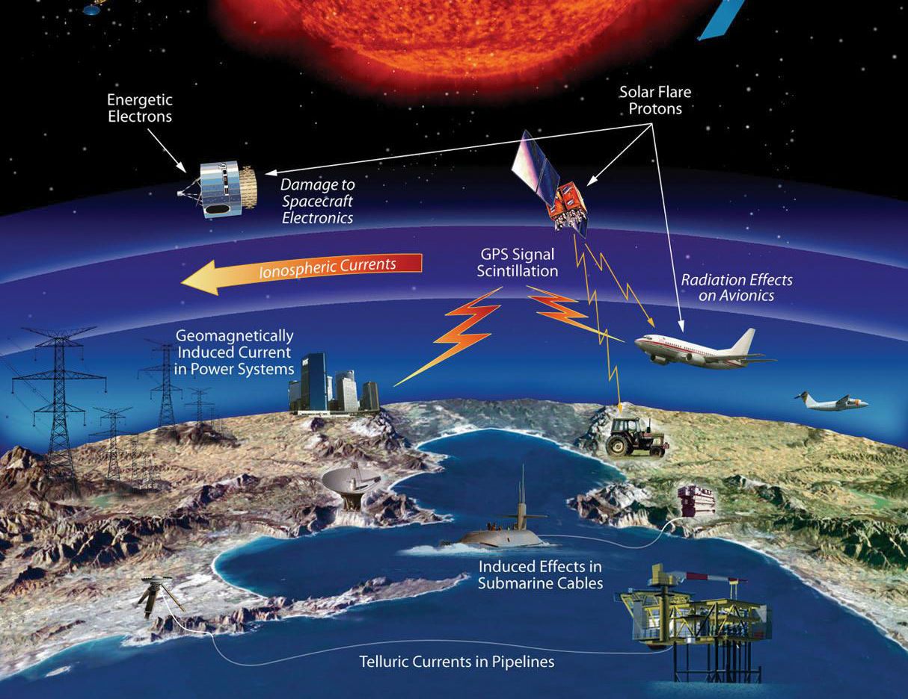
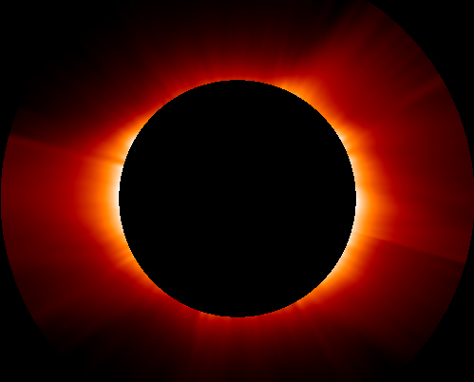
Hazards due to
space
weather
Sun’s corona

Slide 47
Additional material

Slide 48
Additional material for review
IRIS Movies
  What drives plate tectonics:
    https://youtu.be/Nf8xvhb1eBE
  Plate boundaries and tectonic plates:
    https://youtu.be/Xzpk9110Lyw

